Slide 1

Coffee Shop Chain Sales Data Business Implications
Adit Shah
Keeley Ables

Slide 2
Executive Summary
Pre-processing
*Verification of data read-in
*Initial data assessment for cleanliness
*Reformatting of data types as well as data discretization
*Initial summarization
Scenario: A coffee-shop franchise has fallen on tough times and has had to close 5 out of its 8 stores
Data: The last 2 months worth of sales (and other operational data) for the remaining 3 stores.
Customers
Products
Staff
Sales goals
Etc.
Our goal: Evaluation of 3 remaining café's sales & customer data to identify strengths and opportunities to increase sales.
Analysis
*Clustering analysis (K-means)
*Regression Analysis
*Decision Tree analysis
Visualizations
*Bubble chart of sales by cluster with number of orders by cluster
*Kmeans description tables
*Decision tree

Slide 3
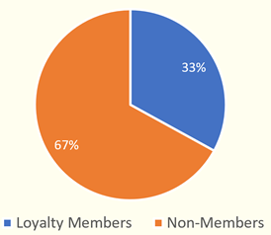
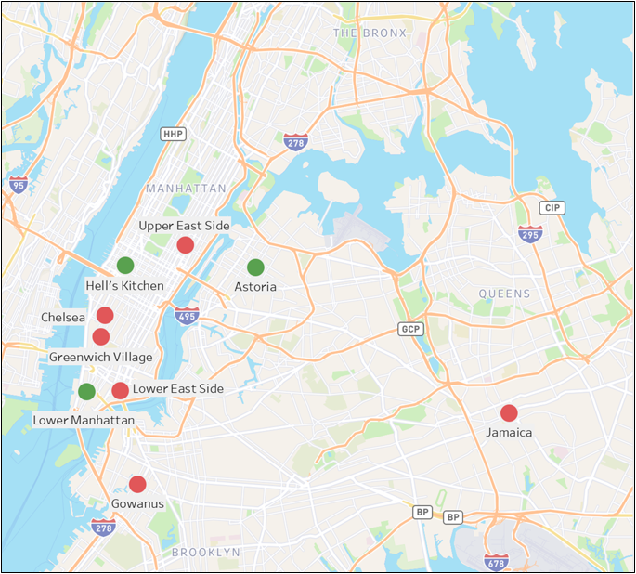
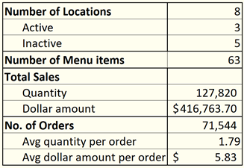
Business Profile
Percent of Sales from Loyalty Members
~ 33% of sales came from loyalty members.
One our primary objectives became to explore who these customers were.
Active vs. Non-Active Stores Bubble map

Slide 4




Business Problem
A coffee shop franchise wants to develop a data-driven marketing strategy to increase sales
Using ~2 months of data, we will apply several analytic techniques to determine optimal marketing investments
What products are most popular at this coffee shop? Is there a clear reason why?
How much does this coffee shop charge, and is there any indication that price affects sales?
Who are our target customers within the loyalty program? Can we estimate who our non-members are ?

Slide 5
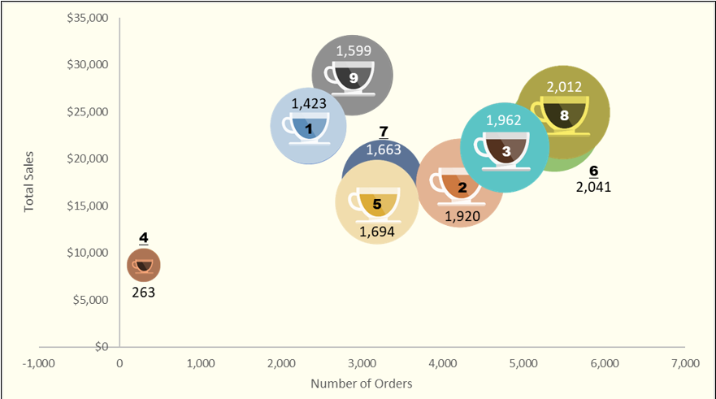
Who are our customers?
We performed a K-Means cluster analysis on the coffee chain’s Loyalty Member customers.
Focus:
1. To find attributes to describe the patrons of the business
2. Use this information to know potential targets of advertising. Features: buying habits, time of patronage, influence of weather on buying habits, gender, and generation
Findings: 9 clusters emerged
Our primary target customers are in clusters 9, 8, and 4.

Slide 6



Target Clusters
8
9
4
The Average Joe
The Connoisseur
The Die-Hard Fans
Justification: Most representative of the top sales across clusters
Age Group: Composed of people born after 1989 (ex Older Millennials, Boomers, etc.)
Product: Simple tastes – Coffee, Tea, and Bakery goods
Behavior: More likely to buy in the afternoon, between 2 and 5 pm at the Astoria Location
Justification: Highest total sales
Age Group: Majority are people born after 1989; High proportion of younger customers (vs other clusters)
Product: Specialty drinks and Bakery goods;
Behavior: More likely to buy at the beginning of the workday (~8 AM – 10 AM) They are more likely to buy promotional goods
Justification: Very likely to buy branded goods
Age Group: Composed of people born after 1989
Product: More likely to buy Branded and Packaged Goods (vs Beverages or Food)
Behavior: More likely to visit stores in commercial areas (Hell’s Kitchen or Manhattan) at the start of the work day (~8 AM – 10AM)

Slide 7
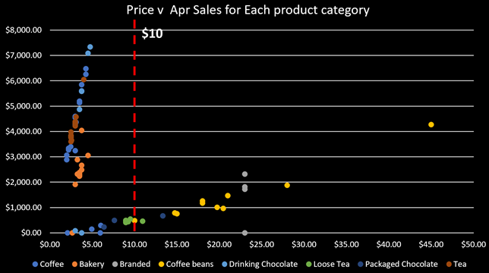
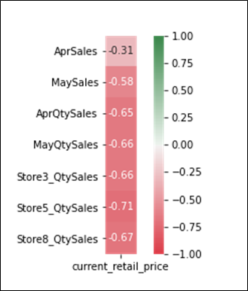
Price's impact on Sales
Items with a price under $10 make up the bulk of sales. Higher priced goods sell, but in much lower quantities. The exception is high end coffee beans.

Slide 8
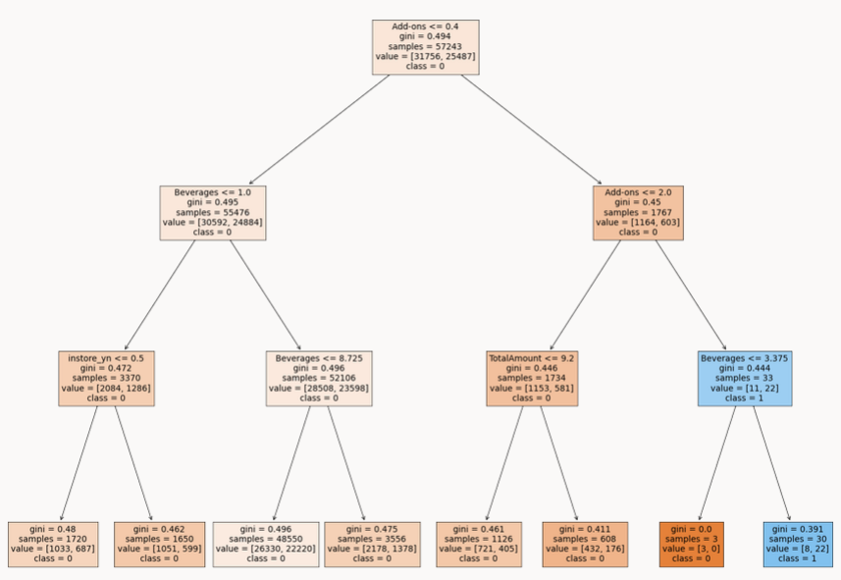
Will a customer become a member?
Analysis:
Decision Tree
Purpose:
Predict if customers will choose to be loyalty members
Findings:
No statically significant relationship between customer buying patterns and Loyalty membership
Model is overfitted to the data
Interpretation:
Data needs to be collected on all customers.
Generation, birthdate, emails

Slide 9
Business Interpretation
Data collection investments needed (for example – via a new PoS system)
Differentiate advertising based on features of these clusters via:
Emails,
App,
In-person upselling
Sell non-members on the loyalty program by instituting member-exclusive discounts
Early-bird specials
Buy 1, get one for coffee and bakery goods
Attract Millenials and tourists by getting involved in local events

