Slide 1
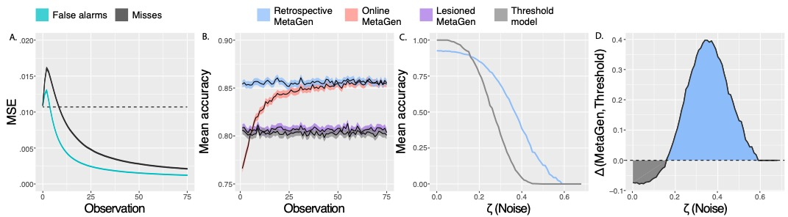
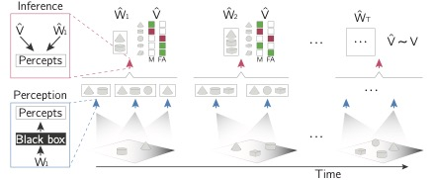


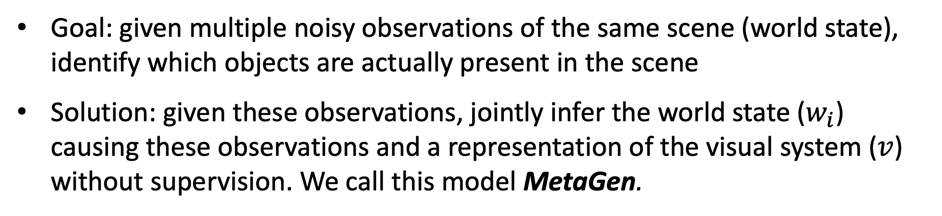


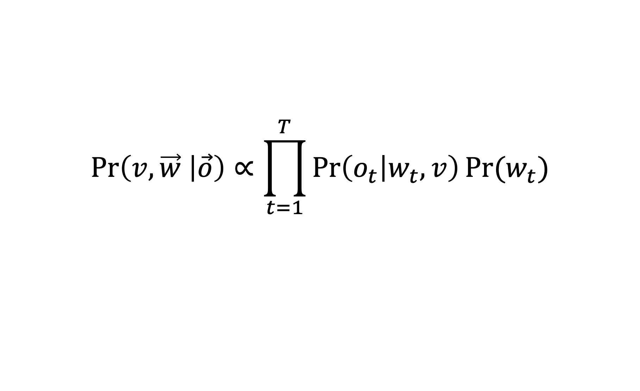
Learning a metacognition for object perception
Marlene Berke, Mario Belledonne, & Julian Jara-Ettinger
Department of Psychology, Yale University, New Haven, CT
Introduction
Problem and Solution Overview
Simulated Experiments
Learning accurate representations of the world is critical for prediction, inference, and planning in complex environments (Lake et al. 2017, Pylyshyn 1984).
When an AI system’s representations of the world are noisy, a typical approach is to try to directly improve those representations of the world.
Here, we suggest a complimentary approach: learning representations of the AI system itself so as to separate artifacts of the system (noise) from accurate percepts (signal).
Goal: given multiple noisy observations of the same scene (world state), identify which objects are actually present in the scene
Solution: given these observations, jointly infer the world state ($w_{i}$) causing these observations and a representation of the visual system ($v$) without supervision. We call this model MetaGen.
Analogy to human vision
As more world states are observed, Online MetaGen learns an accurate representation of the visual system’s false alarm and miss rates per object category.
Simultaneously as it learns this metacognition ($\hat{v}$), its accuracy improves. After 75 observed world states, its average accuracy is 85.4%, more than 5% higher than baseline models (Thresholding and Lesioning).
Taking the metacognition (${\hat{v}}_{T}$) learned after all 75 observations and conditioning on it and then re-inferring the world states results in 85.6% average accuracy.
State-of-the-art artificial visual systems make mistakes in their representations of the world
Facebook AI Research’s Detectron2
Here, we represent the visual system as a generative model $v$ that describes the probability that the visual system would produce observations $o$given world state $w$. This metacognitive representation $v$ is essentially a matrix with the false alarm and miss rates for each object category.
Goal: given multiple noisy observations of the same scene (world state), infer which objects are actually present
Solution: given these sets of observations ($\vec{o}$), jointly infer the world states ($\vec{w}$) causing these observations and a representation of the visual system ($v$) without supervision. Infer $\operatorname{Pr}\left(v, \vec{w} | \vec{o}\right)$ given by:
Human visual systems also make mistakes, as in visual illusions
Concluding Remarks
Here we proposed MetaGen, a model for the unsupervised learning of metacognition for a black-box visual system.
Without feedback or access to the system’s inner workings, MetaGen is able to make inferences about the ground truth world states causing outputs from the visual system
We presented a proof-of-concept that Metagen can learn a metacognitive representation of a black-box visual system and use this representation to make better inferences about the objects that are present in a scene
This MetaGen model could be build on top of current artificial visual systems to improve their performance
$$\operatorname{Pr}\left(v, \vec{w} | \vec{o}\right)∝\prod_{t=1}^{T}{\operatorname{Pr}\left(o_{t} | w_{t},v\right)Pr⁡(w_{t})}$$
Metacognition to identify faulty percepts
But we often recognize an illusion when we see one – we might even say that “our eyes are playing tricks on us.”
We have built-in ‘core knowledge’ of the world (Carey 2009, Spelke & Kinzler 2007) like object persistence that might help make this problem tractable.
By comparing percepts against this ‘core knowledge,’ we can build a metacognitive theory of how our perceptual system works.
Once we have learned this metacognition, we can use it to identify faulty percepts (like visual illusions in humans or missed or hallucinated objects for artificial visual systems)
Inference procedure: particle filters, a sequential Monte Carlo technique.
Simulated Dataset
To test if MetaGen can learn an accurate representation of a variety of visual systems and use it to better infer the world states, we simulated a dataset of visual systems, world states, and percepts
Acknowledgments
We thank Laurie Paul, Ilker Yildirim, and Flora Zhang for helpful discussions. This work was supported by a Google Faculty Research Award and by the Center for Brains, Minds, and Machines NSF-STC award CCF-1231216.
Notes:
Hello and welcome to my poster.
My project is about how having a system learn an intuitive theory of itself, or a metacognition, can benefit a system. For both humans and machines, having accurate representations of the world is really important, and a lot of goes into getting an AI system to have accurate representations of the world. Take an artificial visual system, for instance. When its representations of the world are not that accurate, a typical approach to improving them is to directly improve them by adjusting the model’s architecture or training set, etc.. What we’re suggesting is that having the AI system learn a model of itself can then correct these representations of the world.
As a case-study, we focus on the problem of object detection, though we think this approach of learning a metacognition could be useful for many domains. We develop a model that can learn a metacognition for black-box visual systems, like Detectron2. So here’s how we construe the object detection problem: suppose that you have a noisy perceptual system that makes mistakes. And your only access to the world is through this perceptual system, but you want to figure out what the ground-truth world is actually like. So, what you want to do is detect which percepts are artifacts of your perceptual system, and which percepts actually reflect the real world. We model this problem as Bayesian inference over a generative model that describes how a perceptual system transforms world states into noisy percepts. In particular, the latent variables that we’re trying to infer are the world states actually causing the percepts and a representation of the perceptual system’s propensities to make different kinds of mistakes, which is a kind of “meta-cognition” for the system. This problem is similar to the problem that humans face as we learn a metacognitive theory that helps us recognize visual illusions. We can only access the world through noisy percepts, and yet, we are often able to realize it when those perceptual systems make mistakes and we can figure out what the world state really is.
You might be wondering – if you only have access to the world through noisy percepts, how will you be able to figure out just from those percepts which ones are right and which ones are artifacts? Priors. To make this problem tractable, we’re going to build in some prior assumptions about how the world works. In particular, the assumption that we build into our model is ‘object permanence,’ which is part of the built-in set of ‘core knowledge’ that humans possess, as early as infancy. We think that humans are able to leverage this core knowledge to build a theory of how their own vision works, including things like illusions. Inspired by human cognition, we’re going to build that object permanence assumption into our model and see if that’s enough to learn a metacognition for the visual system, and whether having that metacognition will inferences about which objects were actually present in a scene. So what we want to do here is add metacognition to an artificial visual system so as to help it make better inferences about what objects are actually present in the scene. We set up the problem like this: we have some world states, and multiple percepts of each world state. These observations are noisy because the visual system isn’t perfect. Sometimes, it will false alarm, or hallucinate objects that aren’t there, like here where it hallucinates a sphere. And other times, it will miss objects that are there, like here where it misses the cylinder.
Given just those observations, and with no direct access to the ground-truth world state, the goals is to jointly infer what objects were actually present, and a metacognitive representation of the visual system that would produce these percepts. In particular, our model represents the visual system by its false alarm and miss rates for each object category. As it gets fed percepts from more and more world states, it should learn a better and better representation of its visual system, which should help it make better and better inferences about the world states. We call this model MetaGen. We wanted to test if our model could learn accurate representations of a bunch of different visual systems, and whether having this representation could improve inferences about which objects were actually present. So we constructed a simulated dataset of different visual systems, world states, and used our generative model to produce observations from those combinations of visual systems and world states. Then, we tested if MetaGen could infer an accurate representation of the visual system and the world states. We used a sequential inference procedure called particle filtering. Now we can watch MetaGen learn as it gets to observe percepts from more and more world states. This plot shows that, as MetaGen gets more observations, its estimates for the false alarm and miss rate of the visual system approach the true values. And at the same time as it’s learning this metacognition, MetaGen is also making better and better inferences about what objects are actually present in a scene, and improving in accuracy. You can then take the metacognition that MetaGen has inferred after seeing a bunch of observations, and condition on that, and then go back and re-infer the world states causing the percepts, and this results in perfect inference about the the world states 85% of the time. You might be wondering – was all of that metacognition stuff really necessary? Or is the object permanence assumption doing all the work here? To address that, we compare the model with metacognition and object permanence to baseline models with just object permanence, and find that the model with metacognition has gets the scene right 5% more times than the baseline models, indicating that having this learned metacognition improves object detection accuracy.
So all of this was a proof-of-concept for this approach to learning a metacognition and then using that metacognition to improve object detections. Some of the cool things about this model are that it could do all of this without supervision and with access only to the outputs of a black-box object detection system. But will this work in the real world, for real artificial visual systems? That’s our next step, but as a teaser, here’s what happens if you take those outputs from Detectron2 and then feed them into MetaGen: MetaGen infers a stable object representation!

