Slide 1





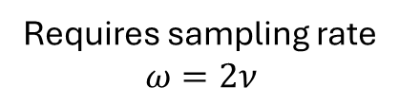

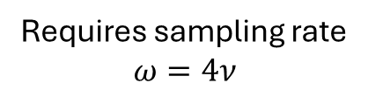


Frequency range of a real signal:
Quadrature: Frequencies can be uniquely identified:
Reduntant due to symmetry with positive range
Encoding bandwidth
-$2ν$
-$ν$
$$ν$$
$$2ν$$
-$2ν$
-$ν$
$$ν$$
$$2ν$$
Requires sampling rate
$$ω=4ν$$
Requires sampling rate
$$ω=2ν$$

Slide 2
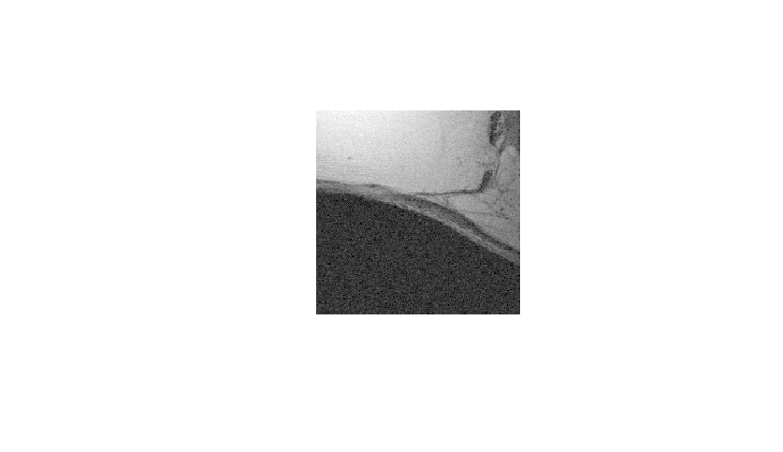
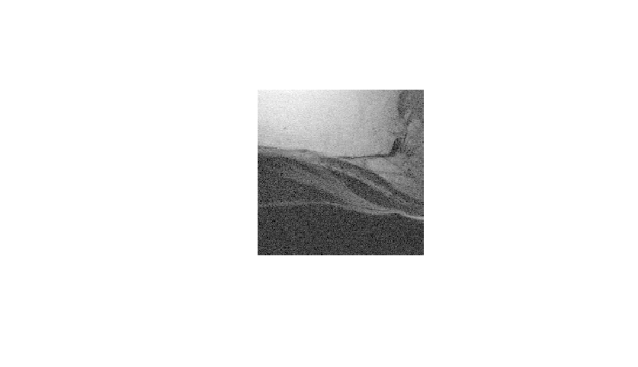






Slide 3
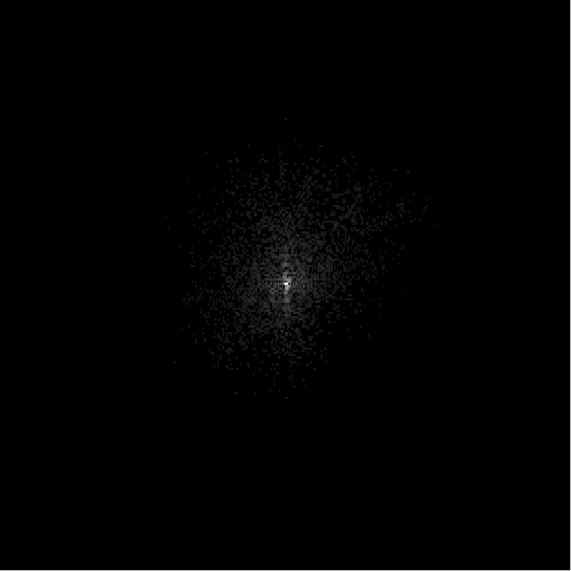
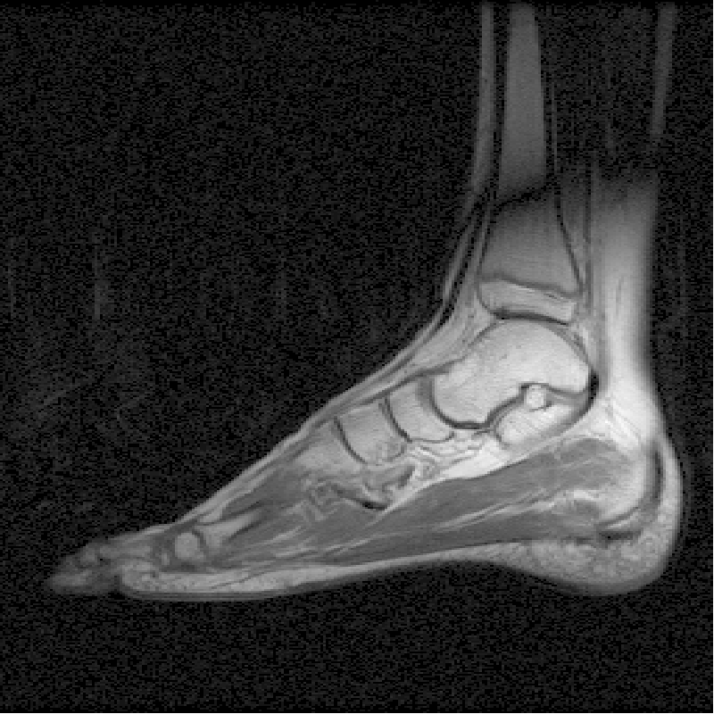
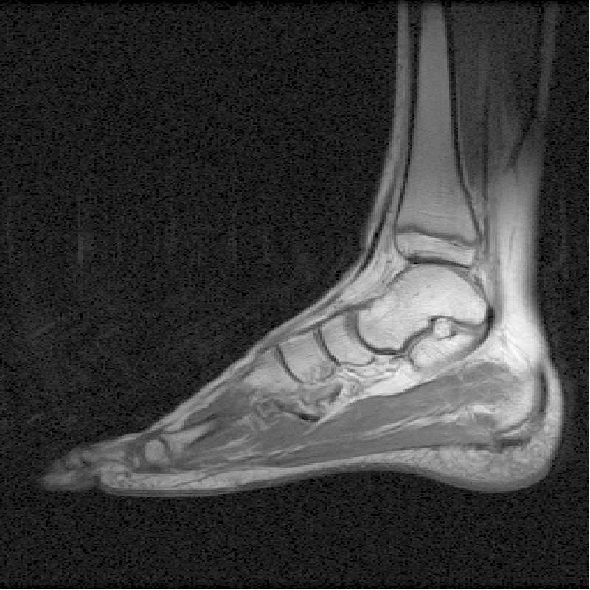
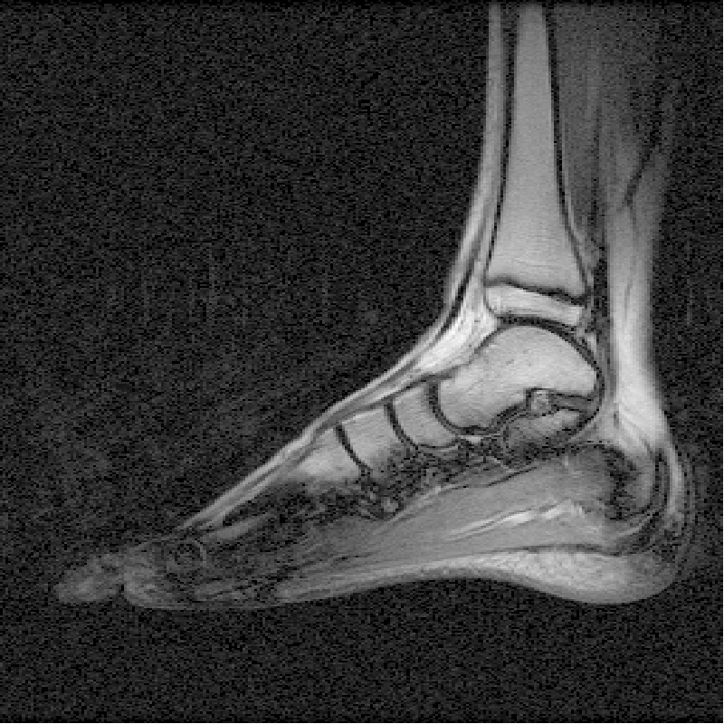
Raw data
Complex image
Magnitude image
IFT
mag
Re
Re
Im
Im

