Slide 1










Frequency range of a real signal:
Quadrature: Frequencies can be uniquely identified:
Reduntant due to symmetry with positive range
Encoding bandwidth
-$2ν$
-$ν$
$$ν$$
$$2ν$$
-$2ν$
-$ν$
$$ν$$
$$2ν$$
Requires sampling rate
$$ω=4ν$$
Requires sampling rate
$$ω=2ν$$

Slide 2
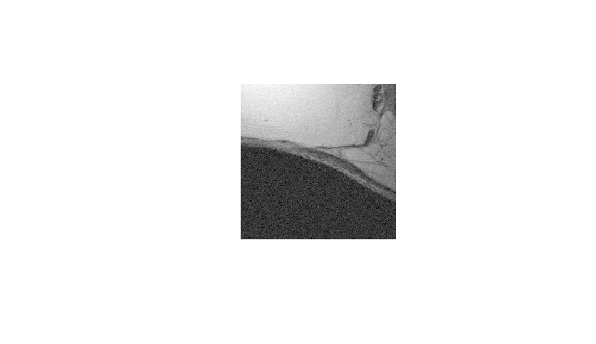
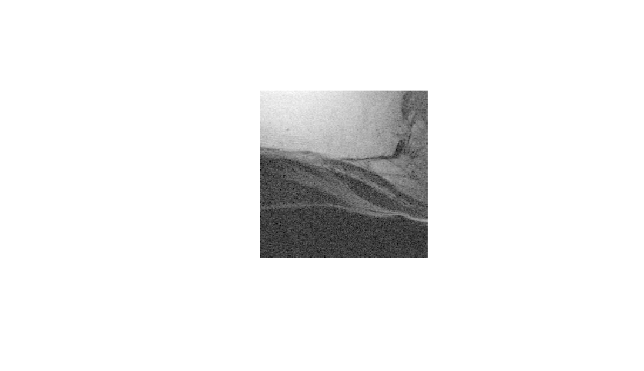


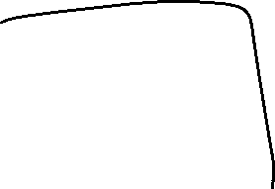



Slide 3
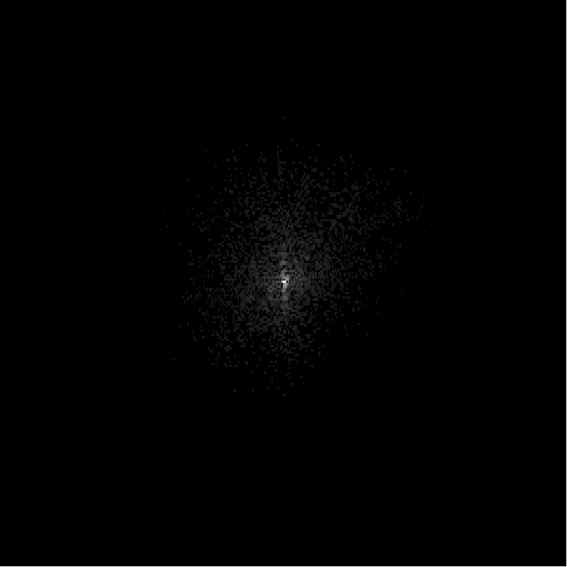
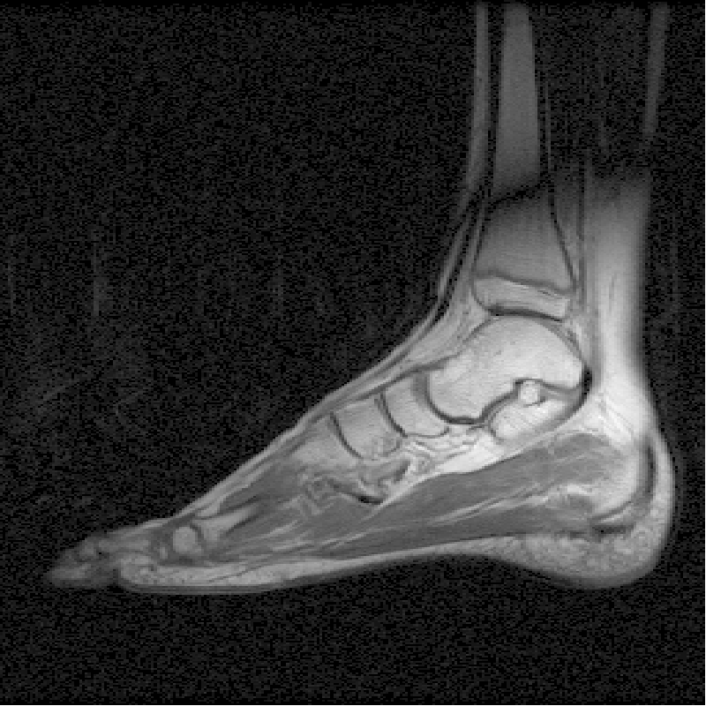
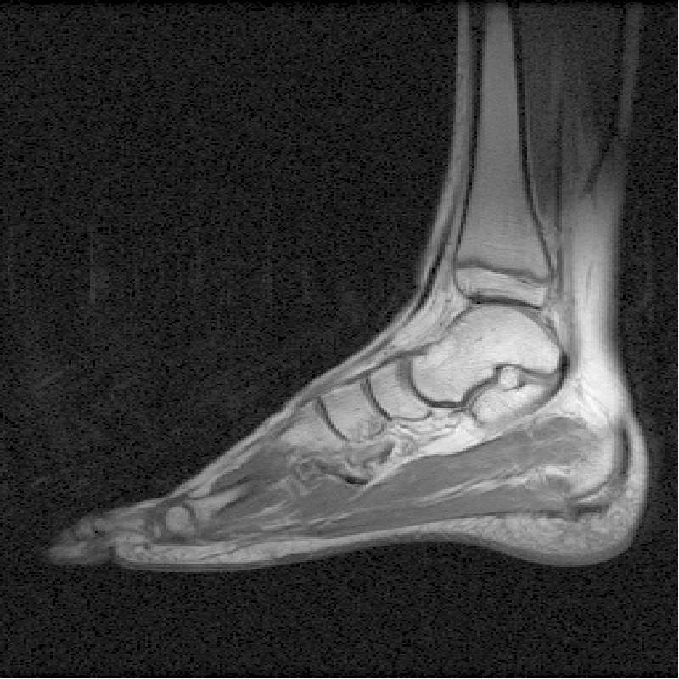
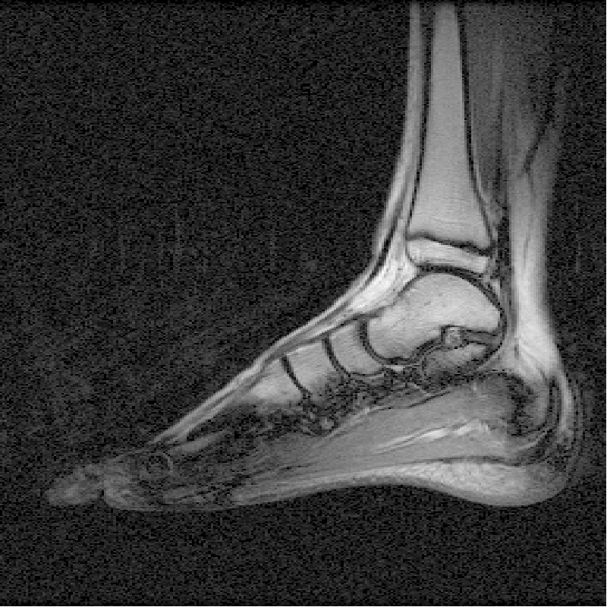
Raw data
Complex image
Magnitude image
IFT
mag
Re
Re
Im
Im

Slide 4

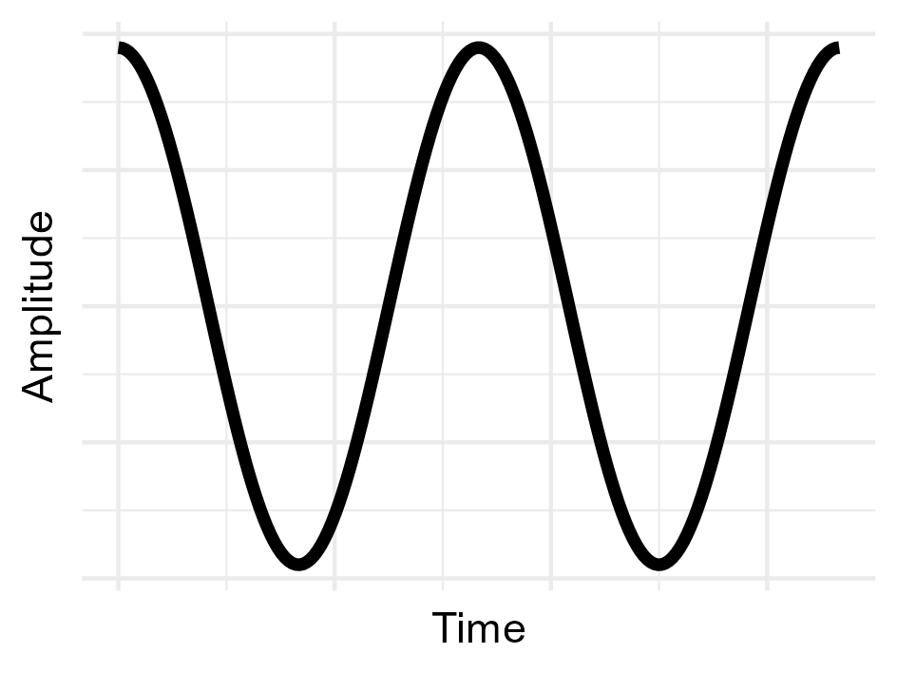
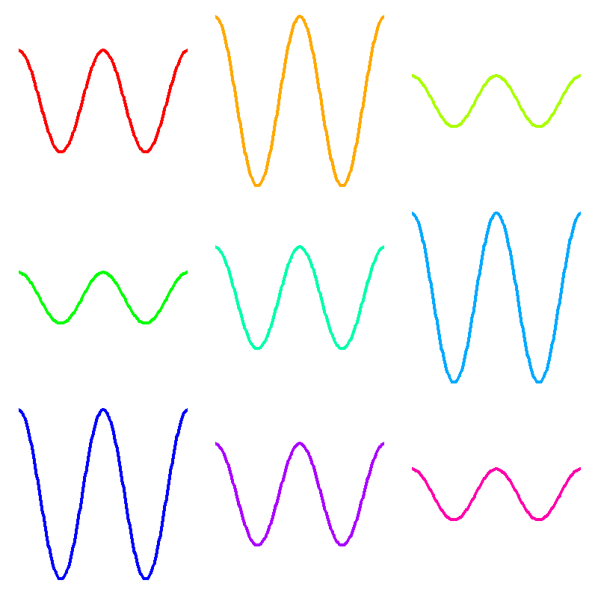
y
x

Slide 5
y
x

Slide 6
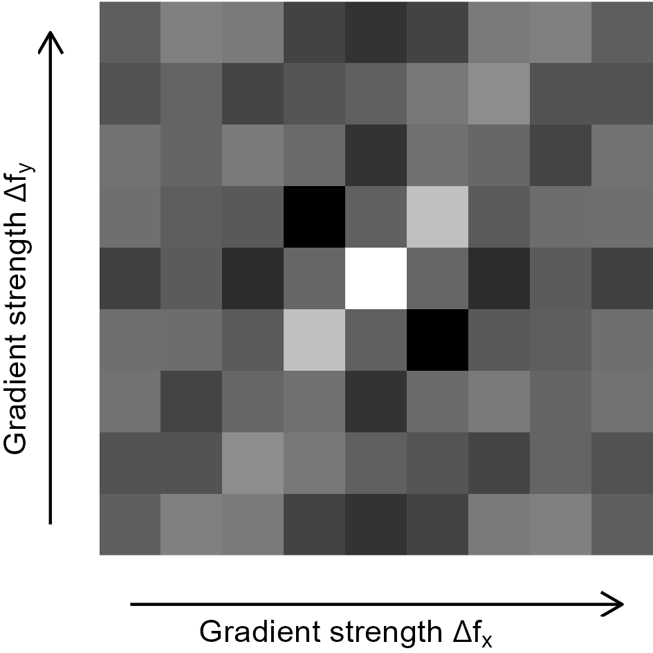


$${Δf}_{y}$$
$${Δf}_{x}$$

Slide 7







Slide 8
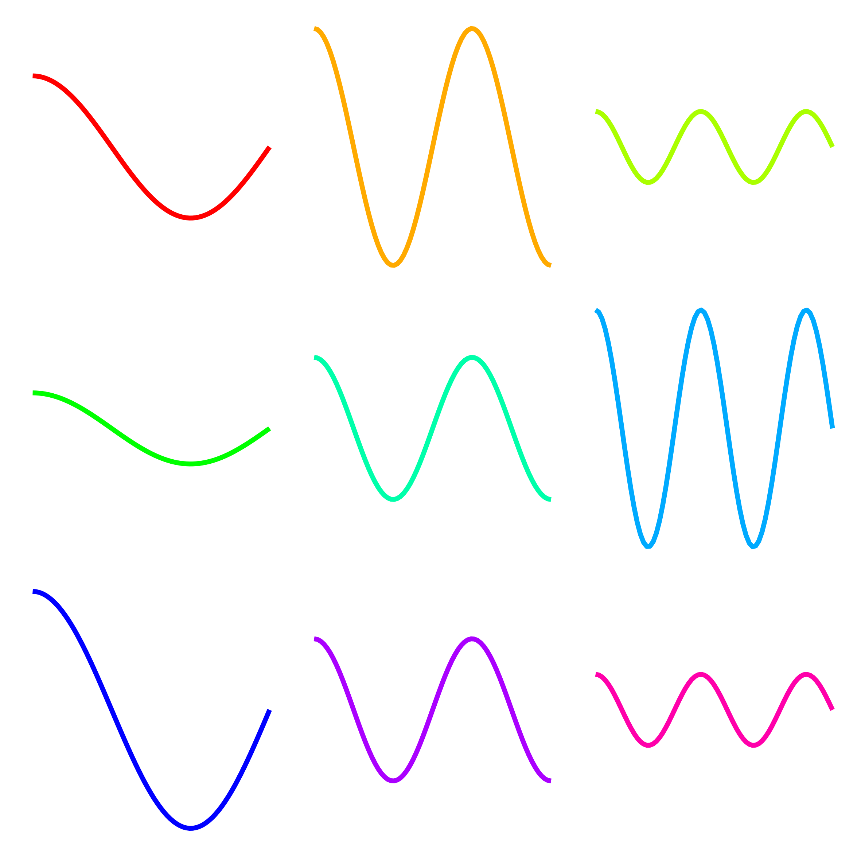
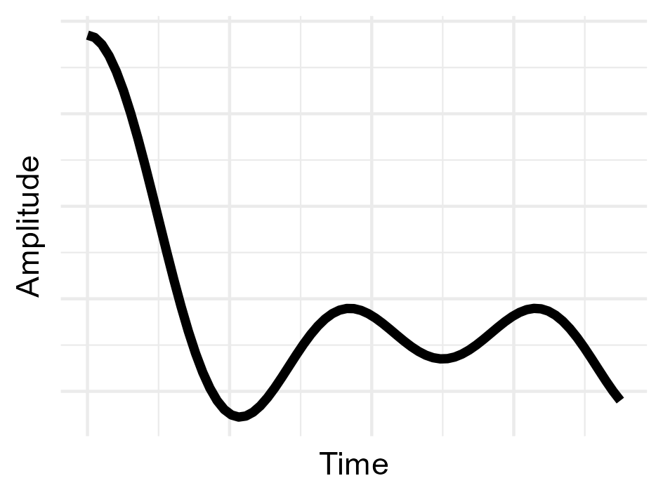


Measured signal
Signal per column
Frequency

Slide 9
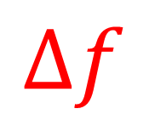
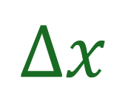

$$f_{max}$$
$$Δf$$
$$Δx$$
FOV

Slide 10
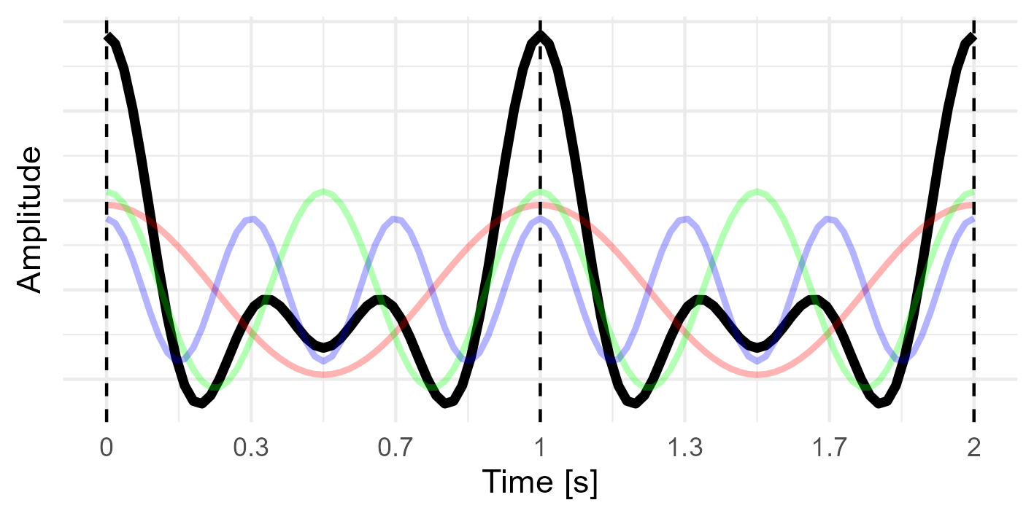
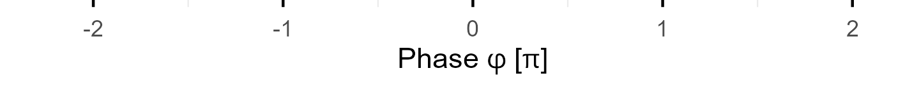

Slide 11
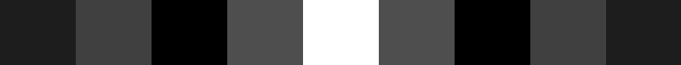

Slide 12
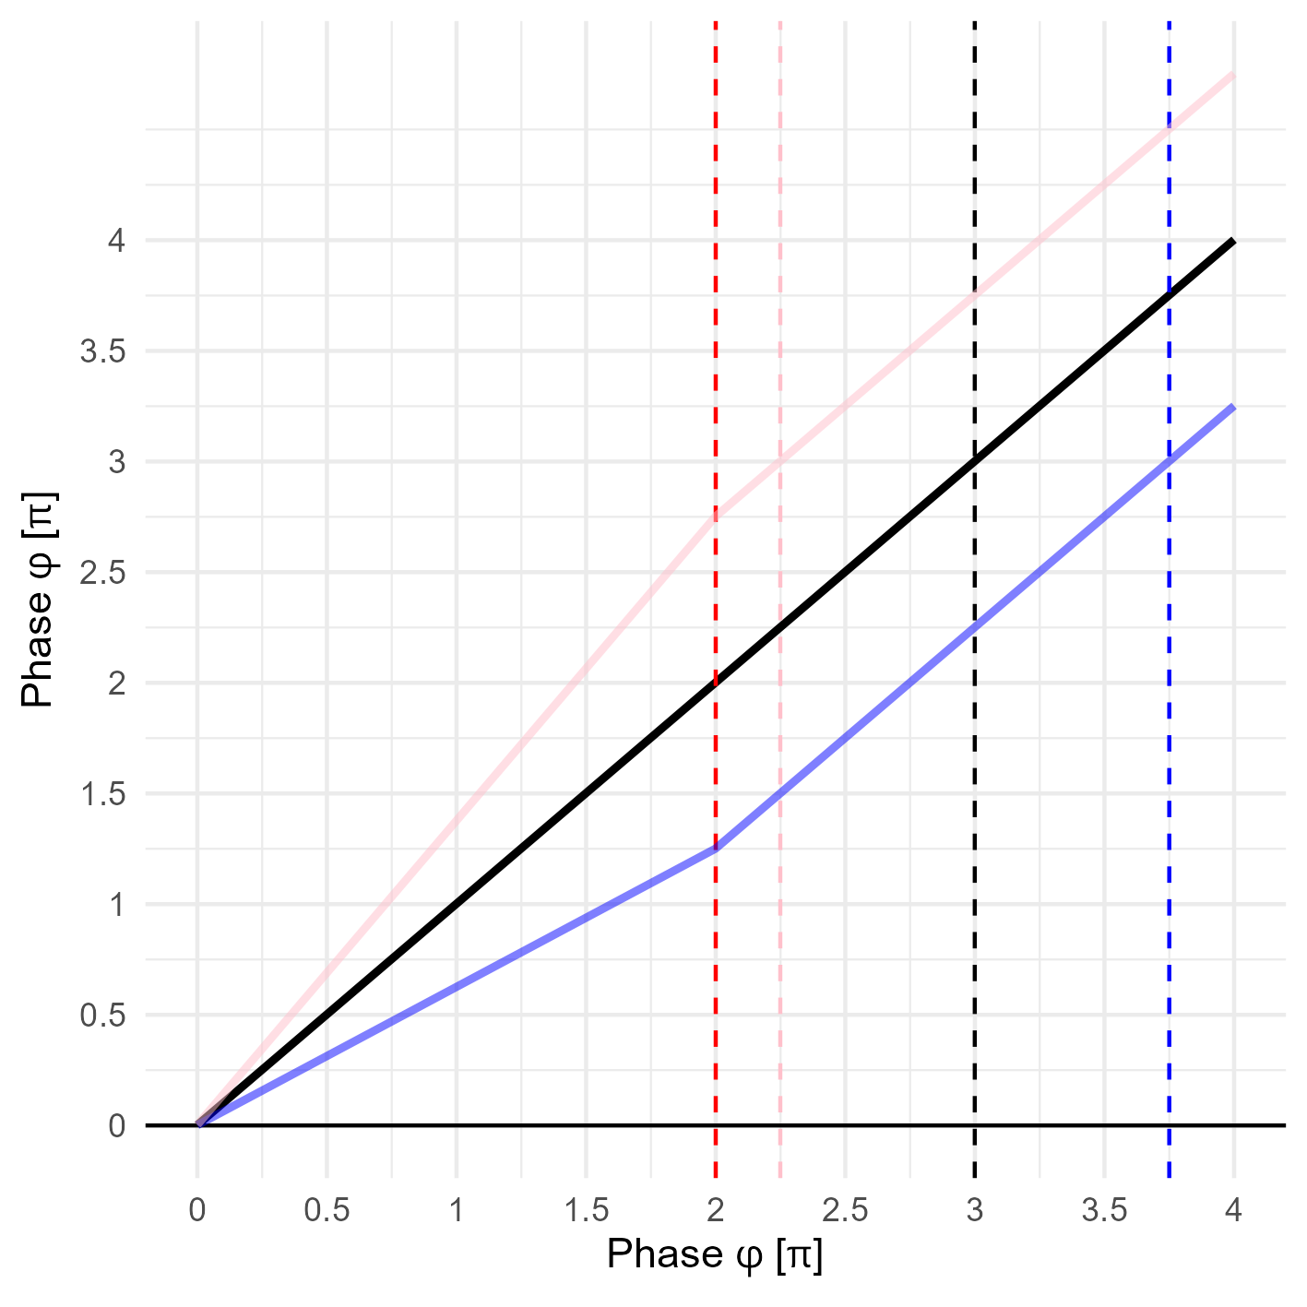



Slide 13


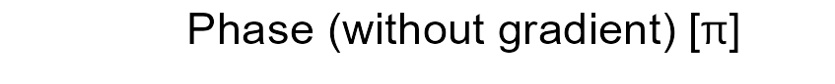

Slide 14

