Slide 1





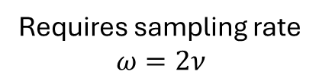

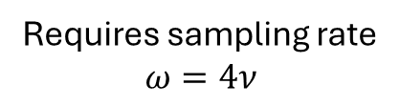


Frequency range of a real signal:
Quadrature: Frequencies can be uniquely identified:
Reduntant due to symmetry with positive range
Encoding bandwidth
-$2ν$
-$ν$
$$ν$$
$$2ν$$
-$2ν$
-$ν$
$$ν$$
$$2ν$$
Requires sampling rate
$$ω=4ν$$
Requires sampling rate
$$ω=2ν$$

Slide 2
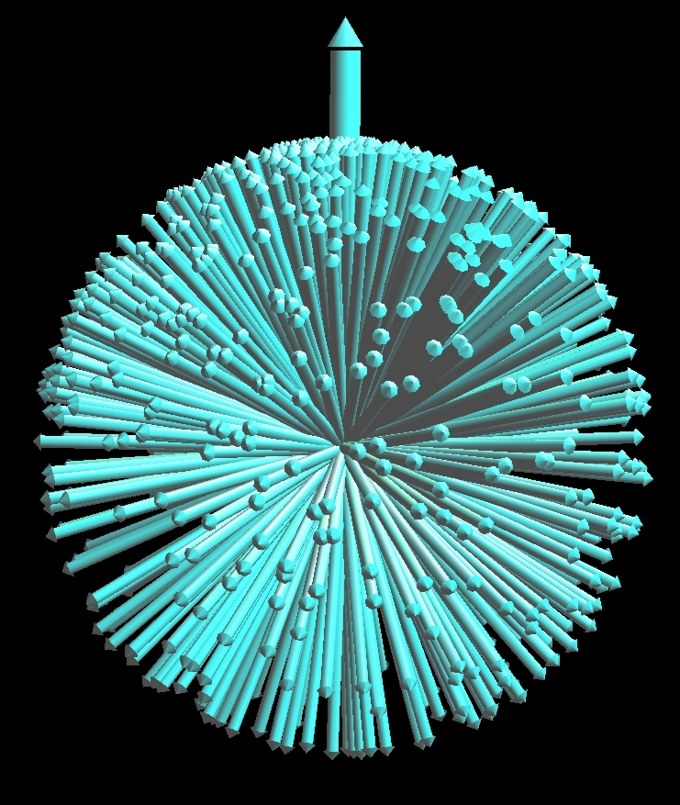
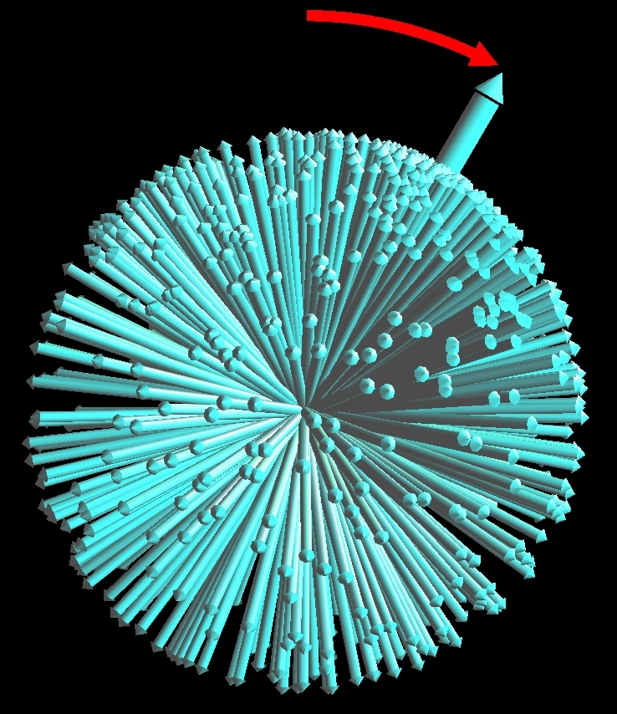

Slide 3
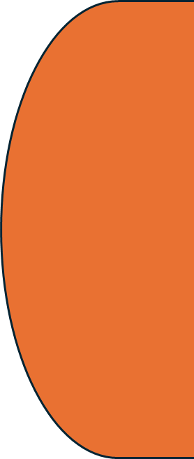


Electrons moving in a loop
Magnetic moment
Rotating negatively charged sphere
Magnetic moment

Slide 4


Hydrogen
Deuterium
Helium
Neutron
Proton
Nuclear Spin:
$$\frac{1}{2}$$
$$1$$
0

Slide 5





z
Magnitude $|\vec{I}|$
$$\vec{I}$$
$$I_{z}$$
y
$$I_{x}$$
$$I_{y}$$
x

Slide 6

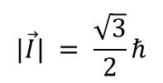

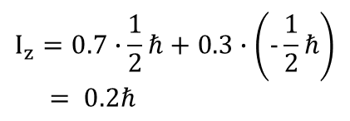
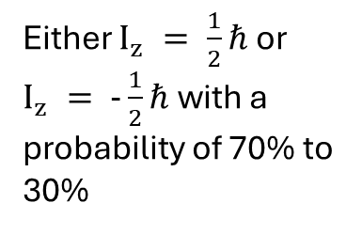
Classical view/
Expectation value
Actual state
Measurement outcome
z
$$|\vec{I}| = \frac{\sqrt{3}}{2}ℏ$$
spin-up eigenstate
$$I_{z} = \frac{1}{2}ℏ$$
$$I_{z} = \frac{1}{2}ℏ$$
x
z
Superposition
“70% up, 30% down“
$$I_{z}=0.7∙\frac{1}{2}ℏ+0.3∙\left(−\frac{1}{2}ℏ\right)$$
$$= 0.2ℏ$$
Either $I_{z} = \frac{1}{2}ℏ$ or $I_{z} = −\frac{1}{2}ℏ$ with a probability of 70% to 30%
x

Slide 7
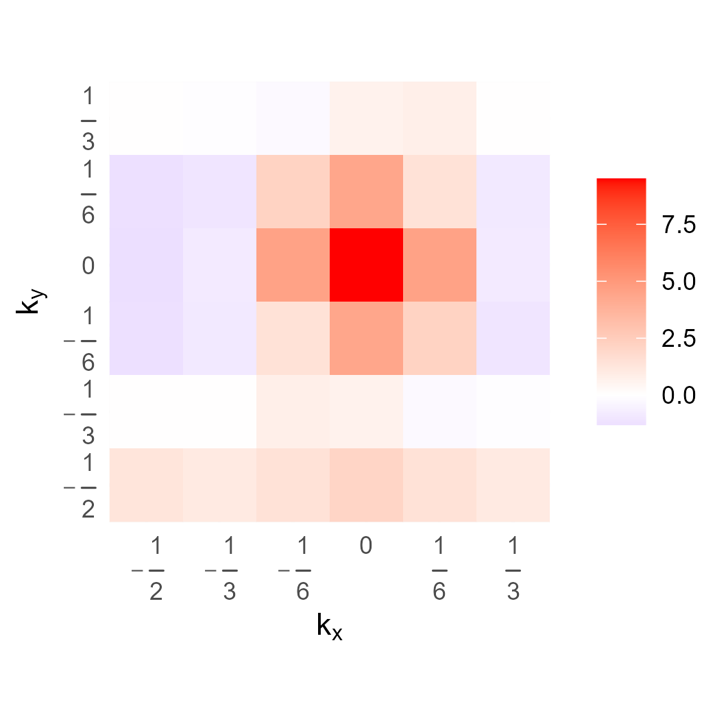
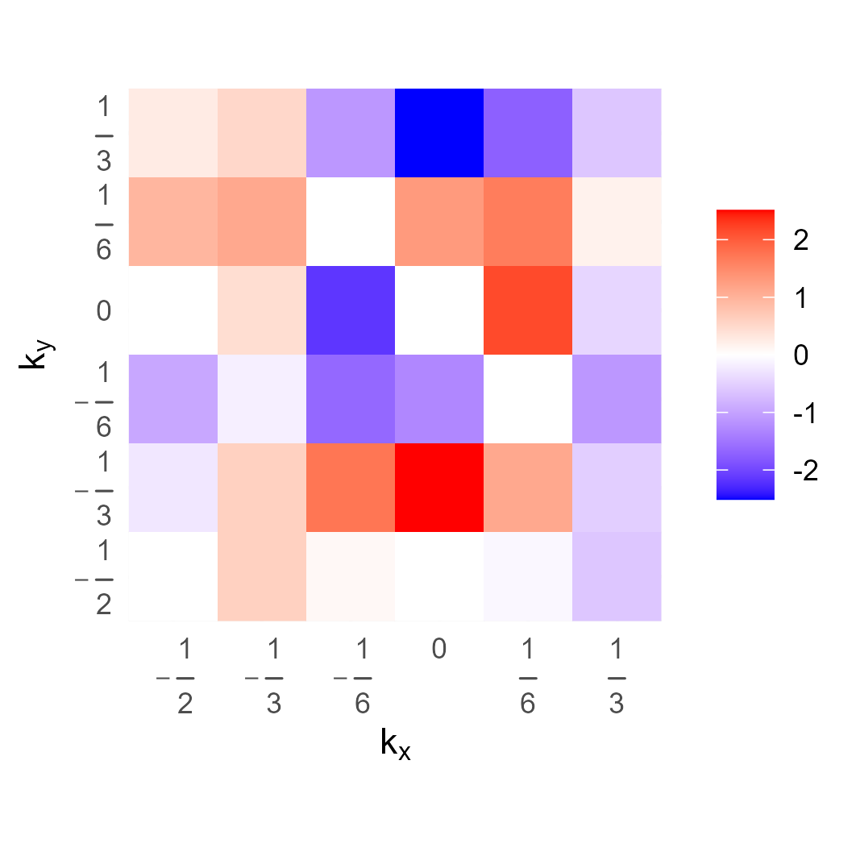


Re(kspace)
Im(kspace)
$$S(k_{x},k_{y}) = S({−k}_{x},{−k}_{y})$$
$$S(k_{x},k_{y}) =−S({−k}_{x},{−k}_{y})$$

Slide 8
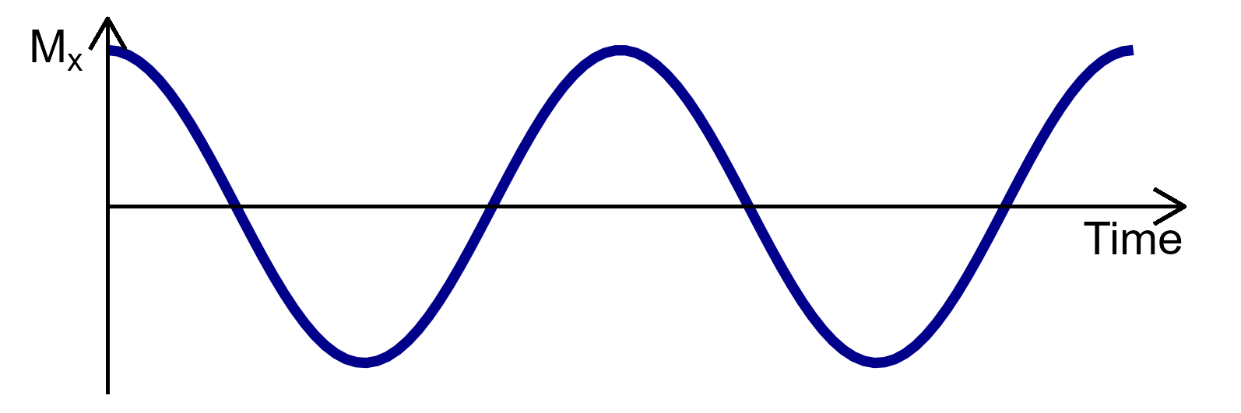
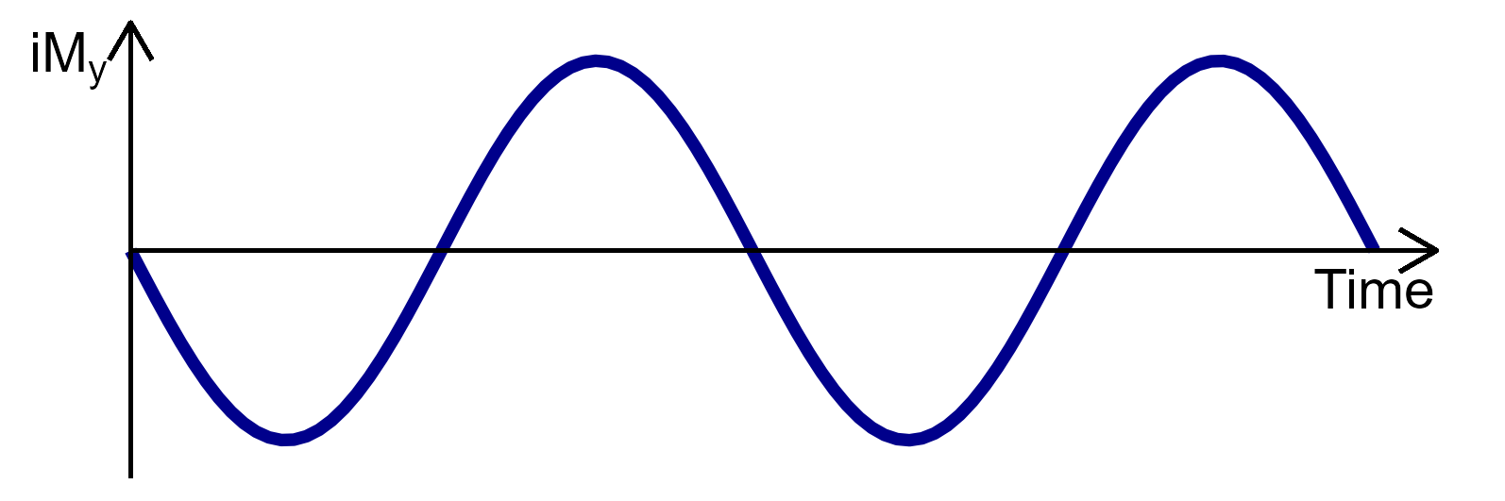
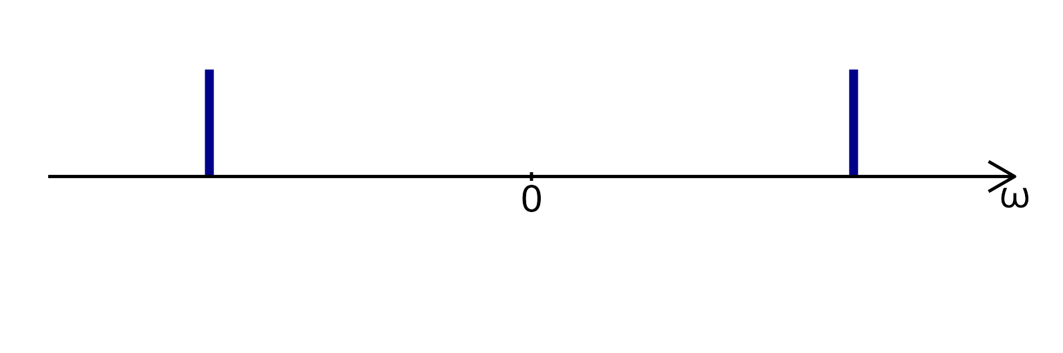
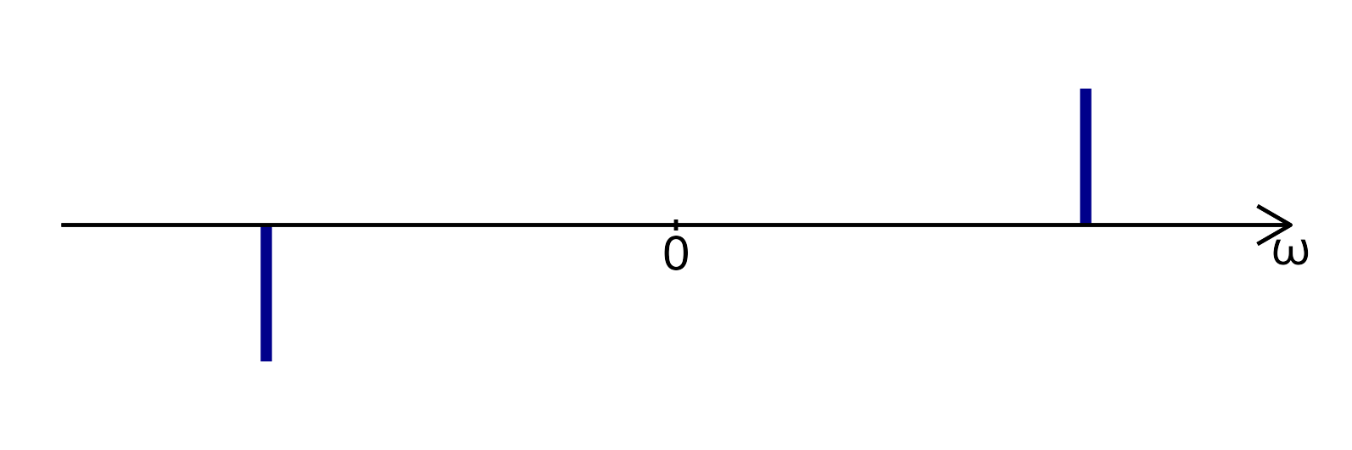
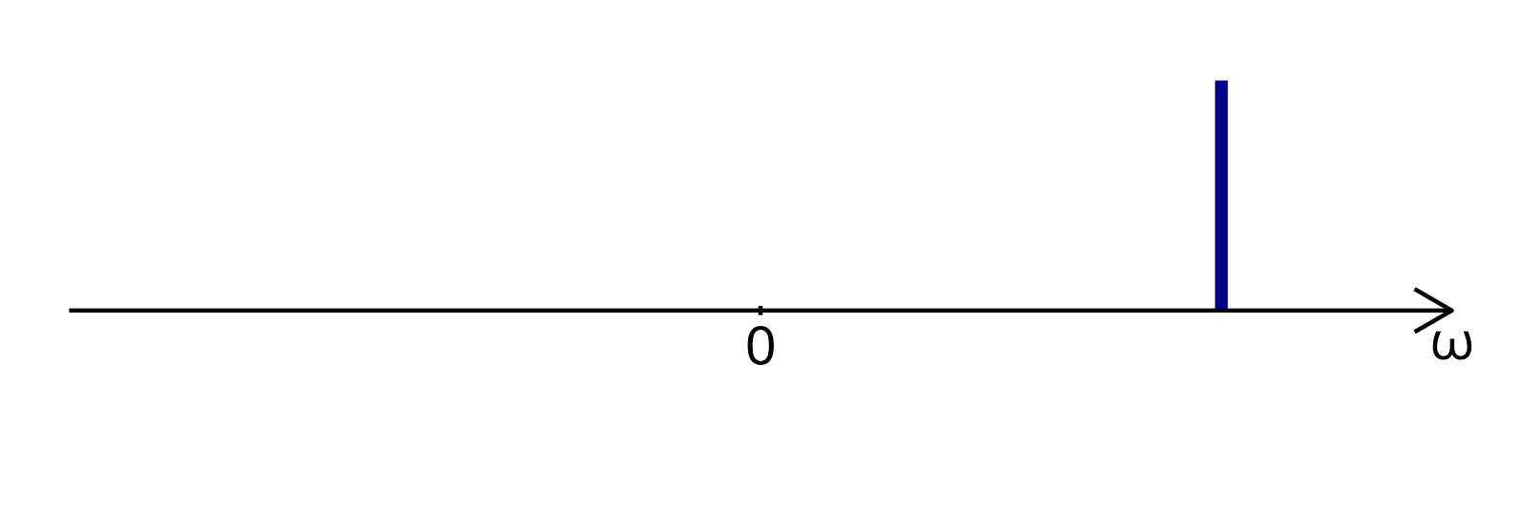


$${\text{𝓕}}^{−1}$$
$${\text{𝓕}}^{−1}$$

Slide 9
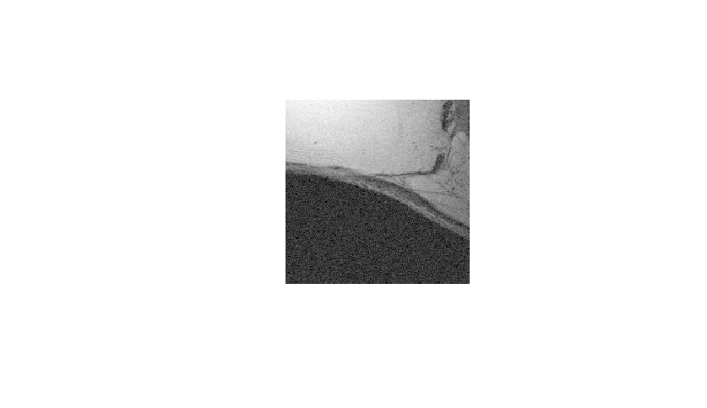
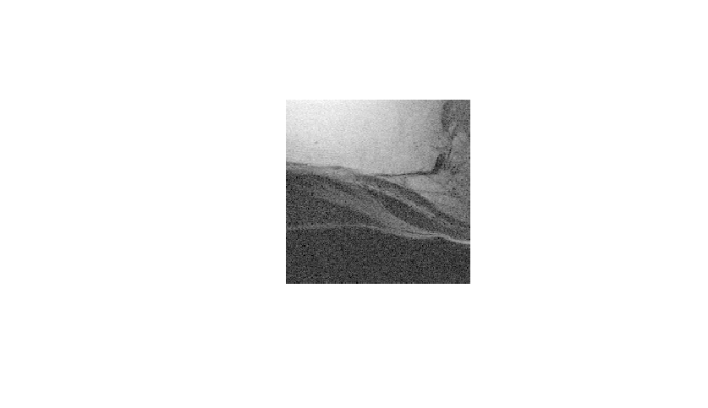


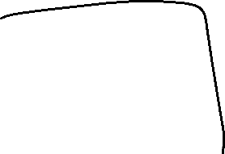



Slide 10
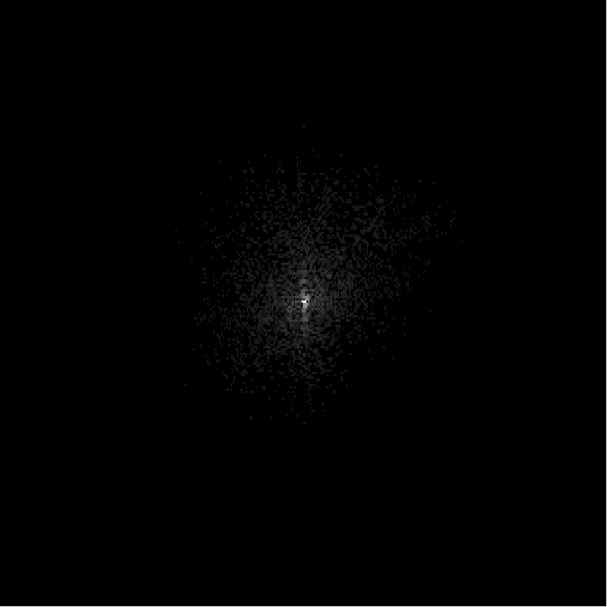
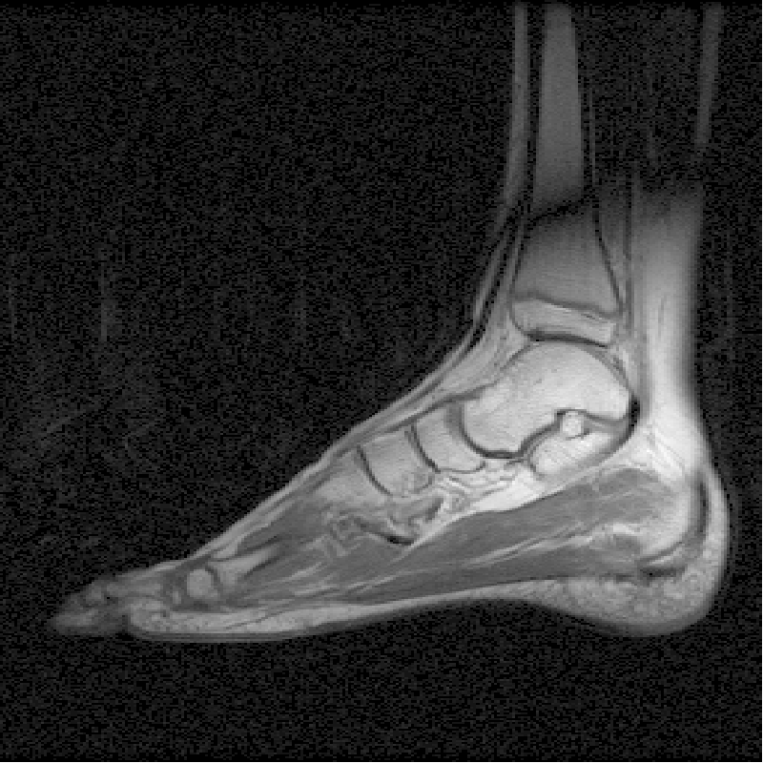
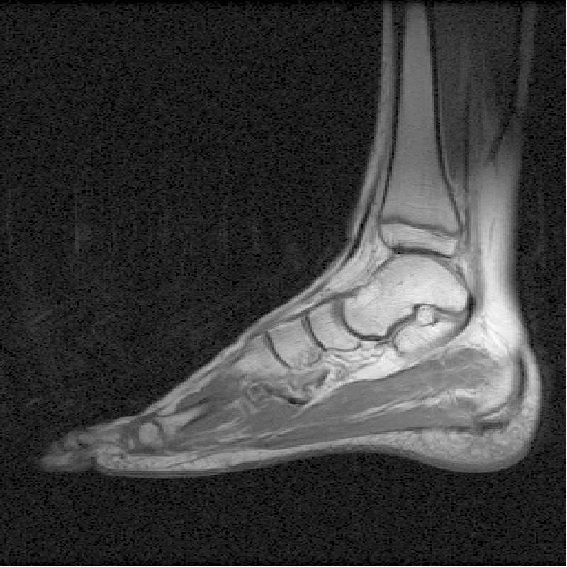
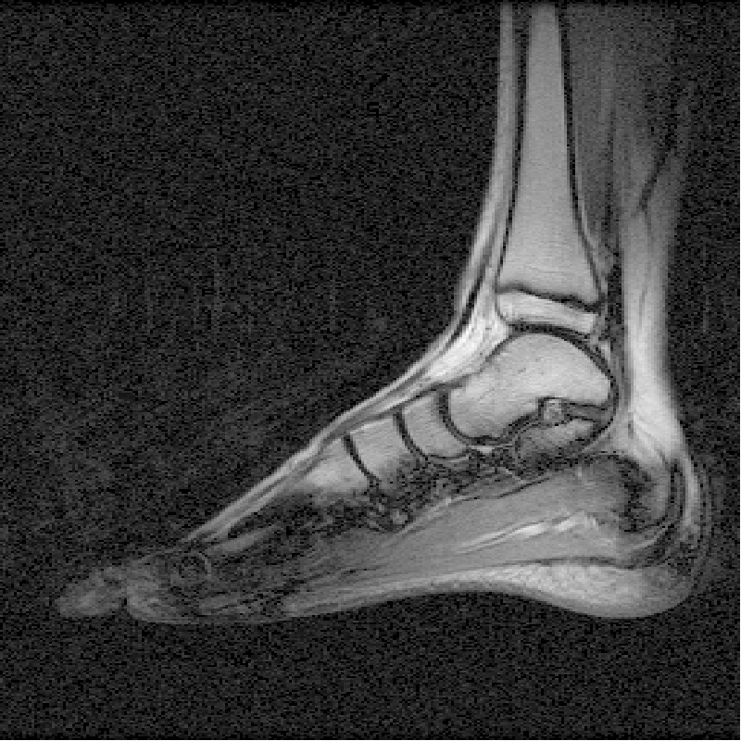
Raw data
Complex image
Magnitude image
IFT
mag
Re
Re
Im
Im

Slide 11
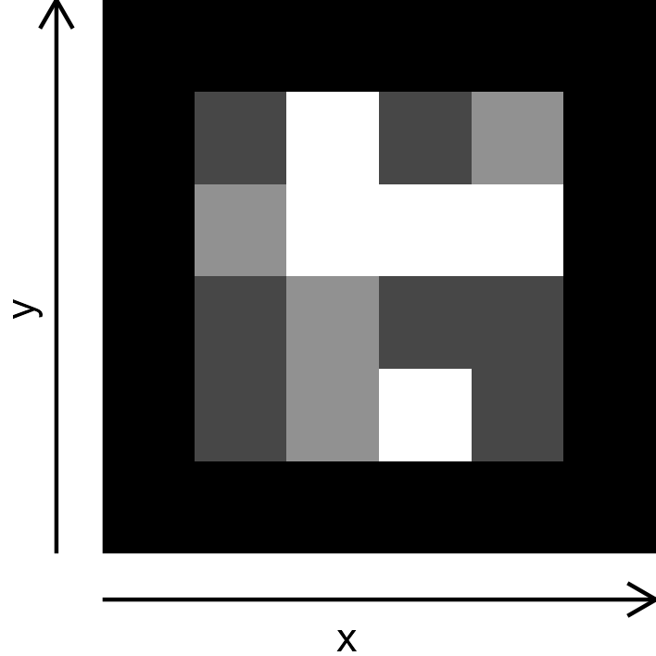
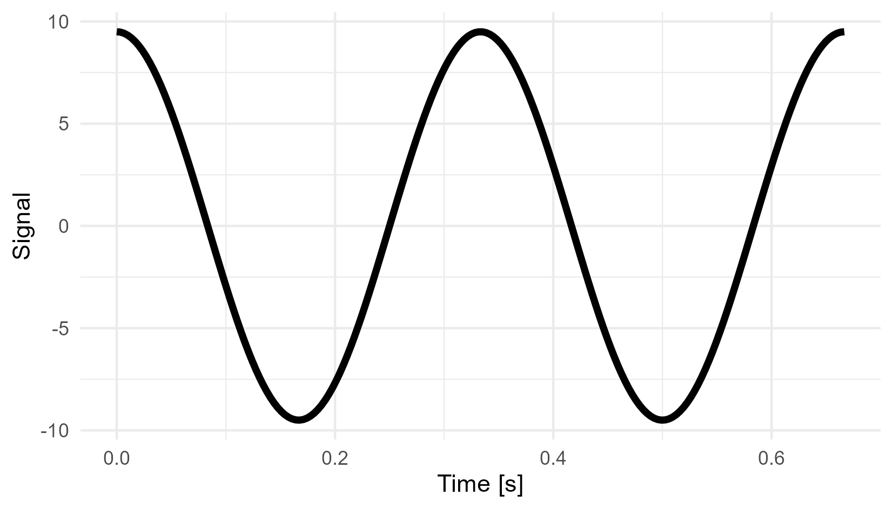


Slide 12
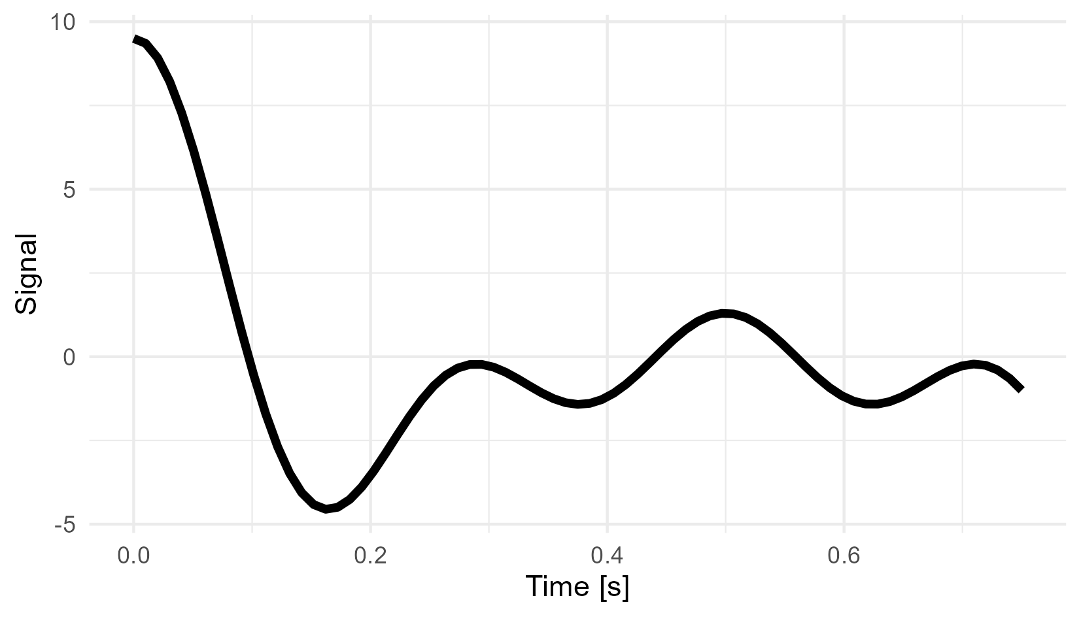

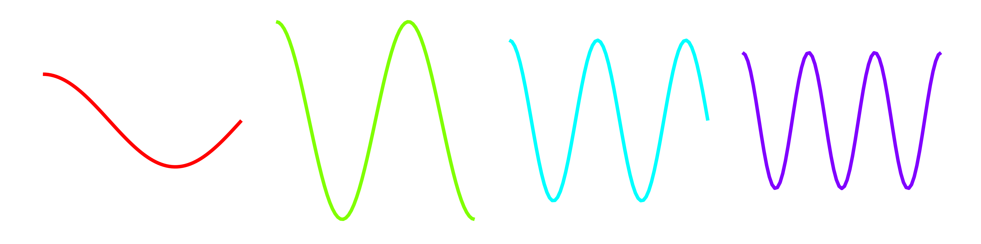

Signal per column
Frequency

Slide 13
Bin: 1 2 3 4 5 6 7 8 9 10
Freq: 0 1 2 3 4 5 -4 -3 -2 -1

Slide 14
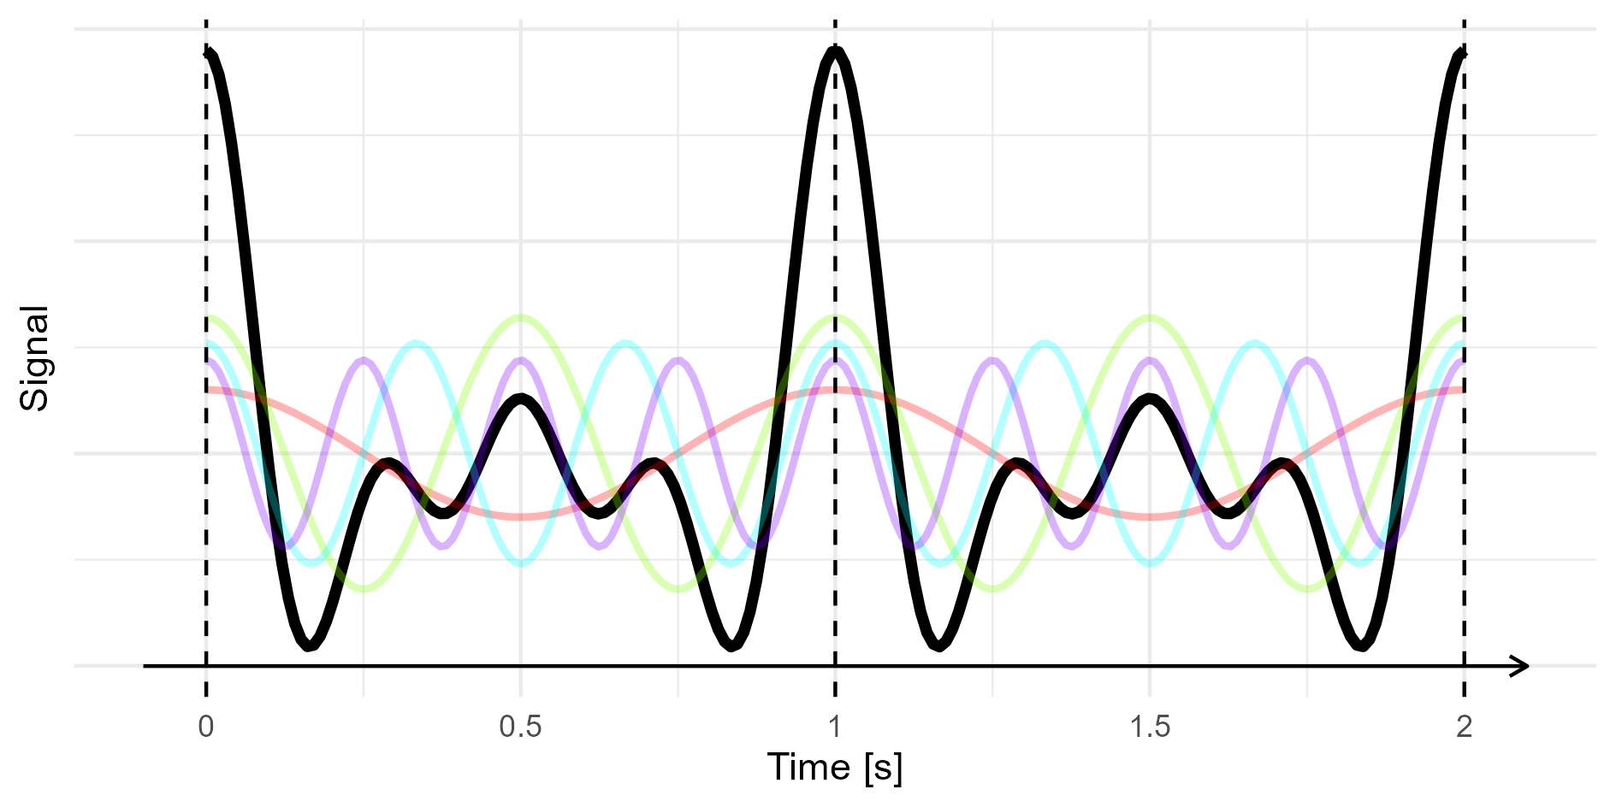
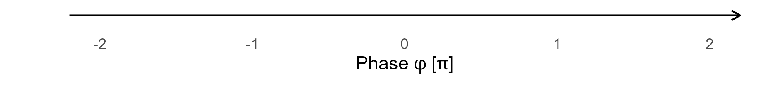

Slide 15
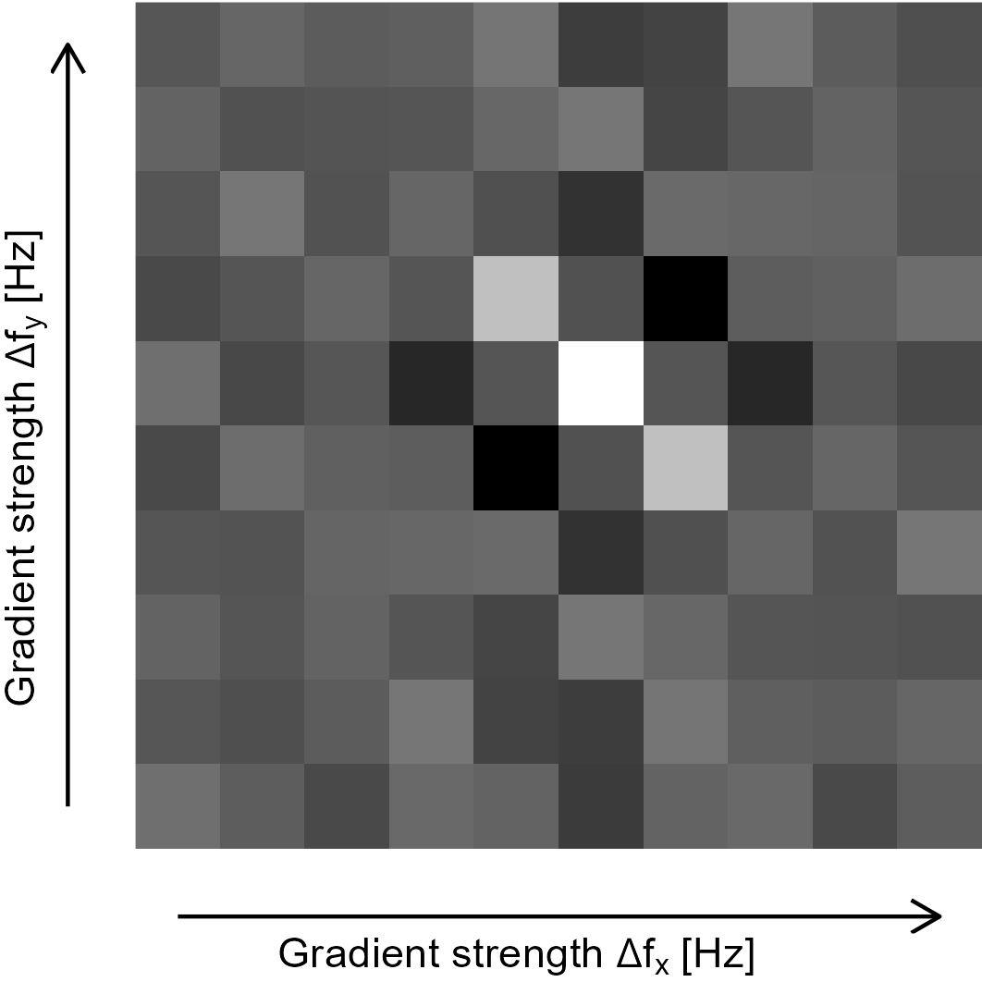
Phase encoding
Frequency encoding

Slide 16






Slide 17

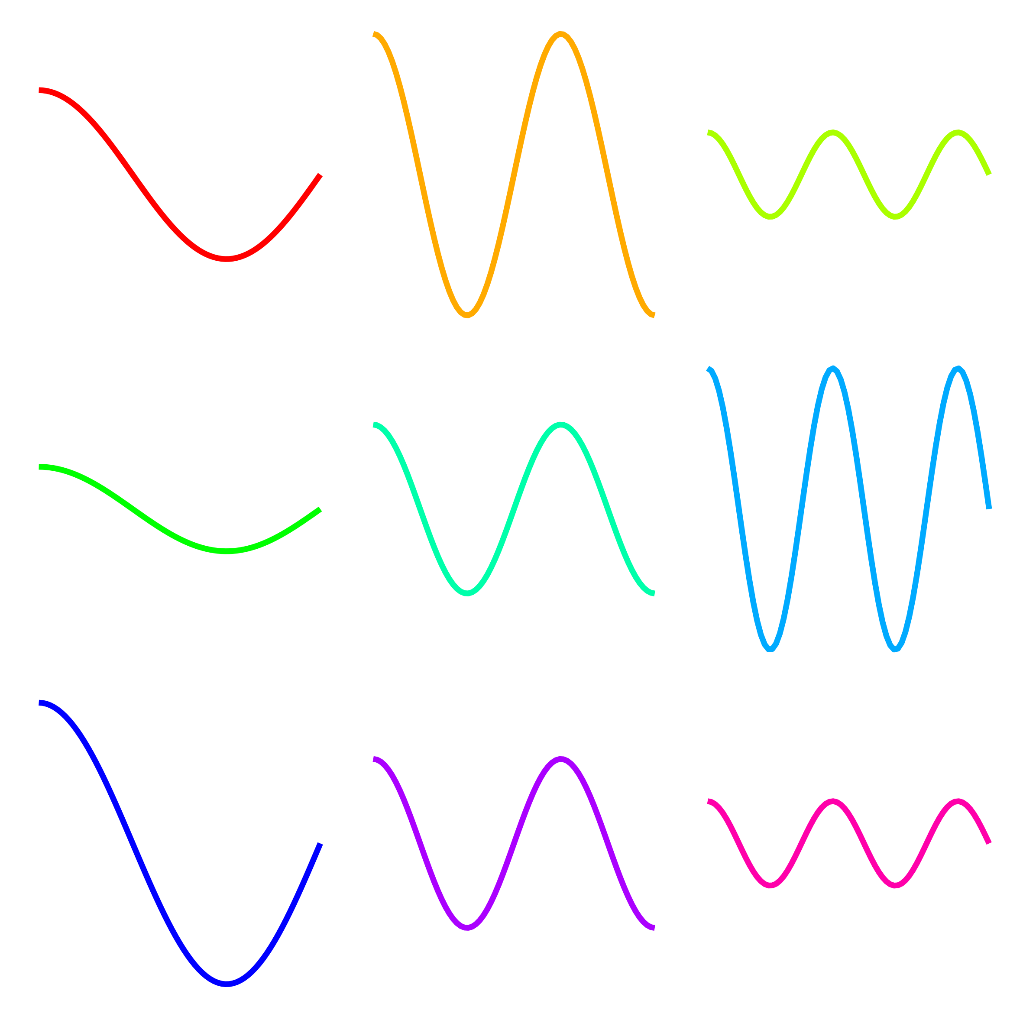
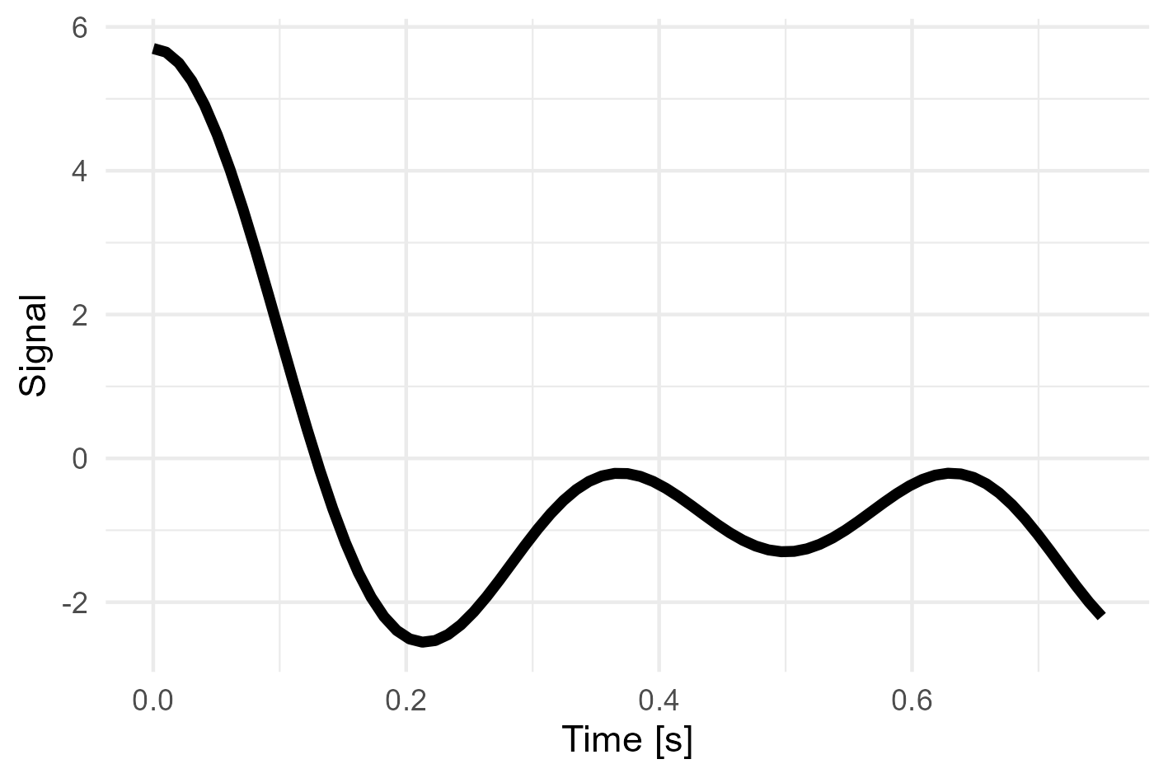
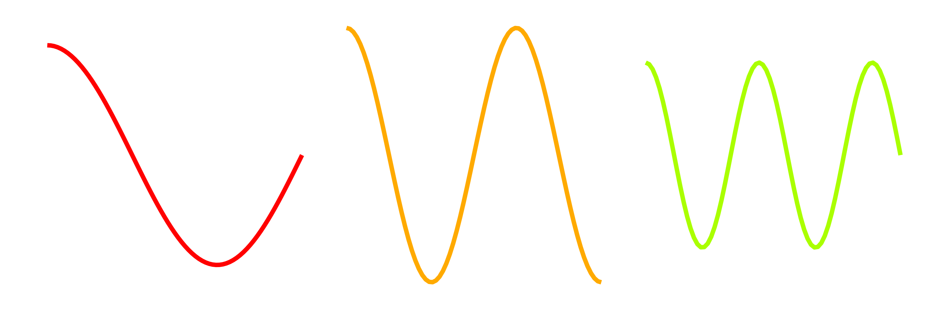

Signal per column
Frequency

Slide 18
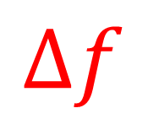
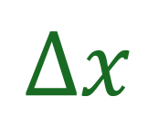
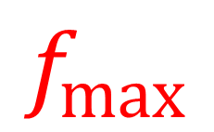
$$f_{max}$$
$$Δf$$
$$Δx$$
FOV

Slide 19
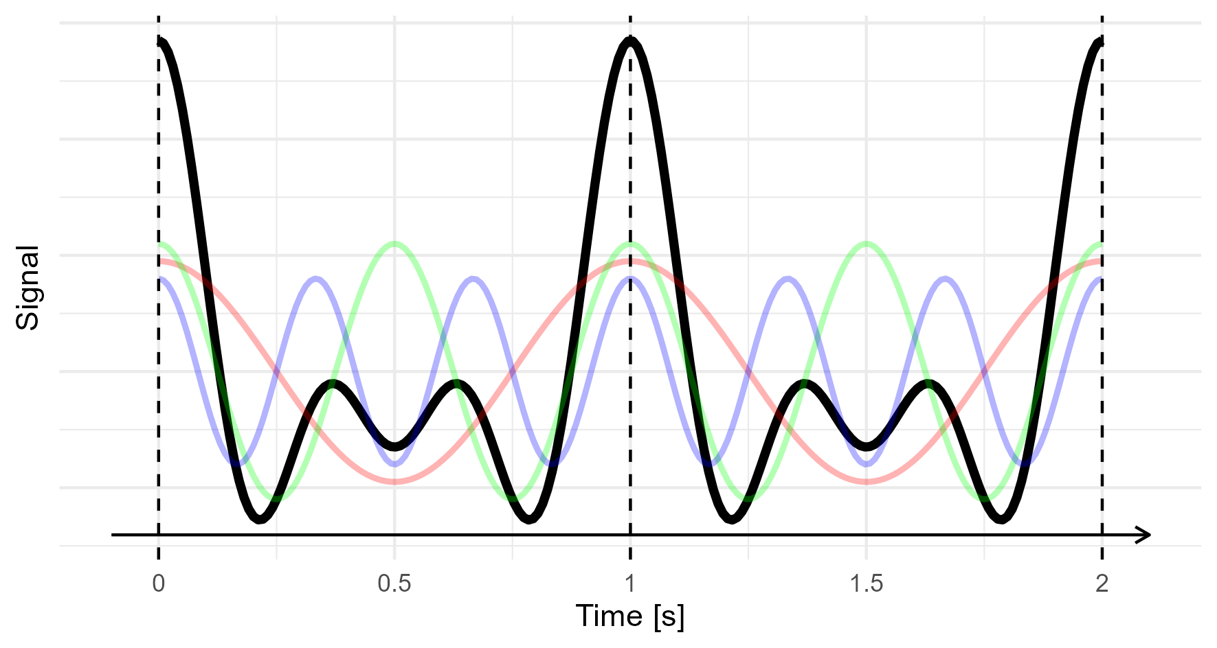
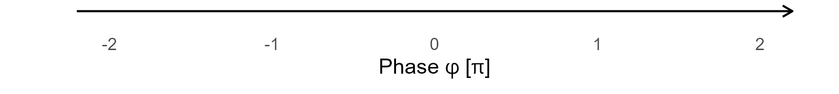

Slide 20
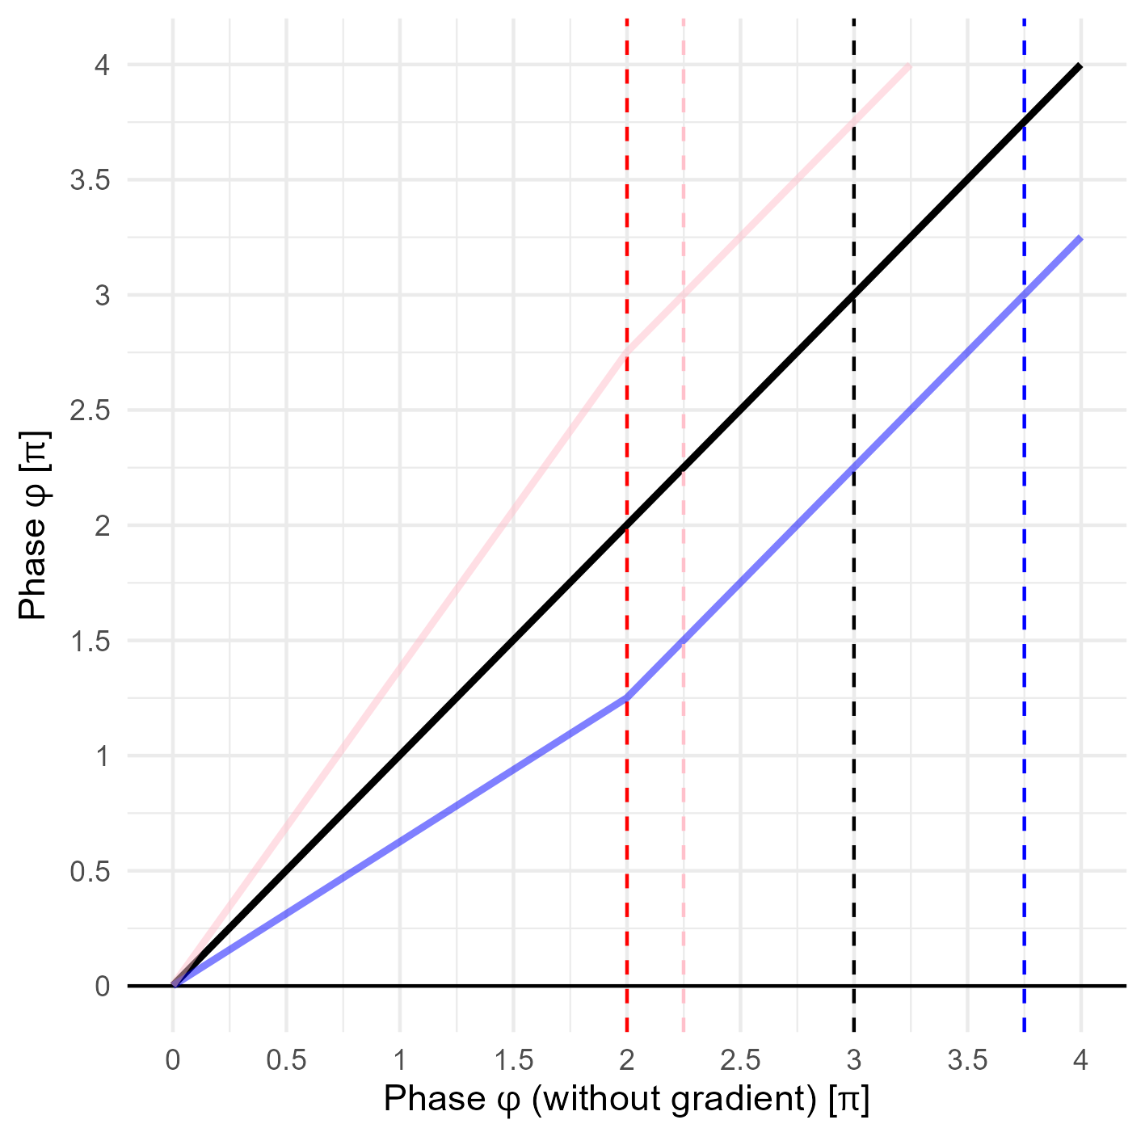
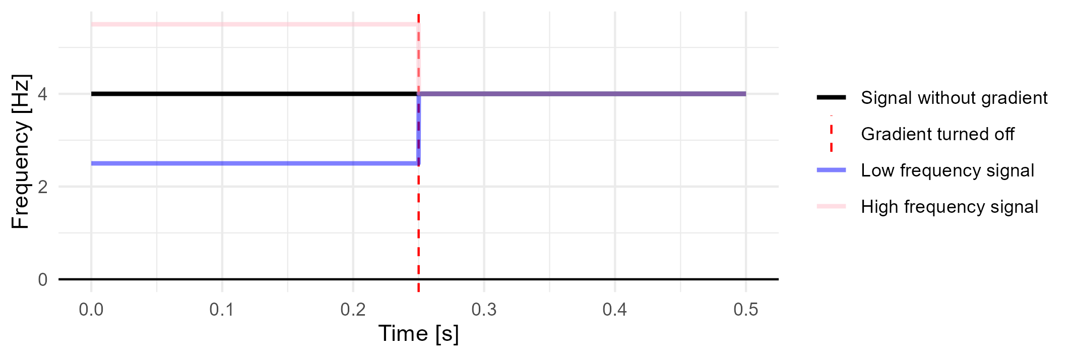
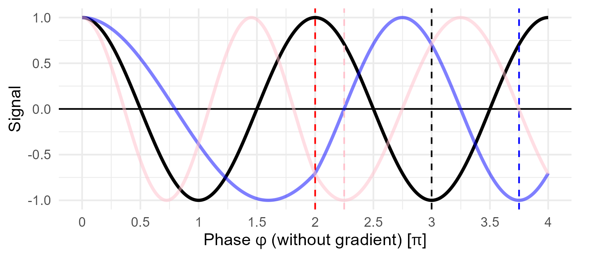

Slide 21


Slide 22
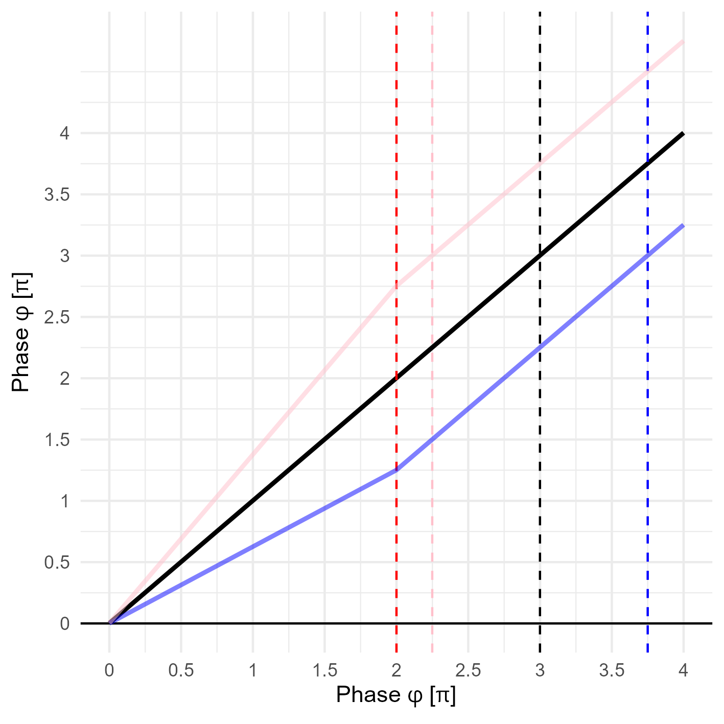
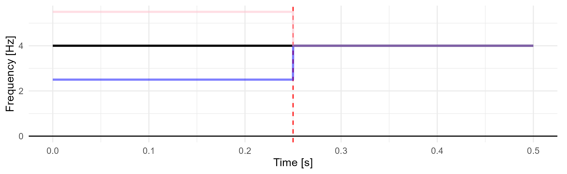
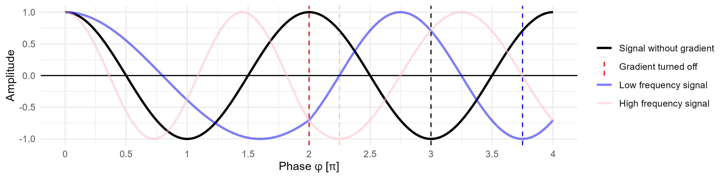

Slide 23
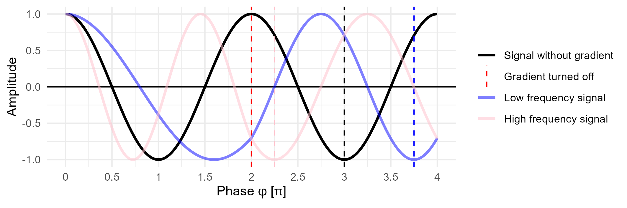
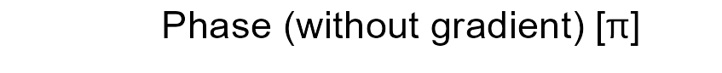

Slide 24
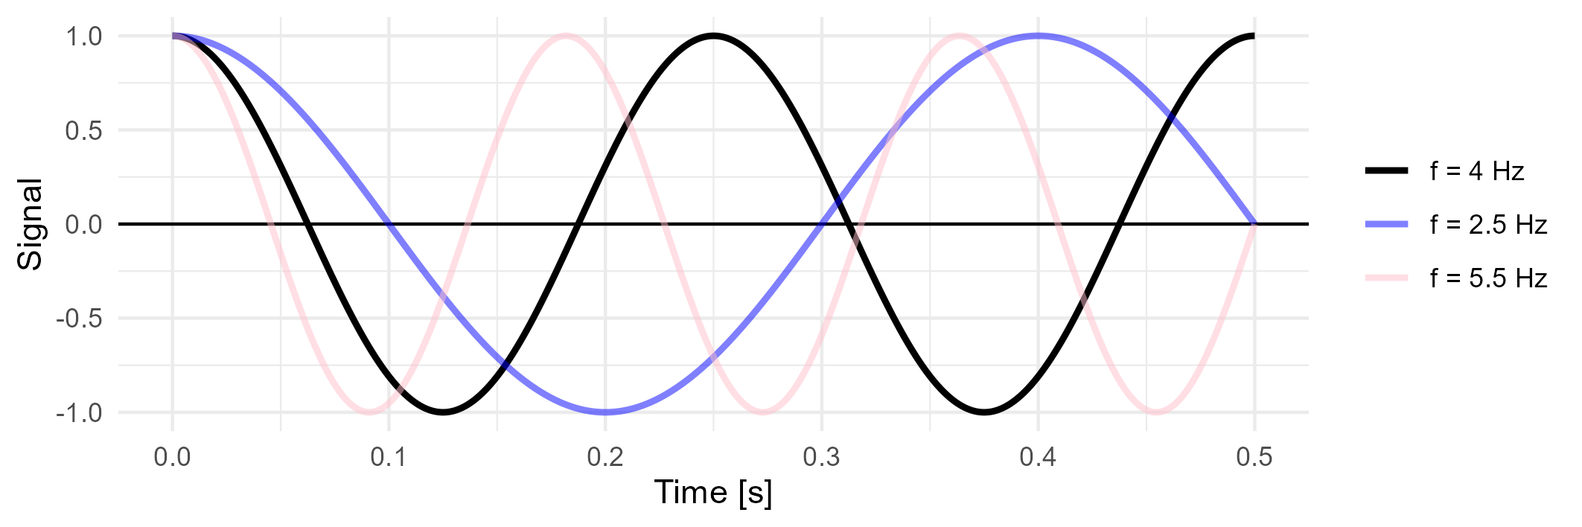
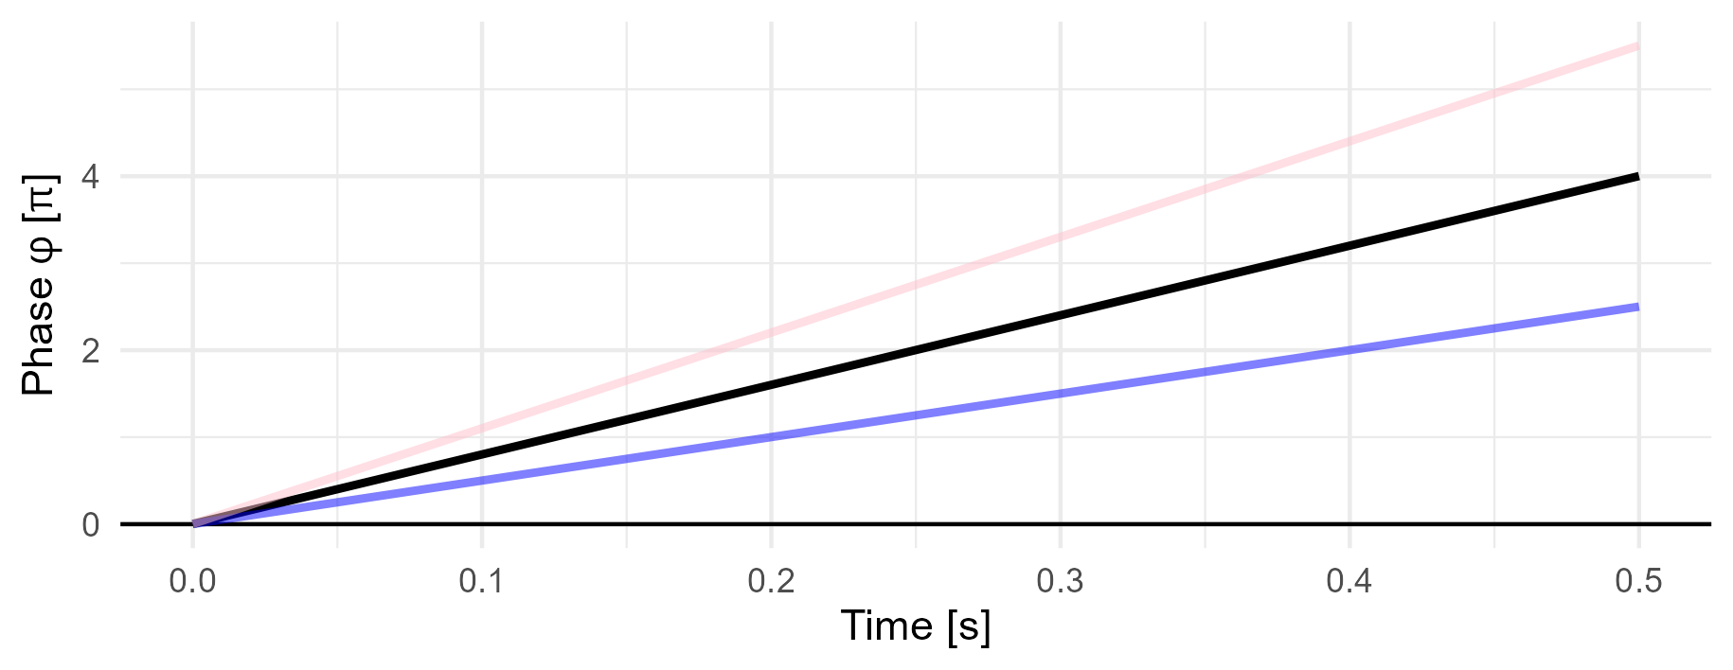

Slide 25

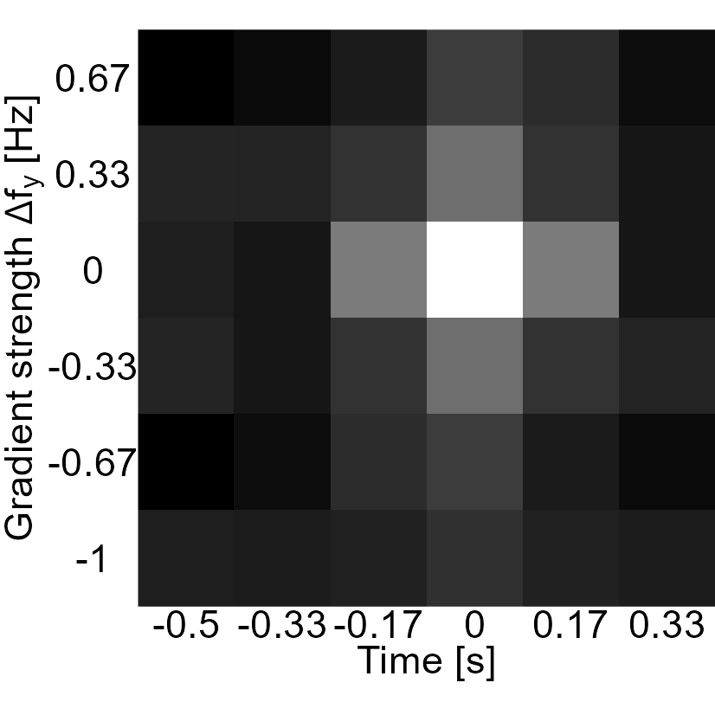
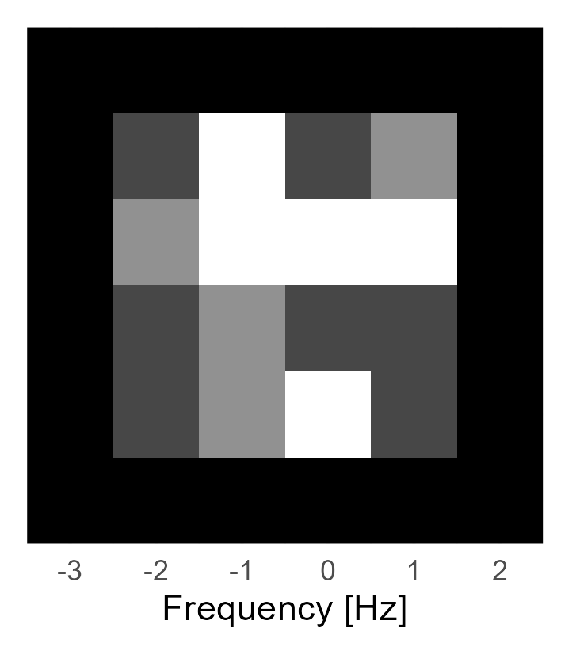

Re(kspace)
abs(kspace)
fft( )
Im(kspace)

Slide 26
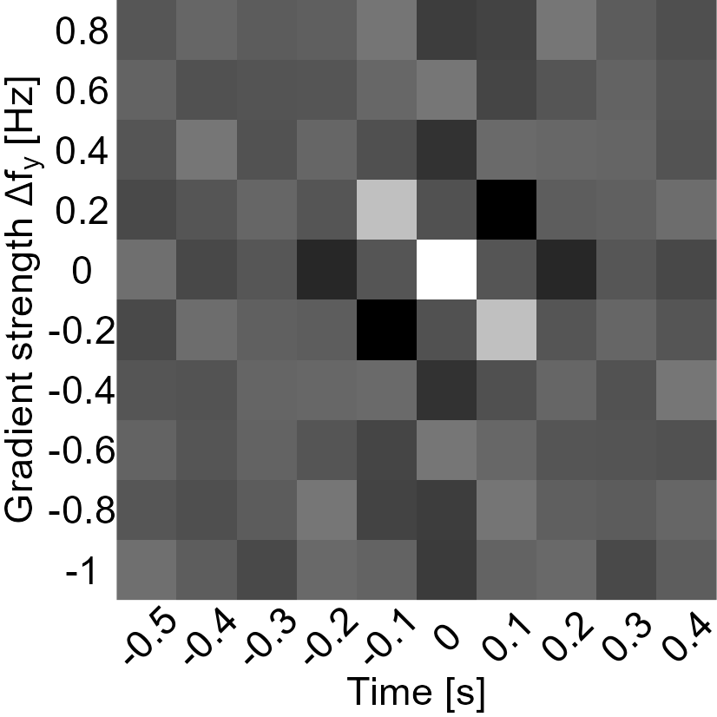

kspace
fft( )

Slide 27

abs(kspace)
abs(image)
abs(kspace) ?
fft(), abs()
fft( ), abs( )

Slide 28



