Slide 1

Notes:
AGNTCon Europe 2026, Amsterdam.
A New Way To Build Software: How GitHub Is Evolving For a Human, Agent Future
Marlene Mhangami — Senior Developer Advocate, Microsoft / GitHub.
Artwork generated with the official GitHub Asset Generator MCP, general-social-banner-light-1. Layout direction inspired by the opening slides of marlene-playwright-talks-aieng. The reference deck was not modified.

Slide 2
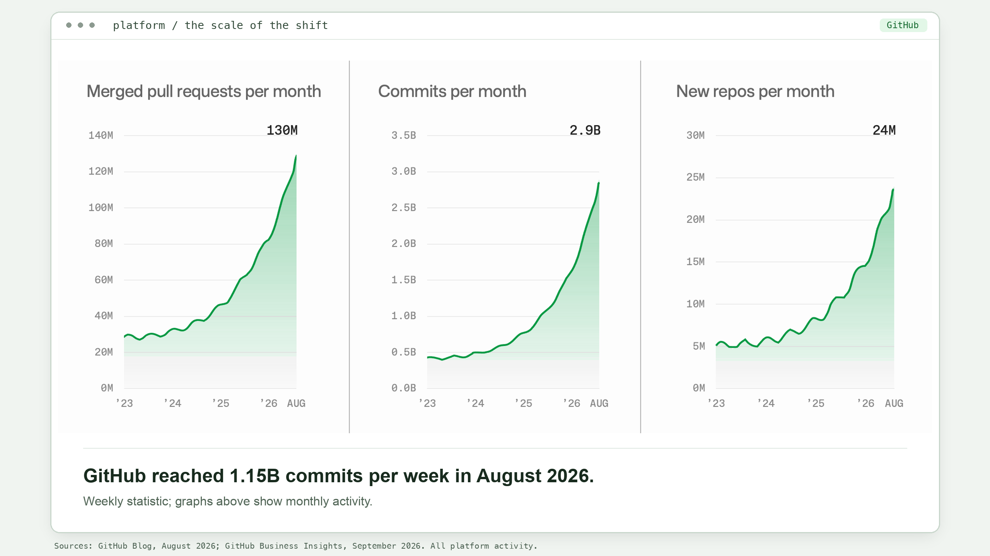
Notes:
Approved tracker wording:
“Commit volume is accelerating: we averaged 918M commits per week over the last 90 days, with August alone hitting 1.15B commits per week.”
The user selected the published three-panel chart, then requested a light theme and a bottom caption. The curves, values, and axes are preserved. Only colors and exterior padding have changed. All three panels show MONTHLY measures: merged PRs, commits, and new repos. The 1.15B WEEKLY figure is displayed as a separate bottom caption, explicitly distinguished from the monthly graphs. No weekly-to-monthly conversion is implied.
Public source for the original chart:
https://github.blog/news-insights/company-news/the-august-17-outage-and-the-work-ahead/
https://github.blog/wp-content/uploads/2026/08/blog-post-aug-17-outage-1.png
Source: Business Insights. Tracker last updated September 2026; next review October 2026; POC Abby Rieflin.
https://github.com/github/public-relations/blob/master/Corp%20Comms%20External%20Reference%20Tracker.md
Approval provenance: external-reference update merged September 11, 2026:
https://github.com/github/public-relations/pull/1136
https://github-grid.enterprise.slack.com/archives/C0F7EKL80/p1789158083089459
IMPORTANT: This is all GitHub commit activity, not a count of agent-authored commits. No approved agent-attributed commit count or percentage was found.
Suggested transition: GitHub has to evolve both how work is produced and how people review, govern, and trust it.
This light-theme line-chart slide precedes the PR bar-chart slide.

Slide 3
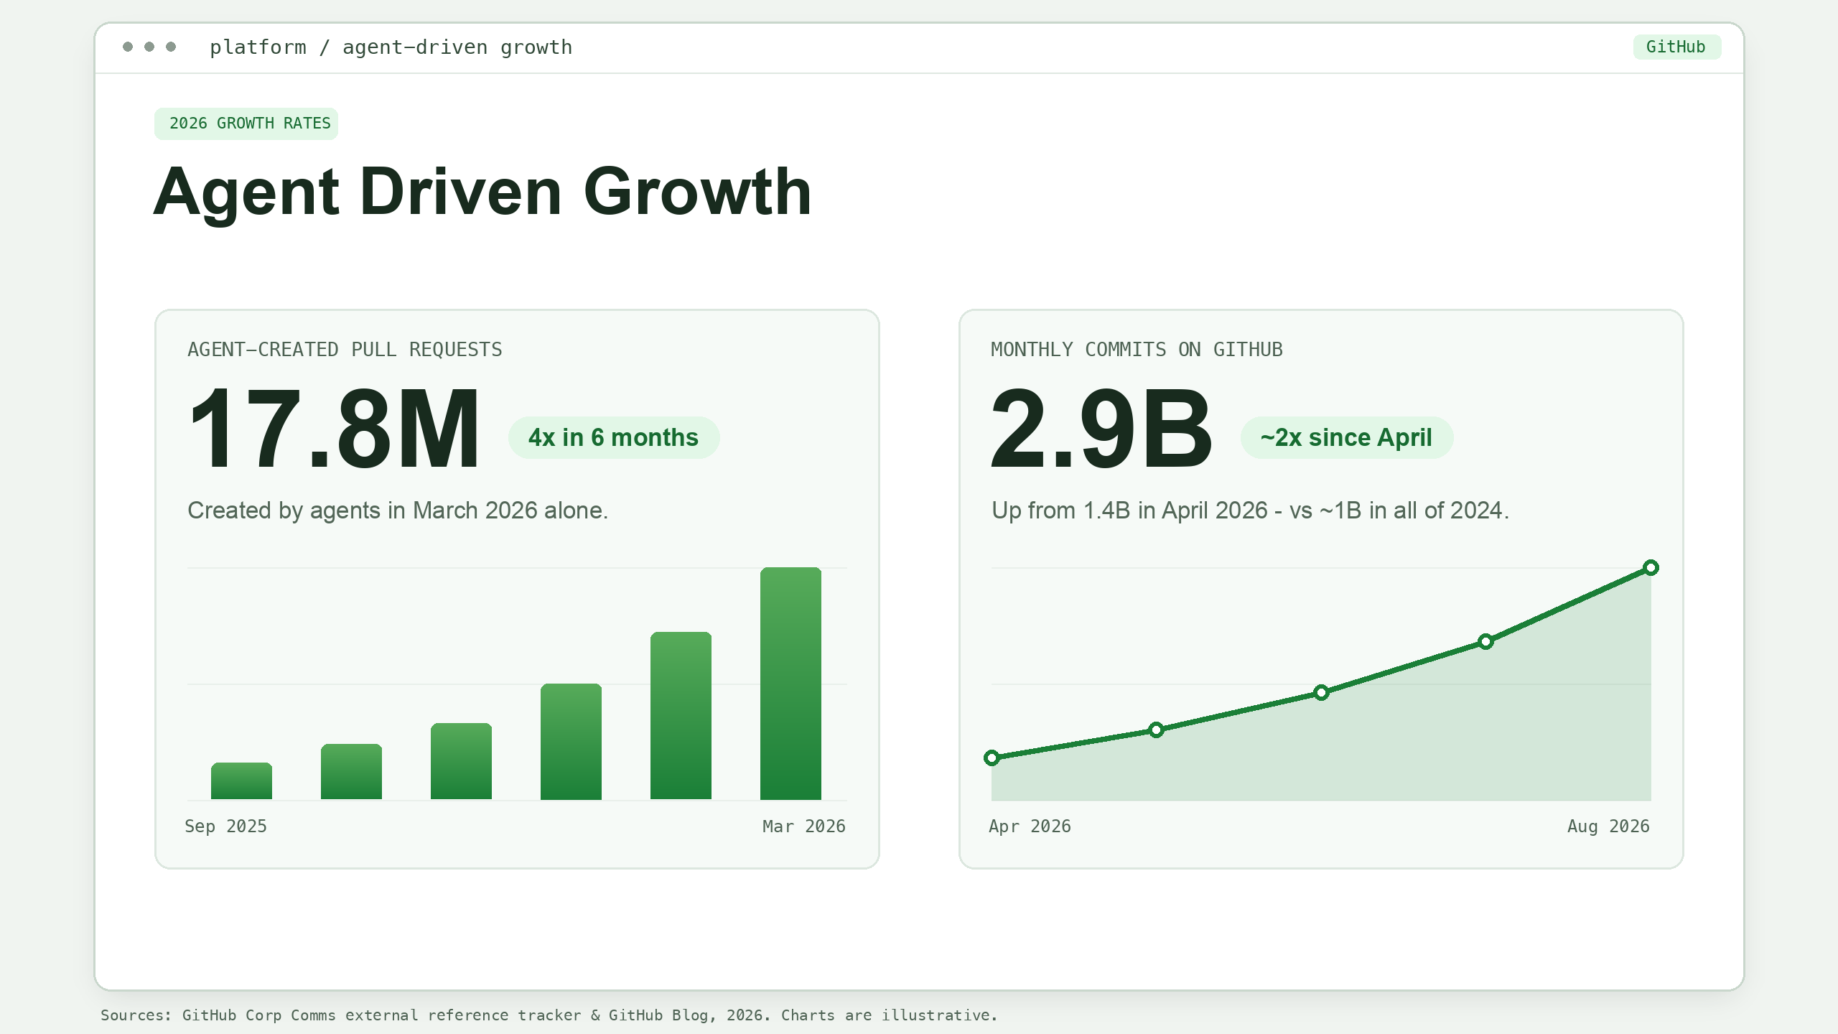
Notes:
Slide title: Agent Driven Growth. Layout inspired by the 'Growth Is Accelerating' slide of marlene-playwright-talks-aieng, restyled to match the light-theme commits slide. The reference deck was not modified.
Approved statistics:
• 17.8 million pull requests CREATED BY AGENTS in March 2026 alone (agent-generated PRs quadrupled in six months). Source: Platform Activity March 2026, Corp Comms External Reference Tracker; POC Julia Tenner.
• Monthly commits grew from 1.4 billion (April 2026) to 2.9 billion (August 2026). Source: GitHub Blog, 'The August 17 outage, and the work ahead':
https://github.blog/news-insights/company-news/the-august-17-outage-and-the-work-ahead/
• Contrast: GitHub recorded ~1 billion commits in ALL of 2024 (GitHub Octoverse; also cited on the 'Growth Is Accelerating' slide of the reference deck). So a single month in 2026 (2.9B) now exceeds the entire 2024 calendar year.
https://github.com/github/public-relations/blob/master/Corp%20Comms%20External%20Reference%20Tracker.md
ACCURACY: The left figure is agent-created pull requests, NOT commits, merged PRs, or Copilot-only contributions. The right figure is TOTAL platform commits, NOT an agent-attributed commit count (no approved agent-commit count exists). Both mini-charts are illustrative: the shapes convey the 4x and ~2x trajectories and the labeled endpoints are the approved values; intermediate points are stylized, not observed data.
Suggested transition: More contributions do not automatically mean better software — review capacity, governance, and trust now matter even more.

Slide 4
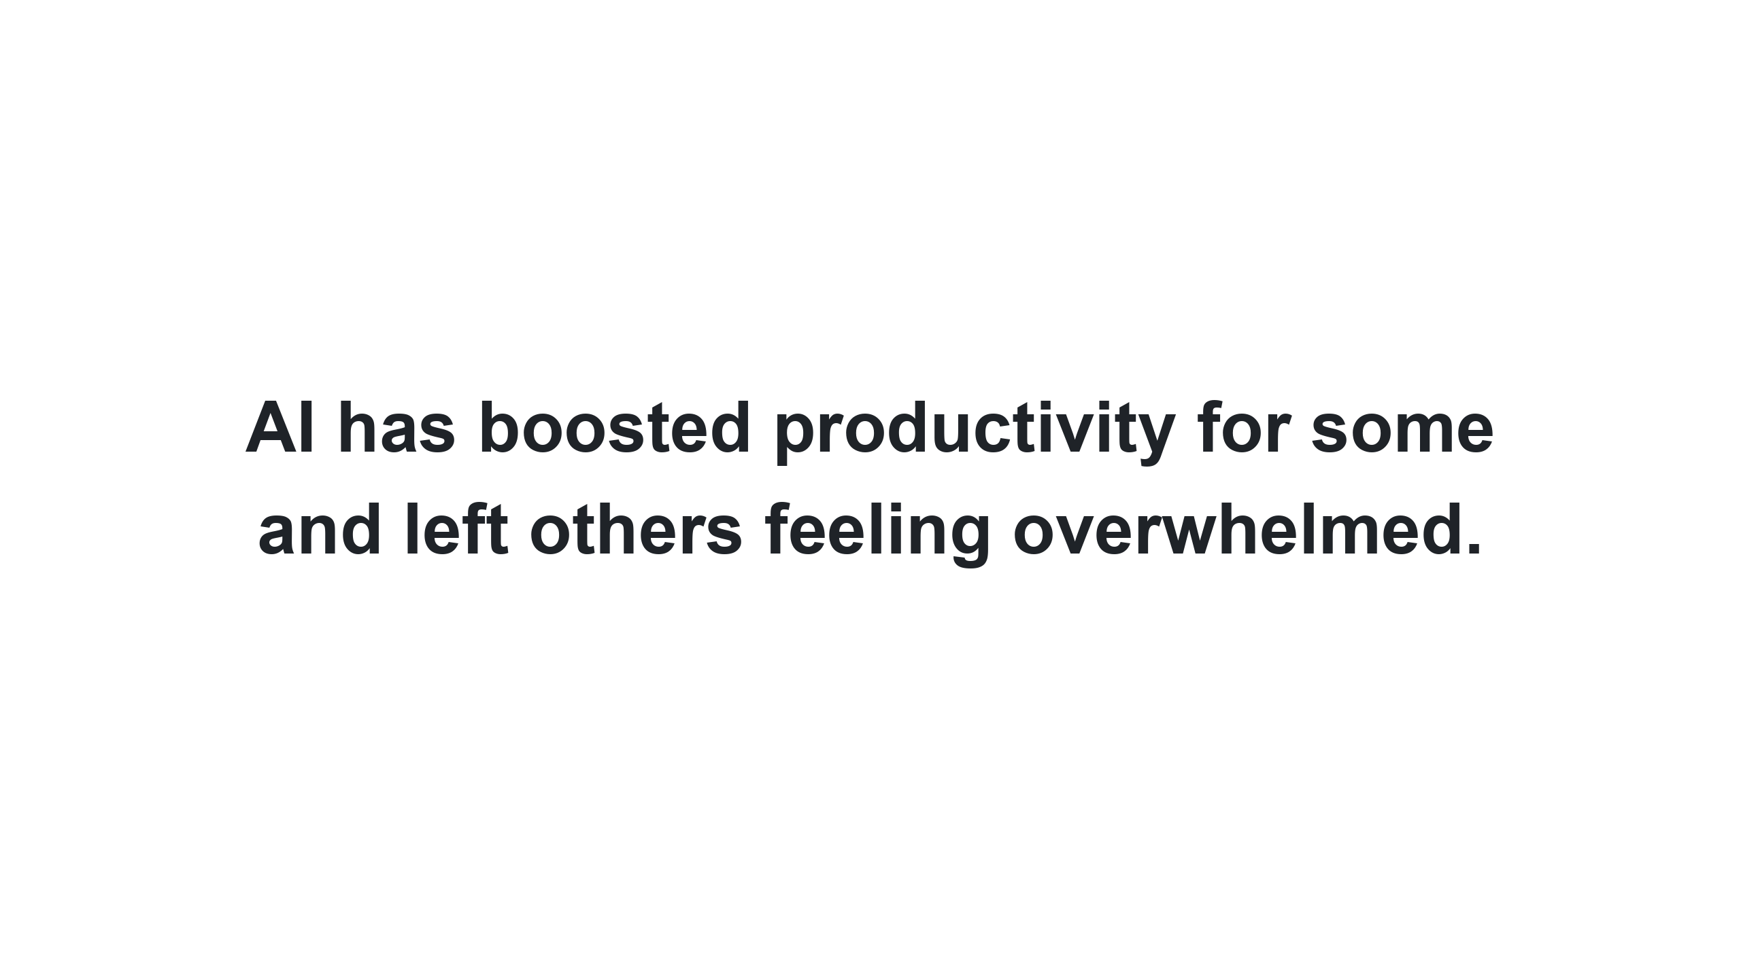
Notes:
Transition slide. Statement: 'AI has boosted productivity for some, and left others feeling overwhelmed.'
Sets up the next slide, which contrasts two sets of REAL, public GitHub issues: developers asking for more agentic capability vs. maintainers asking for guardrails against low-effort AI contributions.
Suggested delivery: pause here. The same wave of agent productivity that thrills some developers is straining others. Both are visible in the open, in public issue trackers.

Slide 5
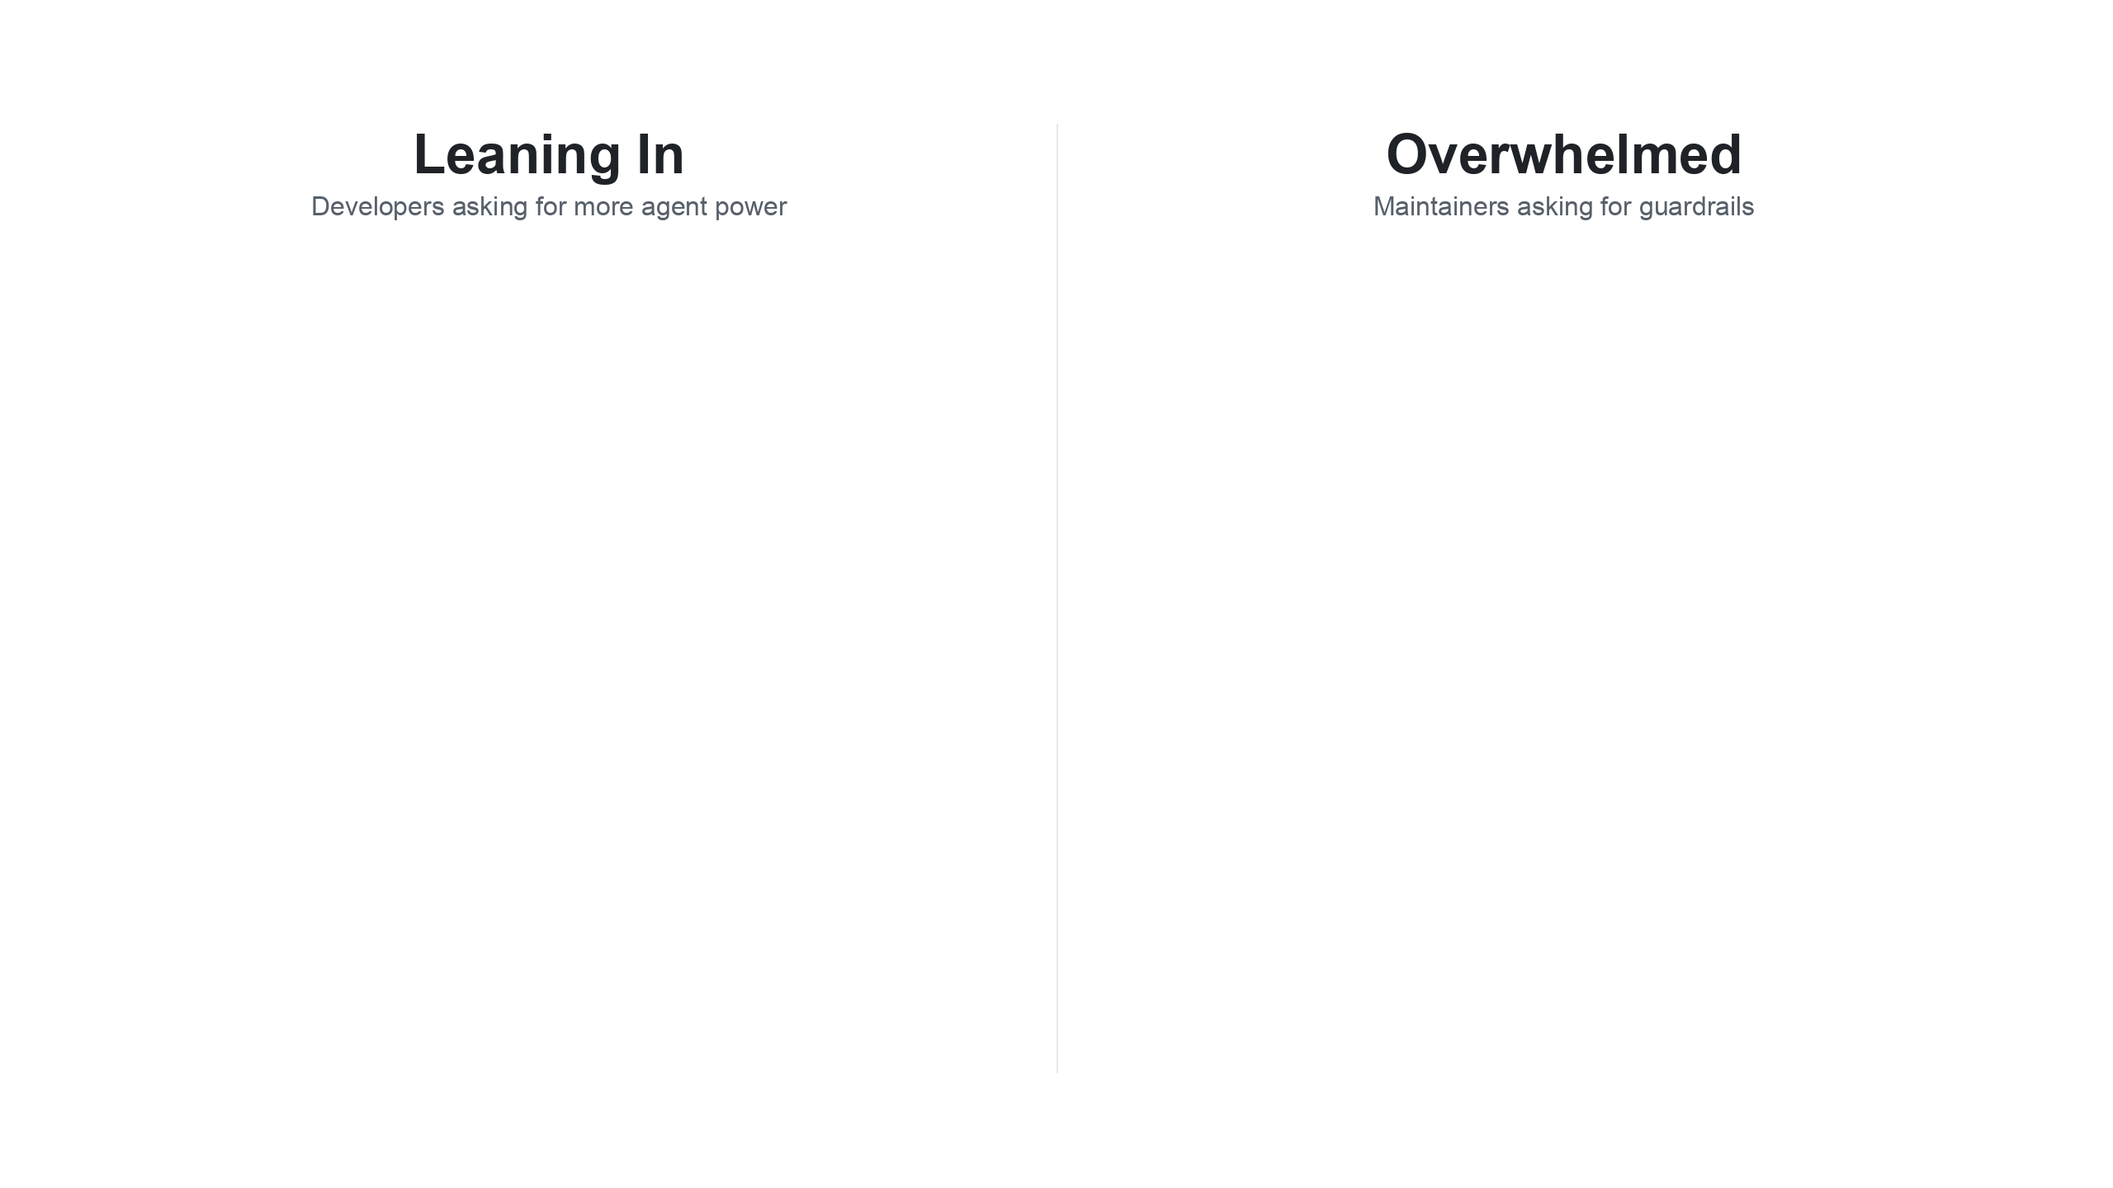
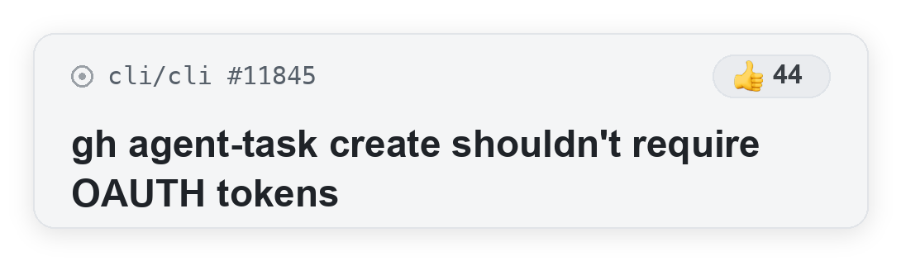
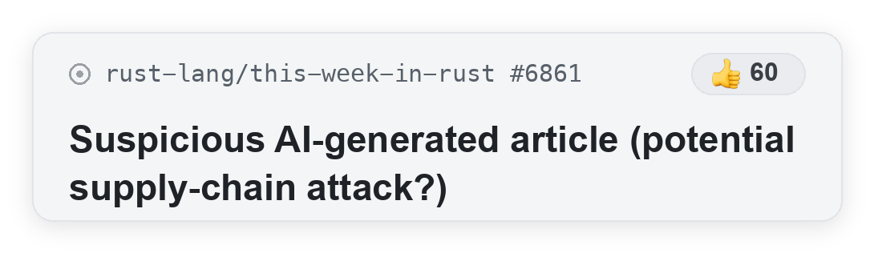
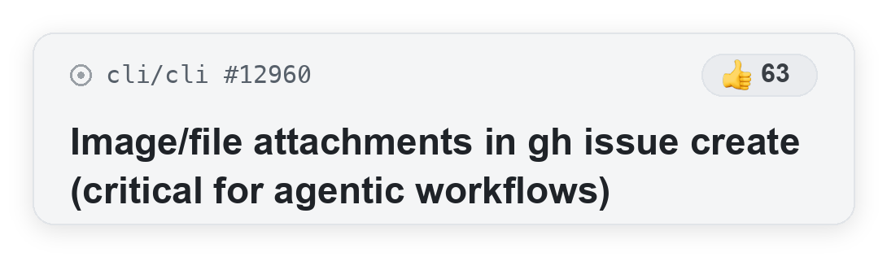
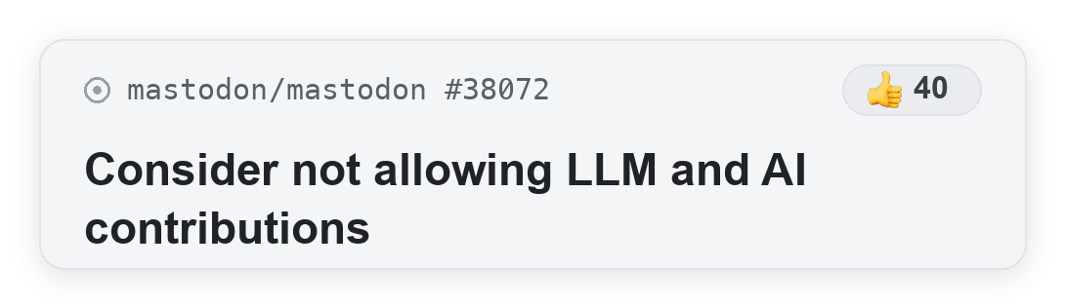
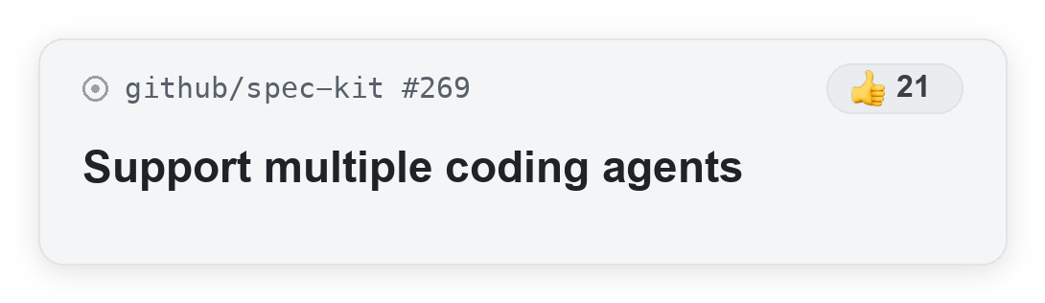
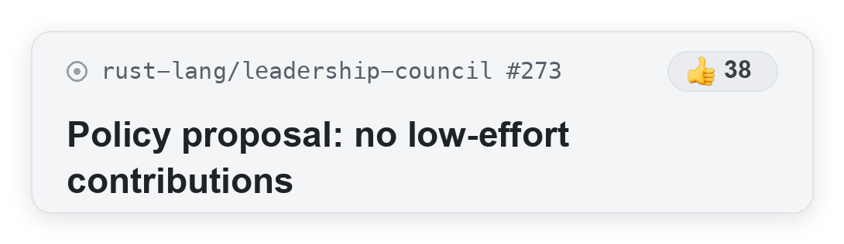
Notes:
Animated split-screen: real, PUBLIC GitHub issues drop into two zones —
'Leaning In' (developers asking for more agentic capability) and 'Overwhelmed' (maintainers asking for guardrails).
In PowerPoint each card is a separate object with a native Fly-In-from-top entrance; they cascade in automatically shortly after the slide appears (and again on click if you advance the build). The exported PDF/preview shows the final resting state.
Leaning In (public issues):
• cli/cli#11845 — gh agent-task create shouldn't require OAUTH tokens — 44
https://github.com/cli/cli/issues/11845
• cli/cli#12960 — image/file attachments in gh issue create (title literally reads 'critical for agentic workflows') — DISPLAYED as 63.
NOTE: this issue's own +1 count is 4. The 63 shown on the slide is the +1 count of the closely related umbrella request cli/cli#1895 (Upload and Embed Files to PRs/Issues/Comments); presenter chose to surface the stronger number with the agentic-titled issue. If asked, cite #1895 for the 63 figure.
https://github.com/cli/cli/issues/12960 (related: https://github.com/cli/cli/issues/1895)
• github/spec-kit#269 — support multiple coding agents — 21
https://github.com/github/spec-kit/issues/269
Overwhelmed (public issues, +1 as of Sep 14, 2026):
• rust-lang/this-week-in-rust#6861 — suspicious AI-generated article / supply-chain concern — 60
https://github.com/rust-lang/this-week-in-rust/issues/6861
• mastodon/mastodon#38072 — consider not allowing LLM and AI contributions — 40
https://github.com/mastodon/mastodon/issues/38072
• rust-lang/leadership-council#273 — policy proposal: no low-effort contributions — 38
https://github.com/rust-lang/leadership-council/issues/273
All issues are in public repositories and are safe to show on screen. Card titles are lightly condensed from the originals; none introduce an em dash that the source title did not use.
Suggested transition: this is exactly the gap GitHub is closing — better tools for the people leaning in, and real guardrails for the people keeping projects healthy.

Slide 6

Notes:
Section-divider slide. Large statement: 'The Modern GitHub Experience.'
Pivot from the tension (previous two slides) into what GitHub is doing about it. Delivery: this is the turn — from the problem to GitHub's answer. The next slide breaks down what that experience covers for both audiences.

Slide 7
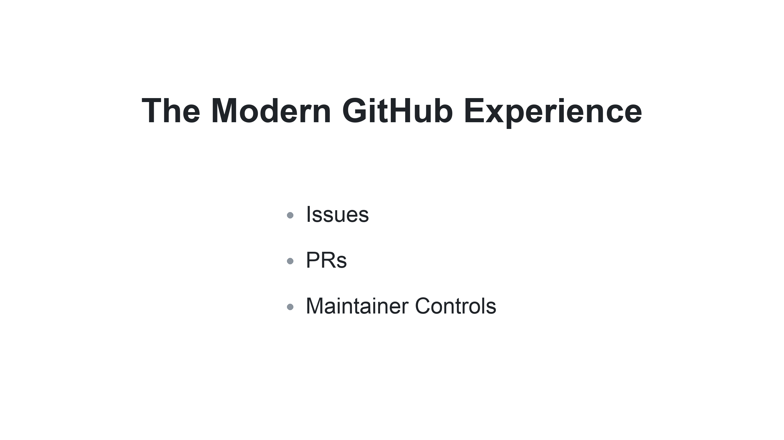
Notes:
Slide title: The Modern GitHub Experience. Agenda slide — the three areas the rest of the talk covers: Issues, PRs, and Maintainer Controls. Grounded in Marlene's GitHub Universe platform planning work (contributor experience + open-source maintainer control).
Talking points to expand each bullet live (keep specific internal release IDs off-screen):
• Issues — attach screenshots & files (gh --attach / image & file attachments); plans, before/after and reports as Artifacts.
• PRs — agents ship changes as stacked PRs (one reviewable PR per plan step); Findings and the Overview tab to review and merge with confidence.
• Maintainer Controls — restrict who can open issues & PRs; queue limits (max open PRs & issues + allowlists); commit-comment controls; triage-role exceptions to stay flexible.
Suggested delivery: 'We're building for both people in that split-screen — the ones leaning in, and the ones keeping projects healthy — across Issues, PRs, and Maintainer Controls.' This slide sets the agenda for the rest of the talk.

