Slide 1

Introductions Introduction to R Workshop
Dr Jeromy Anglim
Deakin University
jeromy.anglim@deakin.edu.au
Internet / Wi-Fi: See "Guest WiFi Deakin"
If you have not already done so, files for workshop can be downloaded from:
http://bit.ly/rworkshop2015
Or by going to
https://github.com/jeromyanglim/introduction-to-r-one-day-workshop
and clicking "Download ZIP"

Slide 2
Overview of the day
Time | Activity
10:00 – 11:30 (90 minutes) | Workshop: Morning session
11:30 – 11:45 (15 minutes) | Break: Morning
11:45 – 1:00 (75 minutes) | Workshop: Noon session
1:00 – 1:45 (45 minutes) | Break: Lunch
1:45 – 3:15 (90 minutes) | Workshop: Afternoon session
3:15 – 3:30 (15 minutes) | Break: Afternoon
3:30 – 5:00 (90 minutes) | Workshop: Final session
Housekeeping
Toilets
Internet / Wi-Fi: See "Guest WiFi Deakin"
Power
Food / Drinks
Laptop security
Feel free to ask questions

Slide 3
Aims of workshop
By the end of this workshop you should have a basic understanding of
What R can do
Whether you want to use R in the future
How the language works
How to perform standard data analysis activities with R such as importing, manipulating, graphing, and modelling data
How to combine knitr and ProjectTemplate to implement a reproducible workflow for a data analysis project

Slide 4
Overview of content
Sessions 1 and 2
Introductions
What can R do? Why and when would you want to use R?
How to get help; Working with RStudio
Core Language
Data types, functions, operations, loading data, saving data
R Packages (installing, loading, using)
Data manipulation
Graphs (base, lattice, ggplot2)
Session 3
Standard statistical functions: Descriptive statistics, correlations, linear regression
Overview of what is possible
Generalised linear models, multilevel modelling, structural equation modelling, Bayesian analysis, bootstrapping, meta-analysis
Session 4
Workflow
How to organise a complete data analysis project with ProjectTemplate
How to use knitr to create reproducible data analysis documents that process raw data and produce statistical output

Slide 5
Workshop format
Slides
I will present some slides
Most content will be covered in the interactive presentations
Interactive presentations
I will introduce many concepts by demonstrating functionality in R and RStudio
You are encouraged to open these script files and run them on your laptop as I work through them
Exercises
There will be regular points where you are given brief exercises where you asked to apply the concepts presented

Slide 6
What is R?
"R is a free software environment for statistical computing and graphics" - http://www.r-project.org
It is a full-featured statistical analysis package (e.g., like SAS, Stata, SPSS, etc.) that allows you to:
Import and export data in a wide range of formats
Manipulate data
Analyse data
Graphically represent data
It is a full-featured programming language designed for data analysis
Why the name "R"?
First letter of two originators: Ross Ihaka and Robert Gentleman
Built on a earlier language called "S"

Slide 7
Why use R?
R is free to use
R is open source
R runs on Windows, OSX, Linux
R has a huge library of user-contributed packages (over 6,000 on CRAN)
Functionality not available in other software
Only need to learn the new bits of the specific package; i.e., you can use the same graphics, data manipulation, data simulation, programming tools across analysis tasks
R is flexible
R facilitates reproducible research
R makes data analysis fun
Popular in academia and industry: lots of free online resources

Slide 8
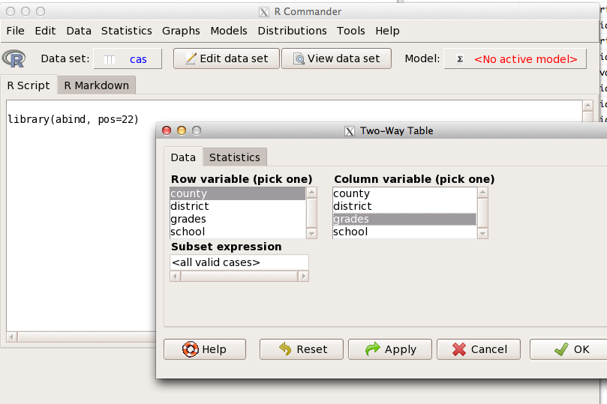
Challenges of using R?
R involves writing scripts; it does not have a GUI like SPSS, SAS, Stata, etc.
Although see Rcmdr (http://socserv.mcmaster.ca/jfox/Misc/Rcmdr/) – GUI training wheels rather than dedicated analysis tool
If you like data mining, see http://rattle.togaware.com/
See RStudio for a user friendly Integrated Developer Environment (IDE)
R is more interactive
In SPSS and SAS you choose a command and get piles of output which you wade through
R is a conversation: You interactively request relevant output
Mental model for R has links with formal statistics, unix, and programming

Slide 9
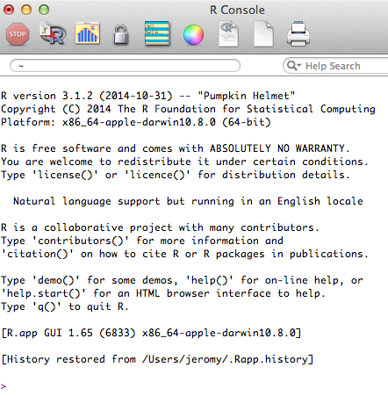
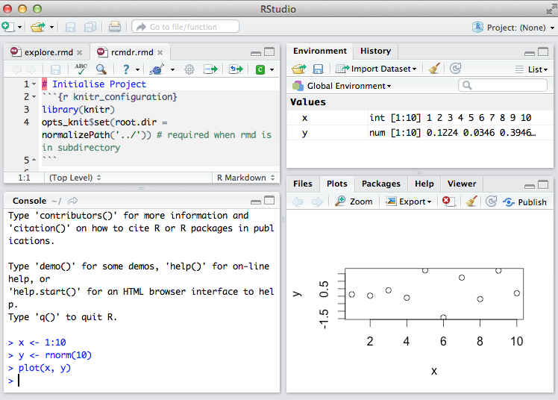
Installing R and RStudio
Install base R
http://www.r-project.org
Install RStudio
http://www.rstudio.com
Install additional R packages
To be discussed later, but generally use RStudio or
install.packages("packagename")
Some R functionality requires other (free) software to be installed
Various compilers, command-line tools, etc.
RTools for Windows http://cran.r-project.org/bin/windows/Rtools
Xcode for OSX http://developer.apple.com/xcode
Python: http://www.python.org/downloads
Java SE JDK: http://www.oracle.com/technetwork/java/javase/downloads/index.html
Perl: http://www.perl.org/get.html
pandoc: http://pandoc.org/installing.html
TeX/LaTeX: http://latex-project.org/ftp.html

Slide 10
RStudio
There are many interfaces to R
http://www.sciviews.org/_rgui
RStudio
Best general interface to R
Improving rapidly
Free and open source
http://www.rstudio.com

Slide 11
Instructional materials on R
Official manuals
http://cran.r-project.org/manuals.html
Fairly technical
Contributed Documentation
http://cran.r-project.org/other-docs.html
Many useful tutorial style documents from a range of different perspectives
Many paper books on R
http://www.r-project.org/doc/bib/R-books.html
Task Views
http://cran.r-project.org/web/views
Curated overviews of packages relevant to particular domain

Slide 12
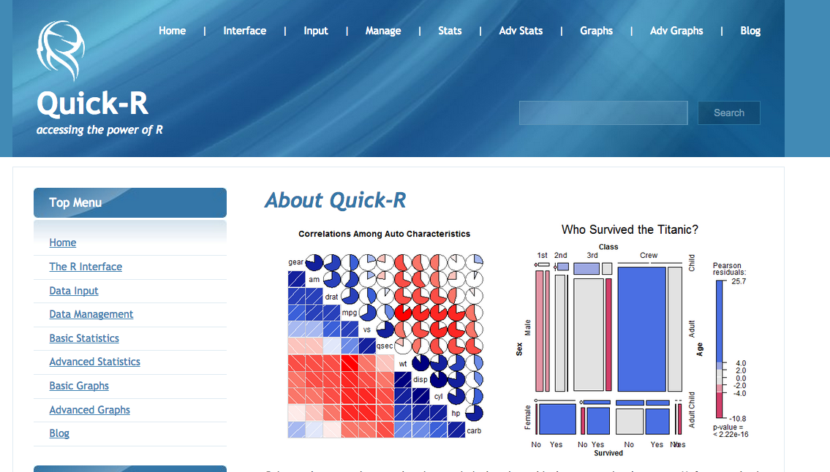
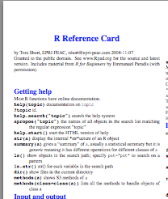
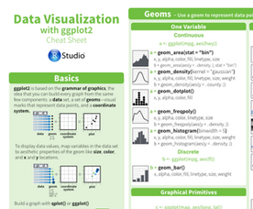
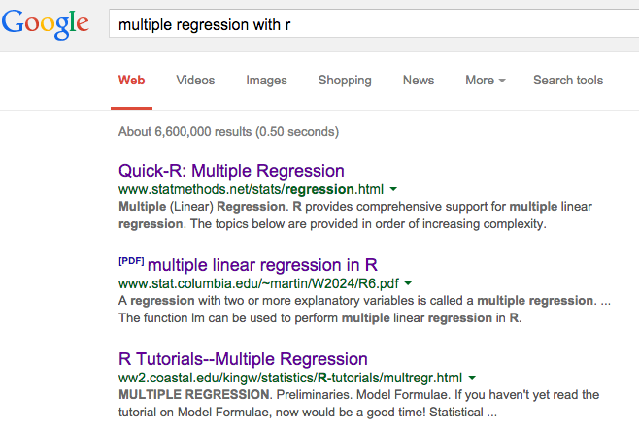
Getting Help Online
Quick-R website:
Excellent website with code templates for common tasks
http://www.statmethods.net
Reference Cards: See particularly Tom Short's
Print out and gradually expand your R vocabulary
See particularly Tom Short's http://cran.r-project.org/doc/contrib/Short-refcard.pdf
RStudio cheatsheetshttp://www.rstudio.com/resources/cheatsheets/
Google usually has the answer
Generally adding "with R" or "in R" to a statement of what you want to do should suffice: e.g., "multiple regression with R"
Or use dedicated R search engine: http://rseek.org

Slide 13
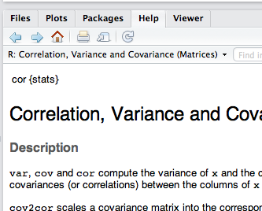
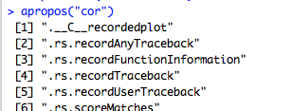
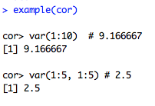
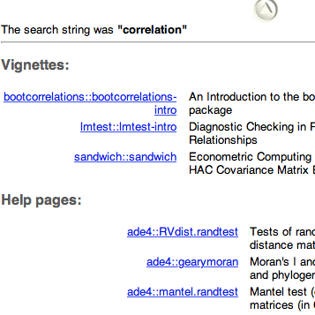
Built-in help
Get help on specific function (e.g., cor)
?cor
help(cor)
Press F1 in Rstudio with cursor over function
Find all functions with text in name
apropos(cor)
Run the example code for function
example(cor)
Search all built-in documentation for text (e.g., "correlation")
help.search("correlation")

Slide 14
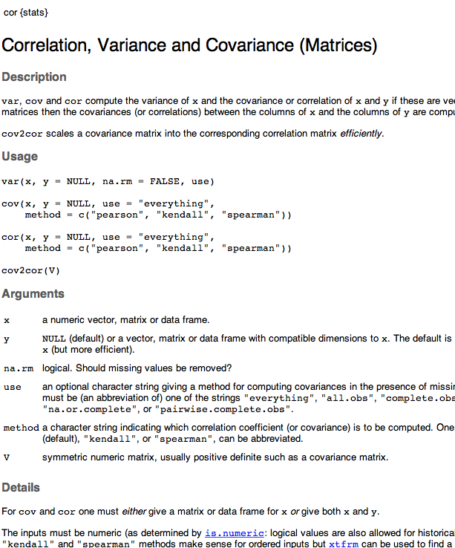
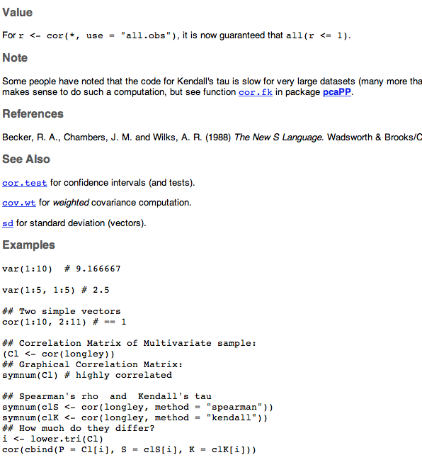
Overview of Function Help Pages

Slide 15
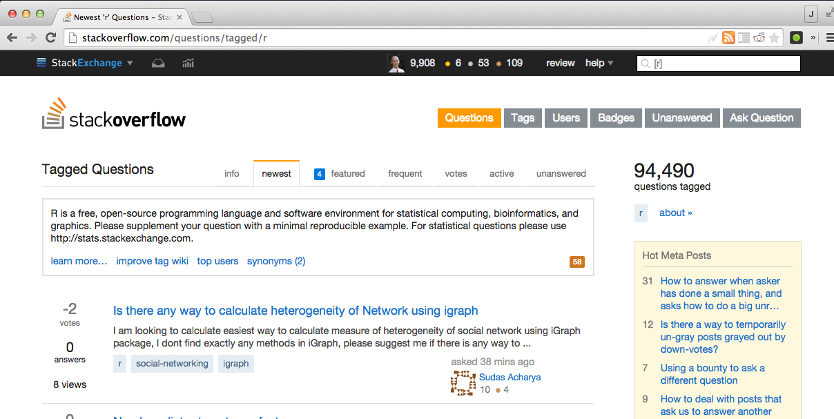
Ask Specific Questions on StackOverflow
StackOverflow with the R tag
http://stackoverflow.com
http://stackoverflow.com/questions/tagged/r
How to ask question?
Search to see whether question has already been asked
Click Ask Question
Include the R tag
Try to make the example reproducible (e.g., include minimal data)
Also see
http://stats.stackexchange.com where the emphasis is on statistical interpretation

Slide 16
Exercises and Files
Open "training-exercises/introduction-to-r-workshop.Rproj"
Each of the main interactive exercises is located in
"training-exercises/reports"
To start with use the File Pane in RStudio to open
"training-exercises/reports/rcmdr.rmd"
Session 1 to 3
"training-exercises/reports/1-core-language.rmd"
"training-exercises/reports/2-graphics-data-manipulation.rmd"
"training-exercises/reports/3-statistical-models.rmd"
Session 4
We'll go through four project examples
See "project-examples" directory

Slide 17
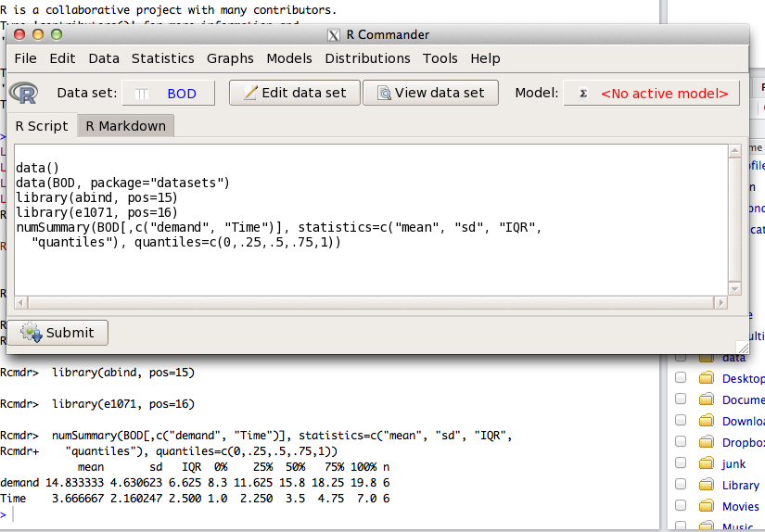
R Commander
Let's start by looking at R Commander
A basic GUI designed as an instructional tool for getting started with R
http://socserv.mcmaster.ca/jfox/Misc/Rcmdr/
It can be integrated with RStudio

Slide 18
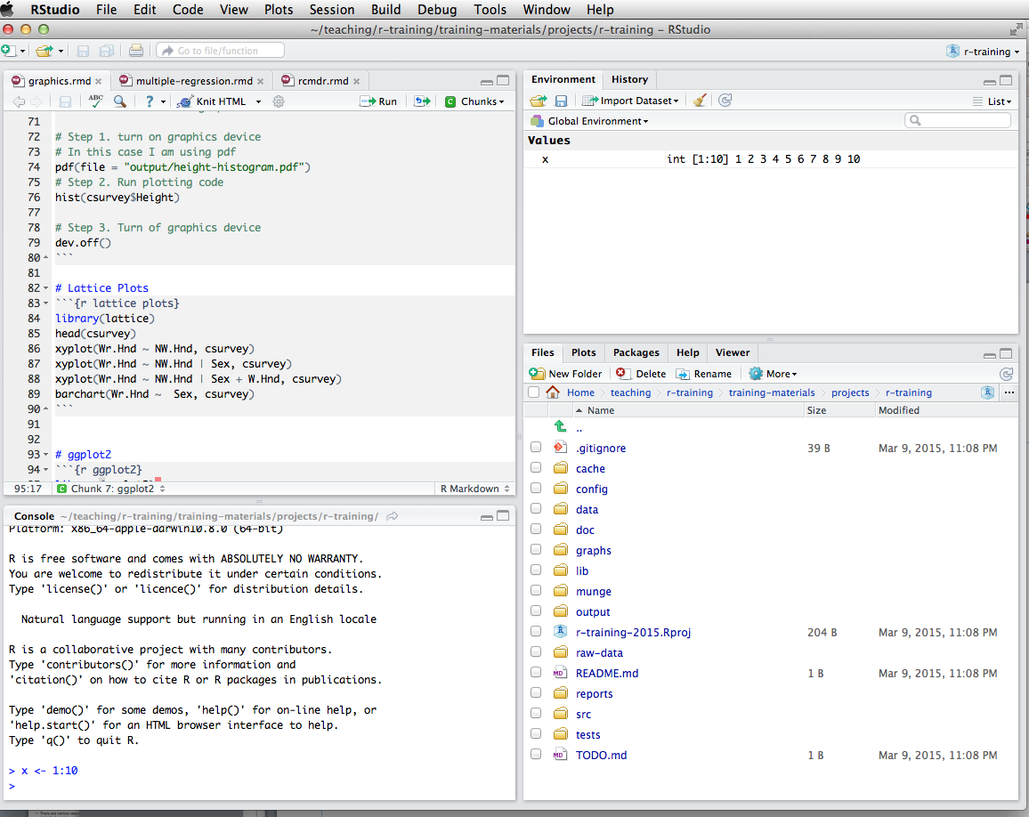
RStudio
R Scripts and source code
Environment: Lists objects in the workspace (e.g., data you've created or imported)
History: list of commands run on console
Console:
Commands can be entered directly or sent from the script pane (e.g., control/command + enter)
Files: quick access typically to files in your working directory
Plots: View current and previous plots you've created
Packages: Helps with loading and installing packages
Help: Show built-in help and allow searching for help

Slide 19
RStudio Projects
It is good practice to store all files related to a particular analysis project within a single directory on your computer that stores only files related to that project
Such files include scripts, data files, configuration files, figures, exported tables, etc.
You may also stores such files in subdirectories (e.g., store data in a subdirectory called data)
If you work with Rstudio it helpful to make this folder an Rstudio Project (Go to: File – New Project)
This will generate a file with an "Rproj" extension (e.g., myproject.Rproj)
You can then double click on this file to open the project

Slide 20
Benefits of RStudio Projects
Ensures that the working directory is the same as the project directory. Thus, when you load or save files, you can have confidence that your script will work.
The file pane is opened in the working directory, so it's easy to access other files in the project
RStudio will re-open previous open scripts

Slide 21
Core Language Features
Review RStudio User Interface
Open 1-core-language.rmd
Topics
Assignment
Workspaces
Data types
Getting Help
Packages
Missing Data
Data Summaries
Functions
Importing / Export Data
Random Variables
Functions

Slide 22
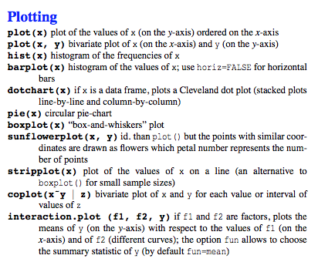
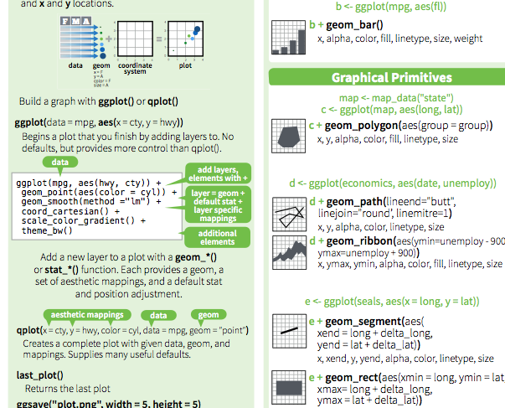
Graphics and Data Manipulation
Review RStudio User Interface
Open 2-graphics-data-manipulaion.rmd
Topics
Base graphics
Lattice graphics
ggplot2
See cheat sheets

Slide 23
Statistical models
Open 3-statistical-models.rmd
Topics
Correlations
Regression models
Formula notation
Factors: Categorical predictors
Illustration of applications
Generalized linear model / logistic regression
Multilevel modelling
Structural equation modelling
Meta analysis
Bootstrapping

Slide 24
Session 4: Reproducible Research and Workflow with RMarkdown and ProjectTemplate Introduction to R Workshop
Dr Jeromy Anglim
Deakin University
jeromy.anglim@deakin.edu.au

Slide 25
Motivation: How to create documents?
Types and distinctions
Formal Documents
Journal articles, books, book chapters, theses, consulting reports, etc.
Informal documents
preliminary analyses, statistical homework,
Online content
web pages, blog posts, forum posts Browser metaphor versus page/slide-based metaphor
Context
When to use reproducible analysis?
When to use knitr with R Markdown or LaTeX?

Slide 26
What is reproducible analysis?
Reproducibility varies on a continuum
One particular form:
code transforms raw data and meta-data into processed data,
code runs analyses on the data, and
code incorporates analyses into a report
Ideally, the process involves a one-click build
Public sharing of document, code, and data is optional, but forms part of gold standard of scientific openness
Goes by many names, particularly “reproducible research”, but I prefer “reproducible analysis”.

Slide 27
Aims of reproducible analysis
Ability to reproduce analysis
Increase accuracy
Ability to verify analyses are consistent with intentions
Ability to review analysis choices
Increase clarity of communication
Increased trustworthiness
Increased accuracy +
Ability for others to verify
Extensibility
Ability to easily modify or re-use existing analyses

Slide 28
Reproducible analysis in R
Combine R and plain text file format to produce documents (e.g., pdfs, HTML documents, etc.)
Popular instances
Sweave
knitr

Slide 29
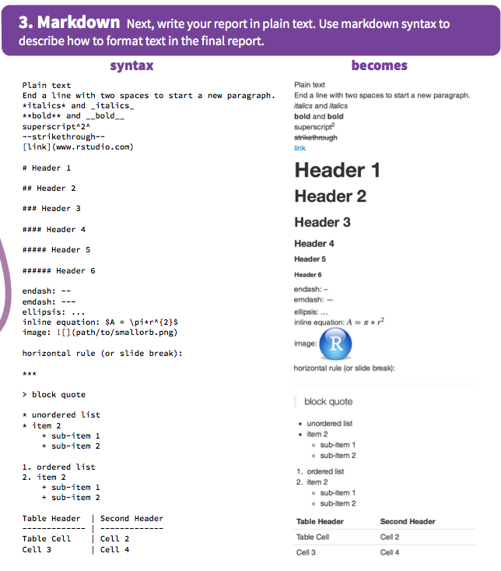
What is markdown?
RStudio RMarkdown cheat sheet
Simple, readable, intuitive, light-weight markup Convert to HTML
Raw HTML can be interspersed to add functionality
Various extensions and flaours of markdown
Popular on websites: e.g., StackOverflow, GitHub, Reddit
see also: http://daringfireball.net/projects/markdown/

Slide 30
knitr, Rmarkdown, RStudio
knitr
R Package developed by Yihui Xie for weaving R (and other languages) with various markup languages including markdown
RMarkdown
A file format that combines R code chunks and markdown text which is converted by knitr into markdown, and other formats (e.g., HTML, pdf, etc.).
RStudio
RStudio facilitates the application of knitr to RMarkdown to produce HTML, pdfs, and so on
Syntax highlighting; Easy to run and create code chunks; Single button to convert RMarkdown to complete documents; useful debugging information
pandoc
General purpose tool used convert between document formats; included in Rstudio
LaTeX
If you want to be able to convert to PDF, you may need a LaTeX installation
http://latex-project.org/ftp.html

Slide 31
Example: 1-rmarkdown-overview
Refer to the excellent RStudio RMarkdown Cheat Sheet
General workflow
Create an RMarkdown File
either use Rstudio File – New File – RMarkdown or just create a file with an empty text file with the .rmd extension
Optionally add a header
Options to specify output format (see RMarkdown cheat sheet)
Write the main document in Markdown
Embed R code chunks
R code chunks can be customised to control output

Slide 32
Example: 2-knitr-regression-example
General points and RMarkdown
It is a good strategy to put library, options, data importing and data processing at the start of the RMarkdown file.
Or as we'll see later, have a single command like in ProjectTemplate that sets up your project at the start (library, options, data importing, data processing, loading scripts, etc.) of your RMarkdown document.
RMarkdown can be a nice way to organise analysis code even if you have no interest in compiling documents.
It's easy to organise code into blocks.
It's easy to run code in blocks
You can intersperse commentary

Slide 33
Exercise 4-1
Create a new folder on your computer
Create a new RMarkdown document in RStudio and save to folder
Type a little text after the header using some headings, dot points, and any other markdown syntax you wish.
Create a first code chunk; put the following code inside; run the code chunk
library(MASS) data(survey)
Add a second code chunk where you add some summary information about the survey dataset: e.g.,
summary(survey) head(survey)
Compile the document by clicking the "Knit" button
Add a third chunk that includes some figures (e.g., a scatterplot of height and pulse)
Compile the document by clicking the "Knit" button

Slide 34
3-Sweave-Item-Analysis
This example provides an illustration of LaTeX and Sweave
LaTeX is a document markup system designed for making beautiful scientific documents
Pros
The typesetting is beautiful
It is excellent for mathematics
It handles complex documents well (e.g., PhD thesis; Scientific books): Table of contents, cross-references, references,
Cons
If your collaborators and the people who consume your documents (e.g., journal editors, clients, etc.) expect a different system, then you may have an unpleasant time.
While it does a lot of things automatically, customising can be difficult, and there is a learning curve (a bit like R)

Slide 35
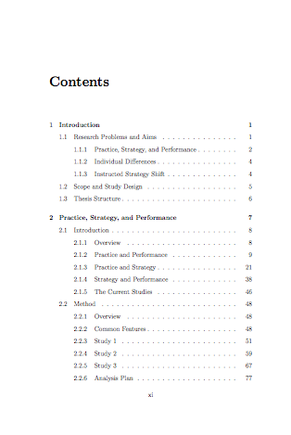
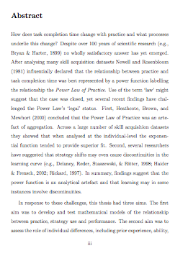
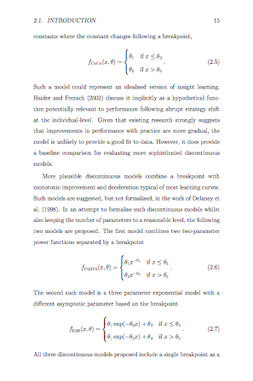
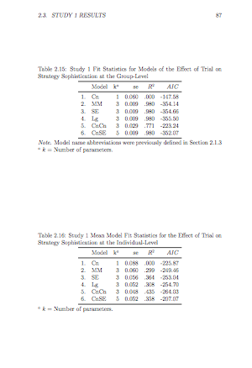
Example pages of PDF of LaTeX Document

Slide 36
Example 3-Sweave-Item-Analysis
Both Sweave and knitr are systems that can combine LaTeX and R code chunks
The notation for indicating R code chunks is slightly different to RMarkdown but the concepts are the same.
The main difference is the actual LaTeX.
Note that you don't have to use Sweave to combine R and LaTeX. You can export your images and your LaTeX tables and then manually incorporate them yourself.

Slide 37
ProjectTemplate
http://projecttemplate.net/
Why use ProjectTemplate
Systematic place to store configuration and package loading settings
Automatically load r-script files
Automatically load data files stored in data directory
Automate running initial data manipulation code
Installation
install.project("ProjectTemplate", dep = TRUE)

Slide 38
Standard Process for Creating a ProjectTemplate Project
Create the folder structure
library('ProjectTemplate') create.project('myproject')
Review config/global.dcf
Choose settings
Specify packages to load
Add data for auto-loading to data directory
Add any additional R support functions to the lib directory
Load the project
library('ProjectTemplate') load.project()
Write any initial data manipulation code and place in the munge directory
Create data analysis files (e.g., r-scripts, RMarkdown, Sweave Files) in home or reports directory
Include the load project commands above at the top of each such file

Slide 39
Customise your own version of ProjectTemplate
Once you start using ProjectTemplate, you find that there are many customisations that you always make to a new project
libraries that you always use
settings that you prefer over the defaults (e.g., as_factors: FALSE)
particular ways that you generate analysis scripts
Integration with RStudio project structure
Save this customised version to a special folder on your computer
To create a new project
Make a copy of your customised folder structure
Rename the project
You only need to complete the project specific customisations
Over time you may recognise features that you want to add to your customised project

Slide 40
My Customised ProjectTemplate
Basic description
http://jeromyanglim.blogspot.com.au/2014/05/customising-projecttemplate-in-r.html
Overview of files
https://github.com/jeromyanglim/AnglimModifiedProjectTemplate
Zip file of Template
https://github.com/jeromyanglim/AnglimModifiedProjectTemplate/archive/master.zip

Slide 41
Customised ProjectTemplate Workflow
Setup ProjectTemplate Folder Structure
Download the zip file (I have it bookmarked) and unzip it
https://github.com/jeromyanglim/AnglimModifiedProjectTemplate/archive/master.zip
Rename the folder and the RStudio Project file
Data
Ensure that raw data is roughly in the right format
Place data files in data folder with the names you want the data.frames to have in R (e.g., mydata.csv becomes mydata in R)
Additional script files
Functions that get created during the project or functions that need to be imported get put in .r script files in the lib folder (e.g., "myfuntions.r")
Data manipulation
Before analysing data, it is usually necessary to clean the data, create new variables, merge data, and so on.
This all goes in scripts in the munge folder.
Run library("ProjectTemplate"); load.project() to load the data and then write any data manipulation code.

Slide 42
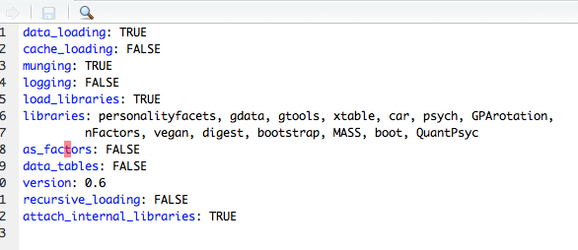
Configuration
Configuration settings are stored in config/global.dcf
data_loading, munging, load_libraries: indicate which aspects of ProjectTemplate should run
libraries: Specify which packages you want to use
as_factors: Specifies whether by default strings should be imported as factors

Slide 43
Customised ProjectTemplate Workflow
Analyses
Store analyses (i.e., code to generate summary statistics, models, tables, figures, etc.) in Rmarkdown files
You need a code chunk before any analysis that loads the project with the following code
library("ProjectTemplate"); load.project()
It can be useful to have multiple RMarkdown files: e.g., for exploratory analyses, final analyses and so on.
If you store your RMarkdown files in a subfolder, you also need to include the following in the first code chunk: library(knitr) opts_knit$set(root.dir = normalizePath('../'))
Alternatively, just put file in the working directory

Slide 44
Running ProjectTemplate
What happens when you run library("ProjectTemplate"); load.project()
Configuration file is loaded
Options are set
Scripts in the lib file are loaded
Packages specified in the configuration file are loaded
Data in the data folder is loaded into R
Data manipulations specified in the munge folder are run
The benefits
Thus, after running a single command you are now ready to analyse your data, or perform new analyses.

Slide 45
Manual integration with MS Word
Results Text
Keep the code that generates the relevant script (".r", ".rmd", etc.)
Run the code and read off the values
or export the output using one of several options:
Running a knitr document so that input and output is displayed
Running the script in batch mode from the command-line: R CMD BATCH yourfile.r
Tables
Prepare content of table in R as a data.frame
Save as a csv file write.csv(mytable, file="output/mytable.csv")
Double click csv file to open in Excel and copy contents into a data processing Excel file
Use Excel to add lines, adjust alignment, etc.
Paste formatted table into MS Word
Figures
Export figures to a folder pdf(file="output/filename.pdf") plot code here dev.off()
Drag and drop image file into relevant place in Word document

Slide 46
4-project-template-personality-example
Example of analyses for a journal article performed using ProjectTemplate
Things to note
Metadata
It can be useful to import metadata (e.g., how to score tests, variable labels, etc.)
Variable lists
I often refer to large variable sets in analyses. Thus, storing these variable sets in a list can make it easier to refer to them.
Exporting tables, figures, plain text
I use RMarkdown as a way of organising analyses where specific results are exported for inclusion in another document.

Slide 47
Exercise 4-2
Go to "exercise-project-template/raw-materials" unzip the Customised version of ProjectTemplate
Give the folder and the rstudio project file an appropriate name
Put cas.sav into the data folder (California Schools Data)
Open the Rstudio project file in RStudio
Open "reports/explore.rmd" and run library(ProjectTemplate); load.project()
Add a few basic analyses of cas to the next R code chunk
Go to "munge/01-munge.R" and add a new variable to cas (e.g., create a variable called performance which is the sum of cas$math and cas$english
Return to "reports/explore.rmd" and add another code chunk. Create a histogram of cas$performance.
Now imagine that you are exiting RStudio and then returning again. i.e., Quit RStudio and then reload the Rstudio Project file
Open "reports/explore.rmd" and run library(ProjectTemplate); load.project()
You should see that your histogram code for cas$performance still runs

Slide 48
Concluding Remarks Introduction to R Workshop
Dr Jeromy Anglim
Deakin University
jeromy.anglim@deakin.edu.au

Slide 49
Reflections on the day
The aim of this training has been to get you oriented with R.
By installing R, RStudio, and related packages you overcame the first obstacle.
R Commander provides a basic starting point
It's a good option if you're used to SPSS-type tools but need a free option.
But ultimately, the power of R comes from learning how to write R scripts.
We have gone over the nuts and bolts of the language
Data manipulation and graphics are common tasks across all data analysis projects
We have illustrated R's functionality using common statistical models.
We've also highlighted a number of good options for managing an R workflow

Slide 50
Future Use of R
Hopefully, at this point you have a sense of whether R might be something you can use. Perhaps one of these use cases will fit:
You may realise that R is not for you. It's not for everyone.
You may be in an environment, where you don't have access to paid statistics packages and you need a free tool.
R may be a tool that you occasionally use when you need particularly functionality not offered by your regular statistics package.
R can be your primary statistics package for data analysis.
R is a tool that becomes more useful over time.
You acquire scripts that you can re-use.
Learning new statistical models becomes easier over time as you learn the conventions in R.
R ultimately makes data analysis more fun.

Slide 51
Next Steps
If you are keen to make R your main platform for data analysis, then there are lots of options for learning more.
Start applying R to a project that you are working on
Have a read through some of the contributed documentation
http://cran.r-project.org/other-docs.html
Get a book on R relevant to your area
http://www.r-project.org/doc/bib/R-books.html
Check out video tutorials on Coursera and YouTube
Follow recent developments in R
https://twitter.com/hashtag/rstats?src=hash
http://www.r-bloggers.com

Slide 52
Thank you for coming...
Please consider filling out the Workshop Feedback form

