Slide 1
网上书店
《eagles》萨拉迪-张然-张庆晨-萨木

Slide 2
语言及环境
前端： HTML,CSS, BootStrap,JavaScript
后端：PHP,MySQL

Slide 3




开发工具
Visual Studio
XAMPP
Google Chrome
Brackets

Slide 4
XAMPP
文件夹路径：C:\xampp\htdocs\
访问数据库：http://localhost/phpmyadmin/
访问网站：
http://localhost:8080/project/

Slide 5
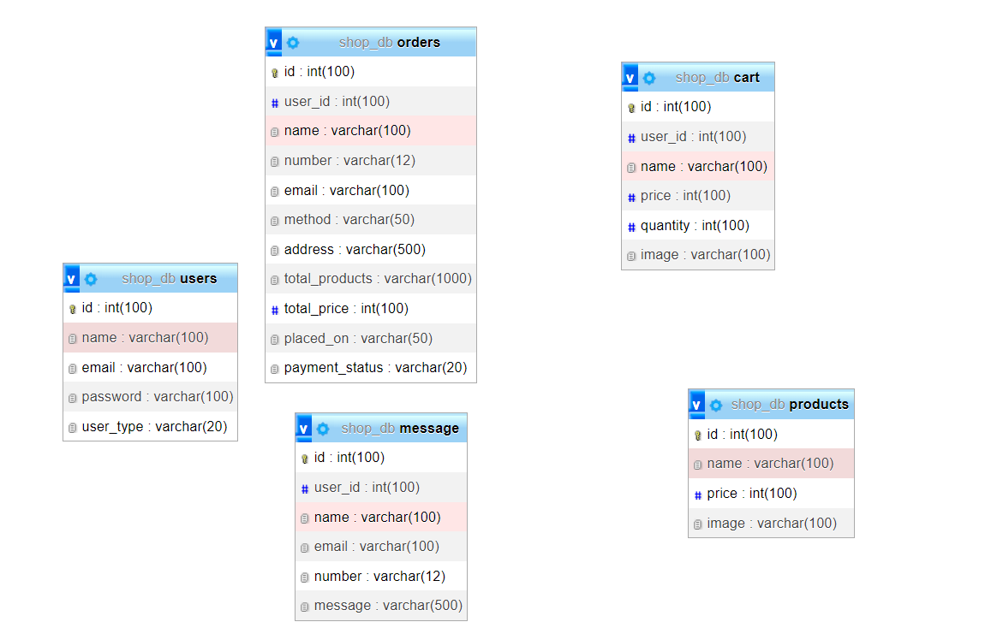
逻辑结构设计

Slide 6
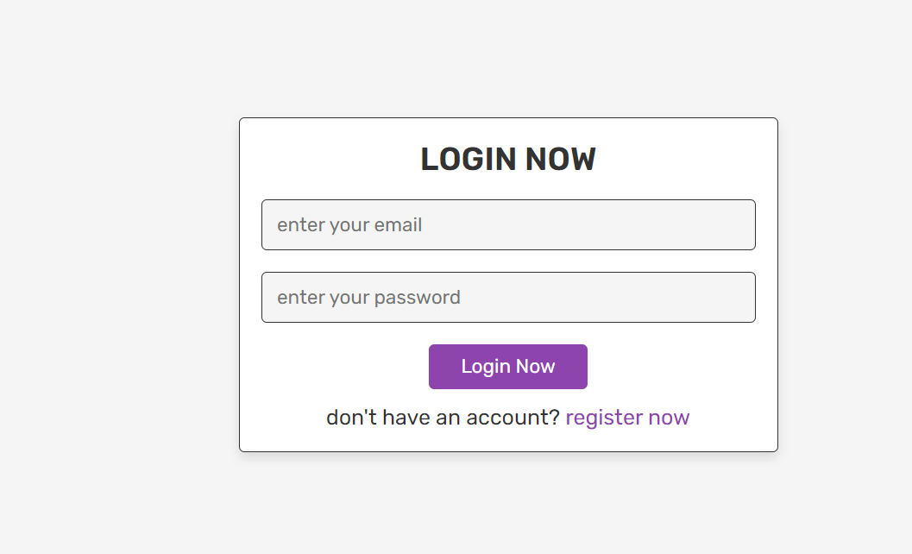
主页

Slide 7
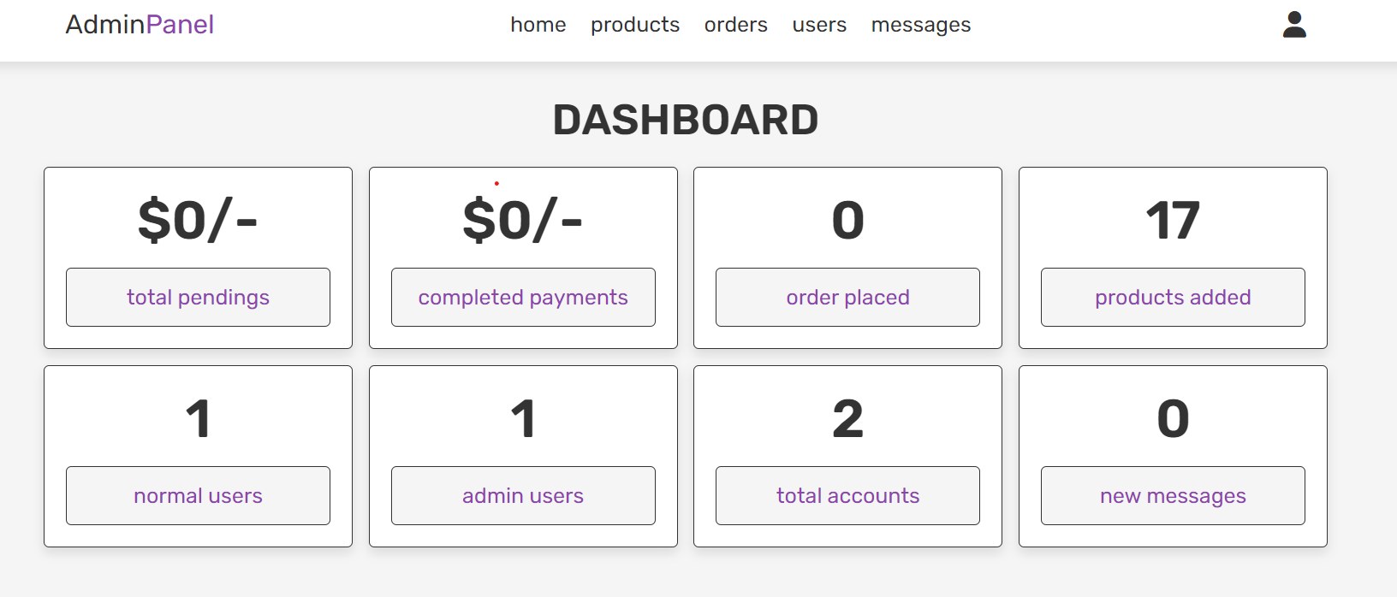
Admin panel

Slide 8
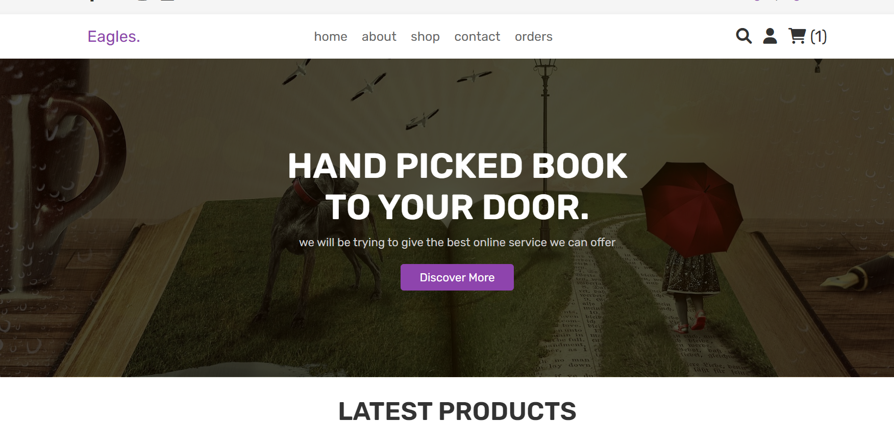
User panel

Slide 9
过程
连数据库
读取数据
处理请求
返回结果

Slide 10
测试
Manual Testing
Browser Compatibility
Responsiveness
Forms and Input Validation
Cross-Page Navigation
User Experience

Slide 11
Manual Testing
Start by manually browsing through your website and interact with different elements, forms, buttons, and links. Pay attention to any unexpected behavior, layout issues, broken links, or missing content.

Slide 12
Browser Compatibility
Test your website on different web browsers such as Google Chrome, Firefox, Safari, and Microsoft Edge. Ensure that the website looks and functions correctly across these browsers, as rendering and behavior may vary.

Slide 13
Responsiveness
Test your website on different devices and screen sizes, including desktops, laptops, tablets, and mobile phones. Ensure that the website is responsive and adapts well to different screen resolutions.

Slide 14
Forms and Input Validation
Test any forms present on your website, such as contact forms or login forms. Verify that input validation is working correctly, preventing incorrect or malicious data from being submitted.

Slide 15
Cross-Page Navigation
Test the navigation flow between different pages of your website. Make sure that all internal links are working correctly and that users can easily navigate through the website.

Slide 16
User Experience
Put yourself in the shoes of a user and test the overall user experience. Check if the website is intuitive, easy to navigate, and if it provides clear instructions or guidance to users.

Slide 17
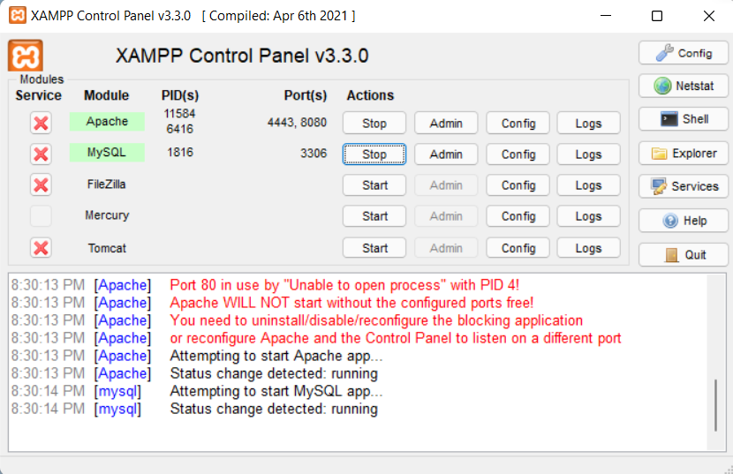
问题

Slide 18
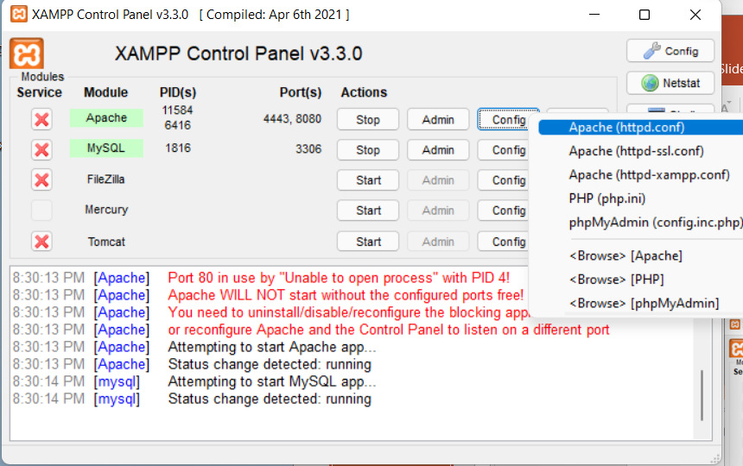
解决问题

Slide 19
参考网站
https://www.w3schools.com/
https://www.runoob.com/
https://getintopc.com/
https://stackoverflow.com/
https://csdn.net

Slide 20
谢谢

