Slide 1
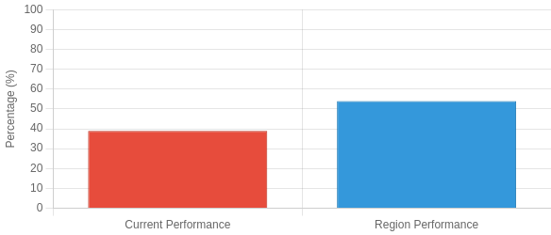
Problem Identification - Literacy Gap Analysis
Identifying key performance domains and subgroup achievement gaps
Performance Domains Subgroup Achievement Gaps
Key Domain: On grade-level ELA shows the most significant gap
⚠ Critical Gap: Special Education students showing largest growth gap at only 35%
Current Performance
Higher Performance
Meeting expectations in basic literacy
Lower Performance
Academic writing production Advanced literacy skills
Grade-level reading comprehension
Source: Campus assessment data 2023-24, District benchmark analysis

Slide 2
Next Steps & Continuous Improvement
Gap analysis and strategic action planning
Identified Gaps
Strategic Opportunities
Writing Conventions
Only 28% of students consistently apply grade-level conventions throughout written responses
Explicit Conventions Instruction
Targeted mini-lessons focusing on specific conventions with immediate application
High-Range Writing
Limited percentage (5-7%) of students demonstrating high-level writing performance
Robust Sentence-Level Work
Scaffold sentence combining and expansion techniques to develop syntax sophistication
Cross-Curricular Transfer
Students showing limited ability to apply academic language skills across content areas
Differentiated Writing Instruction
Tiered response frames and targeted feedback aligned to individual needs
Continuous Improvement Action Plan
Writing Conventions Workshop
HIGH PRIORITY
Tiered Writing Support
Three-tiered writing scaffolds tailored to student performance levels
Formative Assessment Cycle
Two-week assessment cycles with quick-turnaround data analysis
Bi-weekly focused instruction on high-leverage conventions with student editing checklists
⬧ Implementation: Immediate
⬧ Implementation: 4-6 weeks
⬧ Implementation: 4-6 weeks
Sentence Crafting Program
HIGH PRIORITY
Cross-Curricular Integration
Partner with science and social studies teams for subject-specific language frames
Model Exemplars Library
Curate grade-appropriate exemplars with annotation guides highlighting strengths
Daily sentence-level work focusing on complex structures and academic vocabulary integration
⬧ Implementation: 2-4 weeks
⬧ Implementation: 6-8 weeks
⬧ Implementation: Ongoing
Source: Action planning committee, Campus improvement plan, Literacy improvement framework

Slide 3
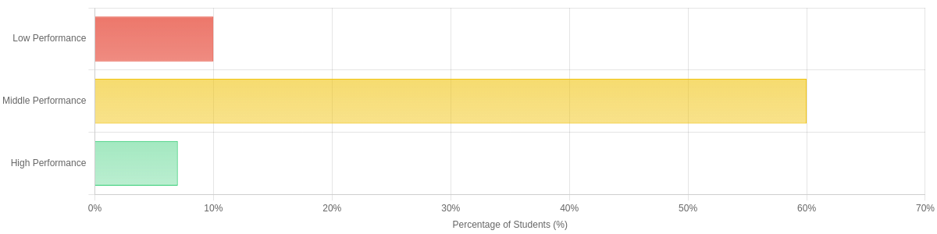
Writing Performance Distribution
Analysis of constructed response writing across performance levels
⚠ Note:Limited high-level writing performance indicates need for more advanced composition instruction
Low Performance (5-10%)
Middle Performance (50-60%)
High Performance (5-7%)
Basic Skill Challenges
Students in this category struggle with basic sentence formation and organizing ideas. Typically showing
minimal academic language usage.
Developing Skills
The majority of students demonstrate adequate comprehension but limited use of advanced academic vocabulary and complex sentence structures.
Advanced Proficiency
Only a small percentage consistently employ sophisticated academic language, show mastery of conventions, and produce well-structured responses.
↓ Remediation needed
– Growth potential
↑ Model for instruction
Source: Campus writing assessment data 2023-24, Constructed response analysis

Slide 4
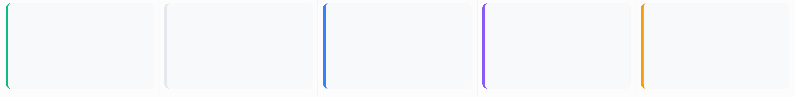
Intervention Strategy Framework
Structured academic language instruction process
Digital Reading
1
Annotation
2
Analysis
3
Composition
4
Revision

Digital Reading
Complex text selection aligned to grade-level standards

Annotation
Strategic markup of text structure and author's craft

Analysis
Examining author's purpose and text structure explicitly
✏
Composition
Structured response using academic language frames

Revision
Targeted feedback and conventions refinement
Implementation Framework

Consistent Routines
Daily 30-minute structured blocks integrated into existing ELA instruction with explicit connections

Digital Resources
Pre-loaded annotation tools and response frames customized to text complexity levels

Substitute Coverage
Simplified lesson plans with visual guides for substitutes to maintain intervention continuity

Progress Monitoring
Bi-weekly skill-specific checks with rapid feedback loops for instructional adjustments
Source: Campus intervention framework, Academic language instruction protocol

Slide 5
Root Cause Analysis
Identifying key factors contributing to literacy gaps
Literacy Achievement Gap
Multiple interconnected factors contributing to performance disparities
−
Curriculum Gaps
Insufficient explicit language instruction
Limited academic vocabulary focus
32% gap in accelerated learning assessment

Pandemic Disruptions
Learning loss during virtual learning
25% of students in disconnected environments Disrupted learning continuity

Staffing Instability
First-year teachers with limited experience Sub coverage: 15 days/year average Inconsistent instructional approaches

Student Factors
Reading engagement declining 63% below grade reading volume Motivation and self-efficacy challenges

Cross-curricular Misalignment
Isolated literacy practices
Limited text use in content areas Inconsistent academic language standards
→
Assessment Misalignment
Gap between taught and tested skills 42% item-objective misalignment Insufficient formative data collection
Source: Campus needs assessment 2023-24, Teacher surveys, District benchmark analysis

Slide 6

Reading Skills Item Analysis
Performance comparison on key reading TEKS standards
Strongest growth seen in Synthesizing Information and Author's Purpose skills
Synthesizing Information (TEKS 6.H)
Top Growth
Author's Purpose (TEKS 10.A)
Key Growth
Overall Skills Growth
Program Impact
+9.5 ↑
Average improvement across all measured reading skill domains
86% ↑
Students effectively synthesizing information to create new understanding
+17% ↑
 Students identify author's purpose with
significantly improved accuracy
Source: Campus assessment results 2023-24, TEKS standard alignment analysis

Slide 7
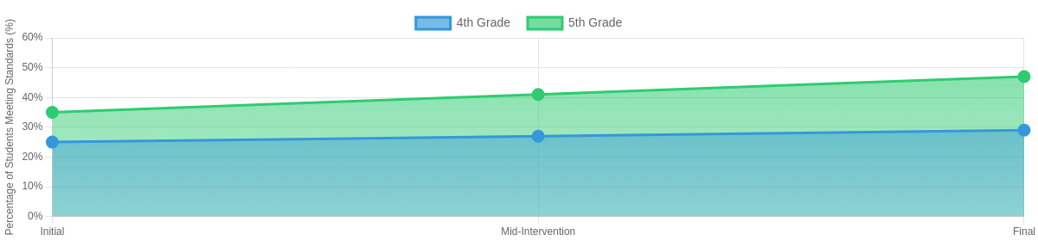
Accelerated Learning Performance
Growth trajectory for students requiring additional support
 Note: 5th grade students showed significantly stronger response to intervention
4th Grade Growth
5th Grade Growth
Overall Acceleration
+8%
Average improvement across grades
25%  29%
35%  47%
+4 points
+12 points
 Key Insights
Developmental Factors: The accelerated learning population showed more significant growth in 5th grade (+12 points) compared to 4th grade (+4 points), suggesting developmental readiness factors may influence intervention effectiveness.
Performance Levels: Students transitioning from "approaching" to "meets"
standards represented the largest growth segment, with of accelerated
68%
learners advancing at least one performance level during the intervention period.
Source: Campus accelerated learning data 2023-24, Intervention monitoring system

Slide 8
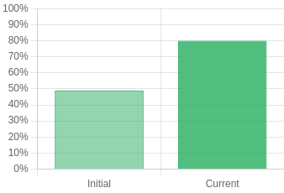
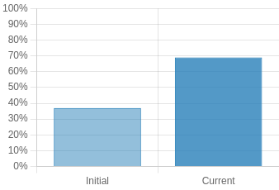
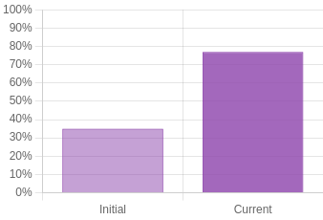
Subgroup Acceleration Dashboard
Performance growth for targeted student populations
$
Economically Disadvantaged

English Learners

Special Education
Initial: 49%
Current: 80%
+31%
Initial: 37%
Current: 69%
+32%
Initial: 35%
Current: 77%
+42%
Key Findings
_{+35%} Average Improvement - All targeted subgroups demonstrated significant improvement, with Special Education students showing the greatest growth at
+42 percentage points. These results exceed district equity goals by an average of 18 percentage points and demonstrate effective differentiation within the academic language intervention.
Source: Campus subgroup performance data 2023-24, Accelerated Learning progress monitoring

Slide 9
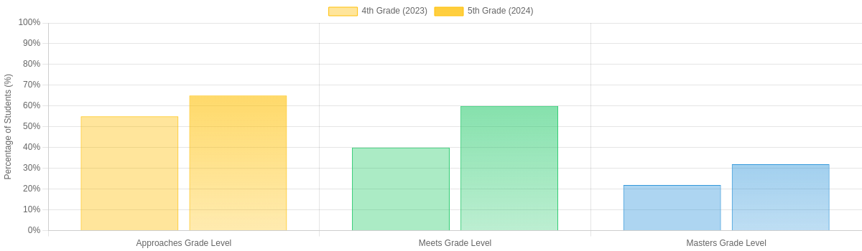
Reading Comprehension Growth Trajectory
Cohort C: 4th Grade (2023) to 5th Grade (2024) Performance
 All performance bands showed improvement after intervention

Overall Growth
+12.3
points average increase across all performance bands

Most Significant Growth
+20
percentage points in "Meets Grade Level" category
⭐
Performance Highlight
✓
Improved outcomes across all student subgroups
Source: Campus assessment data 2023-24, District benchmark comparison

Slide 10
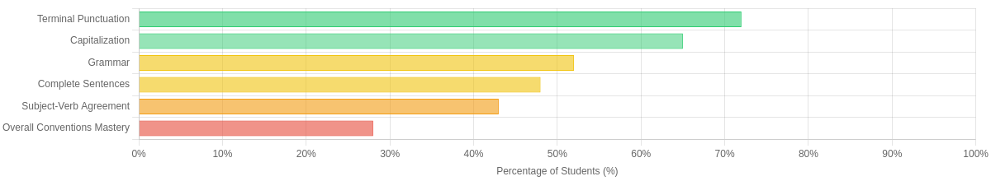
Writing Conventions Analysis
Evaluating the strengths and weaknesses in student writing conventions
⚠ Key Finding: Significant gap between punctuation skills and overall conventions mastery

Strong Punctuation
Students demonstrate proficiency with basic end punctuation and question marks.

Moderate Editing Skills
Students show mixed results in identifying and correcting basic errors.

Low Conventions Mastery
Only a small percentage of students consistently apply grade-level conventions.
Strong Performance
Needs Improvement
Critical Need
72%
of responses show correct terminal punctuation
↔ Self-editing effectiveness varies significantly
28%
of students consistently apply grade-level conventions throughout their writing
across ability levels
⚠ Critical area for improvement
Source: Writing sample analysis 2023-24, Conventions rubric assessment data

Slide 11
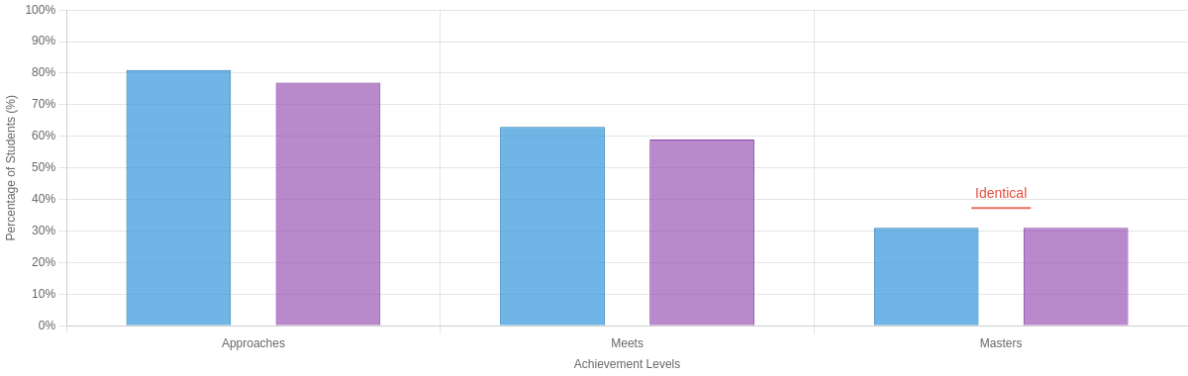


Cohort Comparison Analysis
Performance comparison between Cohorts B and C across achievement levels
 Note: Cohorts achieve similar results at the "Masters" level but show variation in the "Approaches" and "Meets" categories
Cohort B
Cohort C
Comparative Performance Analysis
Cohort B shows slightly stronger overall performance in the "Approaches" and "Meets" categories (81% vs 77% and 63% vs 59% respectively), while both cohorts demonstrate identical achievement at the "Masters" level (31%). These results suggest the intervention strategy is particularly effective at developing advanced academic language skills across different student populations.
Source: Campus cohort performance data 2023-24, Cross-cohort comparative analysis

