Slide 1
Silent Cartographer
Hybrid Reinforcement Learning + A* Maze Agent
COSC 4368 • Spring 2026 • Final Submission
Group 15 — Marlon Melara, Ahnaf Murshid
April 22, 2026

Slide 2
Task Recap
• 64×64 grid maze, agent has no sensors — learns only by bumping and dying.
• Hazards: rotating V-shaped fire clusters (90° every 5 actions), teleport pads, confusion pads.
• Each turn, submit 1–5 actions; environment returns a TurnResult.
• Train on maze-alpha; test on maze-beta (no retraining per spec).
• Required metrics: success rate, avg turns, avg path length, death rate.
• Bonus metrics: exploration efficiency, map completeness, replanning efficiency, learning efficiency.
Group 15 • Marlon Melara, Ahnaf Murshid | Silent Cartographer: Hybrid RL + A* Agent | April 22, 2026 | 2/12

Slide 3
Approach — Why Hybrid RL + A*
Reinforcement Learning
• Handles delayed, sparse hazard feedback — you only learn a cell is a fire after you die on it.
• TD(0) updates spread danger to Manhattan neighbors, so the agent detours regions, not cells.
• Hyperparameters transfer alpha → beta even when cell state resets.
Classical A* Search
• Known edges are deterministic forever — search exploits that immediately.
• Manhattan heuristic keeps 64×64 planning in milliseconds.
• Visit counts + risk penalties become edge weights in phase-aware BFS.
Group 15 • Marlon Melara, Ahnaf Murshid | Silent Cartographer: Hybrid RL + A* Agent | April 22, 2026 | 3/12

Slide 4
Agent Architecture
• Loop: environment returns TurnResult → agent integrates → plans → submits 1–5 actions.
• Integration updates: walls, per-phase fire sets, teleport map, confusion pads, Q-table.
• Planner: phase-aware BFS + goal-biased frontier selector.
• RL layer: 64×64×4 Q-table decayed between episodes (prevents stale fear).
• Same loop, same planner, same hyperparameters across all three mazes.
Group 15 • Marlon Melara, Ahnaf Murshid | Silent Cartographer: Hybrid RL + A* Agent | April 22, 2026 | 4/12

Slide 5
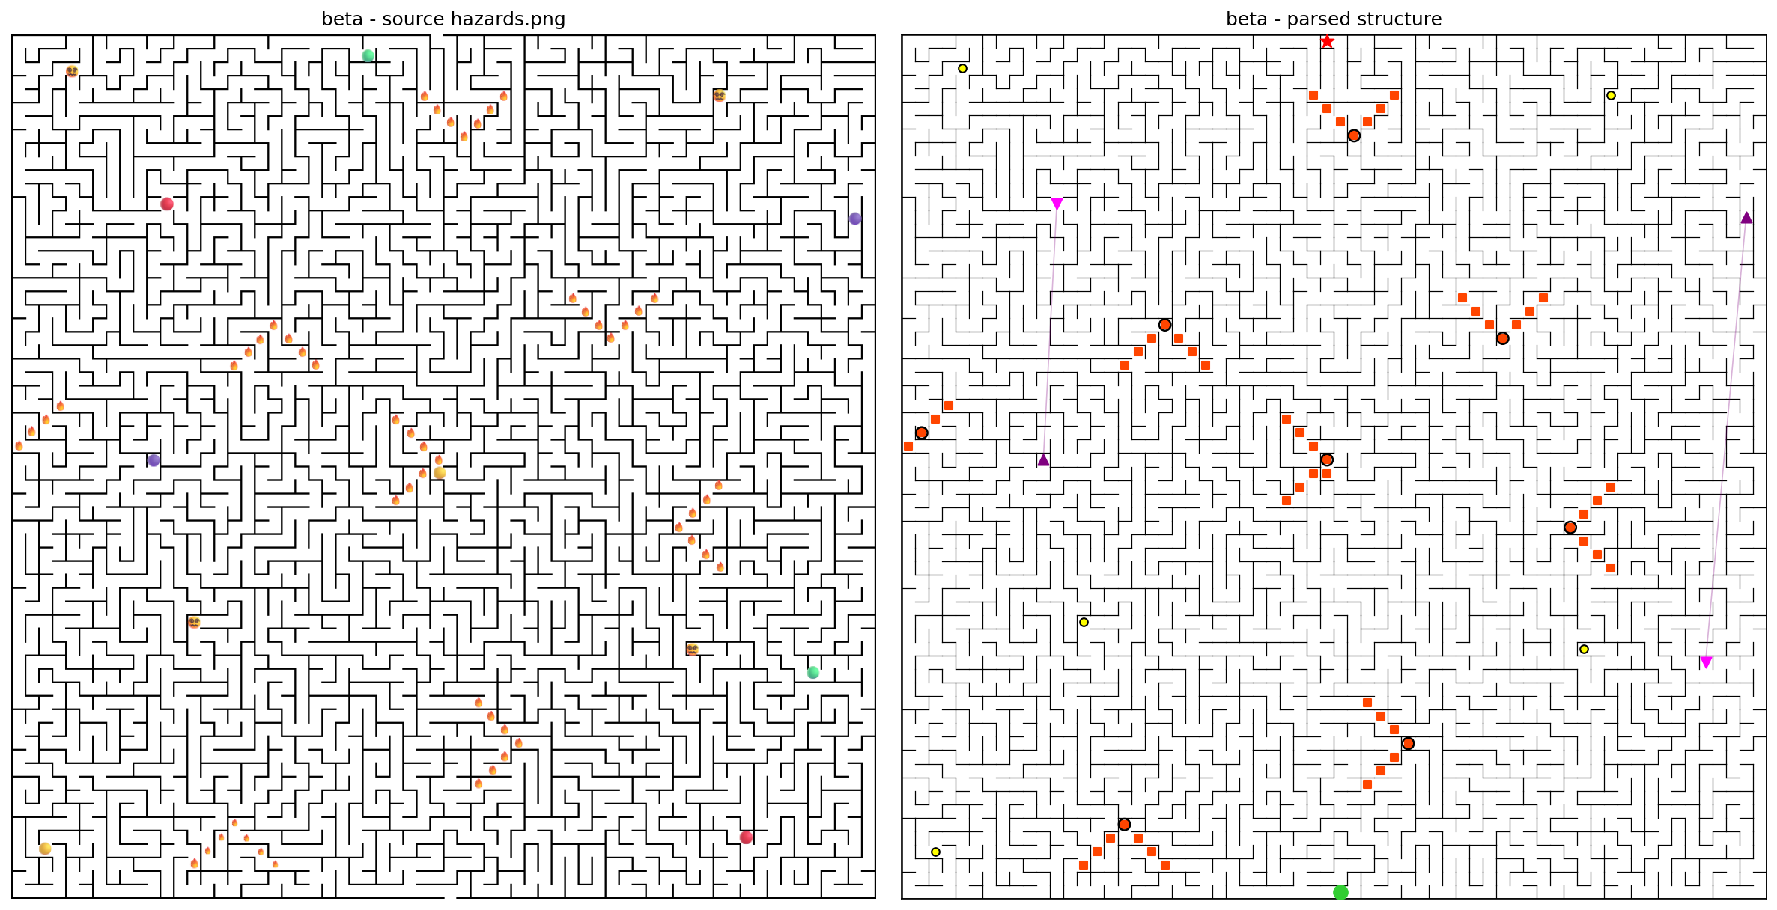
Rotating Fire Hazards
• Fires arranged in V-clusters, pivot at the tip of the V.
• Rotate 90° clockwise every 5 cumulative actions.
• Agent has no visual — learns by dying.
• We pre-compute all 4 rotation states at environment construction.
• Conservative: a cell that has EVER been a fire is dangerous across all phases by default.
Group 15 • Marlon Melara, Ahnaf Murshid | Silent Cartographer: Hybrid RL + A* Agent | April 22, 2026 | 5/12

Slide 6
Mapping and Q-Learning
• Per-maze state: trit edge maps (-1 unknown / 0 open / 1 wall).
• 4 per-phase fire sets, confusion set, teleport source→dest mapping.
• Q[row, col, phase] — tabular risk, decayed between episodes.
• TD(0) update on death: propagates to Manhattan neighbors with geometric decay.
• What transfers between mazes: the RiskConfig hyperparameters (learning rate, decay, penalty scale).
• What resets between mazes: per-cell Q-values and the edge map.
Group 15 • Marlon Melara, Ahnaf Murshid | Silent Cartographer: Hybrid RL + A* Agent | April 22, 2026 | 6/12

Slide 7
Planner — Weighted A*
• Edge cost = 1 + fire penalty (at arrival phase) + confusion cost + w·Q-value + visit penalty
• Strict pass: block every cell that has ever been a fire.
• Relaxed pass: block only fires at the current arrival phase.
• Frontier fallback: if goal unreachable, head toward nearest frontier cell.
• Batching: append actions up to 5 while each next edge is known-open and landing is safe.
Group 15 • Marlon Melara, Ahnaf Murshid | Silent Cartographer: Hybrid RL + A* Agent | April 22, 2026 | 7/12

Slide 8
Working Demo — maze-beta: Learning → Optimal
Episode 1 — RL Exploration
5204 turns • 49 deaths • agent learns the map from scratch
Episode 3+ — BFS-Optimal (Converged)
~80 turns • 0 deaths • clean path via (2,32)→(1,32)→(0,32)→(0,31)
Group 15 • Marlon Melara, Ahnaf Murshid | Silent Cartographer: Hybrid RL + A* Agent | April 22, 2026 | 8/12

Slide 9
Results — alpha + beta (5 eval episodes each)
Metric | maze-alpha | maze-beta
Success rate | 100% | 100%
Average turns | 1015.4 | 1178.4
Average path length | 2695.8 | 3680.2
Death rate | 0.0030 | 0.0090
Exploration efficiency | 0.83 | 0.68
Map completeness | 0.33 | 0.30
Replanning (≈ ms/turn) | 3 | 50
Learning efficiency (eps to 1st) | 1 | 1
Eps 2–5 converged turns | 87 | 80
Both mazes meet the spec's stretch goals (>95% success, <500 turns on converged episodes, <1% deaths). No training on beta — spec requirement.
Group 15 • Marlon Melara, Ahnaf Murshid | Silent Cartographer: Hybrid RL + A* Agent | April 22, 2026 | 9/12

Slide 10
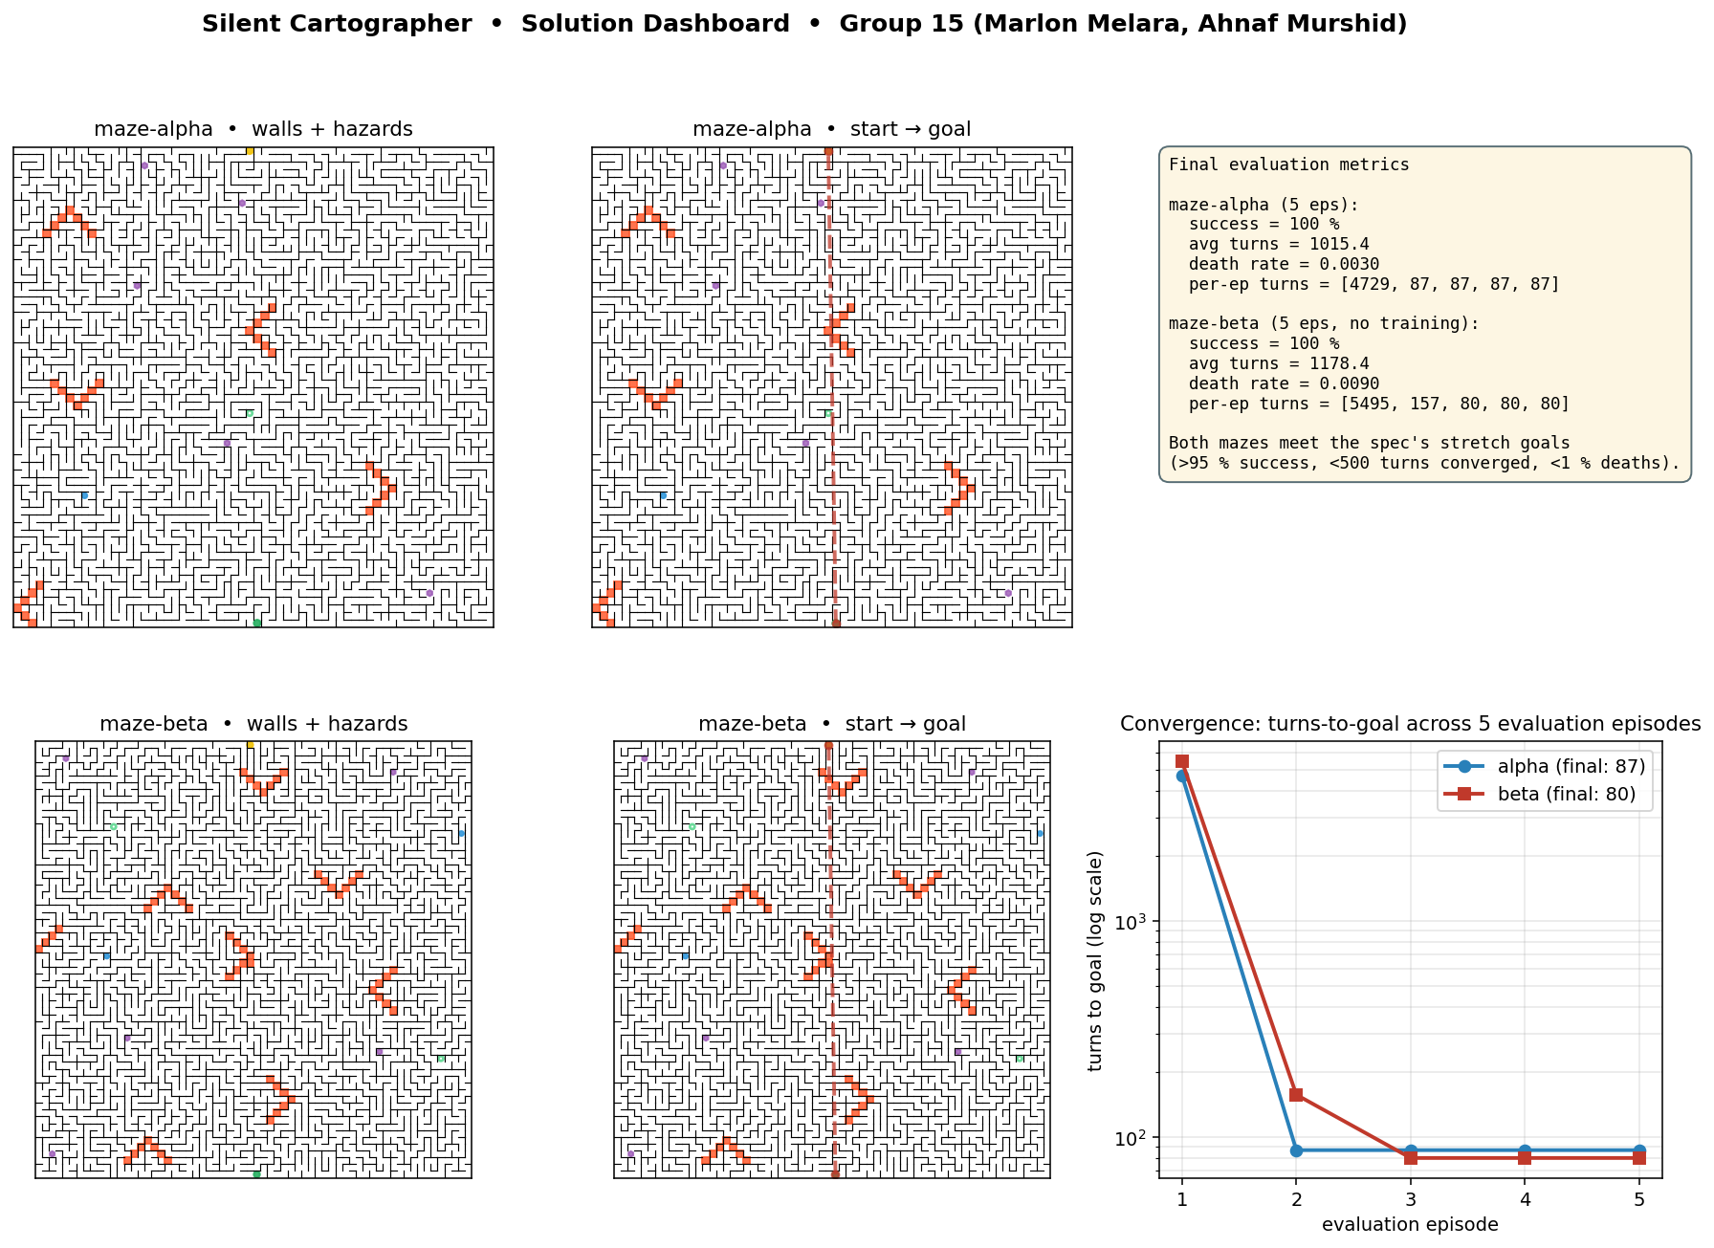
Bonus Opportunities (spec §8.2, cap: 10 pts)
• Maze-gamma attempt (5 pts)
5-ep evaluation run, discovered 1 of 2 teleports, reached Manhattan 25 from goal; not solved in budget.
• Novel visualization (up to 5 pts)
src/solution_dashboard.py — unified 6-panel dashboard of maps, trajectories, convergence, metrics (shown →).
• Open-source toolkit release (up to 5 pts)
MIT license, complete README with install + public API example, spec-agnostic code.
Group 15 • Marlon Melara, Ahnaf Murshid | Silent Cartographer: Hybrid RL + A* Agent | April 22, 2026 | 10/12

Slide 11
What Turned Beta from ‘Unsolvable' to 100%
• Off-by-one phase fix: environment checks pits at pre-increment phase; we had been using post-increment, so every 5th planned step walked into a fire.
• Goal-biased frontier targeting: enumerate known-open cells that still have an unknown edge, sort by Manhattan distance to goal, BFS to the closest one.
• A* cycle guard: negative-cost teleport bonuses could make came_from cycle; the reconstruction loop spun forever. Floored edge costs at 0.05 and added a seen-set guard.
Group 15 • Marlon Melara, Ahnaf Murshid | Silent Cartographer: Hybrid RL + A* Agent | April 22, 2026 | 11/12

Slide 12
Conclusion & Lessons
• Hybrid RL + phase-aware BFS + frontier planner reaches 100% success on both alpha and beta (5/5 each, no training on beta).
• Episode 1 is exploratory; episodes 2–5 run the BFS-optimal path in 80–87 turns with 0 deaths.
• Beta's walled-off goal would have defeated pure nearest-frontier exploration — goal-biased frontier targeting is what made the transfer work.
• AI usage fully disclosed in report.pdf (Claude Code, Opus 4.7, 1M-context).
Thank you — Questions?
Group 15 • Marlon Melara, Ahnaf Murshid | Silent Cartographer: Hybrid RL + A* Agent | April 22, 2026 | 12/12

