Slide 1
JavaScript

Slide 2
JavaScript
Scripting language
All browsers support JS
JavaScript is the language and ECMAScript is an specification on the language.
New characteristics of ECMAScript are not 100% supported by all browsers
JS is a programming language (variables, functions, loops).

Slide 3
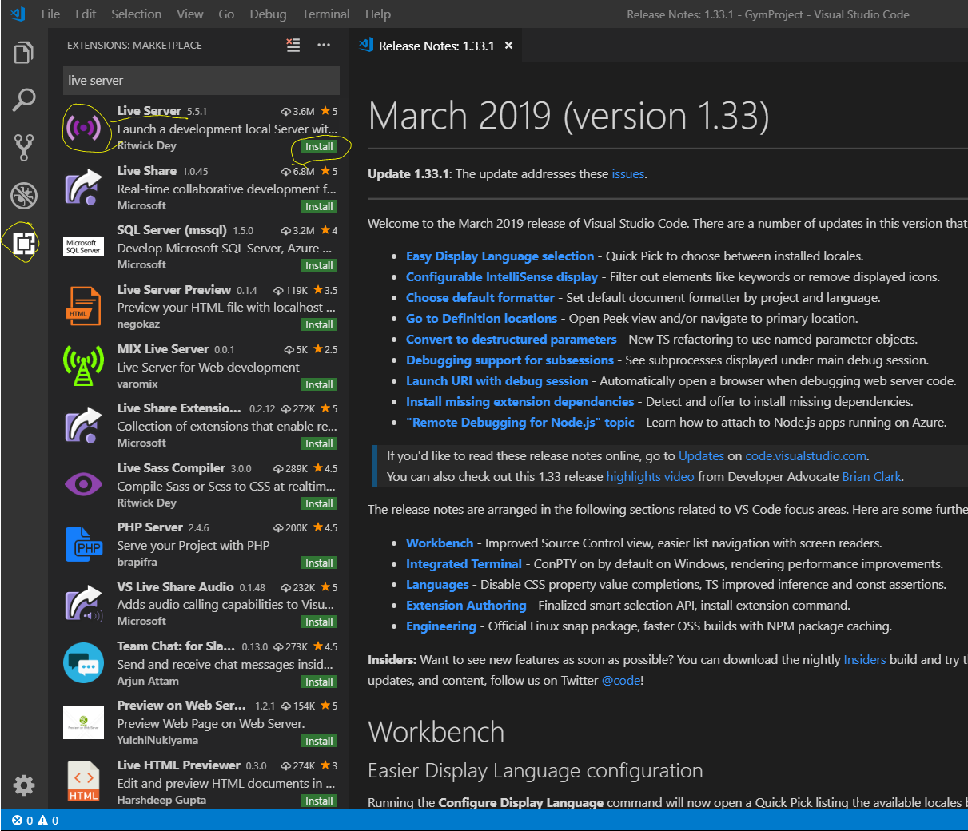
Extensions
JavaScript (ES6)
Beautify
Braket pair colorizer

Slide 4
JS inside HTML
<script type=text/javascript>
</script>

Slide 5
External file for JS script.js
Variables ( var, Let, Const).

Slide 6
Data types
We do not specify data types.
Is a dynamic language.
You can create a variable an assign different types of value during the program.
typeof

