Slide 1
Scorch
Software/Configuration Orchestration
By Marc Loftus

Slide 2
Simplicity is a great virtue but it requires hard work to achieve it and education to appreciate it.
- Edsger W. Dijkstra

Slide 3
ScOrch - What is it?
Concept written as a test suite orchestrator in the 1990s
Modified to be an infrastructure setup tool
Used by internet gateway provider to rebuild 500 servers
Later, abstracted the configuration from the process to create a reusable framework

Slide 4
Scorch Provides
ScOrch pipelines provide:
Parallel runs
Team collaboration
Reuse
Auditing
Break glass solutions

Slide 5
Scorch – use cases
Infrastructure (spinning up hardware and creating virtual machines)
Software Configuration Management (configuration audit control, software packaging and application release note generation)
Documentation (creating live documents for and given system configuration)
Release and Deployment Management (deploying application and database code)
Test Management (running test cycles and generating defect tickets and signing off artefacts and applications)
Performance Management (Metrics capturing)
Support Services (restarting systems and application, monitoring, housekeeping, reporting)
Middleware and Application Management

Slide 6

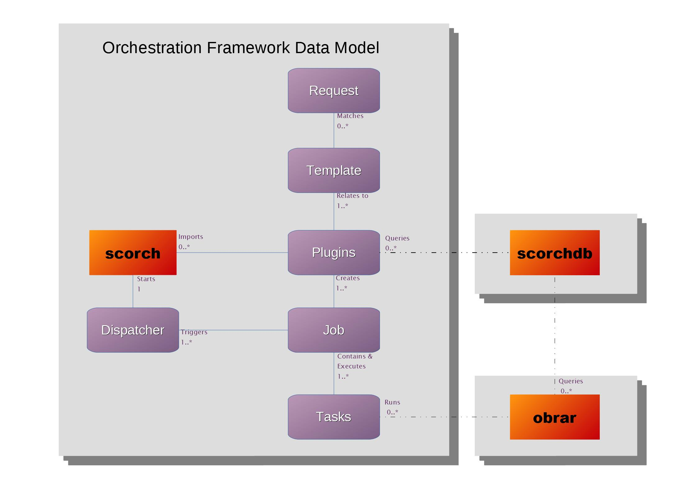
Scorch Data Model

Slide 7
Scorch – Requests/Templates
Stop services on a server type in an environment
Action : STOP
Project : FCRM
Type : DB
Environment: PPD1
Deploy ALL to an environment
Action : DEPLOY
Project : FCRM
Environmet: UAT
Restart apache on a server
Action : RESTART
Component : APACHE
Server : W4QVAP1026

Slide 8
Scorch – request plugins
1 SP_SAFEDEMO()
2 {
3 # Additional variables can be passed with the GetVar command 3 GetVar -pattern "Pause" -name "PAUSE" -default "60"
4 GetVar -pattern "Fail" -name "FAIL" -default "0"
5
6 # The task command can be used to run command line tasks
7 Task "hostname" 8 Task "sleep ${PAUSE}"
9
10 # Task commands can be wrap in standard shell conditional statements or loops
11 if [ ${FAIL} -ne 0 ] ; then
12 Task "false"
13 fi
14
15 # A manual task can be set with the Manual command
16 Manual "This is a manual step"
17
18 # This Try command will not stop the rest of the tasks if the task fails
19 Try "false will fail"
20
21 # A Sleep command can be used to both sleep and leave a log trail of how long
22 Sleep 20
23 }

Slide 9
Scorch – REUSE plugins
Action : RESTART
Project : EPP
Application : APACHE
Server : W4QVAP1026
SP_RESTART()
{
SP_STOP
Sleep 60
SP_START
}
SP_STOP()
{
GetVar -pattern “application" -name APP
Sleep 60
SP_START
Task "ps -ef | grep $APP"
}

Slide 10
Demo
Action : LONGRUN
Action : DEMO-GROUP
Label : L1
Ticket : ISAPPSG-1208
Action : LONGRUN
Parent : L1
Ticket : ISAPPSG-1207
Action : DRINK-TEA
Action : DRINK-TEA
Strength : strong
Size : mug
Sugar : 3
Ticket : Bob
/opt/scorch/scorch -a DRINK-TEA -o Ticket:Marc -o Milk:1 -s

Slide 11
More info
https://github.com/marlof/ScORCH
http://www.autoscorch.com/
https://hub.docker.com/r/webmarcit/scorch-demo

