Slide 1
NHS GP Prescription Analytics Marlon Ducille

Slide 2
Situation
We are looking to expand our portfolio into the healthcare.
We are experiencing market saturation and would like to increase service offering in order to maintain a competitive edge.
The Senior Management team have scheduled an initial meeting in a week’s time with NHS Commissioners. At the meeting, the intention is to hold an informed conversation demonstrating the area’s in which your company can provide cost savings; against GP prescriptions in particular.

Slide 3
Project Goal
To produce an intelligent report which will assist the Senior Management team in their preparation for a meeting, which will demonstrate the areas in which savings can be made against GP prescriptions.
Understand whether there is distinct difference between GP Practices with regards to prescription cost.
To aid the commissioners in making a decision about potential cost savings and proper channelling of funding.
Improve customer’s user experience and overall cost saving by helping commissioners in making a decision about potential cost savings and proper channelling of funding.

Slide 4
Executive Summary
North East London Area has occur the highest prescription cost of 40% , followed by South London Area of 36%, with lowest spending attributed to North West London Area of 24%.
The PCO which cost the NHS the most is Newham CCG, with a cost of just under £6M.
The general practice which cost the NHS the most is Nexus Health Group of £6.7k.
The GP prescription cost tends to be at its highest in October and at its lowest in September.
There is at least ONE GP Practices that is significant different with regards to prescription cost

Slide 5
Executive Summary
The drug prescribed the most is called Zyprexa meaning mental illness is of the greatest concern to the NHS
I have predicted and forecasted that there will be an exponential increase in prescription cost to the NHS within the next 12 months, if extra measures are not put in place. This increase could possibly due to the rise in mental health conditions.
The total cost to the NHS in London between July 2018 and December 2018 is just under £125M

Slide 6
Approach
Engaged with Chief Digital Officer and CCG Information Manager to gather requirements
Collected data from NHS BSA website
Pre-processed the data for analysis
Did some exploratory analysis on the data to understand patterns
Conducted hypothesis testing to determine if there is any distinct difference between GP Practices with regards to prescription cost.
Conducted further analysis to identify cheaper drug alternatives
Translate analysis into insight and make recommendations

Slide 7
Model Description 1
Overview of basic methodology: Test the hypothesis to determine whether or not there is any significant difference between GP Practices with regards to prescription cost.
Model: ANOVA (Analysis of Variance) model
Scope: London Medical Practices dataset between July 2018 and December 2018
Hypothesis Testing: Used Shapiro-Wilk test to test for data normality to validate the need for ANOVA. The hypotheses was test at a 95% confidence interval, or an alpha value of 0.05.

Slide 8
Model Description 2
Overview of basic methodology: Group drugs into categories of prices to quickly identify cheaper alternative drugs
Model: K-Means Clustering
Scope: The analysis was conducted with the Nexus Health Group GP Practice, with drugs of a 10mg medication strength.
Selection of number of clusters: Elbow Method
Number of groupings: 4

Slide 9
Model Description 3
Overview of basic methodology: Predict and Forecast the cost of prescription in the next 12 months
Model: Time Series Analysis
Scope: Data is collected between September 2017 and June 2019
Test accuracy of the model : The model was build at a 95% confidence interval. This means that I am 95% confident that the predicted data could fall within the range.

Slide 10
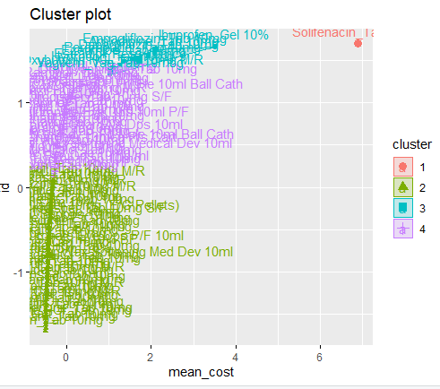
Visualisation – K-Means Clustering

Slide 11
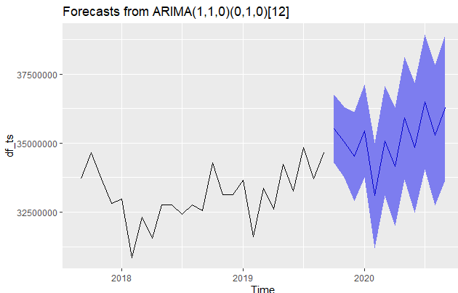
Visualisation – Time Series Analysis

Slide 12
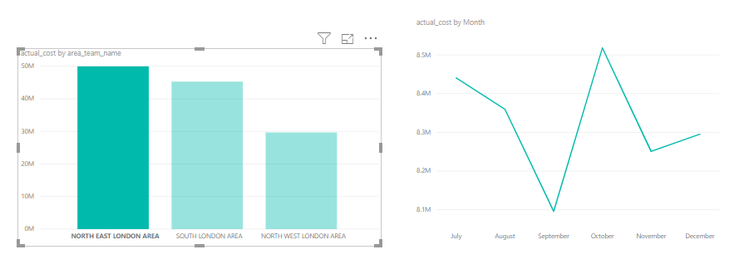
Visualisation – Bar chart and trend Chart at Area Team level

Slide 13
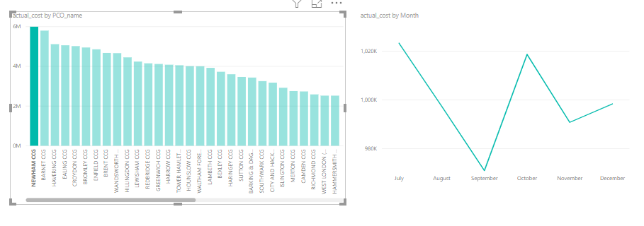
Visualisation – Bar chart and trend Chart at PCO Level

Slide 14
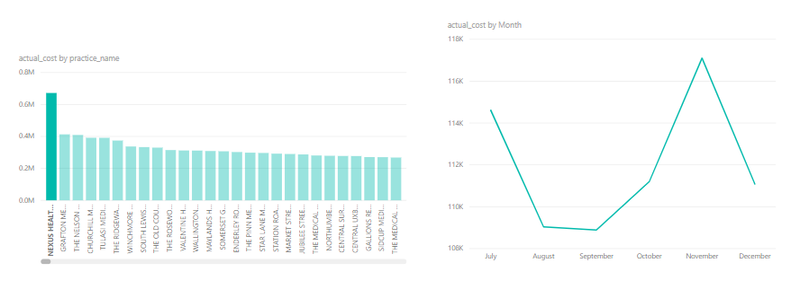
Visualisation – Bar chart and trend Chart at Practice Level

Slide 15
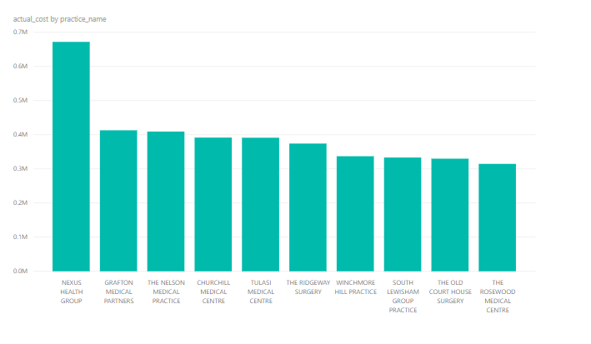
Visualisation - Top 10 Practices by Costs

Slide 16
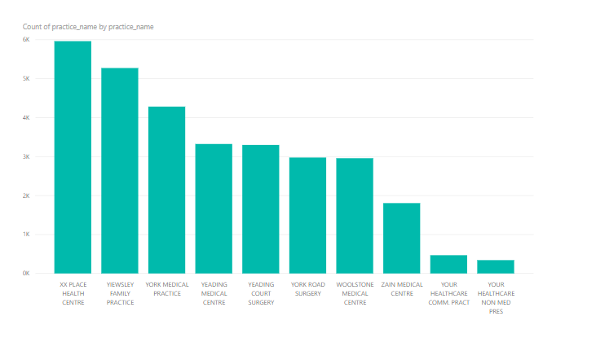
Visualisation - Top 10 Practices by Prescriptions

Slide 17
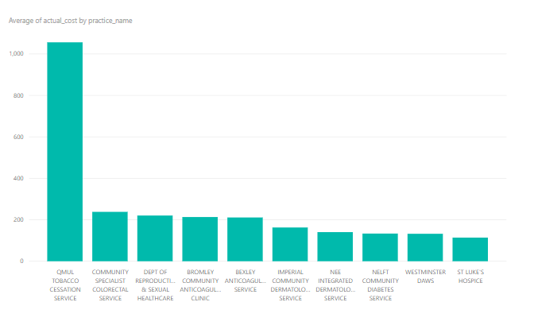
Visualisation - Top 10 Practices by Costs

Slide 18
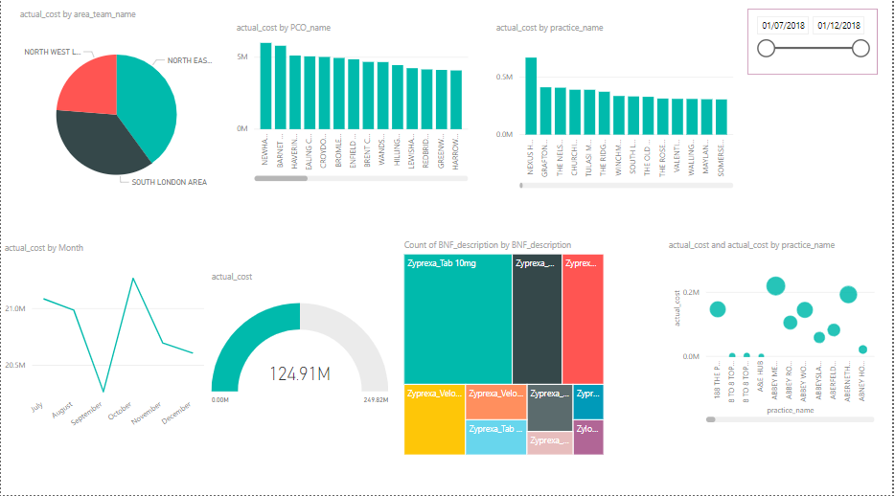
Visualisation - Dashboard

Slide 19
Recommendation - Technical
Implement the model as a pilot, focusing on London as a region
Gather feedback from the target audience and review accordingly
After testing the model and reviewing the solution, it can then be mirrored for other England regions
Create a task scheduler to run R Script code on a monthly basis to pick up newly available data, for ‘live’ reporting and dashboard

Slide 20
Recommendation - Executive
Choose cheaper category drugs as an alternative solution
Provide Mental Health Awareness sessions
Establish programmes to reduce mental illnesses, such as relaxation techniques (meditation, mindfulness, etc.)

