Slide 1
Genetic Algorithm for Route Optimization
Modeling & Simulation

Slide 2
Outline
Objective
Describe the steps
Result
Military purpose

Slide 3
Objective
Fly an unmanned aerial vehicle with constraints:
Fly from startpoint to the endpoint;
Maximum time for the flight is 24 minutes;
Maximize the survivability;
Fly past 10 waypoints.

Slide 4
Introduction

Slide 5
Describe the steps
Survival of the fittest
Create an initial population with e.g. 1000 routes;
Routes with a survivability of less than 30% are not accepted;
Routes that take longer than 24 minutes are not accepted;
Rank these routes from best to worst;
Divide the the population in 3 groups:
1. bottom 15% dies;
2. Top 10% is copied to the next generation;
3. Remaining group is combined with the top 10% to create childeren;
Start a new generation of 1000 routes with the top 10%, children (mutated) and immigrants;
Repeat until all generations are complete.

Slide 6
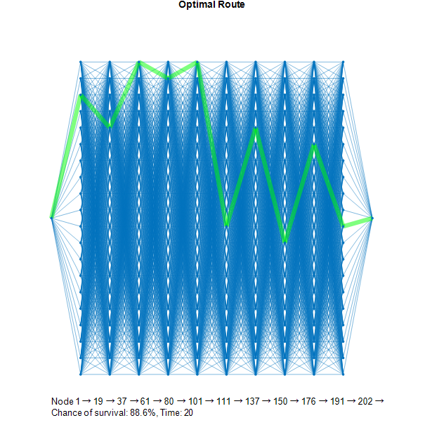
Result

Slide 7
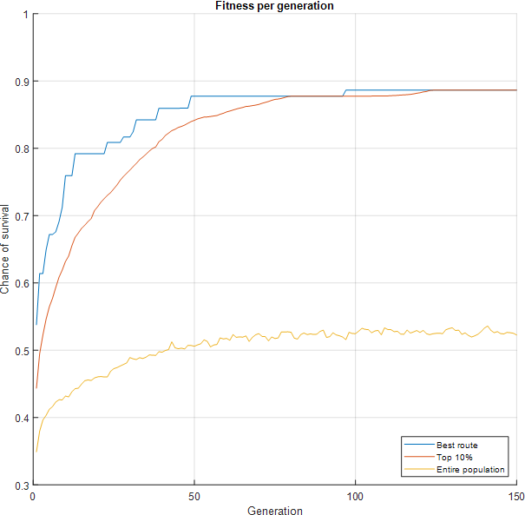
Result

Slide 8
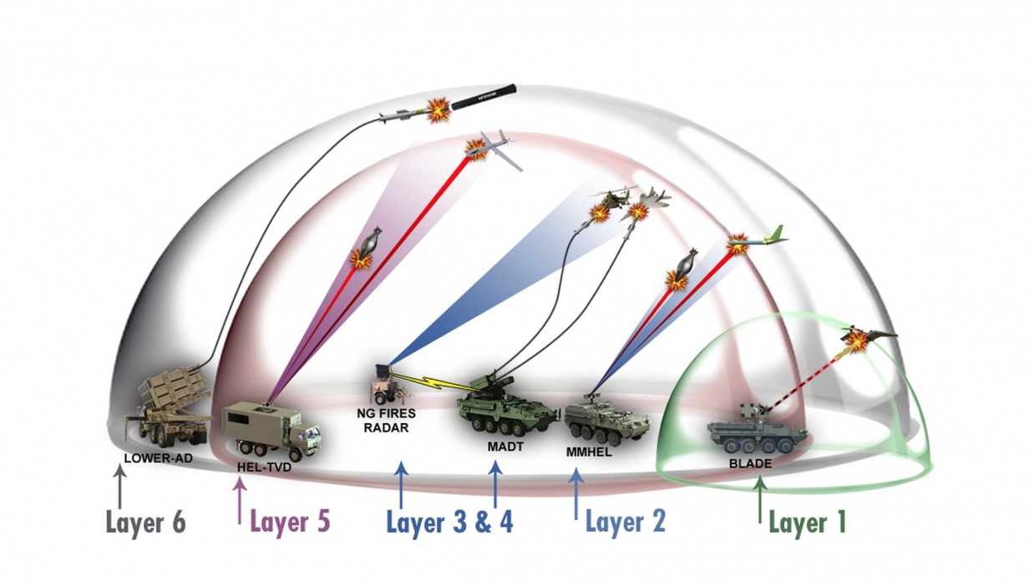
Military purpose
Integrated Air Defense System;
Consists of:
Search radars;
Track radars;
Fire control radars;
Goal:
With a generic algorithm being used to optimize the placement of all air defense systems close to zero gaps will exist in the air defense umberella, depending on the number of systems being used.

