Slide 1
Stock Market Autocorrelation Trading Approach
Marlowe Quart
github: marlowequart
9/27/18

Slide 2
Summary
Autocorrelation Theory
Application to trading system
Code Examples

Slide 3
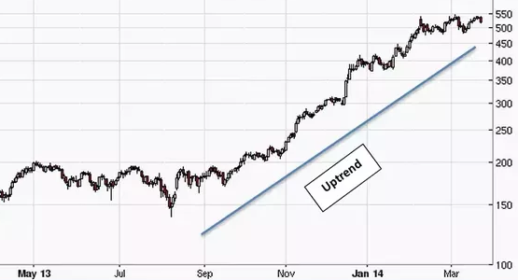
Autocorrelation Theory
Definition: Autocorrelation is the correlation of a signal with a delayed copy of itself
A mathematical tool for finding a periodic signal obscured by noise
Example: a stock market trend

Slide 4
Variance Ratio
Variance is (standard deviation)^2
Measures dispersion of data points around mean value
Variance is a way to measure volatility in stock market
Variance ratio looks at how volatility changes over time

Slide 5
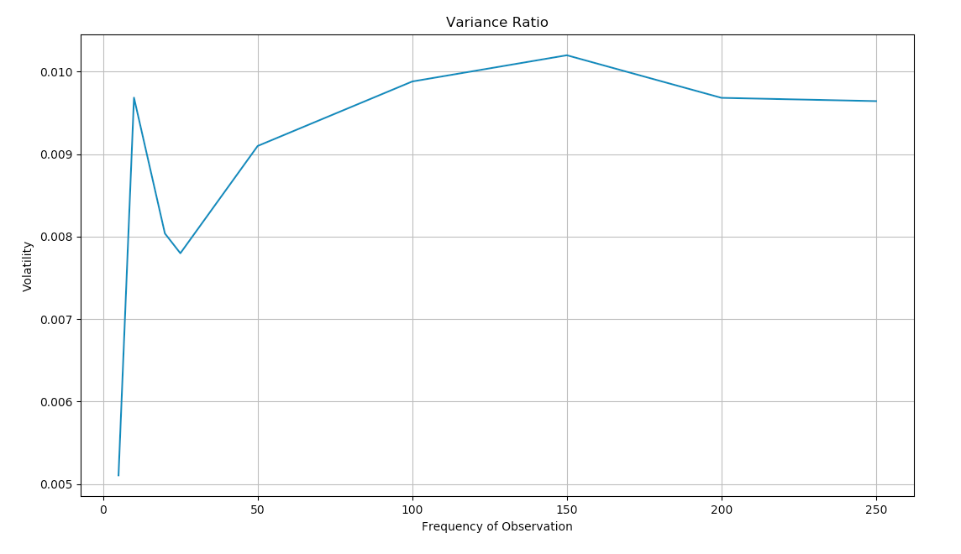
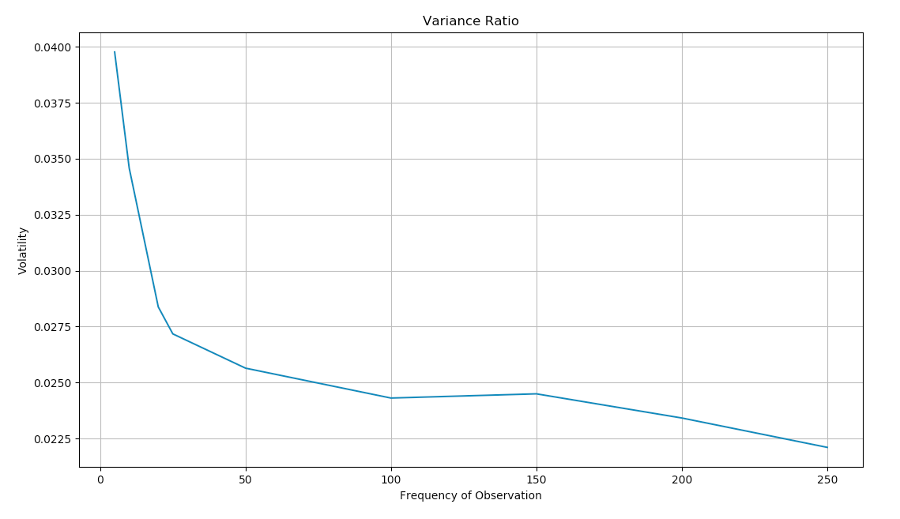
Variance Ratio
Short term volatility < Long term volatility represents a trend
Short term volatility > Long term volatility represents reversion to mean

Slide 6
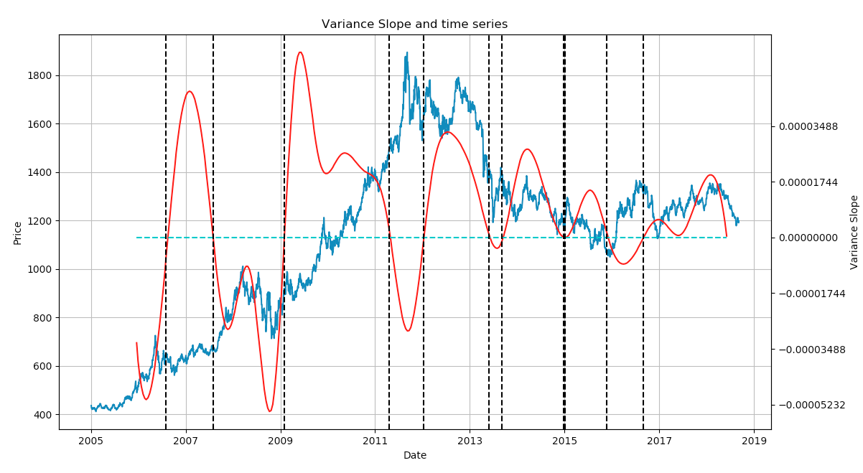
Trend Detection

Slide 7


Use Pandas to Import CSV data

Slide 8

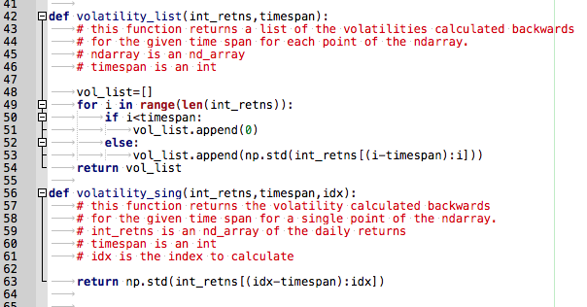
Use Scipy for Statistics

Slide 9
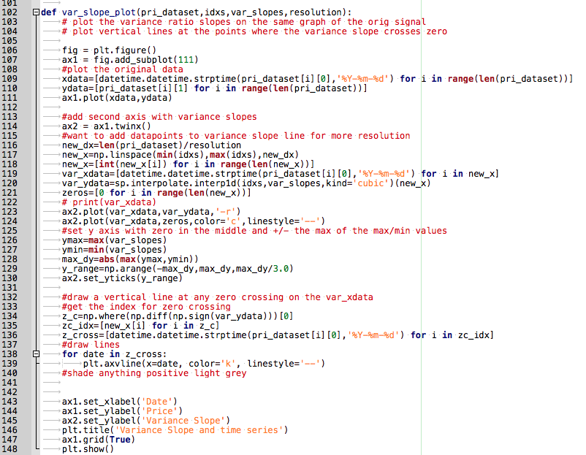
Use Matplotlib for Plots

Slide 10
Questions?

