Slide 2
Priority inheritance with backtracking for iterative multi-agent path finding
Keisuke Okumura, Manao Machida, Xavier Défago, Yasumasa Tamura
2022

Slide 3
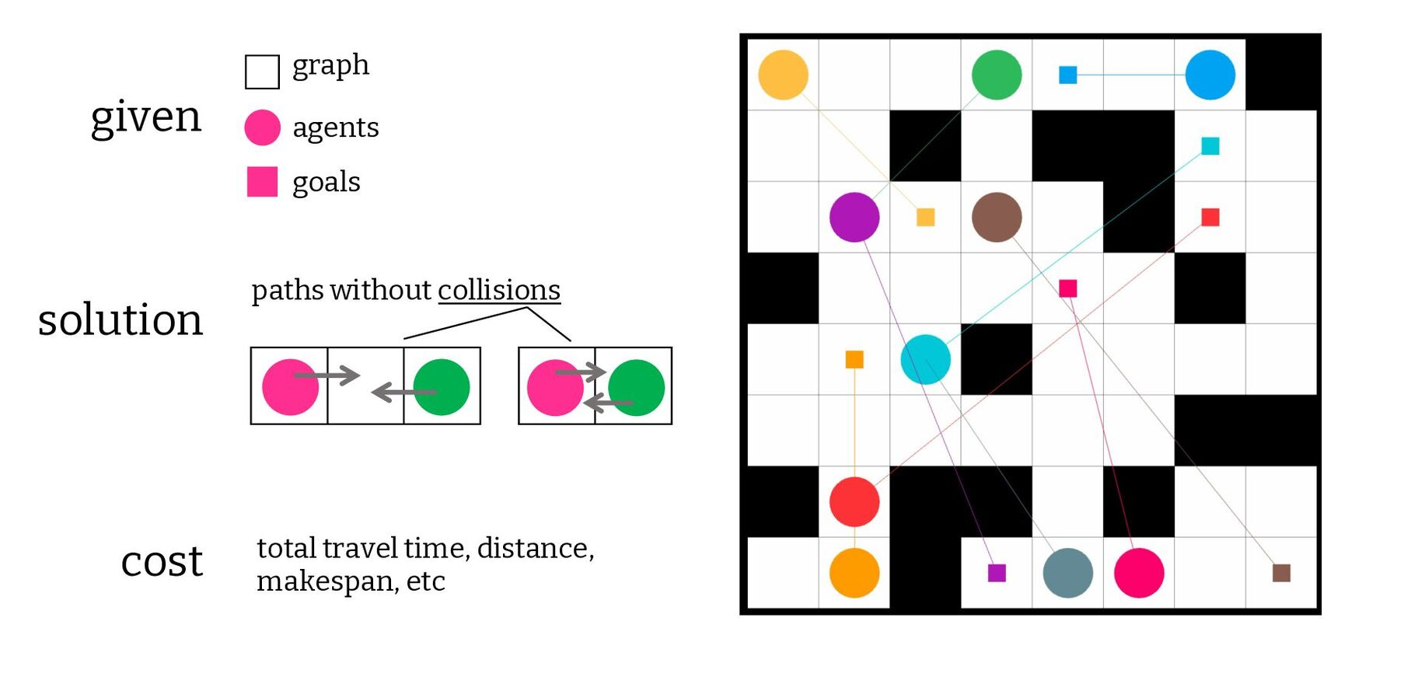
Multi-Agent Pathfinding
MAPF (one-shot, offline)
MAPD (lifelong, iterative, online)
anonymous
real-world (non-grid, kinematics)

Slide 4
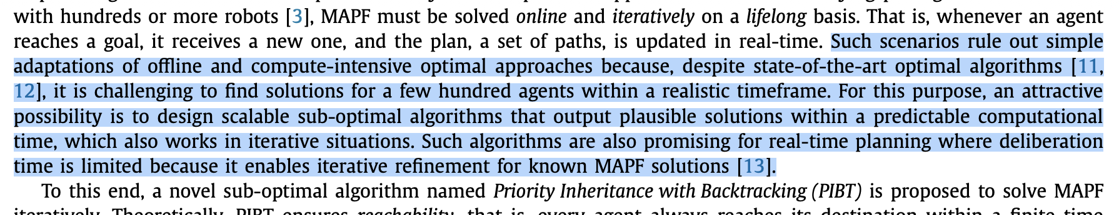
Approaches
Optimal (and bounded sub-optimal)
Search-based
Joint A*
CBS
Compiling
SAT reductions
ASP
Sub-optimal (and some incomplete)
Rule-based
Push and Swap
Push and Rotate
Prioritised planning
PIBT
Learning (no theoretical guarantees)
PRIMAL

Slide 5
Priority Inheritance with Backtracking (PIBT)
Priority based
Sub-optimal
Complete in biconnected graphs
100s to 1000 agents
Fast (e.g. < 50ms)
Notes:
Solves instances that other methods don’t.
Elegant.
Like CBS, the core algorithm is simple and appealing – doesn’t really on any confusing hacks or edge cases.
For CBS, there are a lot of optimisations that rely on pre-processing, special cases, and heuristics.
The main author of PIBT has also developed an algorithm called LaCAM which looks like a similar case of trying to squeeze everything possible out of the PIBT algorithm…
I really like the illustration he has on the page for the algo.

Slide 6
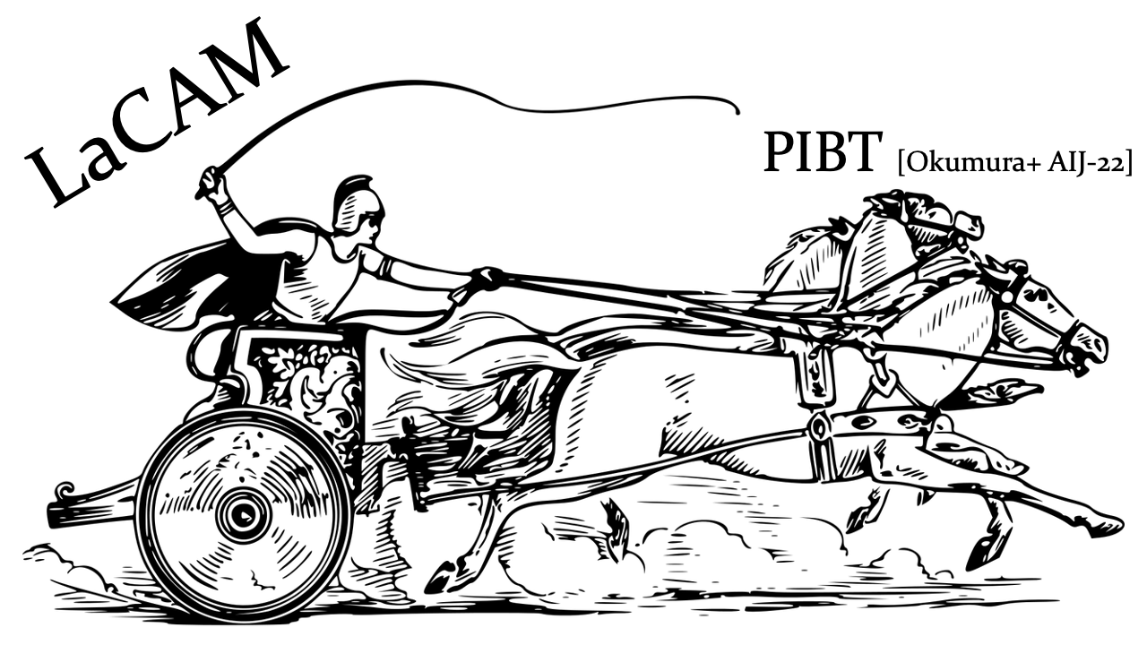

Slide 7
Priority Inheritance with Backtracking (PIBT)
Guarantees reachability
No guarantee that all agents will be at their goals at the same time
Probably not important for MAPD problems

Slide 8
Priority Inheritance with Backtracking (PIBT)
Prioritised planning, one step at a time
Priority inheritance
Backtracking

Slide 9
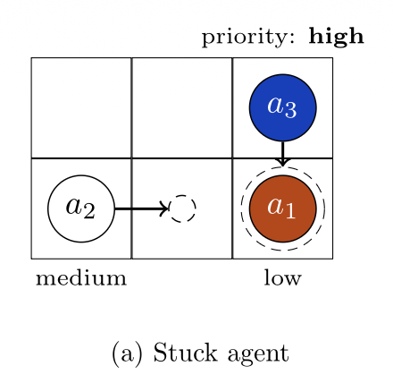
Priority Inheritance with Backtracking (PIBT)
Prioritised planning
Each step, agents update their unique priority (somehow).
In decreasing order of priority, agents pick their next location (e.g. A*) while avoiding nodes requested by higher priority agents.
Agents can ignore lower priority agents.
Deadlocks possible

Slide 10
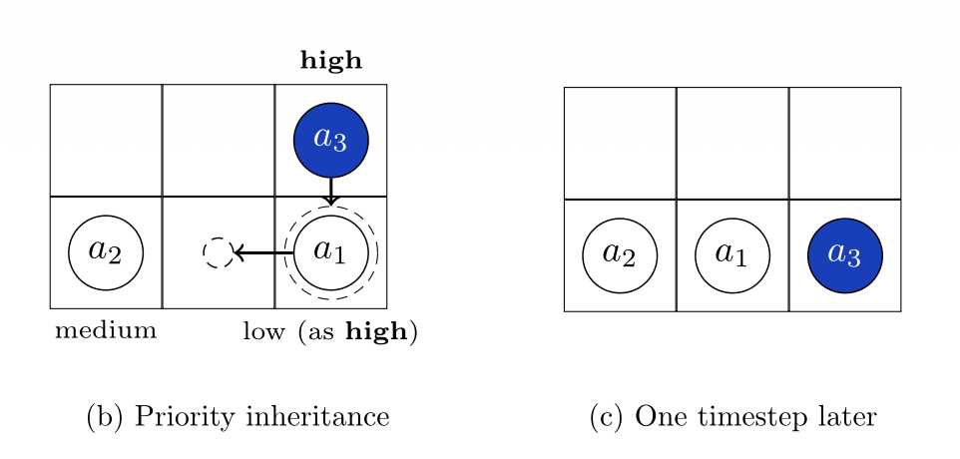
Priority Inheritance with Backtracking (PIBT)
Priority inheritance
Agent a₁ temporarily inherits a₃’s high priority allowing it to force the medium priority a₂ to take a different action.

Slide 11
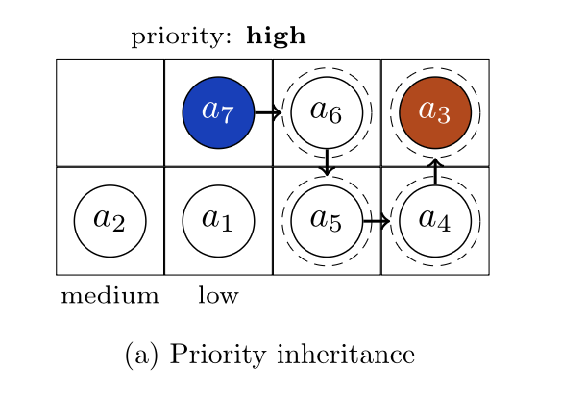
Priority Inheritance with Backtracking (PIBT)
Priority inheritance
Deadlocks are still possible!

Slide 12
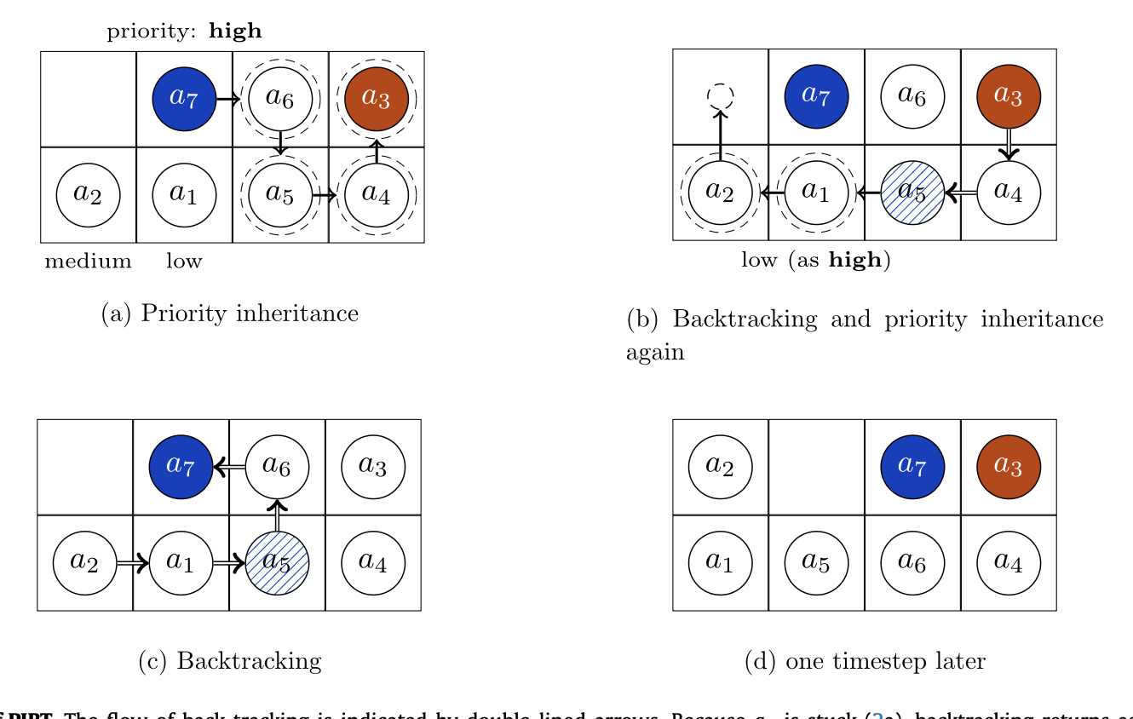
Priority Inheritance with Backtracking (PIBT)
Backtracking
Any agent that executes priority inheritance must wait for an outcome {valid, invalid}.
If it gets invalid, it will look for alternatives to force, otherwise it will return invalid too.

Slide 13
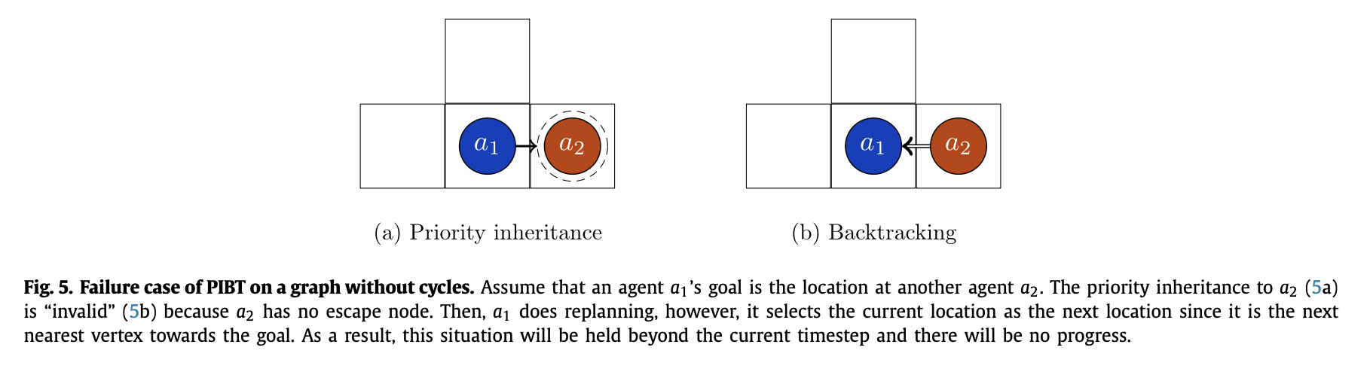
Priority Inheritance with Backtracking (PIBT)
Incomplete on graphs that are not biconnected

Slide 14
PIBT+
Decentralised planning
Results

Slide 15
