Slide 1
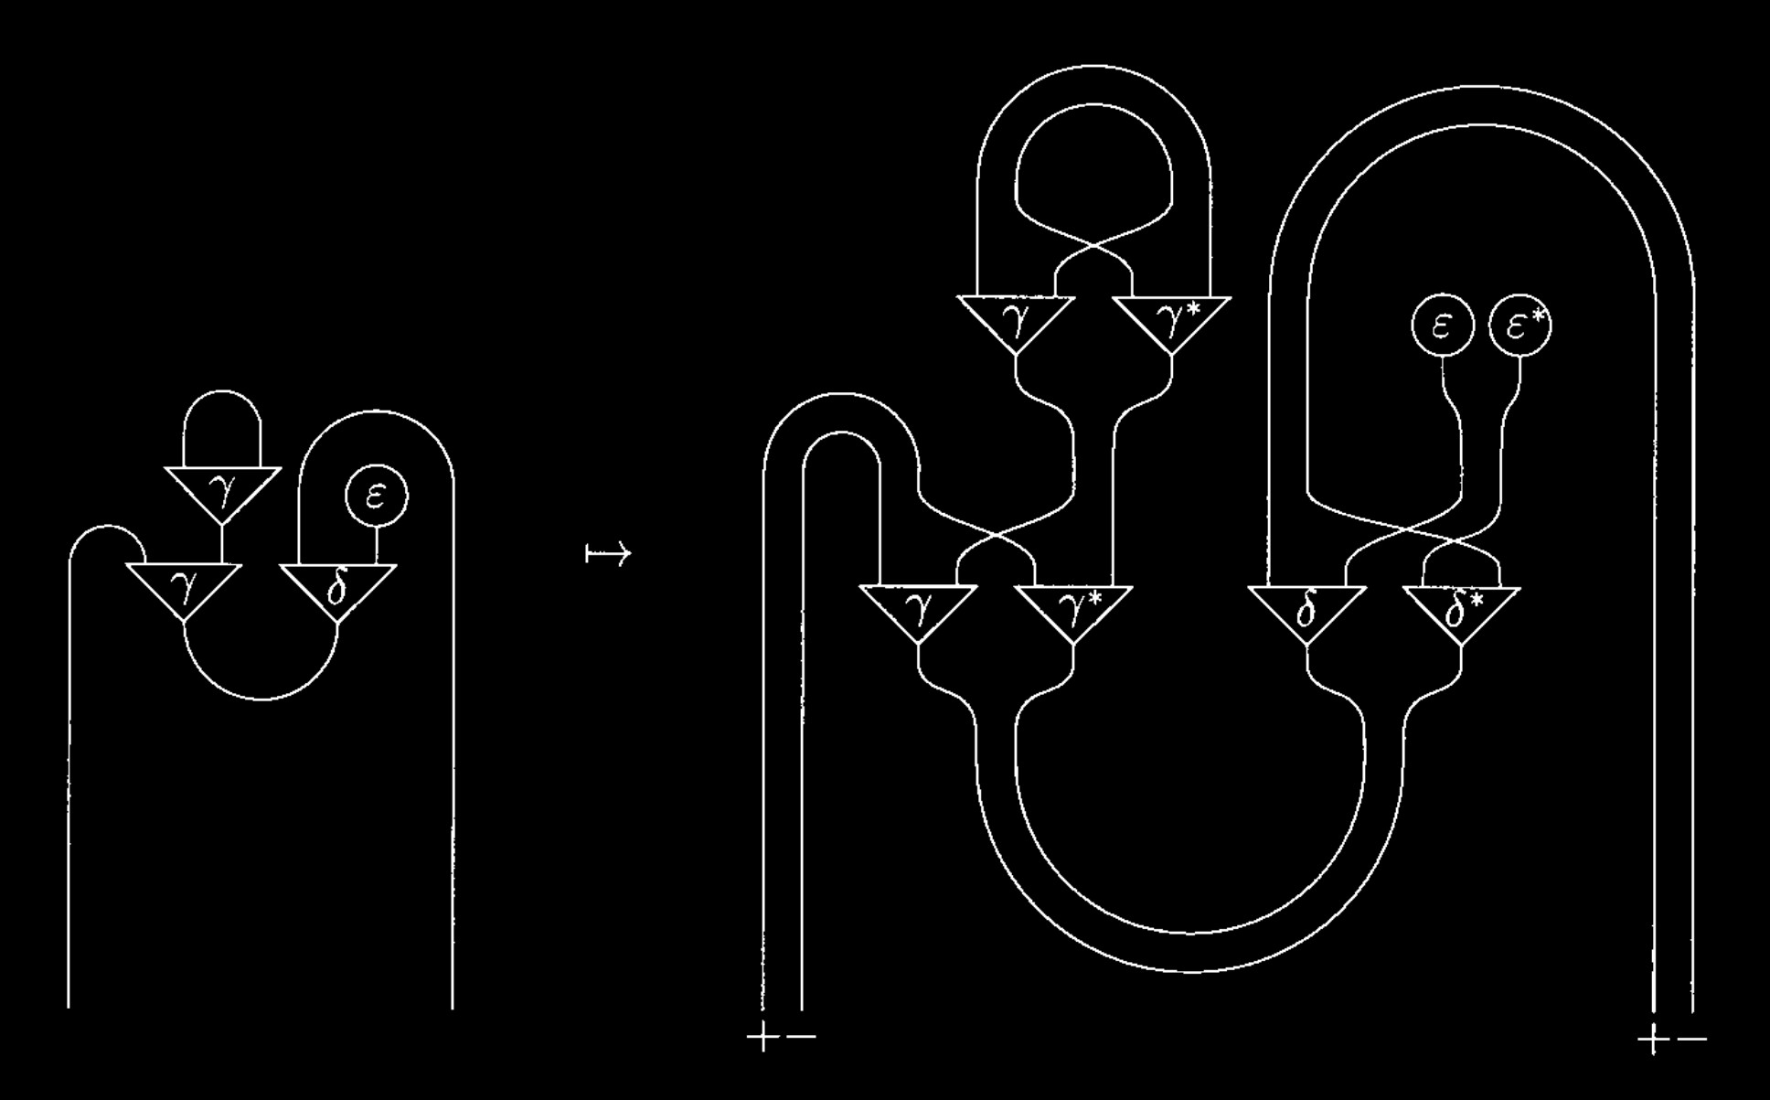

Slide 2
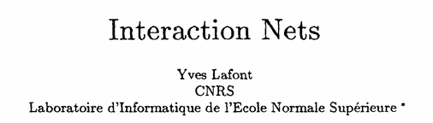


Slide 3
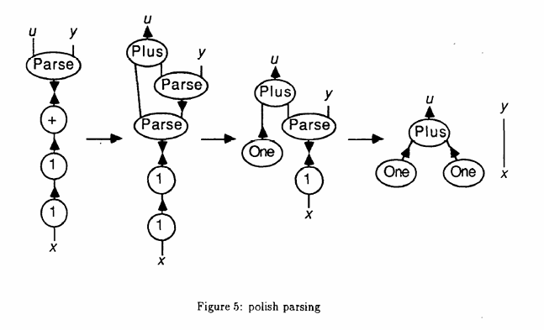

Slide 4
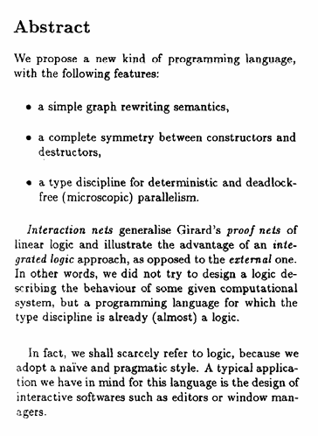
Rewriting languages: intuition is find and replace
Symmetry means no caller/callee relationship between functions/operators, no privileged direction.
Inherently parallel computation model.
Linear logic: you can’t use a proposition multiple times (without specific operators).
Propositions are consumable resources.

Slide 5
Principles of Interaction

Slide 6
Definitions

Slide 7

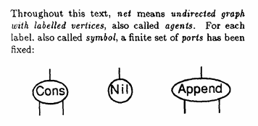
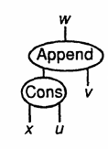
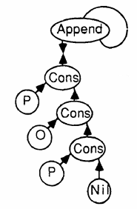
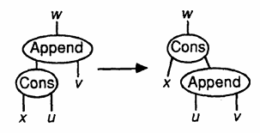
Variables can stand in for parts of a net
Agents, labelled with symbols, have ports
Agents can be connected into nets
Undirected!
Rewriting rules express interaction

Slide 8
Rule properties

Slide 9

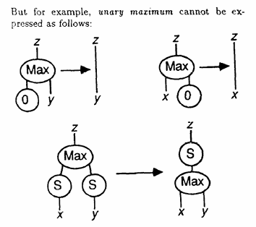

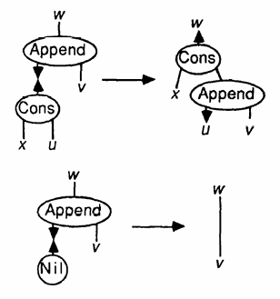
Binary interaction
But… this means local sequentiality.
We have to pick one argument to look at first.
Agents have a single principal port. Interactions only occur through these.
Left side of a rule is always of this form.
The cons and append rewrite rules look like this.
*S here means Successor 0 → S is 1
0 → S → S → S → S is 4
All integers are expressed this way.

Slide 10
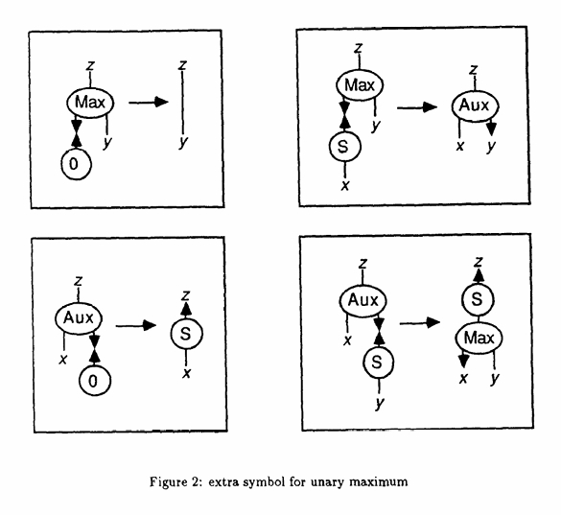

Slide 11
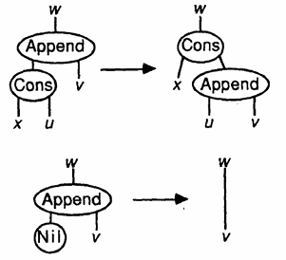
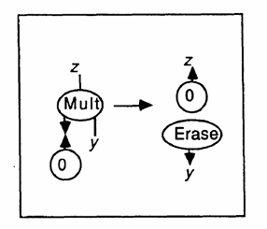
Linearity
Each variable occurs
once on the left side of a rule,
once on the right.
This means we need
explicit duplicate and erase symbols
for algorithms such as
unary multiplication.

Slide 12
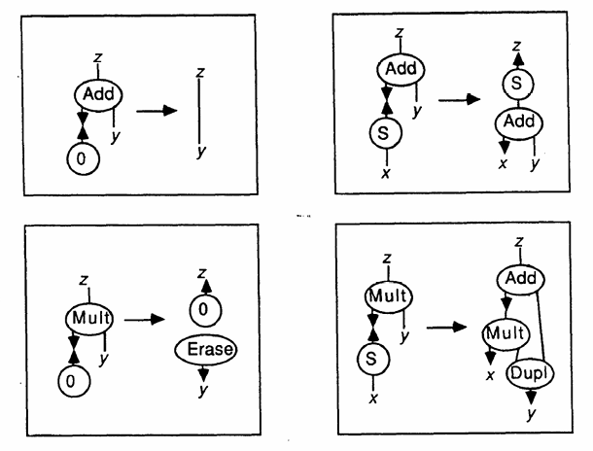
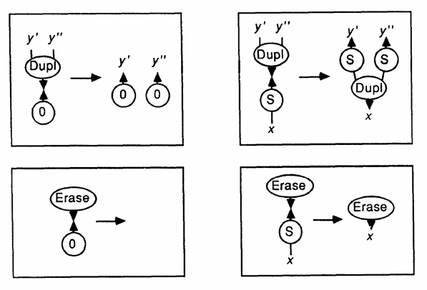
y + 0 = 0
(x + 1) + y =
(x + y) + 1
duplication of zero
duplication of successor
erasure of zero
erasure of successor
y * 0 = 0
(x + 1) * y = (x * y) + y

Slide 13
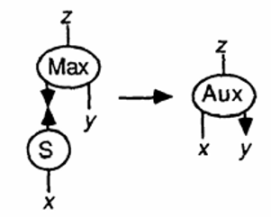
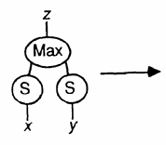
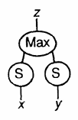

No ambiguity
There is at most one rule for
each pair of distinct symbols S, T,
and no rule for S, S.

Slide 14
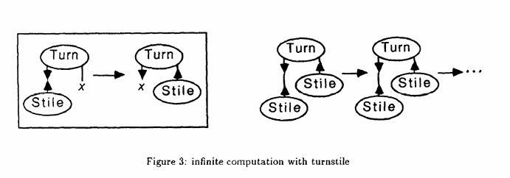
Optimisation
Right side of rules contain no alive pairs.
Note that this still allows non-terminating computation.

Slide 15
Example:
concatenation of difference-lists

Slide 16
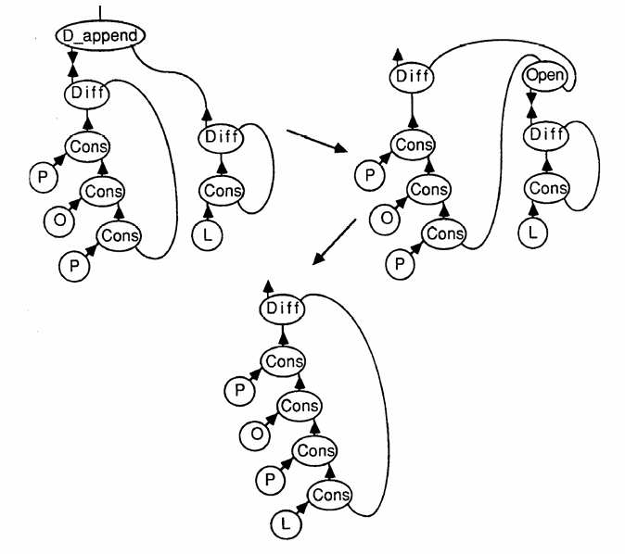
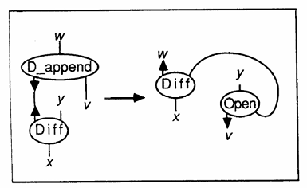
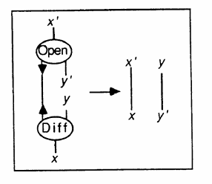














Some new rules
*Difference lists can be concatenated in constant time, compared to linear time for normal lists.

Slide 17
Example:
Polish notation parser

Slide 18
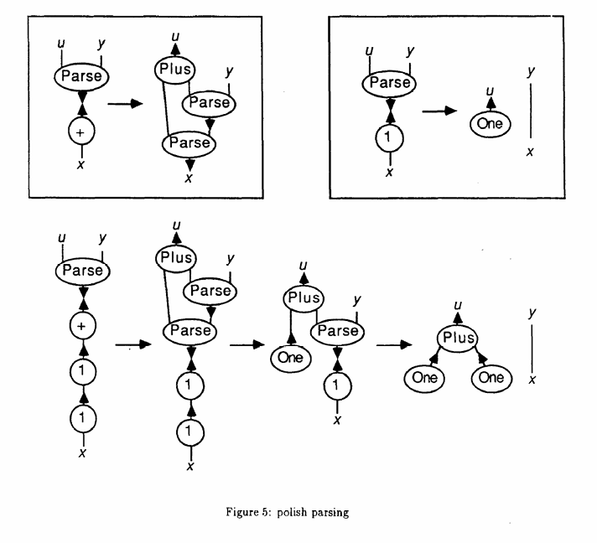
Converts 1 1 + into One Plus One

Slide 19
A Type Discipline

Slide 20
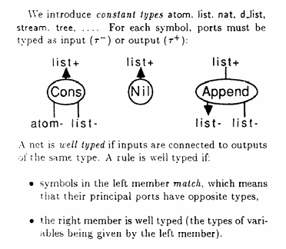
Constant types
Interacting ports must have matching pairs of outputs (i.e. list+ and list-)
Input/output denomination only matters for matching, not actual function

Slide 21
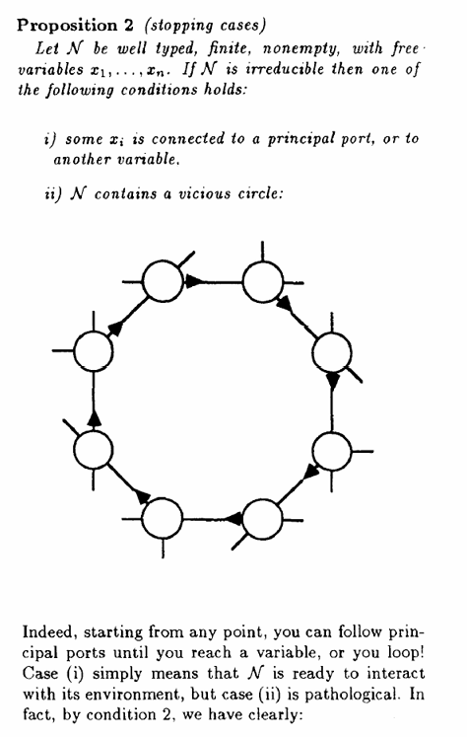
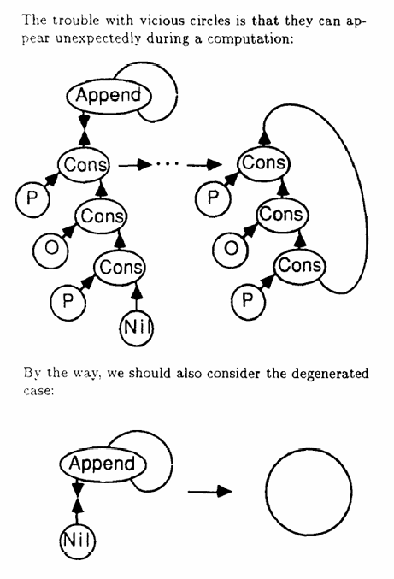

Deadlock

Slide 22
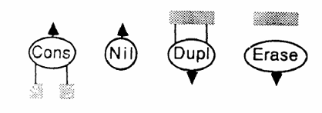
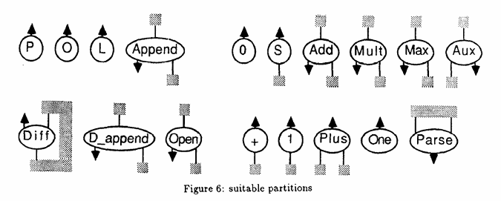
Partitions
Ports in the same partition must connect to the same net.
Ports in separate partitions must connect to different nets.
i.e. non-principal ports
A partition of the auxiliary ports must be given for each symbol.
A net will be called simple, and free of vicious circles, if it is constructed with the following operations…

Slide 23
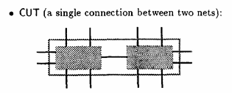



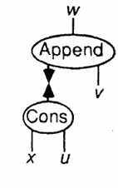
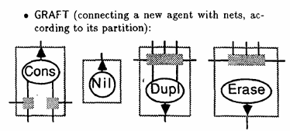
Operations
Base case: create an edge with two free variables
Connects free variables in separate nets
Each partition of the agent must connect to a different net (or be left free)

Slide 24
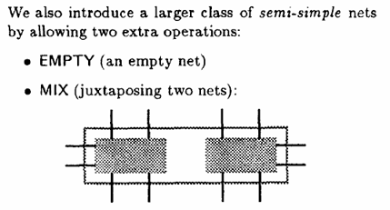
ok.

Slide 25
Programming Language Syntax

Slide 26
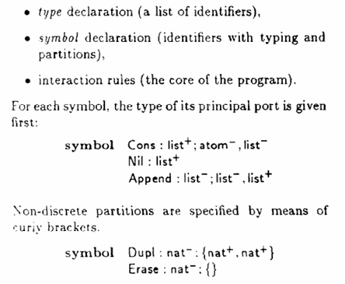
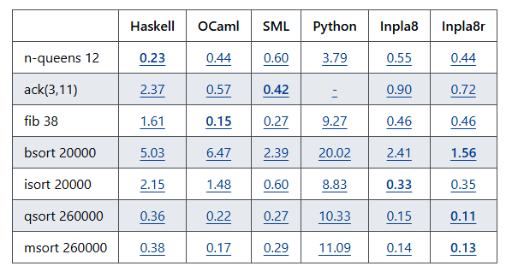
https://github.com/inpla/inpla

Slide 27
Conclusion

Slide 28
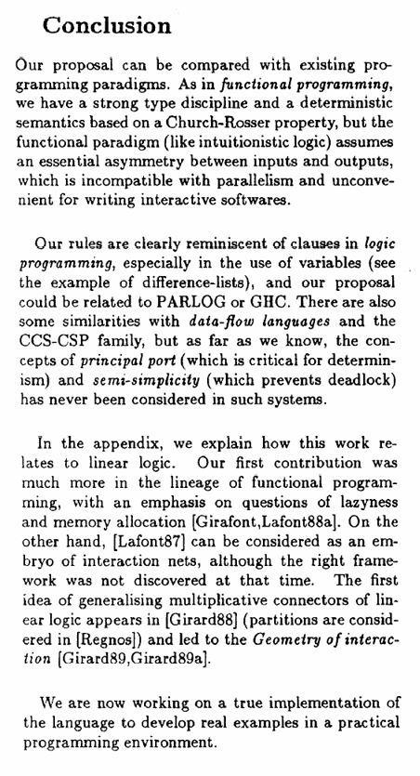

Slide 29
