Slide 1

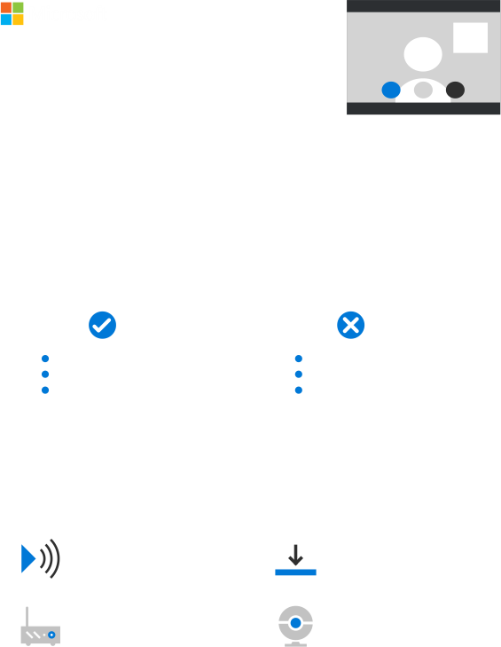
How to ace an online interview
Online job interviews have become the norm, with more than 70% of companies
conducting them regularly. Here’s how to ace your next one.
1. Perfect your profile pic
Make sure your online profile photo is appropriate.
Do
Don’t
Use a hi-res, well-lit photo
Dress professionally
Use a solid-colored, light
background
Leave your profile photo blank
Use an icon instead of a photo
Use a selfie or group shot
2. Upgrade your tech
A poor connection can ruin your prospects.
Make sure you have enough
bandwidth
Download the latest software
updates
Use a wired connection or
locate as close to your
router as possible
Use a hi-res camera and a
reliable headset or speaker

Slide 2

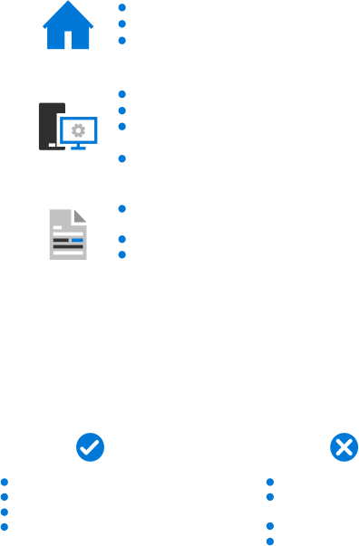
3. Prepare for the call
Thorough prep is essential to a successful online job interview.
Find a clean and quiet venue
Use a simple, light-colored background
Position the light source in front of you
Make a test call to check your equipment one day before
Adjust your webcam to frame your face
Check your privacy settings to make sure you can receive the
interviewer’s call
Close any programs not needed for the interview
Print a copy of your resume, and have a file ready to IM or
screen share
Place a sticky note with your talking points beside your webcam
Practice answering interview questions on camera
4. Hone your nonverbal skills
Your body language and tone of voice help convey meaning in addition to the
words you say.
Do
Don’t
Dress the part
Speak clearly and with a positive tone
Look at the camera, not the screen
Nod your head to show understanding
Frown or furrow your brow
Talk too loudly or softly into the
microphone
Slouch or lean backward
Position yourself too far or too
close to the camera

Slide 3


5. End on a positive note
The end of the interview is a chance to leave a lasting impression.
State your interest in the
position
Thank the interviewer for his
or her time
Ask if there is anything else you
can provide, like references or
work samples
Send a personalized thank you
email or letter
Ask about next steps in the
process and when to follow up
Sources: Futurestep Executive Survey 2015; Sandbox Advisors, Crack Your Video Interview, 2016;
Maxie McCoy, How to have an unforgettable Skype interview, 2016

