Slide 1
RAG-Driven Data Cleaning with PyDI
-Marmee Pandya
Notes:
Good morning everyone. My name is Marmee Pandya and today I will be presenting my seminar work on RAG-driven data cleaning using the PyDI framework. I will take you through the problem, what I built, and what the results tell us.

Slide 2
The Problem: Incomplete Product Data
Real-world product data are rarely complete.
Attributes like model numbers, storage speeds, and physical dimensions are missing for large fractions of records, sellers skip fields, scraping pipelines miss structured specs, different sources use different schemas.
Two approaches to fill them:
1. Ask the LLM from memory, works for general knowledge, fails for exact specs
2. Retrieve from a knowledge base, our approach
Notes:
Real-world product catalogues are rarely complete. Attributes like model numbers, read speeds, and physical dimensions are missing for large fractions of records. Sellers skip fields, scraping pipelines miss structured specs, and different sources use different schemas. There are two ways to approach this — ask the LLM from memory, which works for general knowledge but fails for exact product specs, or retrieve the answer from a knowledge base, which is what we do.

Slide 3
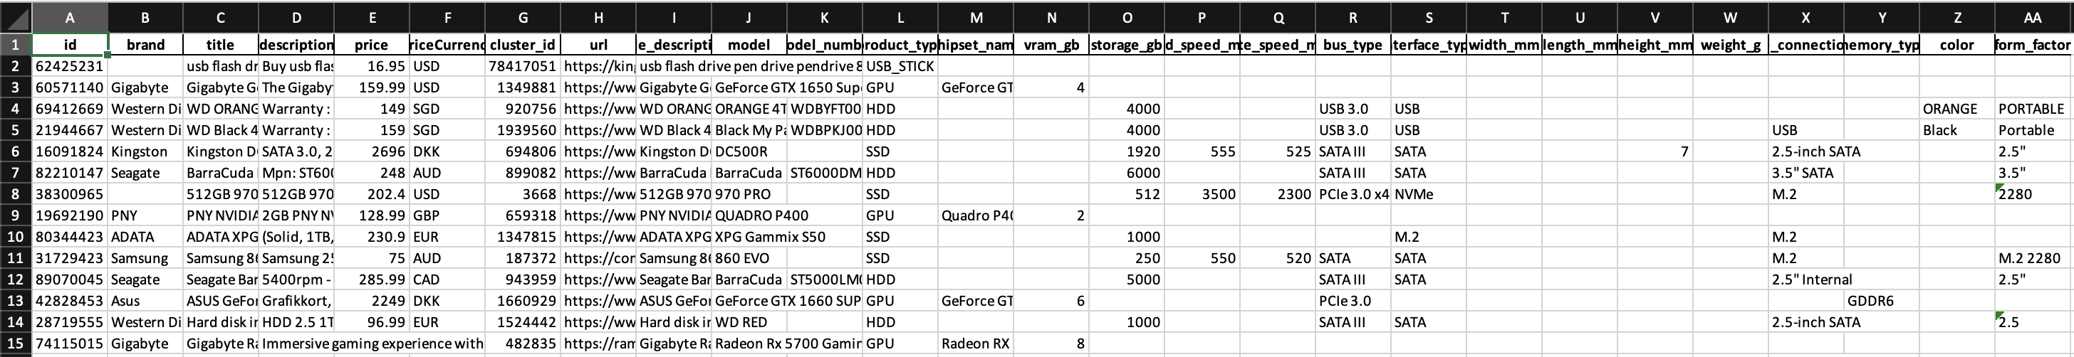
The Problem: Incomplete Product Data
Notes:
Here is a concrete example. This is a row from our dataset. Bus type is filled in but model number, read speed, write speed, height and width are all missing. These are not easy to guess — you cannot infer that a specific SSD reads at exactly 560 MB/s from its product title alone.

Slide 4
RetClean
LLMs alone struggle with data they have never seen but retrieval from a data lake fixes this.
Scenario 1
Scenario 2
Scenario 3
Cloud LLM only
Cloud LLM + retrieval
Local LLM + retrieval
Works for world knowledge.
Fails for enterprise / domain data.
Index data lake → retrieve top-n
→ re-rank → LLM extracts value.
Same as Scenario 2 but privacy-
preserving — no data leaves org.
Notes:
Before I describe what I built, let me give context on the work that inspired it — RetClean, published at VLDB 2024. The key insight is that LLMs are great at general knowledge but fail for enterprise data they have never seen. RetClean proposes three scenarios — cloud LLM only, cloud LLM with retrieval, and local LLM with retrieval for privacy. Our work is essentially Scenario 3 — a local Llama 3.1 8B combined with retrieval from a product knowledge base.

Slide 5
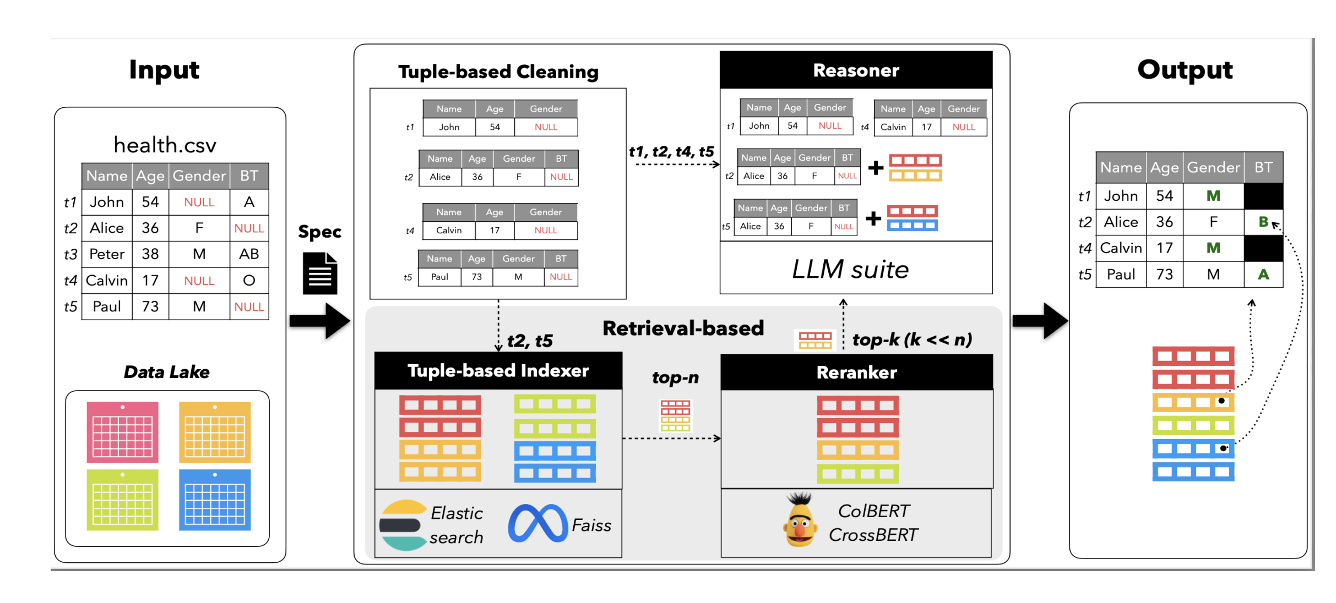
RetClean
Notes:
This is the RetClean pipeline. A query goes in, top-n candidates are retrieved from a data lake, a reranker selects the best ones, and an LLM extracts the value. Our system follows this design directly — and in experiments 4 and 5 we implement the two-stage retrieval exactly as RetClean proposes.

Slide 6
Dataset and Attribute Selection
Dataset 1 (query): 812 rows · Datasets 2–4 (KB): 2,200 rows combined · 25 query rows · 51 evaluation tasks
Attribute | Type
bus_type | Text
model | Text
model_number | Text
read_speed_mb_s | Numeric
write_speed_mb_s | Numeric
height_mm | Numeric
width_mm | Numeric
Notes:
Our dataset comes from the PyDI project. Dataset 1 is the query set with 812 rows. Datasets 2 through 4 form the knowledge base with 2,200 rows combined. I selected 25 query rows and 51 evaluation tasks across 7 attributes — three text and four numeric. The numeric attributes are particularly interesting because their values simply do not appear in product descriptions — they can only be found in structured KB fields.

Slide 7
Experimental Configurations
Exp 1
Exp 2
LLM-only Baseline
RAG
Llama 3.1 8B predicts from product title + description. No KB access. Establishes the floor.
MiniLM top-3 retrieval from 2,200-row KB. LLM extracts value from retrieved candidates.
Exp 4a
Exp 5
RAG + CrossEncoder Reranker
BGE-large + CrossEncoder
MiniLM retrieves top-20, CrossEncoder re-ranks to top-5. Inspired by RetClean's two-stage design.
Replaces MiniLM with BGE-large-en-v1.5. Adds description field. Improved response parser.
Notes:
I ran four configurations. Experiment 1 is a pure LLM baseline — no KB access, establishes the floor. Experiment 2 adds basic RAG with MiniLM top-3 retrieval. Experiment 4a adds CrossEncoder reranking, directly inspired by RetClean's two-stage design. Experiment 5 replaces MiniLM with BGE-large-en-v1.5, a retrieval-optimised embedding model, and adds the product description field for richer context.

Slide 8
System Architecture (BGE + Reranker)
Query
Product
→
BGE-large
Embed
→
Top-20
Candidates
→
CrossEncoder
Re-rank
→
Top-5
Candidates
↑
↓
Knowledge Base
2,200 rows
Llama 3.1 8B
Predict only
↓
Predicted
Value
Evaluation:
CrossEncoder similarity
(text attributes)
Rule-based ±10% tolerance
(numeric attributes)
Notes:
Here is the full pipeline for Experiment 5. The query product is encoded by BGE-large. We retrieve the top-20 most similar KB products by cosine similarity. The CrossEncoder then reranks those 20 pairwise to select the best 5, which go to Llama as reference products. Llama predicts using per-attribute few-shot prompts. For evaluation, text attributes use CrossEncoder similarity scoring and numeric attributes use a 10% tolerance rule. Everything runs locally on a bwUniCluster A100 GPU.

Slide 9
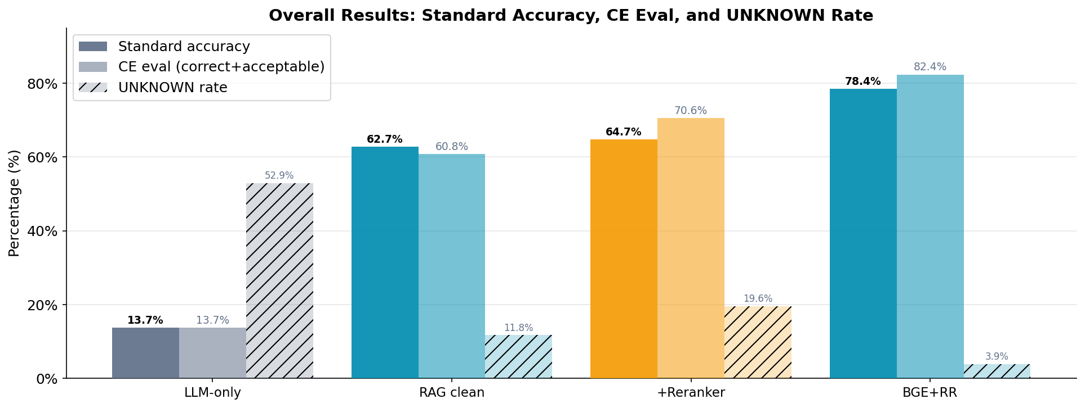
Overall Results
5×
RAG vs LLM-only improvement
3.9%
UNKNOWN rate: BGE+RR (best)
82.4%
CE eval: BGE+RR (best)
Semantic eval: LLM-based for Exp 1–2, CrossEncoder for Exp 4a–5 (removes self-evaluation bias).
Notes:
The results are clear. LLM-only achieves 15.7%. Basic RAG immediately jumps to 62.7% — a 4x improvement just from adding retrieval. The CrossEncoder reranker pushes this to 70.6%. BGE achieves 78.4% standard accuracy and 82.4% semantic evaluation — the best of all configurations. The UNKNOWN rate for BGE is only 3.9% — BGE almost never refuses to answer. One important note at the bottom — experiments 1 and 2 use LLM-based semantic evaluation, while 4 and 5 use CrossEncoder evaluation which removes self-evaluation bias.

Slide 10
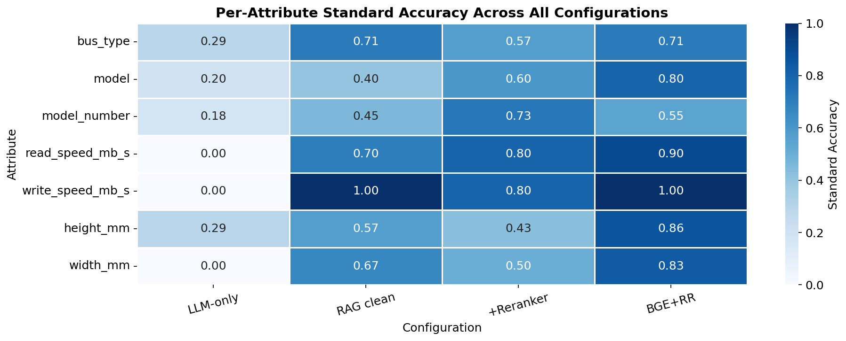
Per-Attribute
Notes:
This heatmap shows the full per-attribute breakdown. The pattern is clear — all numeric attributes start at zero for LLM-only and improve dramatically with retrieval. Model_number benefits most from CrossEncoder reranking. BGE performs particularly well on dimension attributes — height and width — which were the hardest attributes in earlier configurations.

Slide 11
Numeric Attributes Need Retrieval
0%
90%
100%
83%
LLM-only on ALL
numeric attributes
read_speed
+Reranker & BGE
write_speed
with RAG & BGE
width_mm
with BGE+RR
Notes:
This is the most important single finding. LLM-only achieves exactly 0% on every numeric attribute. Not low — zero. There is nothing to extract from a product description. With retrieval these values are found verbatim in structured KB fields and the LLM simply copies the right number. Read speed goes from 0 to 90%. Write speed reaches 100% with basic RAG. Width_mm reaches 83% with BGE.

Slide 12
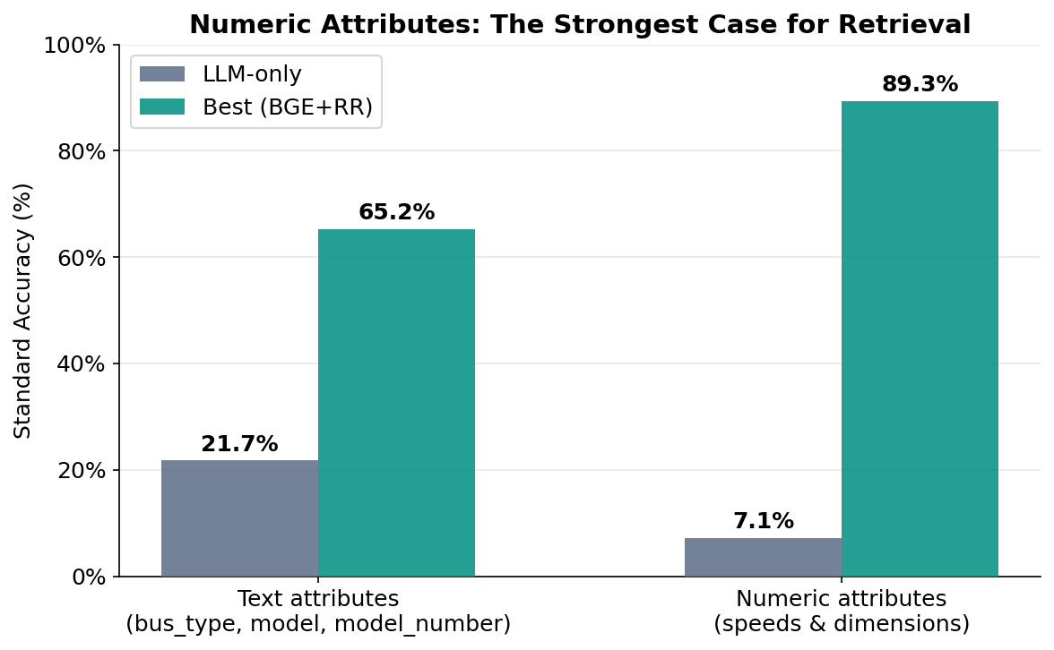
Text vs Numeric: Where RAG Helps Most
Notes:
This chart summarises the contrast between text and numeric attributes. For text attributes the LLM already has some baseline ability — bus_type is 28% for LLM-only because the LLM understands PCIe and SATA. For numeric attributes the baseline is literally zero. Retrieval helps both categories but the gain is far more dramatic for numerics.

Slide 13
Conclusion
01
RAG transforms data cleaning from guesswork into retrieval
Every configuration with KB access outperforms LLM-only by a large margin, 15.7% to 78.4%.
02
Numeric attributes are where retrieval matters most
Speeds and dimensions score 0% via LLM. Once retrieval finds the right product, the LLM simply copies the value.
03
Two-stage retrieval helps but has trade-offs
CrossEncoder reranking improves model_number (18% → 73%) but BGE recovers more dimension values. Neither dominates completely.
04
The bottleneck is retrieval precision
Failures occur when CrossEncoder selects a highly similar but wrong product variant
05
Future work: better entity resolution and stronger rerankers
Replacing the CrossEncoder with a fine-tuned product matching model and using consistent cluster IDs across source datasets would address the remaining near-identical SKU failures.
Notes:
To summarise. RAG transforms data cleaning from guesswork into retrieval — 15.7% to 78.4%. Numeric attributes are where retrieval matters most — impossible without a KB, trivial with one. Two-stage retrieval has trade-offs — CrossEncoder helps model_number, BGE helps dimensions, neither dominates completely. The remaining bottleneck is retrieval precision — failures occur when the CrossEncoder selects the wrong product variant, not because the value is missing from the KB. And future work should focus on fine-tuned product matching models and consistent entity resolution.

Slide 14
Thank you
Questions?
Notes:
Thank you. I am happy to take questions.

