Slide 1
DATASET COMPATIBILITY CHECK
Can PDL replace the GOI
for an open-source paper?
Checking whether People Data Labs' Free Company Dataset can stand in for ISTARI's proprietary GOI in a companion paper derived from this thesis.
Marmee Pandya
Draft for discussion with Ralph · October 2026

Slide 2
WHY THIS MATTERS
The thesis runs on data nobody else can reuse.
Every result in this thesis depends on ISTARI's Global Organisation Index. A companion paper needs a dataset other researchers can actually get their hands on.
GOI (this thesis)
PDL Free Company Dataset
~20M companies. Proprietary to ISTARI. Not something a published paper can point readers to.
→
~23M companies. Publicly downloadable. The obvious candidate, if it actually resembles GOI closely enough.
The rest of this deck is the evidence for whether that "if" holds.

Slide 3
METHODOLOGY
How we tested it
GOI SIDE
PDL SIDE
300,000
35,828,989
A random, query-independent sample, not the 101-query corpus used elsewhere in the thesis. Chosen so the comparison reflects GOI's overall makeup rather than a search-topic-skewed slice.
Every row in PDL's public file. Streamed line by line rather than loaded at once, the file is 10.7GB, too large to hold in memory as a table.
Join key: normalised domain / website (lowercase, protocol and "www." stripped, path removed). This is what every overlap figure in this deck is built on.

Slide 4
SCHEMA COMPARISON
Field by field, where they match
Based on inspecting both schemas directly. Red rows are the ones that matter most.
GOI field | PDL field | Note
domain | website | join key for overlap
name | name | direct match
country | country | direct match
state | region | approximate match
district / municipality | locality | GOI has two finer levels
organization_size | size | bucket boundaries differ
nace_code | industry | different taxonomies entirely
organization_type | — | no PDL equivalent
— | founded | no GOI equivalent
— | linkedin_url | no GOI equivalent
summary | — | MISSING: the field this thesis’ retrieval method depends on most
summary_keywords | — | MISSING: derived from summary, same gap

Slide 5
THE HEADLINE NUMBER
40.4%
of the GOI's random company sample is also findable in PDL, matched by domain
121,300
23.1M
0.53%
GOI companies found in PDL
unique companies in PDL, bigger than GOI's full ~20M
of PDL matched, expected, the GOI sample is a tiny slice of PDL's size

Slide 6
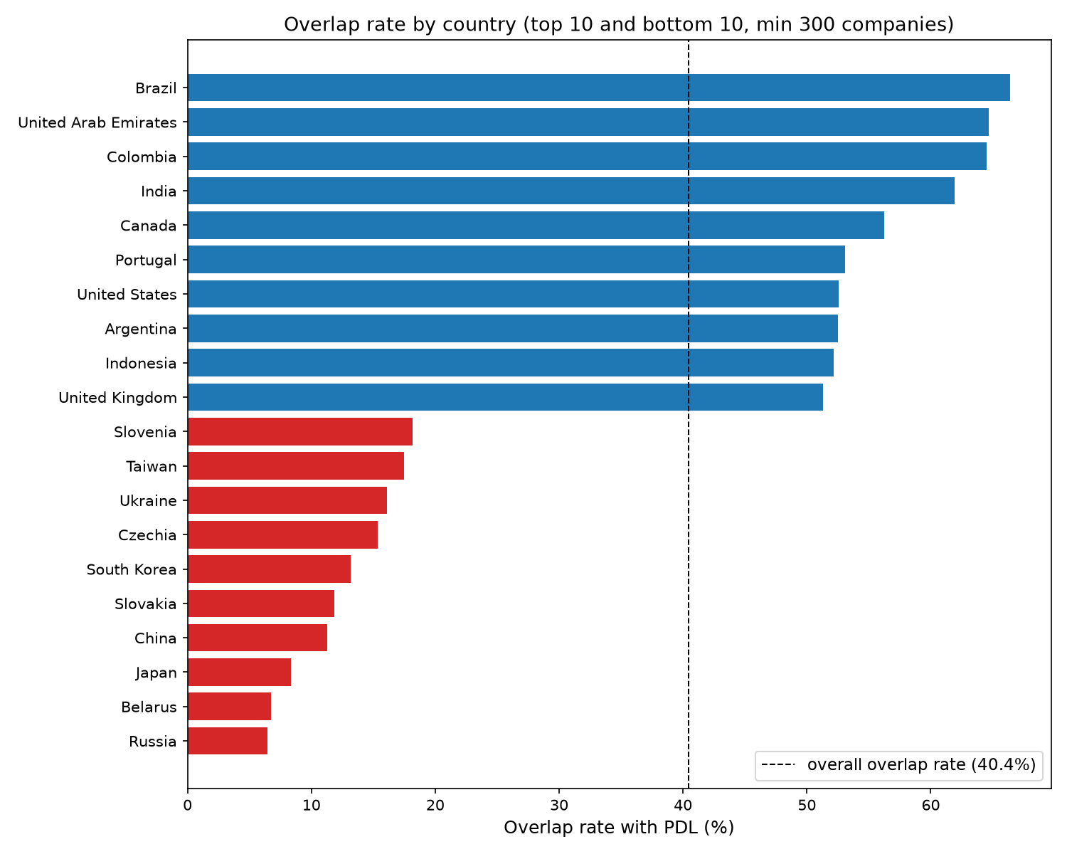
WHERE IT BREAKS DOWN
Geography is the weak point
Overlap rate ranges from 66% in Brazil down to 6% in Russia, a 10× spread. The Americas, India, and the UK are well covered. East Asia and Eastern Europe are not.
Germany, GOI's #2 country by volume, sits at just 29.8% overlap, well below the 40.4% average.

Slide 7
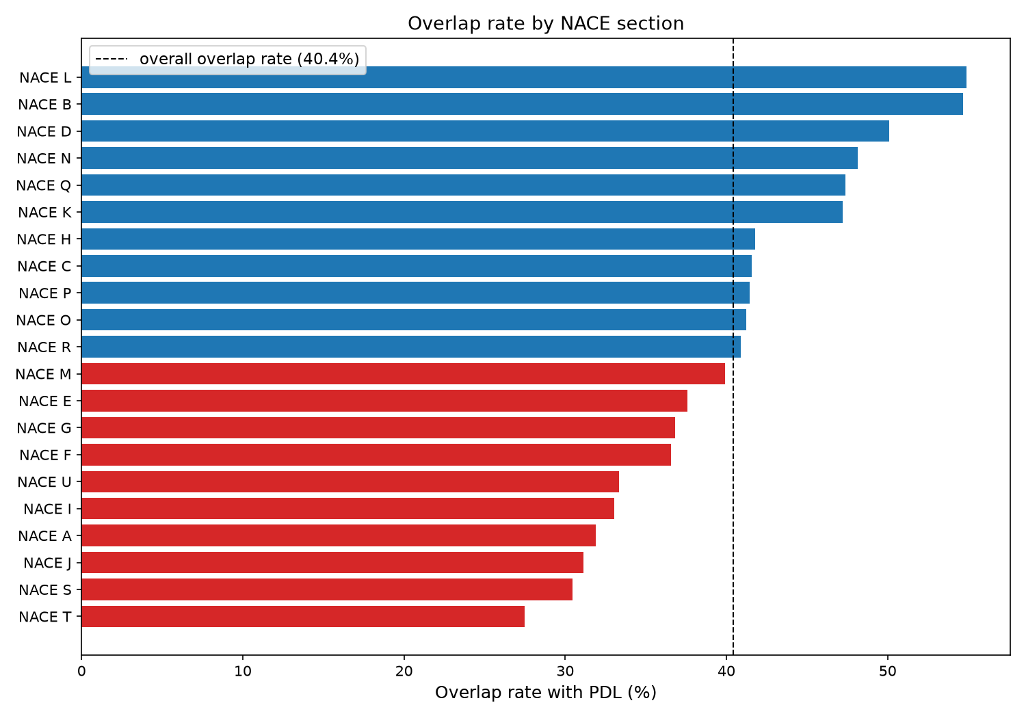
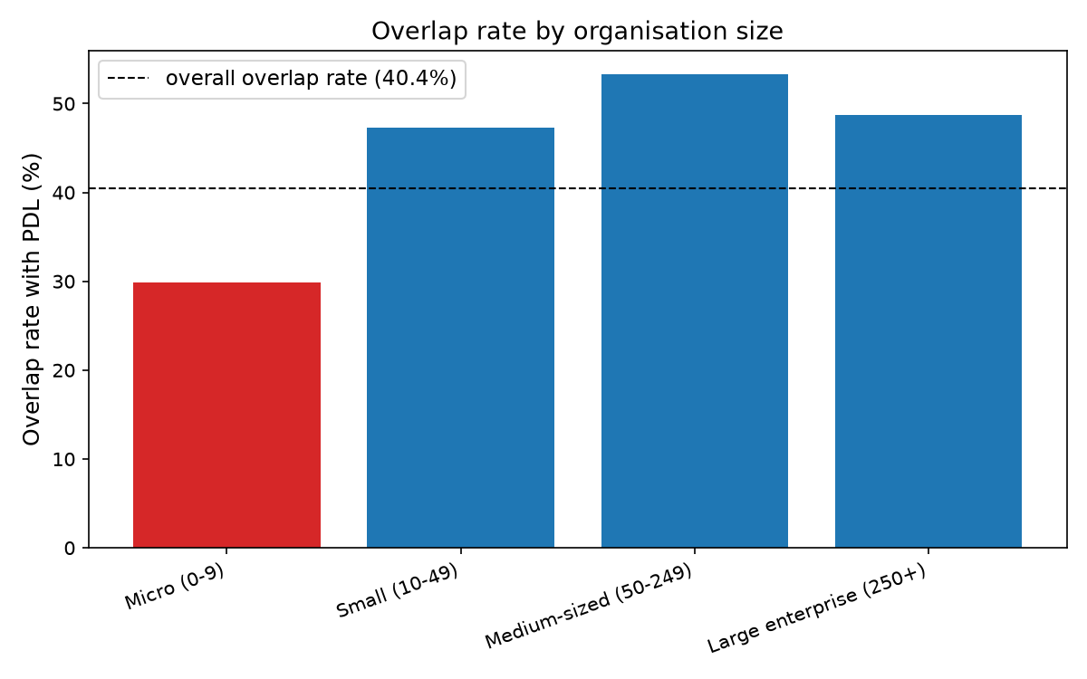
WHERE IT HOLDS UP
Industry is fine. Company size is not.
Not every dimension breaks down the way geography does.
By NACE section
By organisation size
Micro companies (0-9 employees) sit at 30%, well below Small/Medium/Large (47-53%), and Micro is GOI's largest size bucket.
Spread is 27-55%, roughly 2×, not 10×. No industry is badly abandoned by PDL.

Slide 8
THE CRITICAL GAP
PDL has no description field at all.
This thesis's entire retrieval approach is built on embedding the summary field, an AI-generated description of what each company actually does. Confirmed directly from PDL's schema, that field simply doesn't exist.
PDL'S FULL SCHEMA
id, website, name, founded, size, locality, region, country, industry, linkedin_url

Slide 9
VERDICT
A real substitute, with two real caveats.
Holds up
Doesn't hold up
What it means
40.4% direct domain overlap on a random sample
PDL is larger than GOI overall (23.1M vs ~20M)
Industry coverage is fairly even (27-55%)
Most firmographic fields map cleanly
No description field, the one GOI field this thesis's method depends on most
Geography is wildly uneven (6-66%)
Weakest exactly where GOI is biggest: micro companies
PDL is a defensible substitute for company identity, not yet for the retrieval task itself
Scope and a text-sourcing plan are the open questions, not whether PDL is usable at all

Slide 10
FOR DISCUSSION
Three ways forward
1
Scope the PDL corpus to where it's strong
Restrict the paper's PDL-derived sample to well-covered countries and company sizes, and say so explicitly as a limitation.
2
Source descriptions separately
Scrape company websites and generate summaries the same way GOI's own pipeline does, budget this as real added work, not a footnote.
3
Use PDL for identity only
Treat PDL as the public company list, pair it with freshly generated text, rather than expecting it to be a drop-in GOI replacement.
"Given the time left, which of these is worth committing to for the paper?"

