Slide 1

KPMG NLP Skill Assessment
Marcos Martínez Galindo

Slide 2

Data Insights
Approach Overview
Results & Metrics
Next Steps
Demo
KPMG NLP Skill Assessment
Marcos Martínez Galindo

Slide 3

Data Insights
Queries about movies - BIO Labelled
Complex queries & entities
find O
action B-GENRE
movies O
featuring O
comic B-PLOT
book I-PLOT
characters I-PLOT
did O
gwyneth B-ACTOR
paltrow I-ACTOR
play O
a O
mathematician B-PLOT
in O
a O
movie O
with O
anthony B-ACTOR
hopkins I-ACTOR
Different types of PLOT
PLOT
or
CHARACTER?
KPMG NLP Skill Assessment
Marcos Martínez Galindo

Slide 4
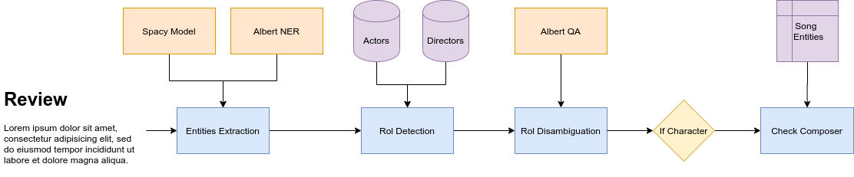
Approach Overview
Machine Learning + Deep Learning + Regular Expressions + Knowledge resources
KPMG NLP Skill Assessment
Marcos Martínez Galindo

Slide 5
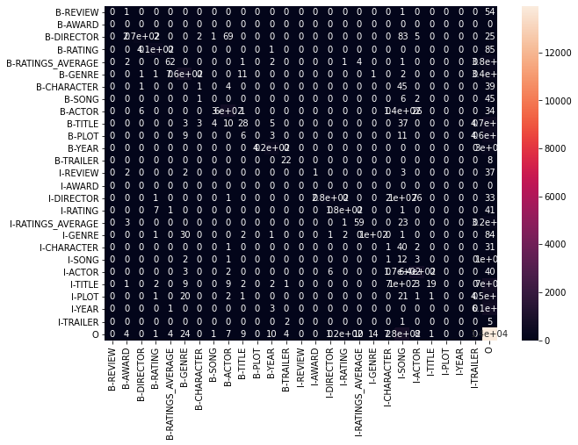
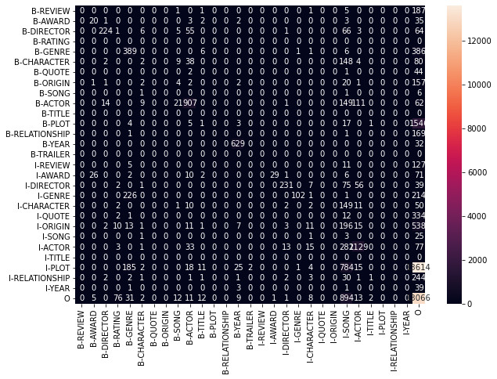
Results & Metrics
engtest.bio
f1-score: 0,68
trivia10k13test.bio
f1-score: 0,74
KPMG NLP Skill Assessment
Marcos Martínez Galindo

Slide 6
Next Steps
Retrain LM with movie reviews - Domain Adaption
Truecaser to solve the casing problems
Train NER names in lowercase
Use Levenshtein distance
To improve regular expressions
To augmentate knowledge resources
KPMG NLP Skill Assessment
Marcos Martínez Galindo

Slide 7

DEMO
http://mmartgal.ddns.net:5000

