Slide 1
ICT304 · ASSESSMENT 3
WeatherGrid
Distributed IoT Weather Monitoring System
Reliable local weather telemetry from sensor node to live web dashboard.
MQTT QoS 1
Edge buffering
Live SSE
PostgreSQL
Group [INSERT NUMBER]
[INSERT NAMES AND STUDENT IDs]
15-minute presentation
Notes:
Presenter 1, 30 seconds. Introduce the group and one-sentence project purpose. Do not explain the architecture yet.

Slide 2
02
Problem and project objectives
Why a distributed weather platform is needed
The problem
Technical challenge
Our objective
Broad public forecasts may not represent a specific farm, campus or facility. Local operators need current, site-level observations and alerts, even when connectivity is unreliable.
Sensors are geographically distributed. Messages may be delayed or duplicated. Multiple users need consistent, secure access while services can fail independently.
Collect six weather measures from multiple stations, deliver them reliably, store each reading once, detect abnormalities and present live information through an authenticated web application.
ICT304 | WeatherGrid
2
Notes:
Presenter 1, 75 seconds. Explain the user problem first, then connect it to distributed-system concerns: independent nodes, unreliable links, duplicates and concurrent users.

Slide 3
03
Solution at a glance
Three stations, one fault-tolerant data path
SYDNEY
MELBOURNE
BRISBANE
WX-SYD-001
WX-MEL-001
WX-BNE-001
Temperature · Humidity · Pressure · Rainfall · Wind speed · Battery
1
→
2
→
3
→
4
→
5
Publish
Validate
Persist
Alert
Visualise
ICT304 | WeatherGrid
3
Notes:
Presenter 1, 60 seconds. State that current nodes are software simulators with interfaces designed for future ESP32 hardware.

Slide 4
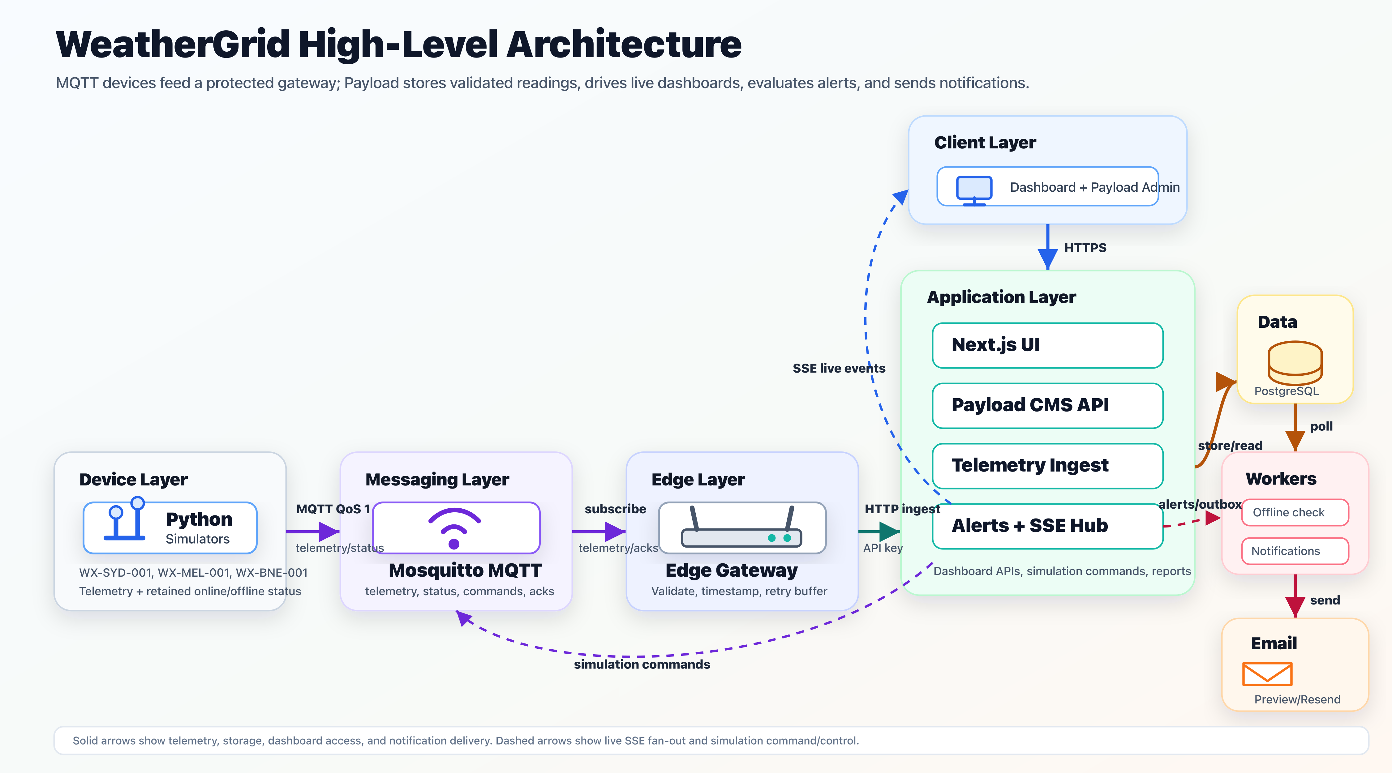
04
High-level architecture
Independent layers communicate through explicit contracts
ICT304 | WeatherGrid
4
Notes:
Presenter 2, 2 minutes. Trace the solid path left to right. Then explain dashed SSE fan-out and simulation commands. Emphasise that each layer can fail or scale independently.

Slide 5
05
How weather data is collected
Current simulator and future physical-node design
MEASURE
EXAMPLE SENSOR
CONNECTION
UNIT
Temperature / humidity
DHT22 or BME280
Digital bus
°C / %
Atmospheric pressure
BME280
I²C
hPa
Rainfall
Tipping-bucket gauge
Pulse input
mm
Wind speed
Cup anemometer
Pulse / ADC
km/h
Battery
Voltage divider
ADC
%
Prototype truth: these values are currently generated by independent Python device processes. Physical calibration is future work.
ICT304 | WeatherGrid
5
Notes:
Presenter 2, 75 seconds. Clearly distinguish simulated sensors from proposed physical sensors. Explain that the ESP32 reads interfaces, converts units, attaches metadata and publishes via Wi-Fi.

Slide 6
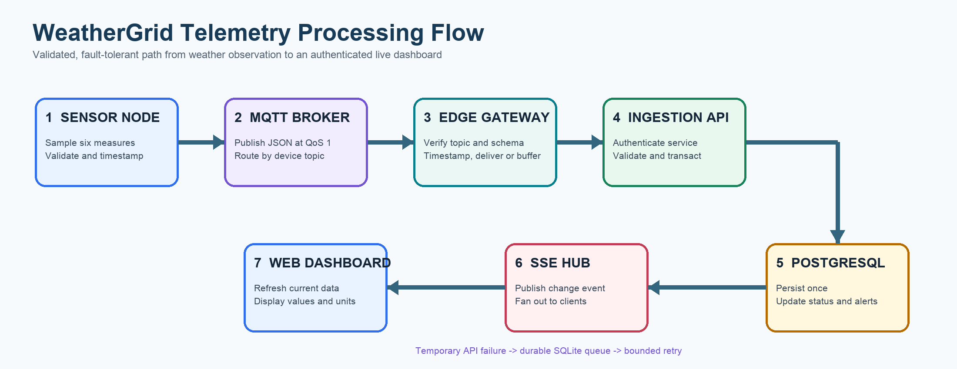
06
End-to-end telemetry flow
From observation to a value displayed with units
Failure path: SQLite queue → bounded retry
ICT304 | WeatherGrid
6
Notes:
Presenter 2, 90 seconds. Walk through all seven steps. Explain that SSE signals a change and the dashboard then refreshes current data.

Slide 7
07
Distributed computing principles
The design choices that make WeatherGrid reliable
Decoupling
Fault tolerance
MQTT publishers do not know which consumer receives the message. Broker topics separate devices from the application.
The edge gateway stores temporary failures in SQLite and retries using bounded exponential backoff.
Idempotency
Concurrency and fan-out
QoS 1 can redeliver. Device ID plus sequence number prevents a repeated message from creating a second reading.
PostgreSQL transactions protect shared state. SSE distributes live change events to authenticated browser clients.
ICT304 | WeatherGrid
7
Notes:
Presenter 2, 90 seconds. This slide directly addresses ICT304. Define idempotency in plain language: repeating the same operation has no additional effect.

Slide 8
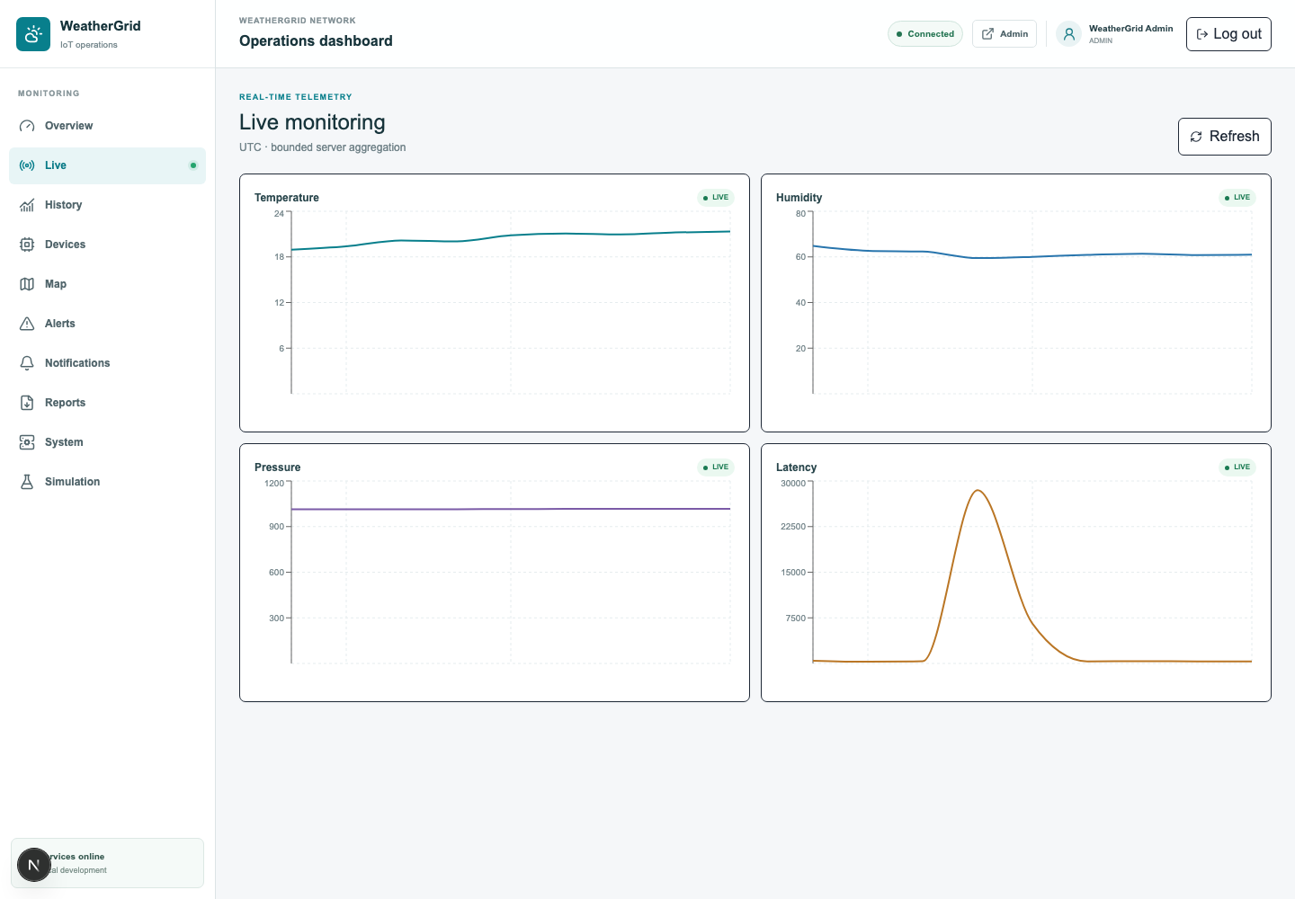
08
Working prototype
Responsive live monitoring with explicit engineering units
Monitor
Overview, live values, history and map
Operate
Devices, alerts, notifications and reports
Demonstrate
Controlled scenarios and acknowledgements
Admin + viewer roles
ICT304 | WeatherGrid
8
Notes:
Presenter 3, 60 seconds. This is a real authenticated screenshot. Mention Celsius, percent, hPa, millimetres, kilometres per hour and battery percent.

Slide 9
09
Security and data integrity
Separate identities and validation at every trust boundary
Human access
Payload sessions with admin and read-only viewer roles
Machine access
Dedicated edge-gateway service account and API key
Validation
Strict schemas, 16 KiB limit, ranges and timestamp ordering
Integrity
UUID messages, persistent sequences, unique database constraint
Local safety
Development MQTT port bound to loopback only
Production requirement
MQTT over TLS, per-device credentials and secret rotation
ICT304 | WeatherGrid
9
Notes:
Presenter 3, 75 seconds. Do not show real .env values. State clearly that the current broker configuration is development-only and production requires TLS.

Slide 10
10
Testing and evaluation
Reproducible evidence from every implemented layer
Web logic
8 passed
Live verification
3 devices
3 locations
4,531 stored readings
53 alert records
Latest values received concurrently from Sydney, Melbourne and Brisbane on 24 Sep 2026.
Gateway
7 passed
Simulator
27 passed
42 automated tests passed
TypeScript: pass
ESLint: pass
Infrastructure: healthy
ICT304 | WeatherGrid
10
Notes:
Presenter 3, 90 seconds. Explain that tests cover invalid data and failure paths, not only successful input. The database count is a point-in-time observation and may be higher during the live demo.

Slide 11
11
Challenges, solutions and learning
How implementation problems improved the architecture
Duplicate MQTT delivery
→
Database idempotency key
→
Transport guarantees require application semantics
Temporary server outage
→
Durable SQLite edge queue
→
Reliable systems preserve state across failures
Silent offline device
→
Scheduled last-seen worker
→
Absence of data is also an operational signal
Untrusted input
→
Layered schema and identity checks
→
Validate at every distributed boundary
Key learning: reliability is a chain of identity, validation, ordering, durable state, retries and observability.
ICT304 | WeatherGrid
11
Notes:
Presenter 3, 75 seconds. Choose two challenges to explain in detail; summarise the remaining two to stay on time.

Slide 12
LIVE PROTOTYPE DEMONSTRATION
Five-minute path through the complete system
01
Sign in
Open Overview and confirm three online stations
02
Observe
Open Live Monitoring and explain values and units
03
Trigger
Simulation → high temperature on one station
04
Verify
Observe alert, acknowledge it, then reset normal
05
Evidence
Open History/Reports and show the stored reading
Fallback
Use saved screenshot and test evidence
Never display passwords, API keys or the .env file during the demonstration.
Notes:
All presenters, 5 minutes. Rehearse with a timer. Start all services before class. Keep this slide visible only while introducing the demo, then switch to the browser. If the system fails, use the screenshot and explain the verified test results.

Slide 13
13
Conclusion and future work
What we achieved and how the prototype can evolve
Objectives achieved
Next steps
✓ Multi-station telemetry
✓ MQTT publish/subscribe transport
✓ Durable edge buffering and retry
✓ Idempotent PostgreSQL persistence
✓ Live dashboard, alerts and reports
✓ Role-based access and audit evidence
✓ 42 passing automated tests
1. Calibrated ESP32 sensor stations
2. MQTT over TLS and per-device certificates
3. Cloud deployment and high availability
4. Load, packet-loss and failover testing
5. Predictive anomaly detection
6. Progressive web application notifications
WeatherGrid demonstrates a complete, testable distributed IoT path from observation to action.
ICT304 | WeatherGrid
13
Notes:
Presenter 1, 60 seconds plus questions. Reconnect the conclusion to the original problem and avoid introducing new technical detail.

Slide 14
Questions
Thank you
WeatherGrid · Distributed IoT Weather Monitoring System
Architecture · Reliability · Live monitoring
Notes:
Invite questions. Be prepared to explain MQTT QoS 1, why duplicates occur, what happens when the Internet fails, the difference between admin and viewer, and which sensors would be used in physical hardware.

