Slide 1
ICT304 DISTRIBUTED COMPUTING
WeatherGrid
Distributed IoT Weather Monitoring System
Local weather data delivered reliably from simulated devices to a live web dashboard.
3 stations
MQTT messaging
Edge gateway
Live dashboard
Group [NUMBER]
[ADD FIVE MEMBER NAMES AND STUDENT IDs]
15-minute presentation
Notes:
Member 1, 15 seconds: Good morning. We are presenting WeatherGrid, a distributed IoT weather monitoring system. It collects local weather data and shows it on a live web dashboard.

Slide 2
02
The problem
Why did we build WeatherGrid?
Local weather changes
Devices can lose connection
Users need clear information
Public forecasts cover large areas. A farm, campus or workplace may need weather information for its exact location.
Weather devices may disconnect. Messages can be delayed, lost or sent more than once.
People need live readings, warnings, history and reports in one simple and secure application.
Our goal: reliable local monitoring that continues to work during short failures.
ICT304 · WeatherGrid
2
Notes:
Member 1, 45 seconds: Explain these three problems in simple words. Finish by saying that reliability is important because devices and networks are not always available.

Slide 3
03
Project objectives
What should the system do?
• Collect six weather measurements
• Support several weather stations
• Show live and historical data
• Detect warning and critical conditions
• Avoid duplicate database records
• Keep messages during short outages
• Protect admin and viewer access
• Provide reports and a test laboratory
Working prototype + testing + live demonstration
ICT304 · WeatherGrid
3
Notes:
Member 1, 30 seconds: Present the objectives as outcomes. Point out that the system must remain reliable when messages are repeated or delayed.

Slide 4
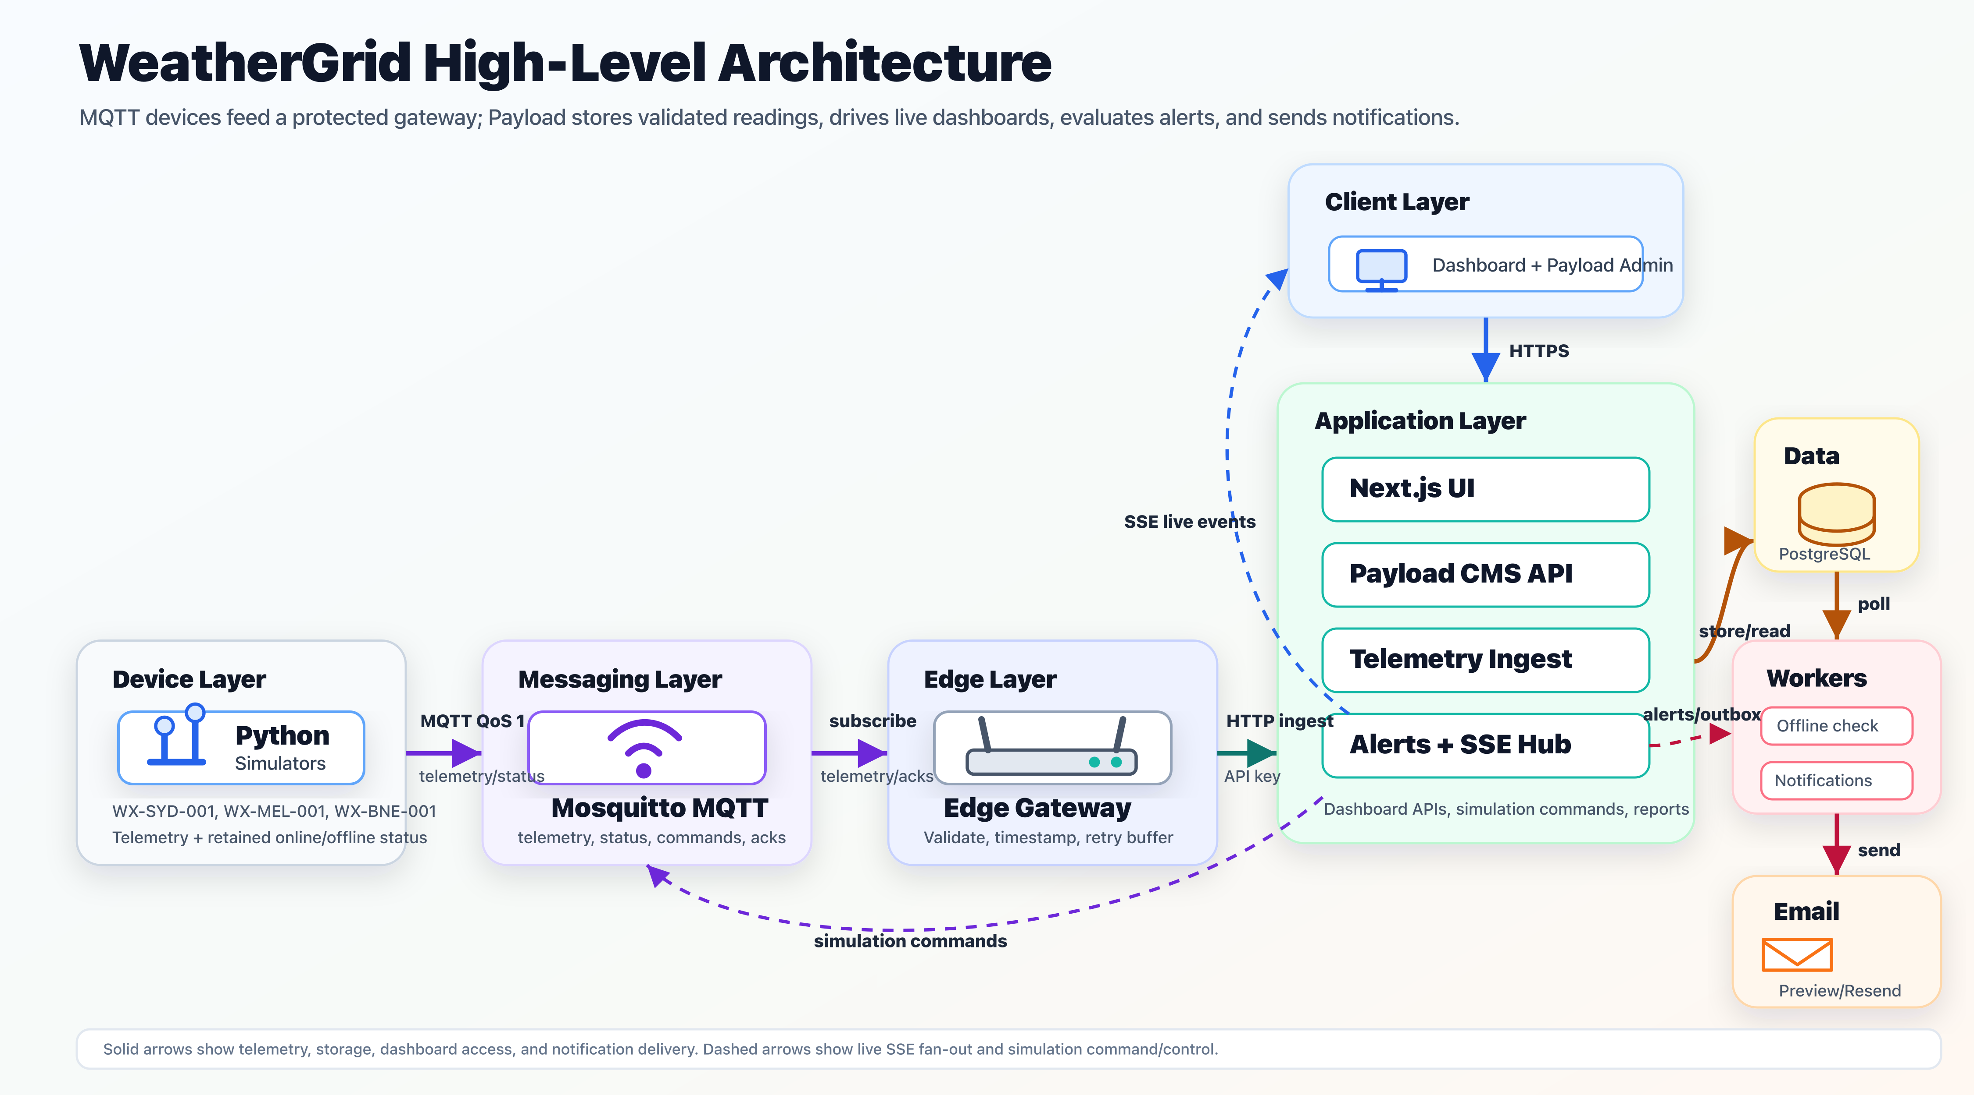
04
System design
Seven parts work together as one distributed system
ICT304 · WeatherGrid
4
Notes:
Member 2, 90 seconds: Move from left to right. Simulators create data. Mosquitto routes MQTT messages. The gateway validates and forwards them. Next.js and Payload process the data. PostgreSQL stores it. Workers check offline devices and notifications. The browser displays the result.

Slide 5
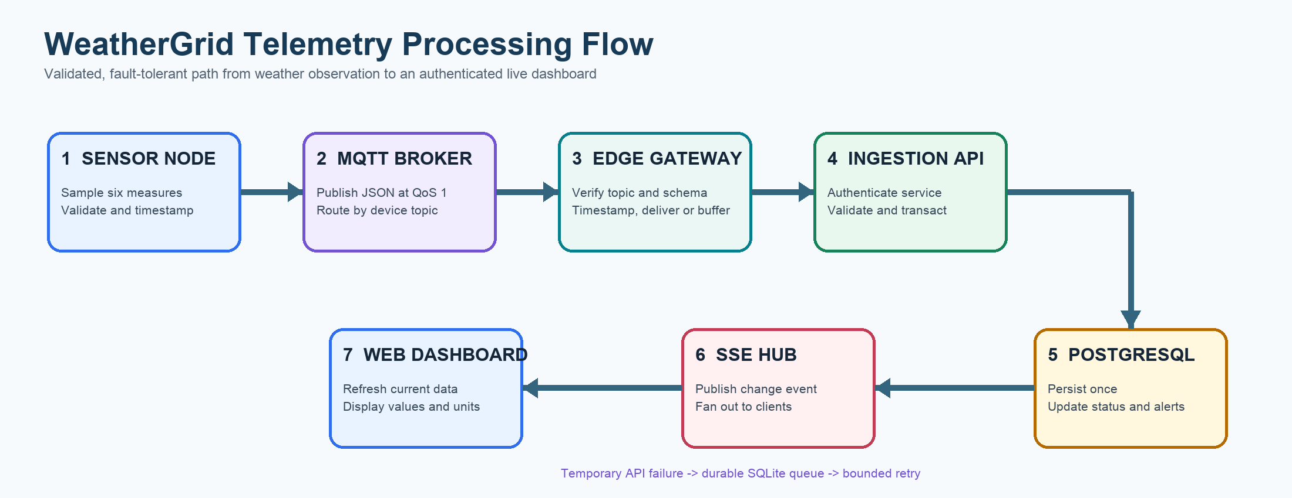
05
How one reading moves through the system
A simple start-to-end flow
Temporary failure → save in SQLite → retry later
ICT304 · WeatherGrid
5
Notes:
Member 2, 60 seconds: Explain the seven numbered steps. Mention that the gateway saves data in SQLite if the backend is unavailable. The browser receives a live update after storage.

Slide 6
06
Our working prototype
Three simulated stations using a realistic IoT message format
Sydney
Melbourne
Brisbane
WX-SYD-001
Independent Python process
WX-MEL-001
Independent Python process
WX-BNE-001
Independent Python process
Temperature · Humidity · Pressure · Rainfall · Wind speed · Battery
The current weather values are simulated. The timestamps are real. Future ESP32 devices can use BME280/DHT22, a rain gauge, an anemometer and a battery sensor.
Same message format for simulated or physical devices
ICT304 · WeatherGrid
6
Notes:
Member 3, 45 seconds: Be clear that the sensors are simulated. Explain that each station runs separately and publishes realistic test values. Physical sensors can replace the simulator without changing the backend message contract.

Slide 7
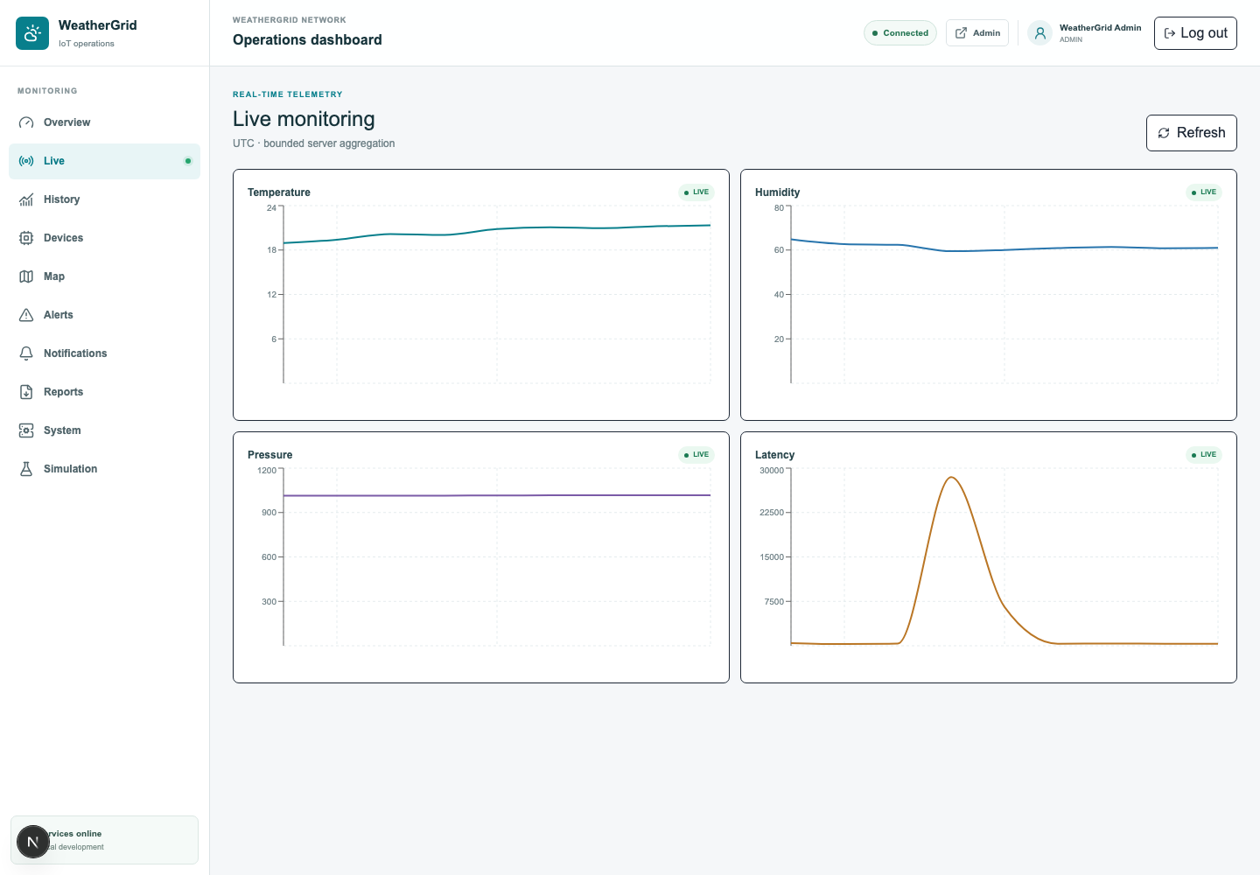
07
Web application
Live information for viewers and control tools for administrators
Monitor
Live readings, history and map
Respond
Alerts, device status and notifications
Manage
Reports, users and simulation commands
Responsive web application
ICT304 · WeatherGrid
7
Notes:
Member 3, 30 seconds: This is a screenshot of the running prototype. Explain the units: Celsius, percent, hectopascals, millimetres, kilometres per hour and battery percent.

Slide 8
08
Why the system is reliable and secure
Important distributed computing decisions
Reliable delivery
No duplicate readings
MQTT QoS 1 improves delivery. SQLite keeps messages when the backend is temporarily unavailable.
Device ID and sequence number identify the same message, so retries are stored only once.
Validation
Access control
Pydantic and Zod check fields, ranges, IDs and timestamps before data is accepted.
Admins manage the system. Viewers can monitor it. The gateway uses a separate machine account.
ICT304 · WeatherGrid
8
Notes:
Member 4, 60 seconds: Define duplicate prevention simply: sending the same reading again does not create another database row. Mention that production MQTT would require TLS and per-device credentials.

Slide 9
09
Testing and findings
Evidence that the prototype works
Web logic
8 passed
Main findings
• Three devices send data together
• Live values update correctly
• Alerts respond to test scenarios
• Duplicate and outage handling works
• Data remains available for history and reports
Gateway
7 passed
Simulator
27 passed
42 automated tests passed
TypeScript passed
ESLint passed
Services healthy
ICT304 · WeatherGrid
9
Notes:
Member 4, 45 seconds: Explain that tests include bad data and failure cases, not only normal readings. State the total of 42 tests and show that all main services were healthy.

Slide 10
10
How our five-person team worked
Clear ownership with shared integration and testing
Member 1
Leadership, requirements, architecture and report
Member 2
Device simulator and MQTT communication
Member 3
Edge gateway, buffering and retry
Member 4
Backend, database, security and alerts
Member 5
Frontend, testing and demonstration
Shared work: integration, testing, documentation, rehearsal and problem solving
ICT304 · WeatherGrid
10
Notes:
Member 5, 30 seconds: Replace Member 1 to Member 5 with real names. Each person should explain their own work. State that integration and testing were shared by the whole team.

Slide 11
LIVE PROTOTYPE DEMONSTRATION
A clear four-minute demonstration
1
Overview
Confirm Sydney, Melbourne and Brisbane are online
2
Live monitoring
Show changing values and explain the units
3
Simulation
Send Temperature critical to Sydney
4
Alert
Show the new critical alert and acknowledge it
5
Recovery
Send Reset to normal and show history/report evidence
Backup
Do not show passwords, API keys or the .env file.
Use screenshots if needed
Notes:
All members, 4 minutes: Member 5 controls the computer. Other members explain the flow while the demo runs. Rehearse the command before class. Keep the architecture image and dashboard screenshot ready as a backup.

Slide 12
12
Conclusion and future work
What we achieved and what comes next
What we achieved
Future improvements
✓ Complete device-to-dashboard flow
✓ Live and historical monitoring
✓ Alerts, reports and admin controls
✓ Buffering and duplicate protection
✓ Tested working prototype
1. Connect calibrated ESP32 sensors
2. Add MQTT over TLS
3. Deploy to cloud infrastructure
4. Test larger numbers of devices
5. Add predictive weather analysis
WeatherGrid turns distributed sensor messages into useful and reliable information.
ICT304 · WeatherGrid
12
Notes:
Member 1, 30 seconds: Return to the original problem. State that the objectives were achieved, but be clear that physical sensors and production security are future work.

Slide 13
Questions?
Thank you
Key references
OASIS Open. (2019). MQTT Version 5.0.
Gubbi et al. (2013). Internet of Things: A vision, architectural elements, and future directions.
Kodali and Mandal. (2016). IoT based weather station.
Satyanarayanan. (2017). The emergence of edge computing.
WeatherGrid · Distributed IoT Weather Monitoring System
Notes:
Invite questions. Every member should be ready to explain their files, MQTT QoS 1, duplicate prevention, outage handling, user roles and the difference between simulated and physical sensors.

