Slide 1

Chapter 11 Secure Two-Party Computation Protocols
Stefan Dziembowski www.crypto.edu.pl/Dziembowski University of Warsaw

Slide 2
Plan
Introduction to two-party computation protocols
Definitions
Information-theoretic impossibility
Constructions
oblivious transfer
computing general circuits
Fully homomorphic encryption
Practical aspects
Private Information Retrieval

Slide 3




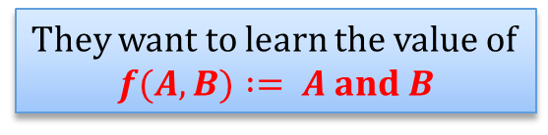



A love problem
$0$ if Alice doesn’t love Bob
$0$ if Bob doesn’t love Alice
$A$ :=
$B$ :=
$1$ if Alice loves Bob
$1$ if Bob loves Alice
They want to learn the value of
$$f(A,B) := A and B$$

Slide 4
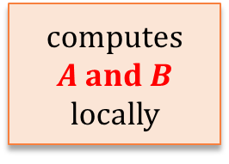
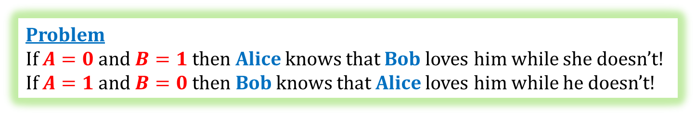


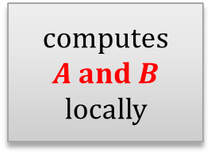
Solution?
$$A$$
$$B$$
computes
$$A and B$$
locally
computes
$$A and B$$
locally
Problem
If $A=0$and $B=1$ then Alice knows that Bob loves him while she doesn’t!
If $A=1$ and $B=0$ then Bob knows that Alice loves him while he doesn’t!

Slide 5


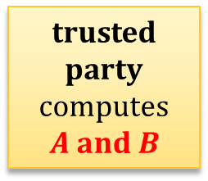
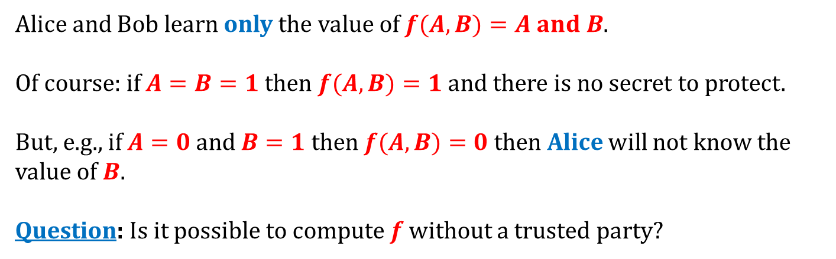
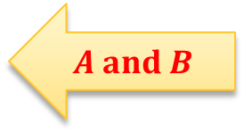
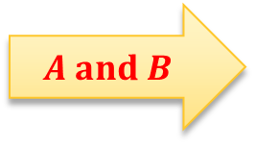
Solution?
$$A$$
$$B$$
$$A and B$$
$$A and B$$
trusted party
computes
$$A and B$$
Alice and Bob learn only the value of $f(A,B)=A and B$.
Of course: if $A=B=1$ then $f(A,B)=1$ and there is no secret to protect.
But, e.g., if $A=0$ and $B=1$then $f(A,B)=0$ then Alice will not know the value of $B$.
Question: Is it possible to compute $f$ without a trusted party?

Slide 6




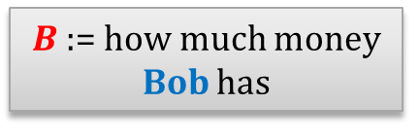
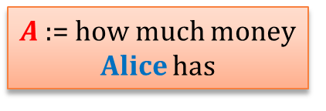


Another example: “the millionaire’s problem”
$A$ := how much money Alice has
$B$ := how much money Bob has
“Alice” if $A>B$
$$f(A,B) :=$$
“equal” if $A=B$
“Bob” if $A<B$

Slide 7
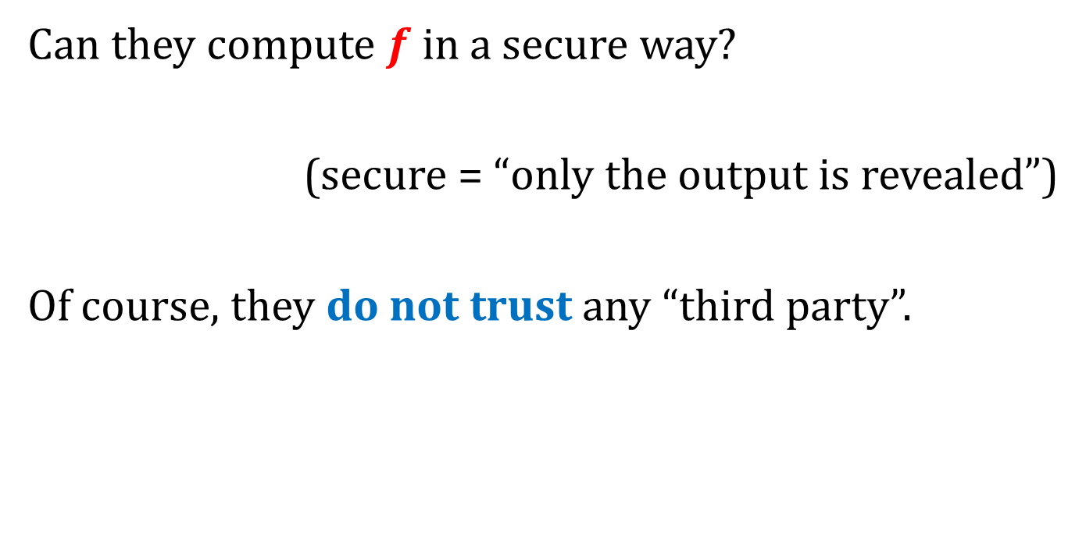
How to solve this problem?
Can they compute $f$ in a secure way?
(secure = “only the output is revealed”)
Of course, they do not trust any “third party”.

Slide 8
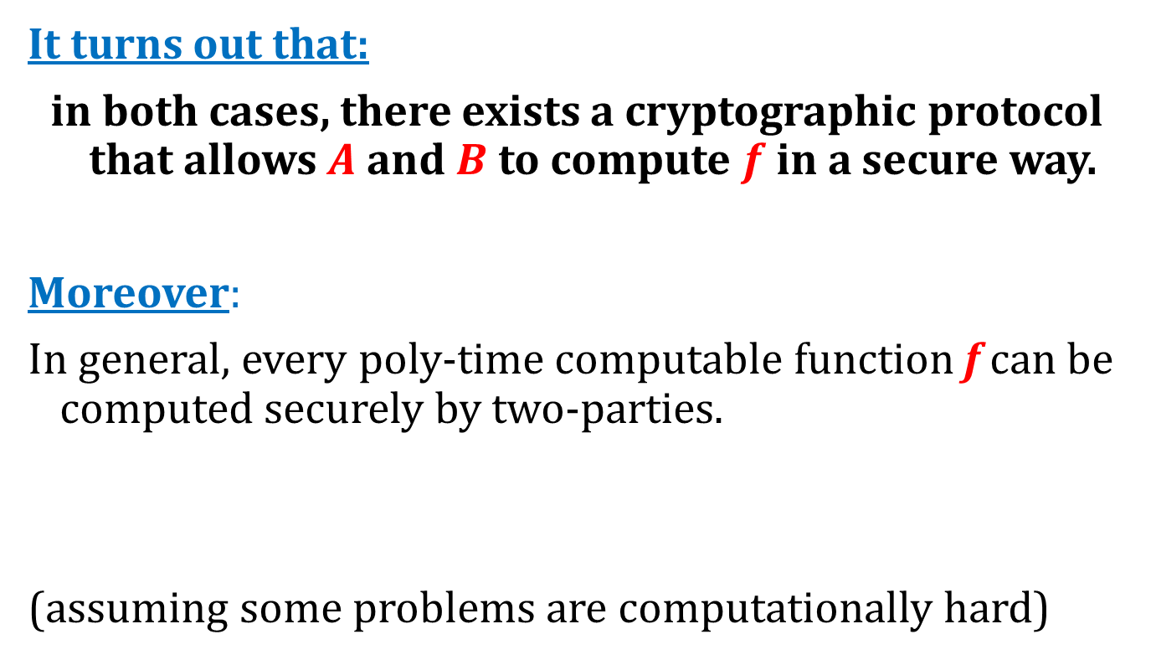
Answer
It turns out that:
in both cases, there exists a cryptographic protocol that allows $A$ and $B$ to compute $f$ in a secure way.
Moreover:
In general, every poly-time computable function f can be computed securely by two-parties.
(assuming some problems are computationally hard)
Of course, this has to be defined...

Slide 9
Plan
Introduction to two-party computation protocols
Definitions
Information-theoretic impossibility
Constructions
oblivious transfer
computing general circuits
Fully homomorphic encryption
Practical aspects
Private Information Retrieval

Slide 10

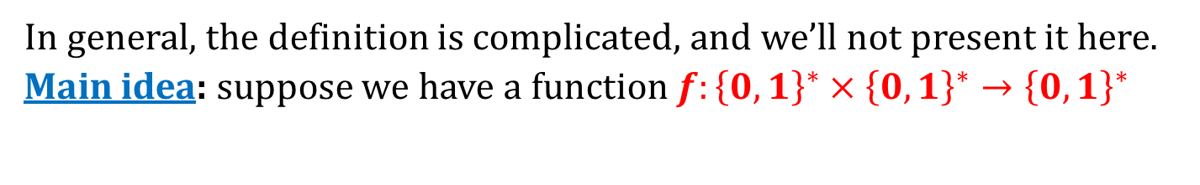


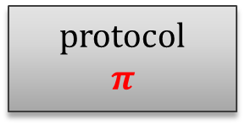

What do we mean by a “secure function evaluation”?
In general, the definition is complicated, and we’ll not present it here.
Main idea: suppose we have a function $f:{\left\{0,1\right\}}^{∗}×{\left\{0,1\right\}}^{∗}→{\left\{0,1\right\}}^{∗}$
$$A$$
$$B$$
protocol $$π$$
$$f(A,B)$$
$$f(A,B)$$
Each of the parties may try to:
learn something about the input of the other party, or
disturb the output of the protocol.

Slide 11

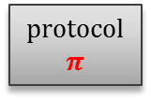



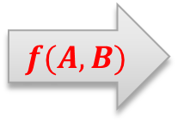



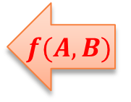



What do we mean by a “secure function evaluation”?
“real” scenario
“ideal” scenario
$$A$$
$$B$$
$$A$$
$$B$$
$$A$$
$$B$$
protocol $$π$$
$$f(A,B)$$
$$f(A,B)$$
$$f(A,B)$$
$$f(A,B)$$
$$f(A,B)$$
$$f(A,B)$$
A malicious participant (Alice or Bob) should not be able to
learn more information, or
do more damage to the output
in the “real” scenario, than it can in the “ideal” one.

Slide 12
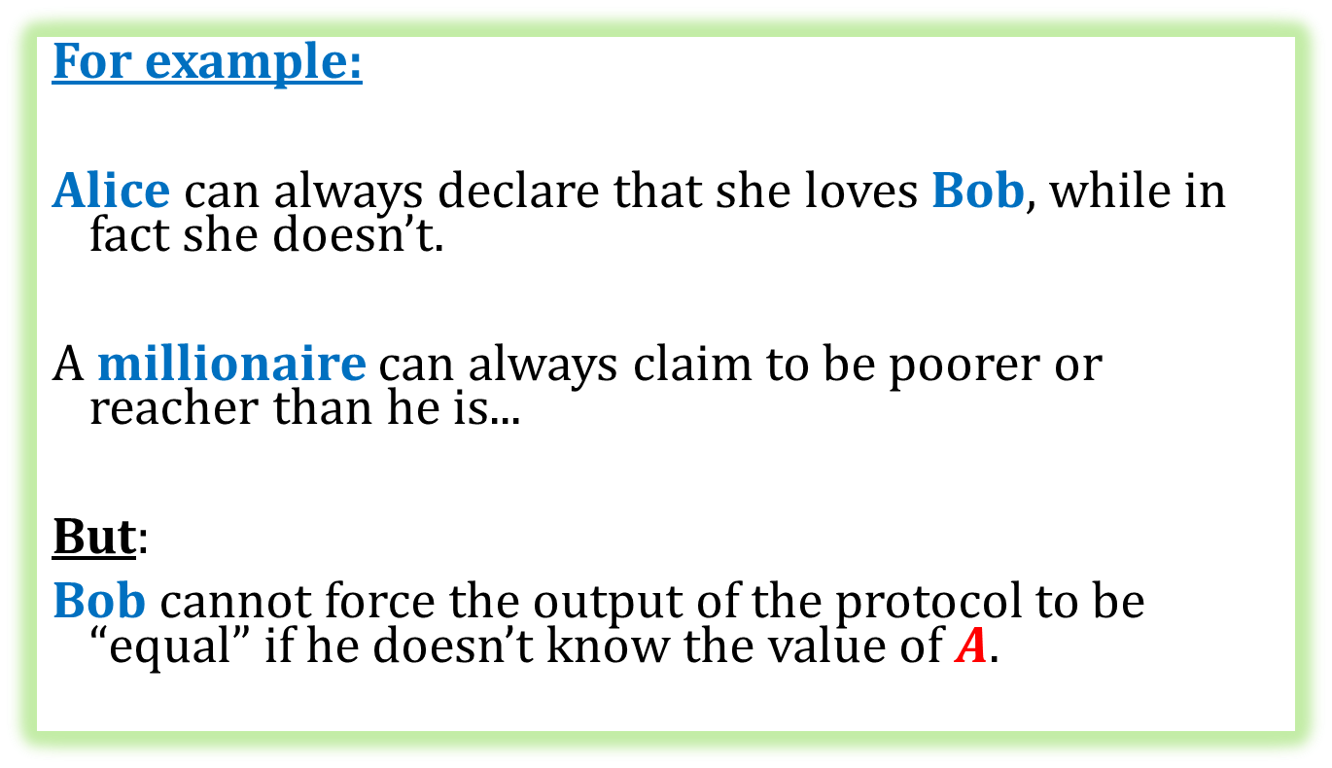
What do we mean by this?
For example:
Alice can always declare that she loves Bob, while in fact she doesn’t.
A millionaire can always claim to be poorer or reacher than he is...
But:
Bob cannot force the output of the protocol to be “equal” if he doesn’t know the value of $A$.

Slide 13




Let’s generalize it a bit:
$$A$$
$$B$$
$$f1(A,B)$$
$$f2(A,B)$$
the outputs of Alice and Bob can be different
the function that they compute may be randomized

Slide 14
An adversary
It is convenient to thing about an adversary that corrupts one of the players.
(clearly if the adversary corrupts both players, there is no sense to talk about any security)

Slide 15
Two goals that the adversary may want to achieve
learn about the input of the other party “more than he would learn in the ideal scenario”,
change the output of the protocol.

Slide 16
Two types of adversarial behavior
In general, we consider two types of adversarial behavior:
passive, also called: honest-but-curious:
a corrupted party follows the protocol
a protocol is passively secure if it is secure against one of the parties behaving maliciously in a passive way.
active, also called Byzantine a corrupted party doesn’t need to follow the protocol
a protocol is actively secure if it is secure against one of the parties behaving maliciously in an active way.

Slide 17
Problem with active security
In general, it is impossible to achieve a complete fairness.
That is: one of the parties may (after receiving her own output)
prevent the other party from receiving her output (by halting the protocol)
(remember the coin-flipping protocol?)

Slide 18
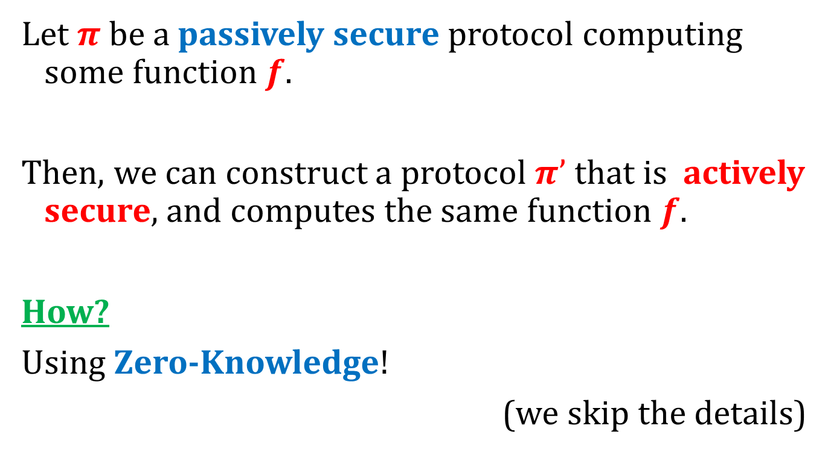
Fact
Let $π$ be a passively secure protocol computing some function $f$.
Then, we can construct a protocol $π’$ that is actively secure, and computes the same function $f$.
How?
Using Zero-Knowledge!
(we skip the details)

Slide 19
Power of the adversary
The malicious parties may be
computationally bounded (poly-time)
computationally unbounded.
We usually allow the adversary to “break the security” with some negligible probability.
In this case we say that security is information-theoretic

Slide 20
Plan
Introduction to two-party computation protocols
Definitions
Information-theoretic impossibility
Constructions
oblivious transfer
computing general circuits
Fully homomorphic encryption
Practical aspects
Private Information Retrieval

Slide 21
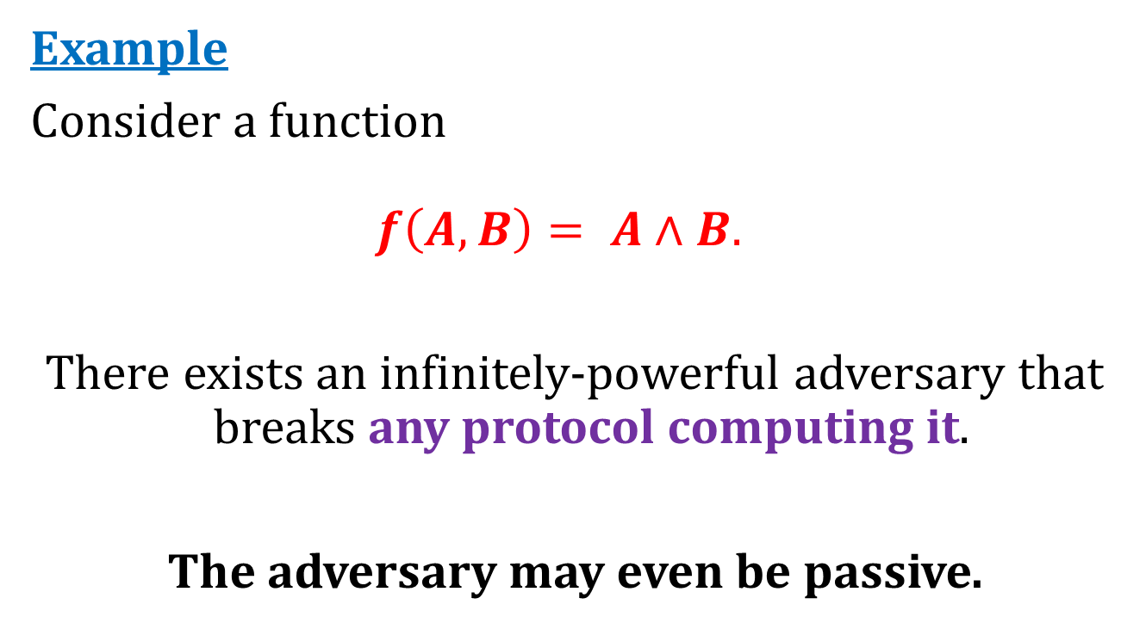
Some very natural functions cannot be computed by an information-theoretically secure protocol
Example
Consider a function
$$f\left(A,B\right)= A∧B.$$
There exists an infinitely-powerful adversary that breaks any protocol computing it.
The adversary may even be passive.

Slide 22
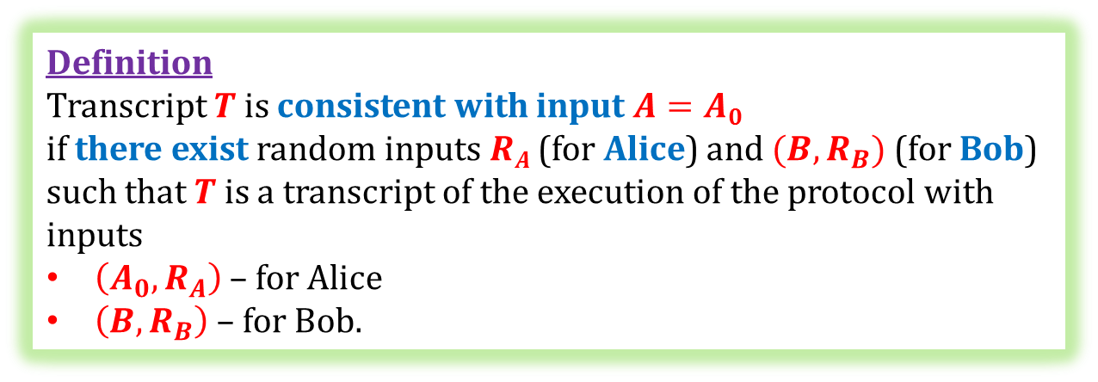








A transcript
$$A$$
$$RA$$
$$B$$
$$RB$$
transcript $$T$$
$$A∧B$$
$$A∧B$$
Definition
Transcript $T$ is consistent with input $A=A0$
if there exist random inputs $RA$ (for Alice) and $(B,R_{B})$(for Bob) such that $T$is a transcript of the execution of the protocol with inputs
$\left(A_{0},R_{A}\right)$– for Alice
$\left(B,R_{B}\right)$– for Bob.
for $B$ – symmetric

Slide 23
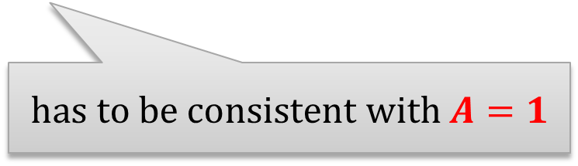




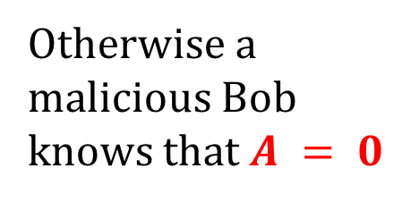

1. Suppose $A = 0 and B = 0$
$$A = 0$$
$$A$$
$$B$$
$$B = 0$$
$$T$$
has to be consistent with $A=1$
Otherwise a malicious Bob knows that $A = 0$

Slide 24
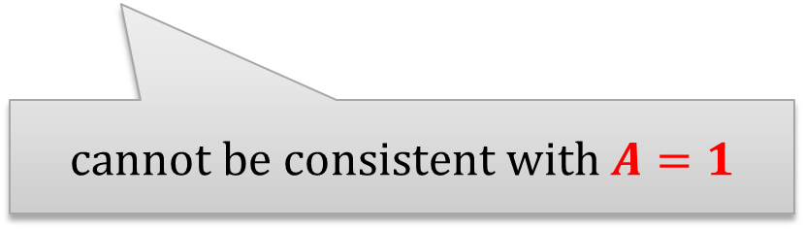


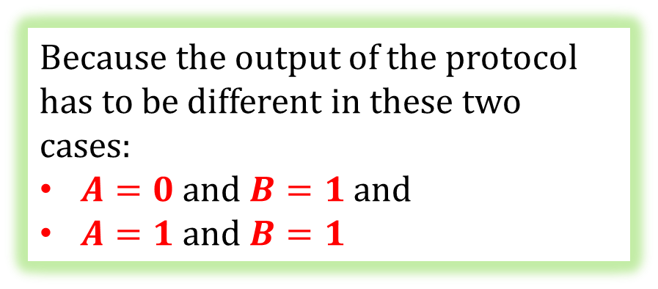
2. Suppose $A=0$and $B=1$
$$A = 0$$
$$A$$
$$B$$
$$B = 1$$
$$T$$
cannot be consistent with $A=1$
Because the output of the protocol has to be different in these two cases:
$A=0$ and $B=1$and
$A=1$ and $B=1$

Slide 25

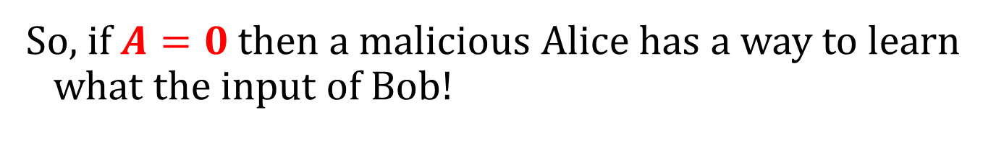


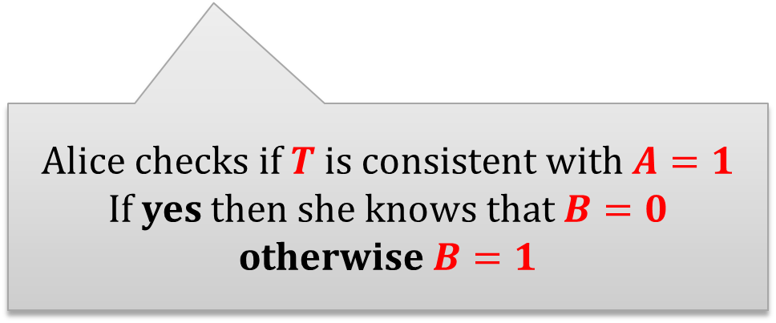
So, if $A=0$ then a malicious Alice has a way to learn what the input of Bob!
$$A$$
$$B$$
$$T$$
Alice checks if $T$ is consistent with $A=1$
If yes then she knows that $B=0$
otherwise $B=1$

Slide 26
Moral
If we want to construct a protocol for computing AND, we need to rely on computational assumptions.

Slide 27
Plan
Introduction to two-party computation protocols
Definitions
Information-theoretic impossibility
Constructions
oblivious transfer
computing general circuits
Fully homomorphic encryption
Practical aspects
Private Information Retrieval

Slide 28
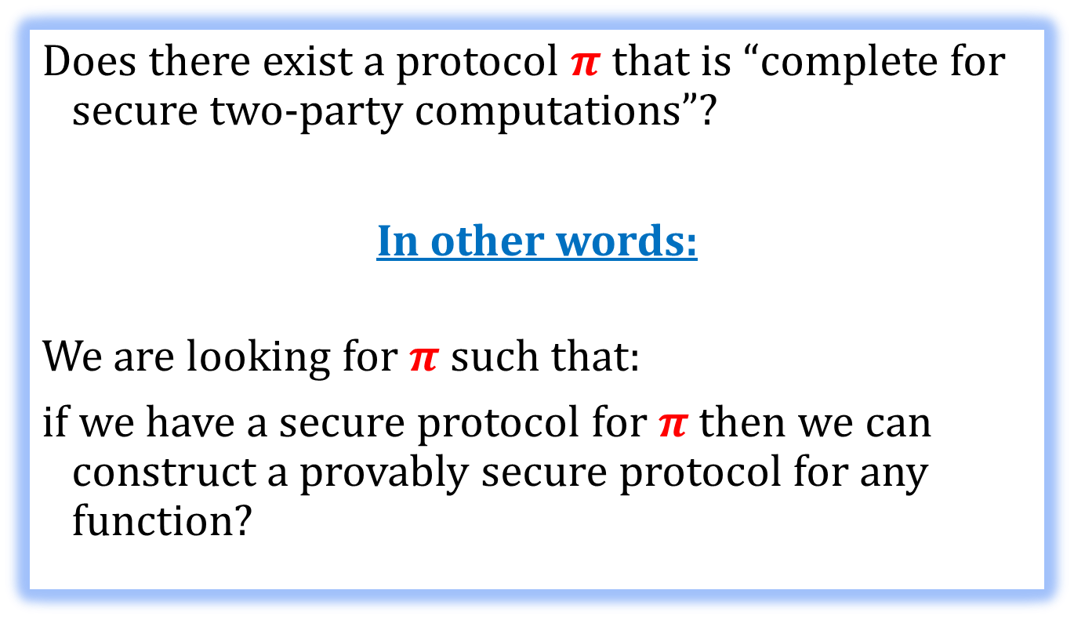
A question
Does there exist a protocol $π$ that is “complete for secure two-party computations”?
In other words:
We are looking for $π$ such that:
if we have a secure protocol for $π$ then we can construct a provably secure protocol for any function?

Slide 29
Answer
Yes!
A protocol like this is exists.
It is called Oblivious Transfer (OT). There are two versions if it:
Rabin’s Oblivious Transfer
M. O. Rabin. How to exchange secrets by oblivious transfer, 1981.
One-out-of-Two Oblivious Transfer
S. Even, O. Goldreich, and A. Lempel, A Randomized Protocol for Signing Contracts, 1985.

Slide 30
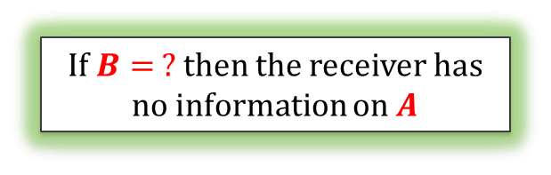
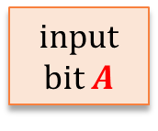



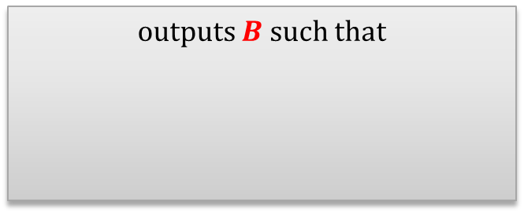
Rabin’s Oblivious Transfer
input bit $A$
sender
receiver
The sender should have no information which was the case
outputs $B$ such that
$A$ with probability $1/2$
$B$ :=
$?$ with probability $1/2$
If $B= ?$then the receiver has no information on $A$

Slide 31


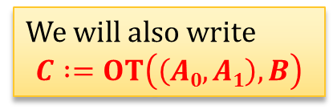
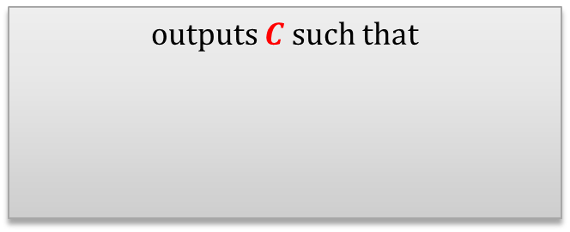
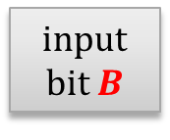
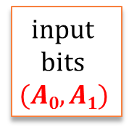
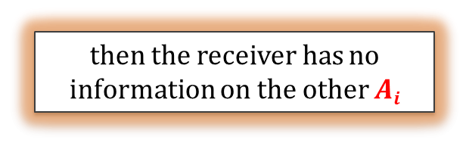

One-out-of-two Oblivious Transfer
input bits $$(A0,A1)$$
input bit $B$
sender
receiver
The sender should have no information which was the case
outputs $C$ such that
$A0$ if $B=0$
$C$ :=
$A1$ if $B=1$
We will also write
$$C :=OT\left(\left(A0,A1\right),B\right)$$
then the receiver has no information on the other $Ai$

Slide 32
Fact
Rabin’s Oblivious Transfer
and
One-out-of-Two Oblivious Transfer
are “equivalent”.
[Claude Crépeau. Equivalence between two flavours of oblivious transfer, 1988]

Slide 33

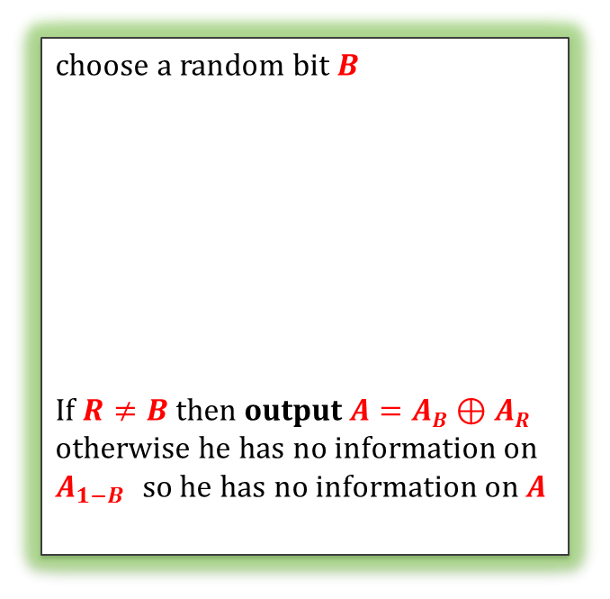
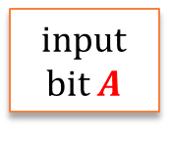

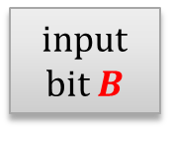

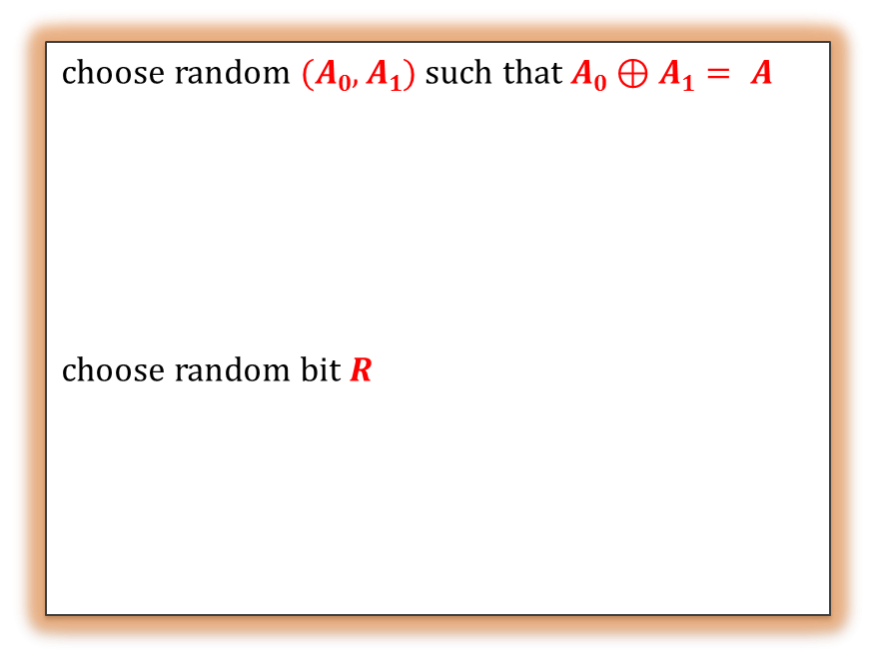
1-out-of-2 OT
Rabin OT
Rabin
input bit $A$
sender
receiver
choose random $(A0,A1)$such that $A0⊕A1= A$
choose random bit $R$
choose a random bit $B$
If $R≠B$ then output $A=AB⊕AR$
otherwise he has no information on $A_{1−B }$ so he has no information on $A$
input bits $$(A0,A1)$$
1-out-of-2
input bit $B$
sender
receiver
$$AB$$
$$AR$$

Slide 34
It remains to show the opposite direction
1-out-of-2 OT
Rabin OT

Slide 35
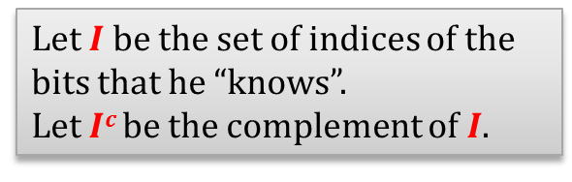
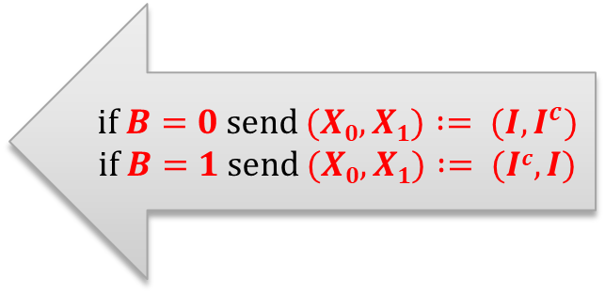

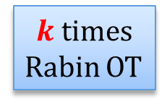
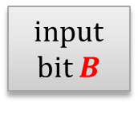

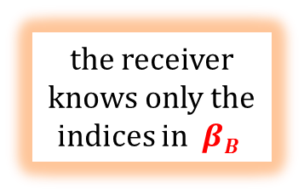

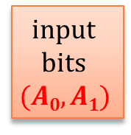



input bits $$(A0,A1)$$
input bit $B$
$$α1$$ | $$α2$$ | $$α3$$ | $$α4$$ | $$α5$$ | $$α6$$ | $$α7$$
$k$ times
Rabin OT
random string of bits
$$α1$$ | $$?$$ | $$?$$ | $$α4$$ | $$α5$$ | $$?$$ | $$α7$$
the receiver knows only the indices in $βB$
if $B=0$ send $(X0,X1) := (I,I^{c})$
if $B=1$ send $(X0,X1) := (Ic,I)$
Let $I$ be the set of indices of the bits that he “knows”.
Let $Ic$ be the complement of $I$.
$$β_{0}≔\sum_{i∈X_{0}}{α_{i}}$$
send
$$\left(Z0,Z1\right)≔ (β0⊕A0, β1⊕ A1)$$
$$β_{1}≔\sum_{i∈X_{1}}{α_{i}}$$
He outputs $βB⊕ZB$

Slide 36

Security?
The learn $B$ the sender would need to distinguish $I$ from $Ic$
To learn both $A0$ and $A1$ the receiver would need to know both $β0$ and $β1$ This is possible only if he knows all $αi$’s This happens with probability $0.5k$.

Slide 37







An implementation of Rabin’s OT
input bit $A$
a random RSA public key $pk≔(N,e)$
$$C :=Encpk(A)$$
sender
receiver
$$y :=x2 mod N$$
chooses a random
$x$ from $Z_{N}^{∗}$
random $z$ such that $z2 = y mod N$
If $x = ± z mod N$output ?
otherwise $gcd⁡(x−z, N)$is a non-trivial factor of $N$
hence the receiver can decrypt $A$ from$C$. Output $A$
Remember the proof that computing square root is equivalent to factoring?
We used the reasoning:
with probability $0.5$ we have $x≠±z mod N$
if $x≠±z mod N$then $gcd⁡(x−z, N)$is a non-trivial factor of $N$

Slide 38

Is it secure?
Against passive cheating?
YES!
Against active cheating?
Not so clear...
The sender acts as an oracle for computing square roots modulo $N$.
Does it can help him?
We don’t know.
Solution Add an intermediary step in which the receiver proves in zero-knowledge that he knows $x$.

Slide 39







How does it look now?
input bit $A$
a random RSA public key $pk := (N,e)$
$$C ≔Encpk(A)$$
receiver
sender
chooses a random
$x$ from $Z_{N}^{∗}$
$$y :=x2 mod N$$
receiver proves in ZK that he knows $x$
If $x = ± y mod N$output ?
otherwise $gcd⁡(x−z, N)$ is a non-trivial factor of $N$
hence the receiver can decrypt $A$ from $C$. Output $A$
random $z$ such that $z2=y mod N$

Slide 40












Implementation of the 1-out-of-2 OT
$(Gen, Enc, Dec)$– public key encryption scheme
$(E,D)$– private key encryption scheme
1. generates two pairs
$$(sk0,pk0)$$
$$(sk1,pk1)$$
$$A0$$
$$pk0 , pk1$$
$$B$$
$$A1$$
$$X := Enc(pkB, K)$$
2. generates a random symmetric key $K$
 | two cases:
 | $$B=0$$ | $$B=1$$
$K0$= | $$K$$ | “random”
$K1$= | “random” | $$K$$
3. computes:
$K0 :=Dec(sk_{0},X)$
$$K1≔Dec(sk_{1},X)$$
$C0 := E(K0, A0)$
$$C1 := E(K1, A1)$$
$$C0 , C1$$
4. computes $AB$ as:
$A_{B}=D(K,C_{B})$

Slide 41







How to solve the love problem of Alice and Bob using OT?
$$A$$
$$B$$
Sets $\left(A0,A1\right)≔(0,A)$
1-out-of-2 OT
the output of Bob is equal to $1$ iff $A=B=1$,
so it is equal to $A∧B$
Bob just outputs it
output $A∧B$
$$A∧B$$
works, because: $A∧B=OT((0,A),B)$

Slide 42

Oblivious Transfer for strings
What if the sender’s input $(A_{0},A_{1})$ is such that each $A_{i}$ is a bit-string $\left(A_{i}^{0},…,A_{i}^{n}\right)$?
If the adversary is passive: just apply OT to each $(A_{0}^{j},A_{1}^{j})$ separately (with the same $B$).
If the adversary is active: it’s more complicated, but a reduction also exists.

Slide 43
Is the oblivious transfer in Minicrypt?
As far as we know: no!
cryptomania
trap-door permutations exist
???
???
???
public-key encryption exists
key exchange protocols exist
oblivious transfer exist
???
???
???
???
one way functions exist
minicrypt

Slide 44
Plan
Introduction to two-party computation protocols
Definitions
Information-theoretic impossibility
Constructions
oblivious transfer
computing general circuits
Fully homomorphic encryption
Practical aspects
Private Information Retrieval

Slide 45

How to compute any function?
We will now show how Alice and Bob can securely compute any function $f$.
More precisely: they can compute any function that can be computed by a poly-time Boolean circuit.

Slide 46
Boolean circuits
size: number of gates
output gates
c₁
c₂
c₃
c₄
c₅
and
and
conjunciton
gates
and
and
neg
and
neg
and
depth
neg
and
and
and
and
and
neg
negation gates
input gates
a₀
a₁
a₂
a₃
b₁
b₂
b₃
b₄
input of Alice
input of Bob

Slide 47
Main idea
“Yao’s Garbled circuits” (Andrew Yao, FOCS’86):
Alice “encrypts” the circuit together with her input and sends it to Bob.
Bob adds his input and computes the circuit gate-by-gate.
They do it in such a way that the values on the gates remain secret (except of the output gates)
Simplifying assumptions:
Dishonest parties are honest-but-curious.
Only Bob learns the output.

Slide 48

Let’s number the gates
function$f$:
c₁
c₂
c₃
c₄
c₅
and
and
and
and
neg
and
neg
and
5
neg
and
and
and
3
4
and
and
neg
1
2
a₀
a₁
a₂
a₃
b₁
b₂
b₃
b₄

Slide 49







Step 1: key generation
For every gate (except of the output) Alice chooses two random symmetric keys.
z
$$K_{z,0}$$
and
z
$$K_{z,1}$$
x
y
$$K_{x,0}$$
$$K_{y,0}$$
or
$$aj$$
x
y
$$K_{x,1}$$
$$K_{y,1}$$
Alice does not send these keys to Bob.

Slide 50

Question
How to encrypt a message
$$M$$
in such a way that in order to decrypt it one needs to know two keys $K_{0}$ and $K_{1}$?
Answer
encrypt twice:
$$E(K0, E(K_{1},M))$$

Slide 51

Another assumption
Let’s assume that the encryption scheme $(E,D)$ is such that decrypting
$$C=E(K,M)$$
with a random key $K′$ yields error ($⊥$) with overwhelming probability.

Slide 52






Step 2: encrypting keys
z
z
and
$$K_{z,0}$$
$$K_{z,1}$$
x
y
x
y
$$K_{x,0}$$
$$K_{y,0}$$
$$K_{x,1}$$
$$K_{y,1}$$
x | y | x and Y | encrypted keys
0 | 0 | 0 | E(K_{x,0} , E(K_{y,0} , K_{z,0}))
0 | 1 | 0 | E(K_{x,0} , E(K_{y,1} , K_{z,0}))
1 | 0 | 0 | E(K_{x,1} , E(K_{y,0} , K_{z,0}))
1 | 1 | 1 | E(K_{x,1} , E(K_{y,1} , K_{z,1}))
analogously for the xor and neg gates

Slide 53

Main idea
x | y | x and Y | encrypted keys
0 | 0 | 0 | E(K_{x,0} , E(K_{y,0} , K_{z,0}))
0 | 1 | 0 | E(K_{x,0} , E(K_{y,1} , K_{z,0}))
1 | 0 | 0 | E(K_{x,1} , E(K_{y,0} , K_{z,0}))
1 | 1 | 1 | E(K_{x,1} , E(K_{y,1} , K_{z,1}))
If one knows
$K_{x,a}$ and $K_{y,b}$
then one is able to decrypt only $K_{z,c}$ such that $c=a∧b$
(all the other $K_{z,i }$’s decrypt to $⊥$)

Slide 54
Output gates
y
y
out
“0”
“1”
x
x
K_{x,0}
K_{x,1}
x | ciphertexts
0 | E(K_{x,0} , ”0”)
1 | E(K_{x,1} , “1”)

Slide 55

Step 3: sending ciphertexts
For every gate Alice randomly permutes “encrypted keys” and sends them to Bob.
encrypted keys
E(K_{x,0} , E(K_{y,0} , K_{z,0}))
E(K_{x,0} , E(K_{y,1} , K_{z,0}))
E(K_{x,1} , E(K_{y,0} , K_{z,0}))
E(K_{x,1} , E(K_{y,1} , K_{z,1}))
$$C_{z,1}$$
$$C_{z,2}$$
$$C_{z,3}$$
$$C_{z,4}$$

Slide 56





The situation: Bob knows 2 or 4 ciphertexts for each gate
5
5
and
$$C_{5,1}$$ | $$C_{5,2}$$ | $$C_{5,3}$$ | $$C_{5,4}$$
4
4
$$C_{4,1}$$ | $$C_{4,2}$$
neg
3
3
neg
$$C_{3,1}$$ | $$C_{3,2}$$
2
and
2
$$C_{2,1}$$ | $$C_{2,2}$$ | $$C_{2,3}$$ | $$C_{2,4}$$
1
1
and
$$C_{1,1}$$ | $$C_{1,2}$$ | $$C_{1,3}$$ | $$C_{1,4}$$

Slide 57
How can Bob compute the output?
Our method: decrypt the circuit “bottom up” to obtain the keys that decrypt the output.
In order to start Bob needs to learn the keys that correspond to the input gates.
Recall that the input gates “belong” either to Alice or to Bob.
a₀
a₁
a₂
a₃
b₁
b₂
b₃
b₄
Alice’s input
Bob’s input

Slide 58

There is no problem with Alice’s input
Step 4: Alice sends to Bob the keys that correspond to her input bits.
Alice’s input
1
2
3
4
1
0
1
1
K_{1,1}
K_{2,0}
K_{3,1}
K_{4,1}
Note: since the gates are permuted Bob does not learn if he got a key that corresponds to $0$or to $1$.

Slide 59

How to deal with Bob’s input?
K_{5,0} | K_{6,0} | K_{7,0} | K_{8,0}
K_{5,1} | K_{6,1} | K_{7,1} | K_{8,1}
5
6
7
8
b₁
b₂
b₃
b₄
Problem: Bob cannot ask Alice to send him the keys that correspond to his input (because he would reveal his input to her).
On the other hand: Alice cannot send him both keys (because then he would he able to compute $f$ on different inputs).
Solution: 1-out-of-2 Oblivious Transfer!

Slide 60




Yao’s method summarized
“garbled” circuit computing $f$
keys corresponding to input bits $a1,…,an$
$$a1,…,an$$
$$b1,…,bm$$
$m$times oblivious transfer (for each bit $b_{i}$)
computes the circuit bottom up and learns the output

Slide 61
Plan
Introduction to two-party computation protocols
Definitions
Information-theoretic impossibility
Constructions
Fully homomorphic encryption
Practical aspects
Private Information Retrieval

Slide 62
A problem
Yao’s protocol has a high communication complexity:
Alice needs to send the entire encrypted circuit to Bob.
Can we do better?

Slide 63






An idea
If we could construct an encryption scheme
homomorphic with respect to field operations
then secure function evaluation would be simple.
Fully homomorphic encryption:
(assume that the set of messages is a field)
does not know $sk$
$\left(sk,pk\right) −$ a key pair
can compute
$$Enc(pk, X)$$
$$Enc(pk, X + Y)$$
$$Enc(pk, Y)$$
$$Enc(pk, X×Y)$$

Slide 64









How to compute $f$ using such a cipher?
Assume that the field is $Z_{2}$.
Then logical conjunction is equal to multiplication and negation equals to “adding $1$”.
$$pk, a1,…,an$$
input: $b1,…,bm$
input: $a1,…,an$
generates a pair $(sk,pk)$
for every $i$ computes: $ci=Enc(pk,a_{i})$
for every $i$ computes: $di=Enc(pk,b_{i})$
computes $f$ using the homomorphism.
computes the ciphertext $c$ that corresponds to the output
computes the result as $Dec(sk,c)$

Slide 65
Do such ciphers exist?
Some well-known ciphers are homomorphic with respect to one field operation, e.g.:
RSA is homomorphic with respect to multiplication,
Paillier encryption is homomorphic with respect to addition.
Fully Homomorphic Encryption – see Chapter 7

Slide 66
Plan
Introduction to two-party computation protocols
Definitions
Information-theoretic impossibility
Constructions
Fully homomorphic encryption
Practical aspects
Private Information Retrieval

Slide 67
Practicality?
In practice this protocol is extremely inefficient.
But it shows that some things in principle can be done.
Research direction
Construct protocols (for concrete problems) that are efficient.

Slide 68



Example
Michael J. Freedman, Kobbi Nissim, Benny Pinkas: Efficient Private Matching and Set Intersection. EUROCRYPT 2004
Set intersection:
Alice and Bob want to see which friends they have in common (without revealing to each other their lists of friends)
input:
set $A$
input:
set $B$
output:
intersection of $A$ and $B$

Slide 69






Another popular practical scenario
(Gen, Sign, Vrfy) – signature scheme
public output: $pk$
“distributed key generation”
Alice’s output: $sk_{A}$
Bob’s output: $sk_{B}$
such that
$$sk_{A}⊕sk_{B}=sk$$
signing a message $m$
public output: $Sign_{sk}\left(m\right)$
The same works for public-key encryption!

Slide 70

A natural question?
What if the number of parties is greater than $2$?
Solutions for this also exist!
(see Chapter 12)

Slide 71
Plan
Introduction to two-party computation protocols
Definitions
Information-theoretic impossibility
Constructions
Fully homomorphic encryption
Practical aspects
Private Information Retrieval
introduction
constructions

Slide 72
Private Information Retrieval (PIR)
In a nutshell:
a protocol that allows to access a database without revealing what is accessed.
Main difference with the secure two-party computations:
secrecy of only one party is protected,
on the other hand: there is a restriction on communication complexity.
PIR was introduced in:
B. Chor, E. Kushilevitz, O. Goldreich and M. Sudan, Private Information Retrieval, Journal of ACM, 1998

Slide 73



Our settings
database $D$
user $U$

Slide 74




Question
How to protect privacy of queries?
user $U$
database $D$
wants to retrieve some
data from $D$
shouldn’t learn what $U$
retrieved

Slide 75







Let’s make things simple!
?
database $B$:
index $i=1,…,w$
$$B1$$ | $$B2$$ | … | $$Bw$$
$$Bi$$
the user should learn $Bi$
each $Bi∈\{0,1\}$
(he may also learn other $Bi$’s)

Slide 76

Trivial solution
$$B1$$ | $$B2$$ | $$…$$ | $$Bw$$
The database simply sends everything to the user!

Slide 77

Non-triviality
The previous solution has a drawback:
the communication complexity is huge!
Therefore we introduce the following requirement:
“Non-triviality”:
the number of bits communicated between $U$ and $D$ has to be smaller than $w$.

Slide 78



Private Information Retrieval
polynomial time randomized interactive algorithms
input:
index $i=1,…,w$
input:
$$B1$$ | $$B2$$ | $$…$$ | $$Bw$$
This property needs to be defined more formally
at the end the user learns $Bi$
the database does not learn $i$
the total communication is $< w$
Note: secrecy of the database is not required
correctness
secrecy (of the user)
non-triviality

Slide 79






How to define secrecy of the user [1/2]?
For fixed $i$ and $B$
$$T(i,B)$$
is a random variable
(since the parties are randomized)
Def. $T(i,B)$ – transcript of the conversation.
query $Q(i)$
$$i$$
reply $A(Q(i),B)$
$$B$$

Slide 80


How to define secrecy of the user [2/2]?
Secrecy of the user: for every $i,j∈\{0,1\}$
?
single-round case:
it is impossible to distinguish
between $Q(i)$ and $Q(j)$
multi-round case:
it is impossible to distinguish between
$T(i,B)$and $T(j,B)$
even if the adversary is malicious
depending on the settings: computational or unconditional indistinguishability

Slide 81


Computationally-secure PIR – formally
computational-secrecy:
For every $i,j∈\{0,1\}$
it is impossible to distinguish
efficiently
between
$T(i,B)$and $T(j,B)$
?
Formally: for every polynomial-time probabilistic algorithm $A$ the value:
$$|P(A(T(i,B)) = 0) – P(A(T(j,B))=0)|$$
should be negligible.

Slide 82
Is it possible?
Fact
Information-theoretically secure single-server PIR does not exist [exercise].
What can be constructed is the following:
computationally-secure PIR (we show it now)
information-theoretically secure multi-server PIR [exercise]

Slide 83

PIR vs OT
PIR looks similar to the $1$-out-of-$w$ OT
Differences:
advantage of PIR: low communication complexity
advantage of OT: privacy of the database is protected
Can we combine both?
Yes! It’s called “symmetric PIR”.

Slide 84
Plan
Introduction to two-party computation protocols
Definitions
Information-theoretic impossibility
Constructions
Fully homomorphic encryption
Practical aspects
Private Information Retrieval
introduction
constructions

Slide 85
The construction
Kushilevitz and R. Ostrovsky Replication Is NOT Needed: SINGLE Database, Computationally-Private Information Retrieval, FOCS 1997
based on the Quadratic Residuosity Assumption.
Our presentation strategy:
we first present a wrong solution
then we fix it.

Slide 86









Quadratic Residuosity Assumption
$a←Z_{N}^{+}$
↓
?
$Z_{N}^{∗}$:
$$QR_{p}$$
$$Q{NR}_{p}$$
$$QR_{q}$$
$$QR_{N}$$
$$Q{NR}_{p}$$
Quadratic Residuosity Assumption (QRA):
For a random $a←Z_{N}^{+}$ it is computationally hard to determine if $a∈QR_{N}$.
Formally: for every polynomial-time probabilistic algorithm $D$ the value:
$$\left|P\left(D\left(N,a\right)= Q_{N}\left(a\right)\right)–\frac{1}{2}\right|$$
(where $a←Z_{N}^{+}$) is negligible.
Where a predicate $Q_{N}:Z_{N}^{+}→\{0,1\}$ is defined as follows:
$Q_{N}(a)$ $=0$if $a∈QR_{N}$
$Q_{N}(a)$ $=1$otherwise

Slide 87


Homomorphism of $Q_{N}$
For all $a,b∈Z_{N}^{+}$
$$Q_{N}\left(ab\right)=Q_{N}(a)⊕Q_{N}\left(b\right)$$

Slide 88












First (wrong) idea
$$i$$
$$i$$
$$↓$$
$$B1$$ | $$B2$$ | $$…$$ | $$B_{i−1}$$ | $$Bi$$ | $$B_{i+1}$$ | $$…$$ | $$B_{w−1}$$ | $$Bw$$
QR $$X1$$ | QR $$X2$$ | ... | QR $$X_{i−1 }$$ | NQR $$Xi$$ | QR $$X_{i+1 }$$ | ... | QR $$X_{w−1 }$$ | QR $$X_{w }$$
for every $j = 1,…,w$the database sets
$$Yj =$$
{
$X_{j}^{2}$ if $Bj=0$
$Xj$ otherwise
$Yi$is a QR iff $Bi=0$
QR $$Y1$$ | QR $$Y2$$ | ... | QR $$Y_{i−1}$$ | $$Y_{i}$$ | QR $$Y_{i+1}$$ | ... | QR $$Y_{w−1}$$ | QR $$Y_{w}$$
$M$ is a QR iff $Bi=0$
the user checks
if $M$ is a QR
$$M$$
Set $M = Y1 · Y2 ·⋯ · Yw$

Slide 89




Problems!
PIR from the previous slide:
correctness √
security?
To learn $i$ the database would need to distinguish NQR from QR. √
QR $$X1$$ | QR $$X2$$ | ... | QR $$X_{i−1 }$$ | NQR $$Xi$$ | QR $$X_{i+1 }$$ | ... | QR $$X_{w−1 }$$ | QR $$X_{w }$$
non-triviality? doesn’t hold!
communication: user → database: $\left|B\right|⋅\left|N\right|$
database → user: $\left|N\right|$
Call it:
$\left(\left|B\right|, 1\right)$–PIR

Slide 90





How to fix it?
Idea Given:
$\left(\left|B\right|, 1\right)$–PIR
construct
$\left(\sqrt{|B|},\sqrt{|B|}\right)$–PIR
Suppose that $|B|=v2$ and present $B$ as a $v×v$–matrix:
$$B1$$ | $$B2$$ | $$B3$$ | $$B4$$
$$B5$$ | $$B6$$ | $$B7$$ | $$B8$$
$$B9$$ | $$B10$$ | $$B11$$ | $$B12$$
$$B13$$ | $$B14$$ | $$B15$$ | $$B16$$
consider each row as a separate
database

Slide 91











An improved idea
Looks even worse:
communication: user → database: $v2·|N|$
database → user: $v·|N|$
$$v$$
execute $v$
$(v,1)$- PIRs in parallel
$$B1$$ | $$B2$$ | $$B3$$ | $$B4$$
$$B5$$ | $$B6$$ | $$B7$$ | $$B8$$
$$v$$
$$B9$$ | $$B10$$ | $$B11$$ | $$B12$$
$$B13$$ | $$B14$$ | $$B15$$ | $$B16$$
The method
$$j$$
$$↓$$
Let $j$ be the column where $Bi$ is.
In every “row” the user asks for the $j$th element
So, instead of sending $v$ queries the user can send one!
Observe: in this way the user learns
all the elements in the $j$th column!
$$Bi$$

Slide 92












Putting things together
$j$th column
$$B1$$ | $$…$$ | $$B_{j−1}$$ | $$B_{j}$$ | $$B_{j}$$ | $$…$$ | $$Bv$$
 |  |  | $$B_{i}$$
 | ... |  |  |  | ... | $$B_{vv}$$
i
$k$th row
here the same row is copied v times:
QR $$X1$$ | ... | QR $$X_{j−1}$$ | NQR $$X_{j}$$ | QR $$X_{j+1}$$ | ... | QR $$X_{v}$$
$$X1$$ | $$…$$ | $$X_{j−1}$$ | $$X_{j}$$ | $$X_{j+1}$$ | $$…$$ | $$Xv$$
$$X1$$ | $$…$$ | $$X_{j−1}$$ | $$X_{j}$$ | $$X_{j+1}$$ | $$…$$ | $$Xv$$
for every $j=1,…,v$set
$$Yj =$$
$$M1$$
$$⋮$$
$$Mk$$
$$⋮$$
$$Mv$$
$$\{$$
only this counts
$X_{j}^{2}$ if $Bj=0$
$X_{j}$ otherwise
$$M1$$
$$⋮$$
$$Mv$$
$$Y1$$ | $$…$$ | $$Y_{j−1}$$ | $$Y_{j}$$ | $$Y_{j+1}$$ | $$…$$ | $$Yv$$
 |  |  |  |  | ... | $$Y_{vv}$$
multiply
elements
in each row
$Bj=0$ iff
$Mk$ is QR

Slide 93

So we are done!
PIR from the previous slide:
correctness $√$
non-triviality: communication complexity = $2\sqrt{\left|B\right|}⋅\left|N\right| √$
security?
To learn $i$ the database would need to distinguish NQR from QR.
Formally:
from any adversary that breaks our scheme we can construct an algorithm that breaks QRA

Slide 94





Improvements
$$(X1,…,Xv)$$
$$(M1,…,Mv)$$
user $U$
the user is interested
just in one $Mi$.
database $D$
Idea: apply PIR recursively!

Slide 95
Extensions
Symmetric PIR (also protect privacy of the database).
[Gertner, Ishai, Kushilevitz, Malkin. 1998]
Searching by key-words
[Chor, Gilboa, Naor, 1997]
Public-key encryption with key-word search
[Boneh, Di Crescenzo, Ostrovsky, Persiano]

Slide 96
©2022 by Stefan Dziembowski. Permission to make digital or hard copies of part or all of this material is currently granted without fee provided that copies are made only for personal or classroom use, are not distributed for profit or commercial advantage, and that new copies bear this notice and the full citation.

