Slide 1



JavaScript
Slides for
Eng / Ryhab Farouq

Slide 2



Fundamentals
JavaScript
Operators
Controlling Flow
LECTURE ONE

Slide 3



THE ROLE OF JAVASCRIPT IN WEB DEVELOPMENT
NOUNS
<p></p>
means “paragraph”
CONTENT
ADJECTIVES
p {color: red}
means “the paragraph text is red”
VERBS
p.hide();
means “hide the paragraph”
PRESENTATION
PROGRAMMING LANGUAGE: BUILDING WEB APPLICATIONS

Slide 4



WHAT IS JAVASCRIPT?
We don’t have to worry about complex stuff like memory management
JAVASCRIPT
JAVASCRIPT IS A HIGH-LEVEL, OBJECT-ORIENTED, MULTI-PARADIGM PROGRAMMING LANGUAGE.
We can use different styles of programming
Based on objects, for storing most kinds of data

Slide 5


CORE JAVASCRIPT
HTTP Request
Client : html , css , js
HTTP Response
Js minimized the traffic between client and server

Slide 6








A BRIEF HISTORY OF JAVASCRIPT
1995
Brendan Eich creates the very first version of JavaScript in just 10 days. It was called Mocha, but already had many fundamental features of modern JavaScript!
1996
Mocha changes to LiveScript and then to JavaScript, in order to attract Java developers. However, JavaScript has almost nothing to do with Java
Microsoft launches IE, copying JavaScript calling it JScript;
1997
With a need to standardize the language, ECMA releases ECMAScript 1 (ES1), the first official standard for JavaScript (ECMAScript is the standard, JavaScript the language in practice);
2009
ES5 (ECMAScript 5) is released with lots of great new features;
2015
ES6/ES2015 (ECMAScript 2015) was released: the biggest update to the language ever!
ECMAScript changes to an annual release cycle in order to ship less features per update
2016 – ∞
Release of ES2016 / ES2017 / ES2018 / ES2019 / ES2020 / ES2021 / … / ES2089

Slide 7


JAVASCRIPT RELEASES... (MORE ABOUT THIS LATER)
Biggest update to the language EVER
New updates to JS every single year
ES6/ ES2015
ES7/ ES2016
ES8/ ES2017
ES9/ ES2018
ES10/ ES2019
ES11/ ES2020
...
ES5
...
Modern JavaScript
ECMAScript
Learn modern JavaScript from the beginning, but without forgetting the older parts!
Let’s finally get started!

Slide 8
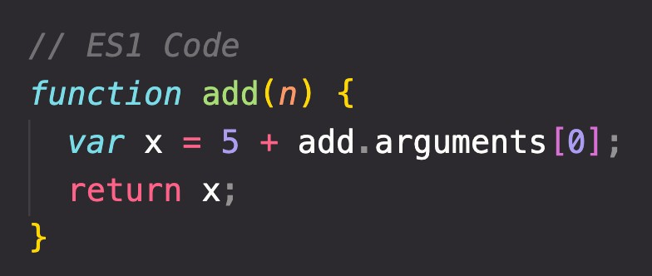



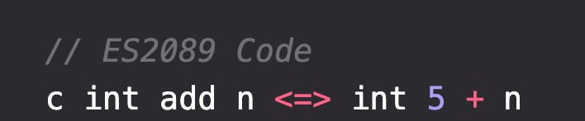

BACKWARDS COMPATIBILITY: DON’T BREAK THE WEB!
Modern JavaScript Engine
BACKWARDS COMPATIBLE
1997
2020
Old features are never removed; Not really new versions, just
incremental updates (releases)
Websites keep working forever!
DON’T BREAK THE WEB!
Modern JavaScript Engine
NOT FORWARDS COMPATIBLE
2020
2089

Slide 9

WHERE TO WRITE JAVASCRIPT
External : file with extension .js
Internal HTML : within script tag
Inline Script : event handling scripts

Slide 10
OBJECTS AND PRIMITIVES DATATYPES
VALUE
EVERYTHING ELSE
OBJECT
OR
PRIMITIVE

Slide 11
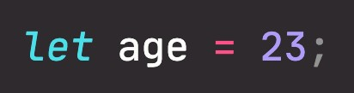
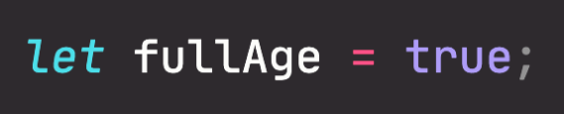
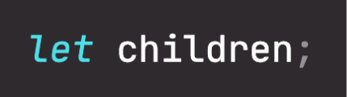
THE 7 PRIMITIVE DATATYPES
Number: Floating point numbers
String: Sequence of characters
Used for decimals and integers
Used for text
Boolean: Logical type that can only be true or false Used for taking decisions
Undefined: Value taken by a variable that is not yet defined (‘empty value’)
Null: Also means ‘empty value’
Symbol (ES2015): Value that is unique and cannot be changed
BigInt (ES2020): Larger integers than the Number type can hold
JavaScript has dynamic typing: We do not have to manually define the data type of the value stored in a variable. Instead, data types are determined automatically.
Value has type, NOT variable!

Slide 12
THE 7 OBJECT DATATYPES
Number: Floating point numbers
String: Sequence of characters
Boolean
Date
Array
Maths
Regular Expressions

Slide 13




DIFFERENCE BETWEEN PRIMITIVE AND OBJECT DATATYPES
Primitive Object
20
x 10
y 0x00
Stack
Heap
Literal Creation
Constructor Creation

Slide 14
OPERATORS
Arithmetic Operators
y = 5
Assignment Operators
Operator | Description | Example | Result
+ | Addition | x=y+2 | x=7
- | Subtraction | x=y-2 | x=3
* | Multiplication | x=y*2 | x=10
/ | Division | x=y/2 | x=2.5
% | Modulus (division remainder) | x=y%2 | x=1
++ | Increment | x=++y | x=6
-- | Decrement | x=--y | x=4
Comparison Operators
Bitwise Operators
Logical Operators

Slide 15
OPERATORS
Arithmetic Operators
x = 10 , y = 5
Assignment Operators
Comparison Operators
Operator | Example | Same As | Result
= | x=y |  | x=5
+= | x+=y | x=x+y | x=15
-= | x-=y | x=x-y | x=5
*= | x*=y | x=x*y | x=50
/= | x/=y | x=x/y | x=2
%= | x%=y | x=x%y | x=0
Bitwise Operators
Logical Operators

Slide 16
OPERATORS
Arithmetic Operators
Operator | Description
< | Less than
> | Greater than
<= | Less than or equal to
>= | Greater than or equal to
== | Equality
!= | Inequality
=== | Strict Equality
!== | Strict Inequality
Assignment Operators
Comparison Operators
Bitwise Operators
Logical Operators

Slide 17
OPERATORS
Arithmetic Operators
Operator | Description
& | Bitwise AND
| | Bitwise OR
Assignment Operators
Comparison Operators
Bitwise Operators
Logical Operators

Slide 18
OPERATORS
Arithmetic Operators
Operator | Description
&& | Logical "AND" – returns true when both operands are true; otherwise it returns false
|| | Logical "OR" – returns true if either operand is true. It only returns false when both operands are false
! | Logical "NOT"—returns true if the operand is false and false if the operand is true. This is a unary operator and precedes the operand
Assignment Operators
Comparison Operators
Bitwise Operators
Logical Operators

Slide 19
CONTROLLING PROGRAM FLOW
Control statements
Conditional
OR
Loop

Slide 20
CONTROLLING PROGRAM FLOW
Conditional
switch / case
if….else
if (condition)
{
do something;
}
else if (Condition)
{
do something else;
}
else
{
do something else;
}
switch (expression)
{
case value1:
statements
break;
case value2:
statements
break;
default :
statements
}

Slide 21
CONTROLLING PROGRAM FLOW
Loop
  for
do…while
for ( var i=0 ;i<10;i++)
{
document.write(“ number” + i)
}
do
{
statements
} while (condition)
while
while (condition)
{
statements
}

Slide 22

THE DIALOG BOXES IN JAVASCRIPT
Alert Dialog Box
Prompt Dialog Box
Confirm Dialog Box

Slide 23
CASTING IN JAVASCRIPT
Convert type to another type
Implicit
OR
Explicit

Slide 24
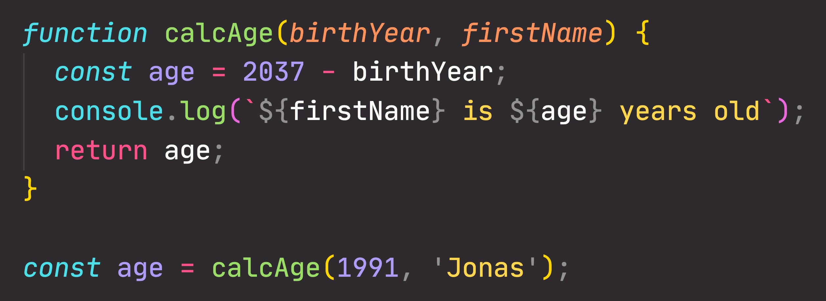
FUNCTIONS REVIEW : ANATOMY OF A FUNCTION
Parameters: placeholders to receive input
values. Like local variables of a function
Function body: block of code that we want to reuse. Processes the function’s input data
Function name
return statement to output a value from the function and terminate execution
Calling, running or invoking the function, using ()
Variable to save returned value (function output)
Arguments: actual values of function parameters, to input data

Slide 25
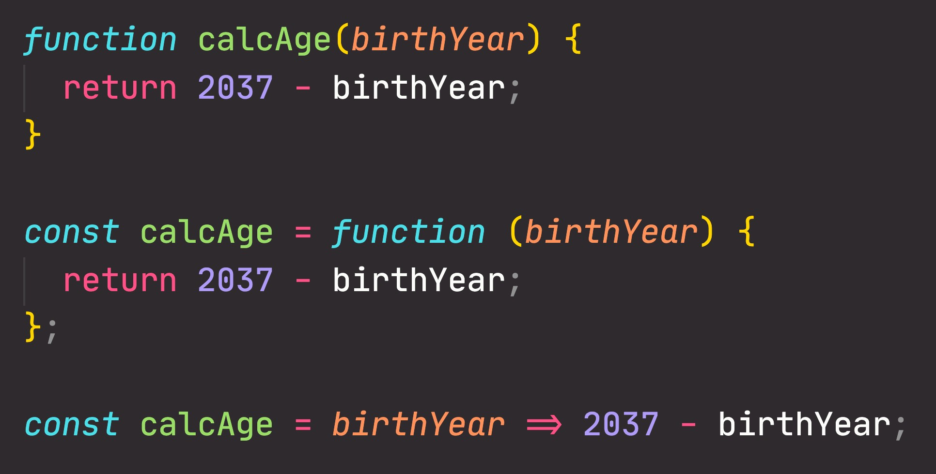
FUNCTIONS REVIEW : 3 DIFFERENT FUNCTION TYPES
Function declaration
Function that can be used before it’s declared
Function expression
Essentially a function
value stored in a variable
Arrow function
Great for a quick one-line functions. Has no this keyword (more later...)
Three different ways of writing functions, but they all work in a similar way: receive input data, transform data, and then output data.

Slide 26
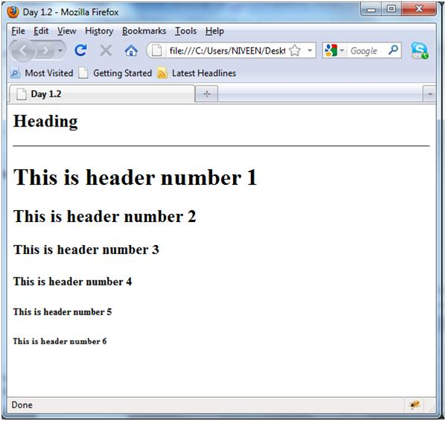
Tasks
1-Make function that write “welcome to my page” 6 times using h1 to h6 header sizes using one line (document.write) javascript code “see attached image” . (Use for loop, and don’t use h1 to h6 explicitly).
2- Make a function that takes today’s temperature as a parameter, prints: “HOT” if the entered temperature are more than or equals 30 and “Cold” if it’s less than 30 (use ternary conditional operator).

Slide 27
Tasks
3- Write a script that takes from the user n values and returns their sum, stop receiving values from user when he enters 0 or sum exceeds 100, check that the entered data is numeric and inform the user with the total sum of the entered values in console.
4- On your page, show alert for the user that say “Welcome to my site”, then show him prompt ask him to enter his name and write to the page “ welcome + his name”. (Remark what happen to the home page after writing welcome page).
5- Create a function that accepts three numerical values x, y and z. The function should check if x is divisible by y only or z only or both y and z.
Example: If user entered values are 10, 2, and 5 then the output will be: 10 is divisible by both 2 and 5.
If user entered values are 10, 2, and 4 then the output will be: 10 is divisible by 2 only.
If user entered values are 10, 5, and 4 then the output will be: 10 is divisible by 5 only.
6- On contact page prompt user to enter his name, make sure that name is string, and let the user enter his birth year and make sure that it is a number, and it is less than 2010, and then calculate his age. For each prompt if user input valid show him next prompt, if not valid show him the same prompt again until user enters it correctly (use loops). And after validating user input, write all user input on the page in that format:
Name: ahmed
Birth year: 1981
Age: 30

