Slide 1





Tasks
JavaScript
LECTURE THREE

Slide 2
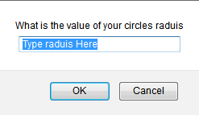
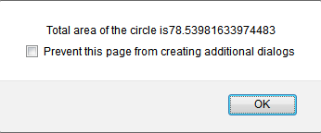
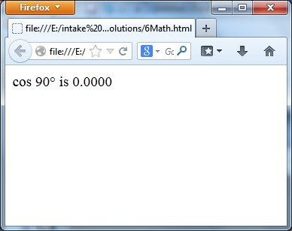
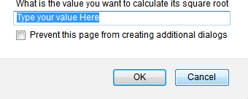
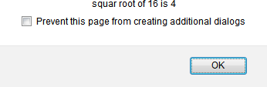
TASKS
1. Write a script that ask the user to
  Enter the value of a circle’s radius in order to calculate its area as
shown in fig.
Enter an angle to calculate its cos value then display the output as shown in Fig.
Enter another value to calculate its square root and alert the result as shown in fig.

Slide 3
TASKS
2. Write a function that takes 2 parameters: start and end number and print odd numbers between the given 2 numbers.
3. Create array that contain some tips about JavaScript (Array of 10 strings, each string is tip about JS), and show random tip for the user each time he opens the page "Tip of the day".
4. Make a prompt on a page, ask user to enter math expression (Ex. 3+4*5/10*8), and then pass this expression (user input) to a function that take one parameter and execute this expression and then show the result of this expression for the user in an alert in that format: (You entered: 3+4*5, and the result is: 23).

Slide 4
TASKS
5. Create an array of objects that hold student name along with his degree (Each element of the array is an object has 2 properties: Name and Degree).
  Find student Name, who got degree between 90 and 100 [Use find()].
  Print students names, who got a degree less than 60 [Use filter()].
  Add a new student to the array [Use push()],()], and then use for…in to print all elements of the array.
  Remove the last student of the array [Use pop()], and then use for…of to print all elements of the array.
  Sort the array alphabetically based on the student name.
  Use splice() function to add 2 new students after the second element of the array [Bonus].
  Use splice() function to remove 1 student after the third element in the array [Bonus].

Slide 5
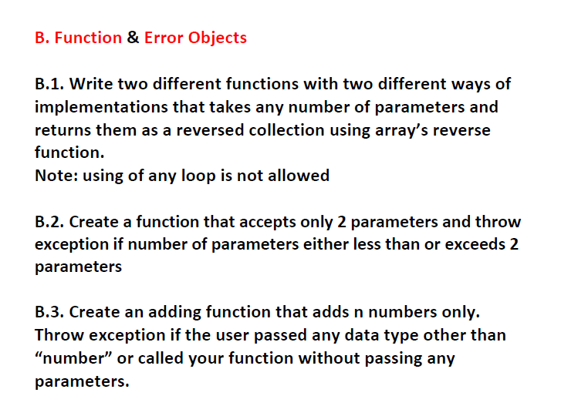
TASKS

