Slide 1
Preliminaries: we are using Python 2.7 Python v.2.7
Open a terminal window and go to the directory where you would like to store this repository.
On the command line enter: (directions are for mac)
git clone https://github.com/bpraggastis/git-your-python-booty.git
cd git-your-python-booty
pip install –r requirements.txt
jupyter notebook
Jupyter Notebook
python
>>>
Terminal

Slide 2
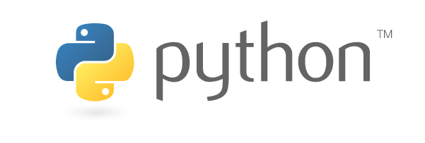
Introduction To Python
Katie Porterfield
&
Brenda Praggastis

Slide 3


SPECIAL THANKS
Caroline Harbitz & Gina Schmalzle - for making the original slides and repository for this workshop
Ian Gorton & Northeastern University – for sponsoring this workshop
Women Who Code – for all You Do!

Slide 4
About Us
Katie Porterfield
Data Sciences Engineer
Brenda Praggastis, PhD
Applied Mathematics/Data Science Engineer
Computational Sciences and Analytics
Pacific NW Laboratory, Seattle WA

Slide 5
Today’s Objectives
* Part 1: Basic Commands & Data Types
* Part 2: Loops and Conditionals
* Part 3: Functions
* Part 4: Reading and Writing

Slide 6
We have one rule
Ask for help!
Use your colored sticky notes to reflect your current status.

Slide 7

What is Python?
* Programming Language created in 1990 by Guido van Rossum (BDFL)
* It’s not named after snakes
* Pretty unpopular until 2.0 was released in 2000
* 3.0 was released in 2008
* Backwards incompatibility issue
* We’re using v2.7 for this workshop
By Doc Searls - 2006oscon_203.JPG, CC BY-SA 2.0, https://commons.wikimedia.org/w/index.php?curid=4974869
Notes:
Benevolent dictator for life

Slide 8

What is Jupyter?
The Jupyter Notebook is a web application that allows you to create and share documents that contain live code, equations, visualizations and explanatory text….
http://jupyter.org/
Notes:
Supports over 40 programming languages including Python

Slide 9
Preliminaries: we are using Python 2.7 Python v.2.7
Open a terminal window and go to the directory where you would like to store this repository.
On the command line enter: (directions are for mac)
git clone https://github.com/bpraggastis/git-your-python-booty.git
cd git-your-python-booty
pip install –r requirements.txt
jupyter notebook
Jupyter Notebook
python
>>>
Terminal

