Slide 1
Elaine’s Slides

Slide 2
A Buggy Rock, Paper, Scissors Example
Smart contracts can range from very simple to extremely complex
Very easy to write an insecure contract
Very easy to skip over and miss bugs
We will use a two player Rock, Paper, Scissors example to show these mistakes.

Slide 3
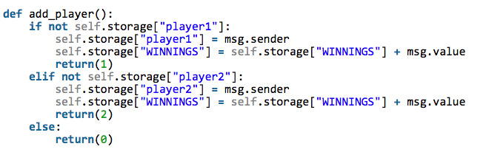
Typical Mistake 1: Stealing Money
In this section, a user adds themselves to the game by sending a small amount of ether with the transaction.
If they send too much or too little, or are not allowed in the game, the contract keeps their money. They could even bet two different amounts!
This can be resolved by making sure to refund (using the send function) any unused value

Slide 4
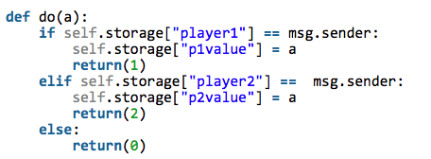
Typical Mistake 2: Failing To Use Crypto
In this example, when a person sends rock, paper or scissors, they send it in plaintext.
This means that the other player could see what was played and make a decision to ensure they win
This can be fixed by hashing (with a nonce) the value to send to the contract.
Then, when both parties have decided what to play, they send their answer and a nonce to show what they played

Slide 5
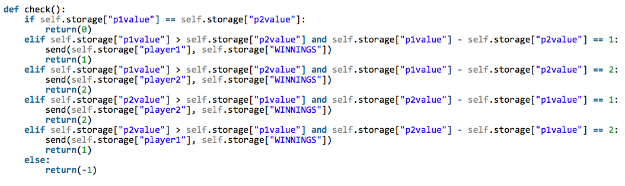
Typical Mistake 3: Not Incentive Compatible
Currently above, we are incentive compatible, since only one party needs to call the check() command in order for the winnings to be redeemed.
If we implemented the crypto from part 2, we would need to wait a certain number of blocks before checking. If someone didn’t bother to decrypt their rock/paper/scissors, we would have the money by default go to the person who did decrypt their rock/paper/scissors.
This way, it doesn’t hurt if the person doesn’t bother to decrypt. The money will go to the same person it would have anyways.

