Slide 1















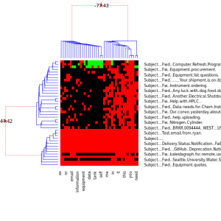
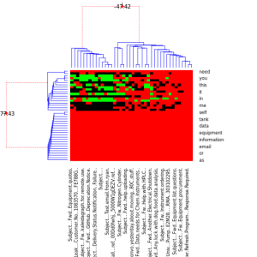

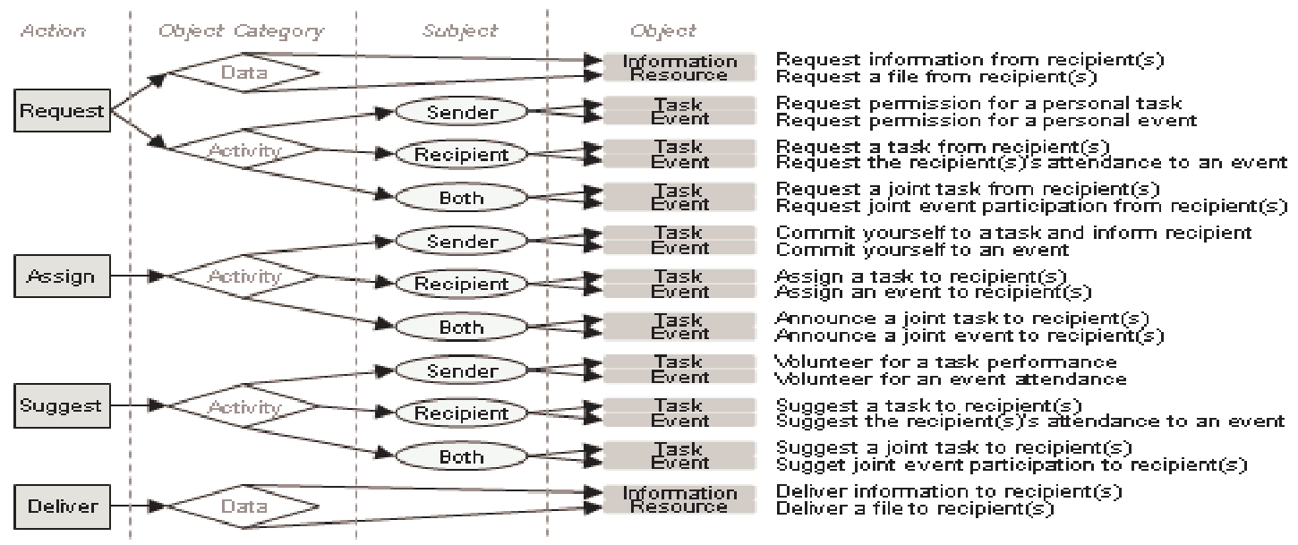



In Brief:
The Acme project is an open-source toolkit for experts in statistics (like Chemists, Astrologers, Geologists, etc.,) to gain access to the treasure trove of information hidden in their own inbox.
We aim to empower everyone, regardless they have a CS background, the capacity to apply statistical inference and machine learning tools to their email inbox. Be it introspective analysis for insight into their own processes, or the development of custom filtration/classification tools to improve their workflow.
A.C.M.E.:
Automated
Collection and
Manipulation of
Email
For most people, handling high email volume is a necessary evil, it’s just part of getting the job done.
But, for many of us, our passions and strengths don’t include organizing an inbox…
It’s time to call A.C.M.E.!
On average, professionals have more than 200 emails in their inbox and receive 120 new ones each day but respond to only 25% of them.
- https://hbr.org/2019/01/how-to-spend-way-less-time-on-email-every-day
Automated email classification and categorization is a long-standing issue, where most existing solutions are closely guarded behind IP patents or buried in archaic technical obscurity (we’re looking at you imap protocol RFC822.
But with A.C.M.E., you can build the tools you need more easily than ever! So put on your mining cap, because it’s time to unlock data potential of your inbox! If exploring new data, or finding new correlations in the world is your thing, you’re going to love digging into your inbox!
Preliminary analysis and future steps
Some of the project’s currently active undertakings.
A sample of the project’s next steps
A backlogged module for this project’s future is to explore the development an Agent/Patient/Object structured module. Built according to publications on the Speech-Act-Theory.
A truncated table showing an abstracted component structure can be seen bellow.
Python
Exploring the impact of including “stop-words” in word frequency analysis.
Taken from a conference paper published in 2010,
titled: “Classifying Action Items for Semantic Email”
By: Scerri, Simon & Gossen, Gerhard & Davis, Brian & Handschuh, Siegfried

