Slide 1
Raising the Bar: Learning and Teaching Better Data Visualization in R
Interactive Website: https://raisethebar.netlify.app/ Presented by Marney Pratt & June Arriens Contributions by Audrey McCombs & Dan Turner

Slide 2
Why Bar Graphs Are Misleading
Go to Chapter 1 then click on (1) Introduction
https://raisethebar.netlify.app/chapter1
Notes:
This website is an introduction to why bar graphs can be misleading and what alternatives can be used instead

Slide 3
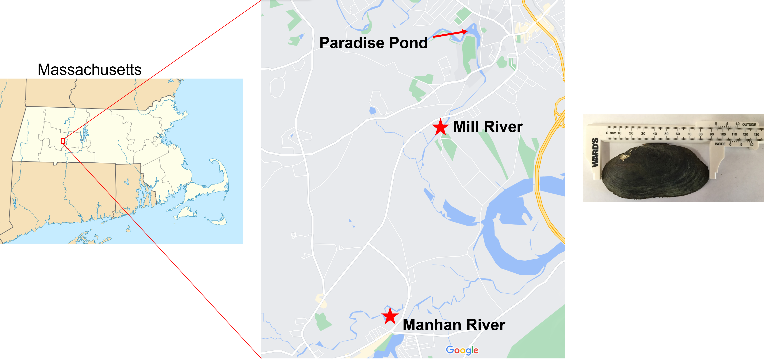
How does the population of Elliptio complanata mussels differ through time and location?
Notes:
Smith College faculty and students sampled Elliptio complanata mussels in two rivers in Western Massachusetts in June of 2016-2019 to determine whether or not the college’s management of sediment in Paradise Pond was impacting the mussels. At each sampling time, we set up a 10m by 30m area in the river and then chose x and y coordinates of predetermined number of random starts (in this case 3) using a systematic sampling technique (pages 10-18 in Strayer and Smith 2003). We placed a 50 cm x 50 cm quadrat at each set of coordinates, looked with a view bucket to see if any mussels were at the surface, then we excavated the substratum with a trowel or gloved hands down to about 15 cm. The excavated substrate was passed through a sieve with 4.67 mm mesh. All mussels found were identified to species, counted (also noted if on the surface or under the surface, alive or dead), and had their length measured to the 0.1mm.

Slide 4
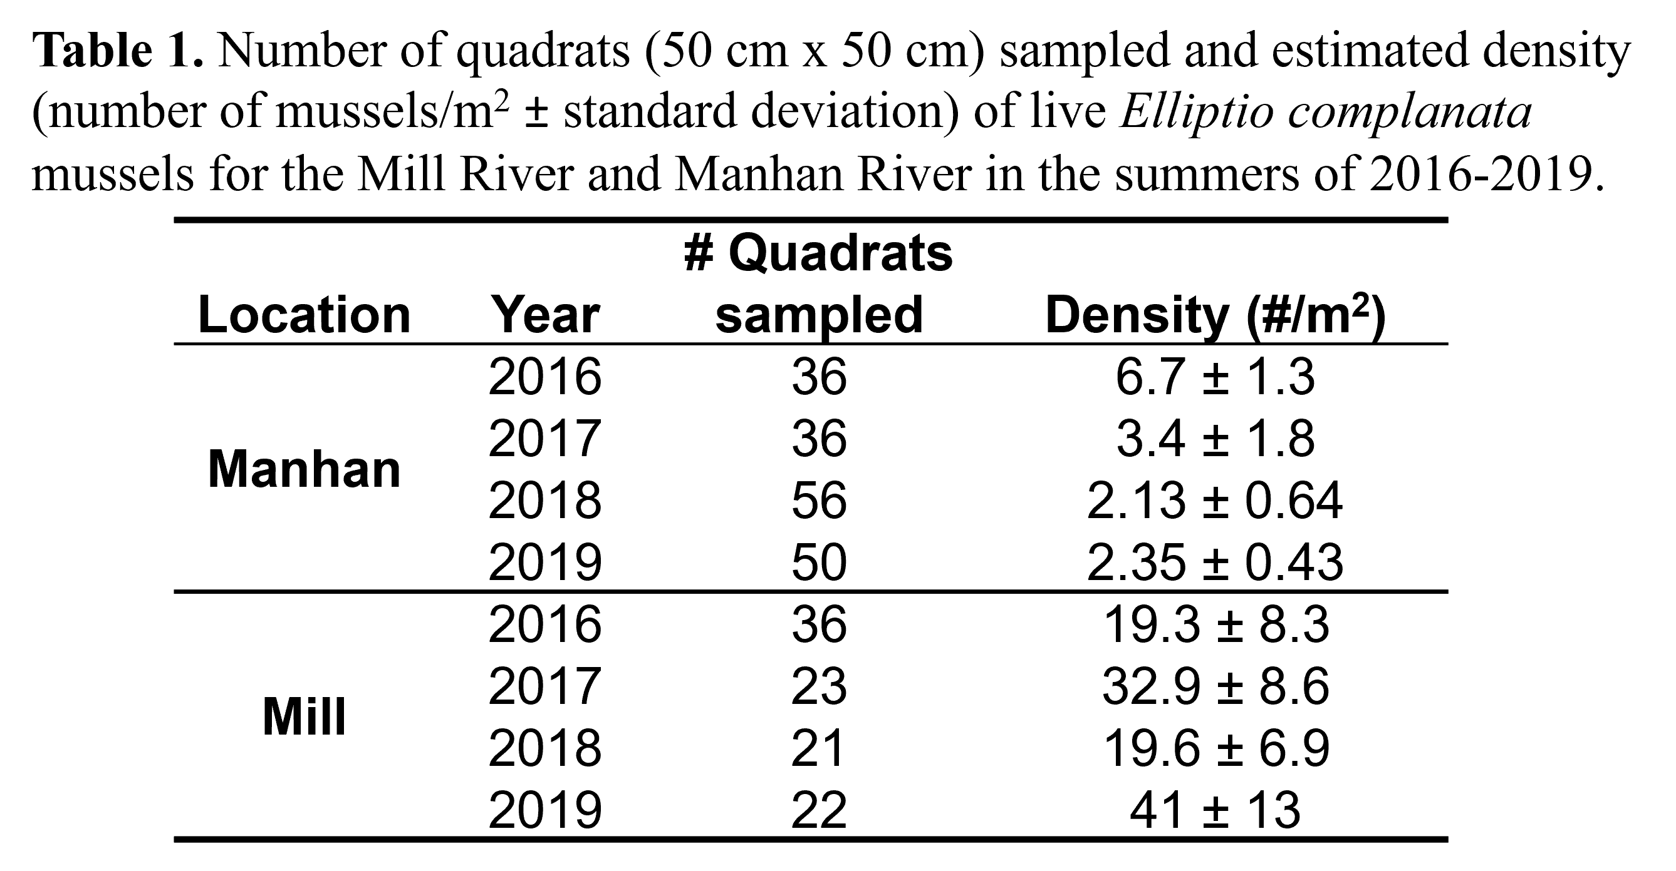
Mussel Density
Notes:
The density of mussels decreased in the Manhan River, but increased in the Mill River overall. How did the mussel size change?

Slide 5
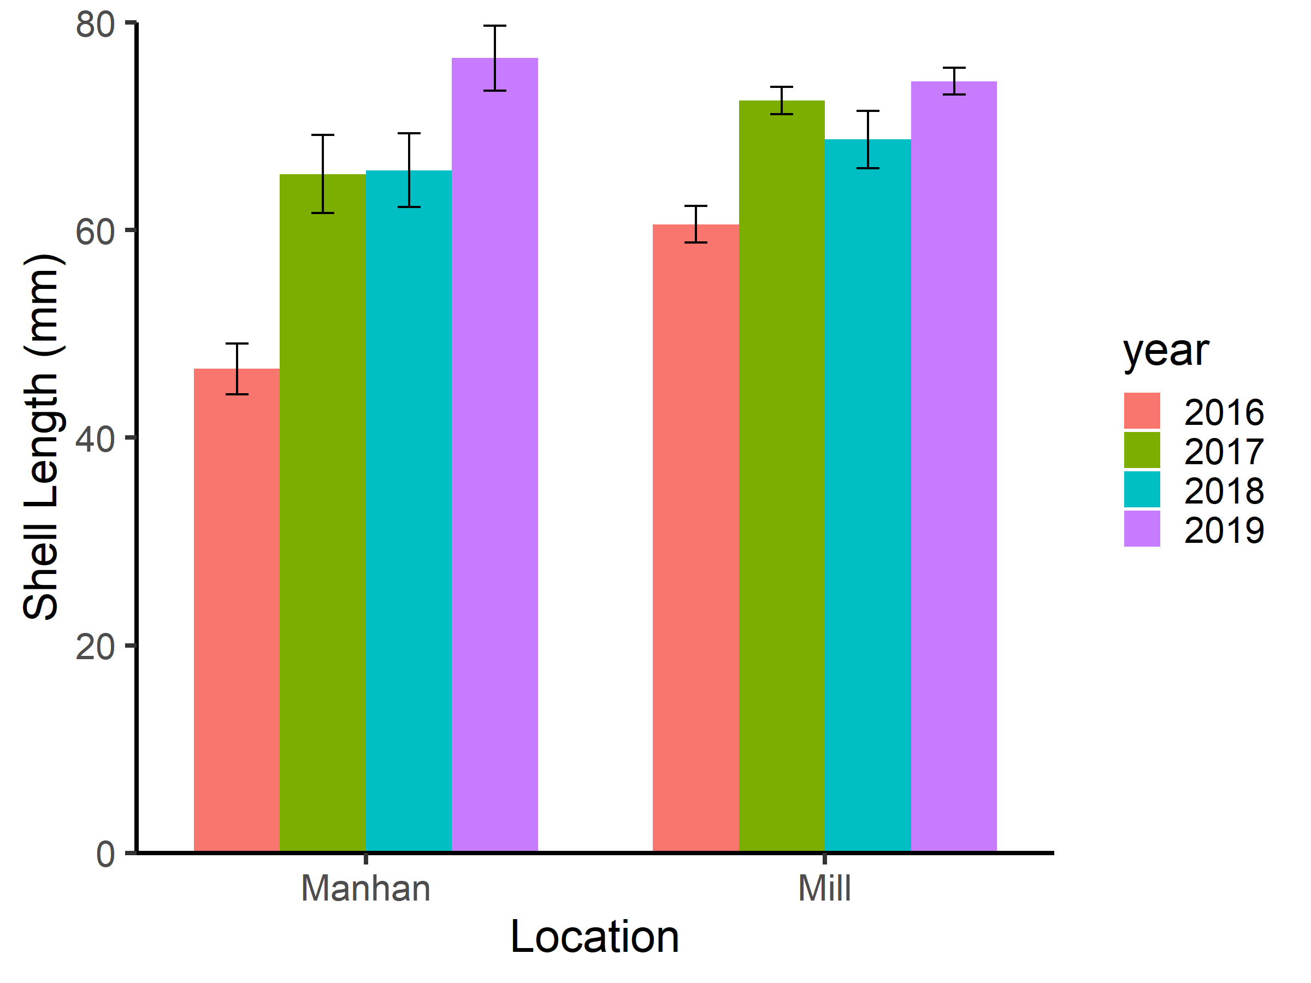
What does this Graph Tell us about Mussel Sizes?

Slide 6
https://raisethebar.netlify.app/chapter1
Notes:
This graph shows the average and standard error for shell length in each river in each year for live Elliptio complanata mussels. This is a very typical graph type used in biology, but is it the best type of graph to use in this case? Let’s go back to the website to see what information you can get (or not) from this type of graph.

Slide 7
Bar Graphs with Means & Error Bars Can Be Misleading
Does not show the distribution, range, or sample size of the actual values
Misleads because of common belief that values fall within the bar rather than above
You can get the same bars with very different distributions
See Weissgerber et al. 2019 paper from the journal Circulation
Notes:
Did those previous three questions help you see that bar graphs can be misleading? See Weissgerber et al. 2019 paper from the journal Circulation (as well as the references cited within) for a good overview of why it is recommended that you DO NOT use bar graphs for data with continuous dependent variables grouped by a categorical independent variable.

Slide 8
Bar graphs do not allow us to answer questions about
distribution,
sample size, or
range
Are there other graph types that can help use answer these questions more effectively?
Notes:
Bar graphs may not help use answer questions about the distribution, sample size, or range of data, but there are other graph types that can help us answer these questions.

Slide 9
Resources for Other Useful Graph Types
How to Interpret Boxplots
How to Interpret Violin Plots
How to Interpret Histograms
Dot plots using geebeeswarm in ggplot2
Note: We use the term “dot plot” here, but a plot that shows all the points for different groups can also be called a beewarm-stye plot, jitter plot, violin scatter plot, column scatter plot, jittered strip plot, jittered individual value plot, among others.
Notes:
There are lots of other graph types that can be useful for data with a continuous dependent variable grouped by a categorical independent variable.
Here are some resources if you are unfamiliar with box plots, violin plots, histograms, and/or dot plots to help you understand the different graph types we will be discussing

Slide 10
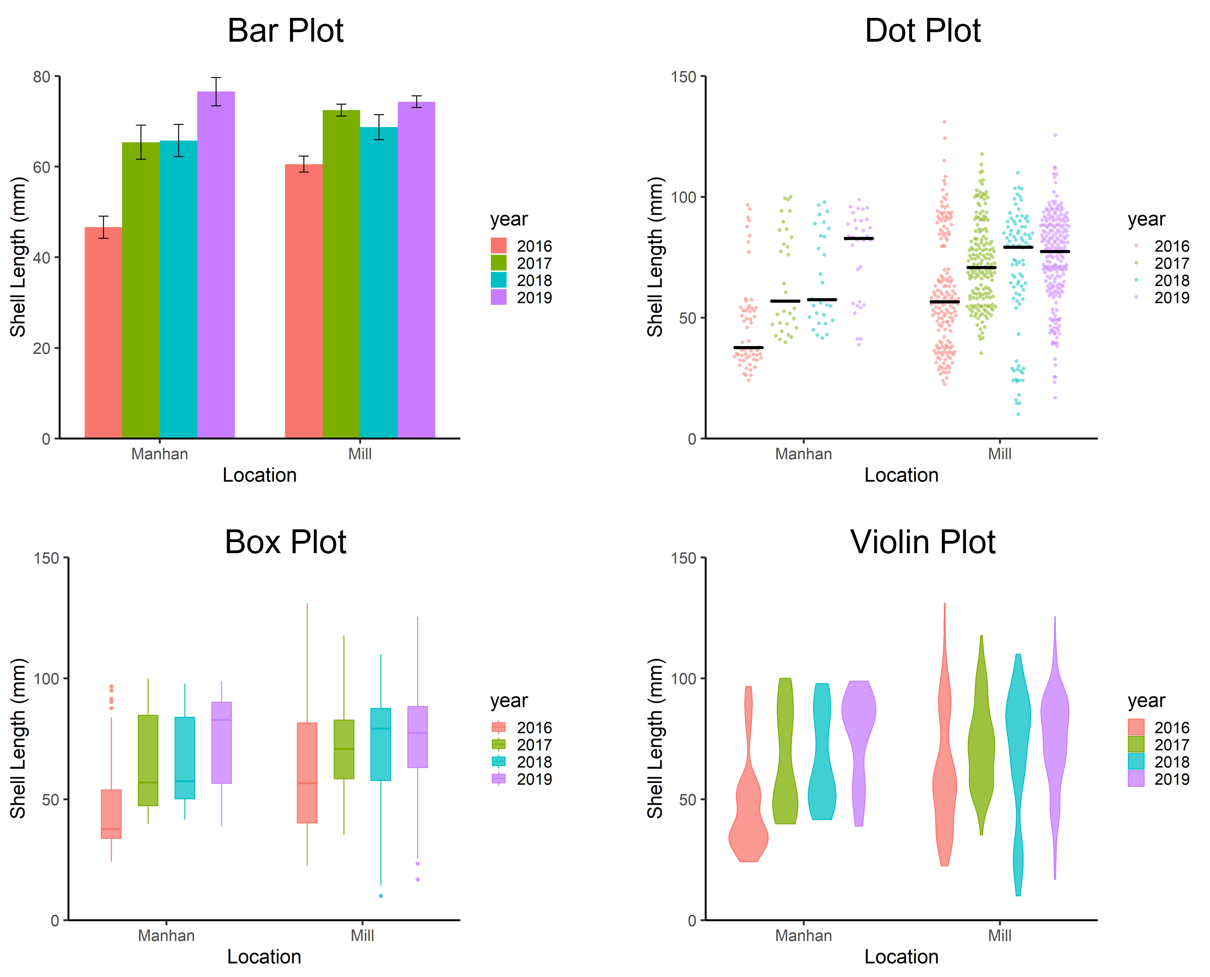
Mussel Length Data Graphed in 4 Ways
Notes:
Here we see the same Elliptio complanata mussel length data graphed in four different ways:
Bar plots showing the means and standard errors,
Dot plots showing individual points jittered to show the data distribution and the median shown as the horizontal bar,
Box plots showing the median (middle horizontal bar), middle 50% of the data (= the interquartile range shown as the box), whiskers (reach up to 1.5 times the interquartile range from the edges of the box), and outliers (points shown outside of the whiskers), and
Violin plots which show the distribution of the data as a mirrored, smoothed probability density curve. Go back to the previous slide and click on the resource links if you need help interpreting what these plots show. What are the pluses and minuses of each of these graph types?

Slide 11
Visualizing Grouped Continuous Data
Show all points or distribution when possible
Distribution of data & sample size determine summary statistics to use
Small samples size makes summary stats less reliable
Only use mean & SD if normal
Box plots should NOT be used for multimodal distribution
Notes:
Here are some key best practices to graph data with a continuous dependent variable and one or more categorical independent variables.

Slide 12
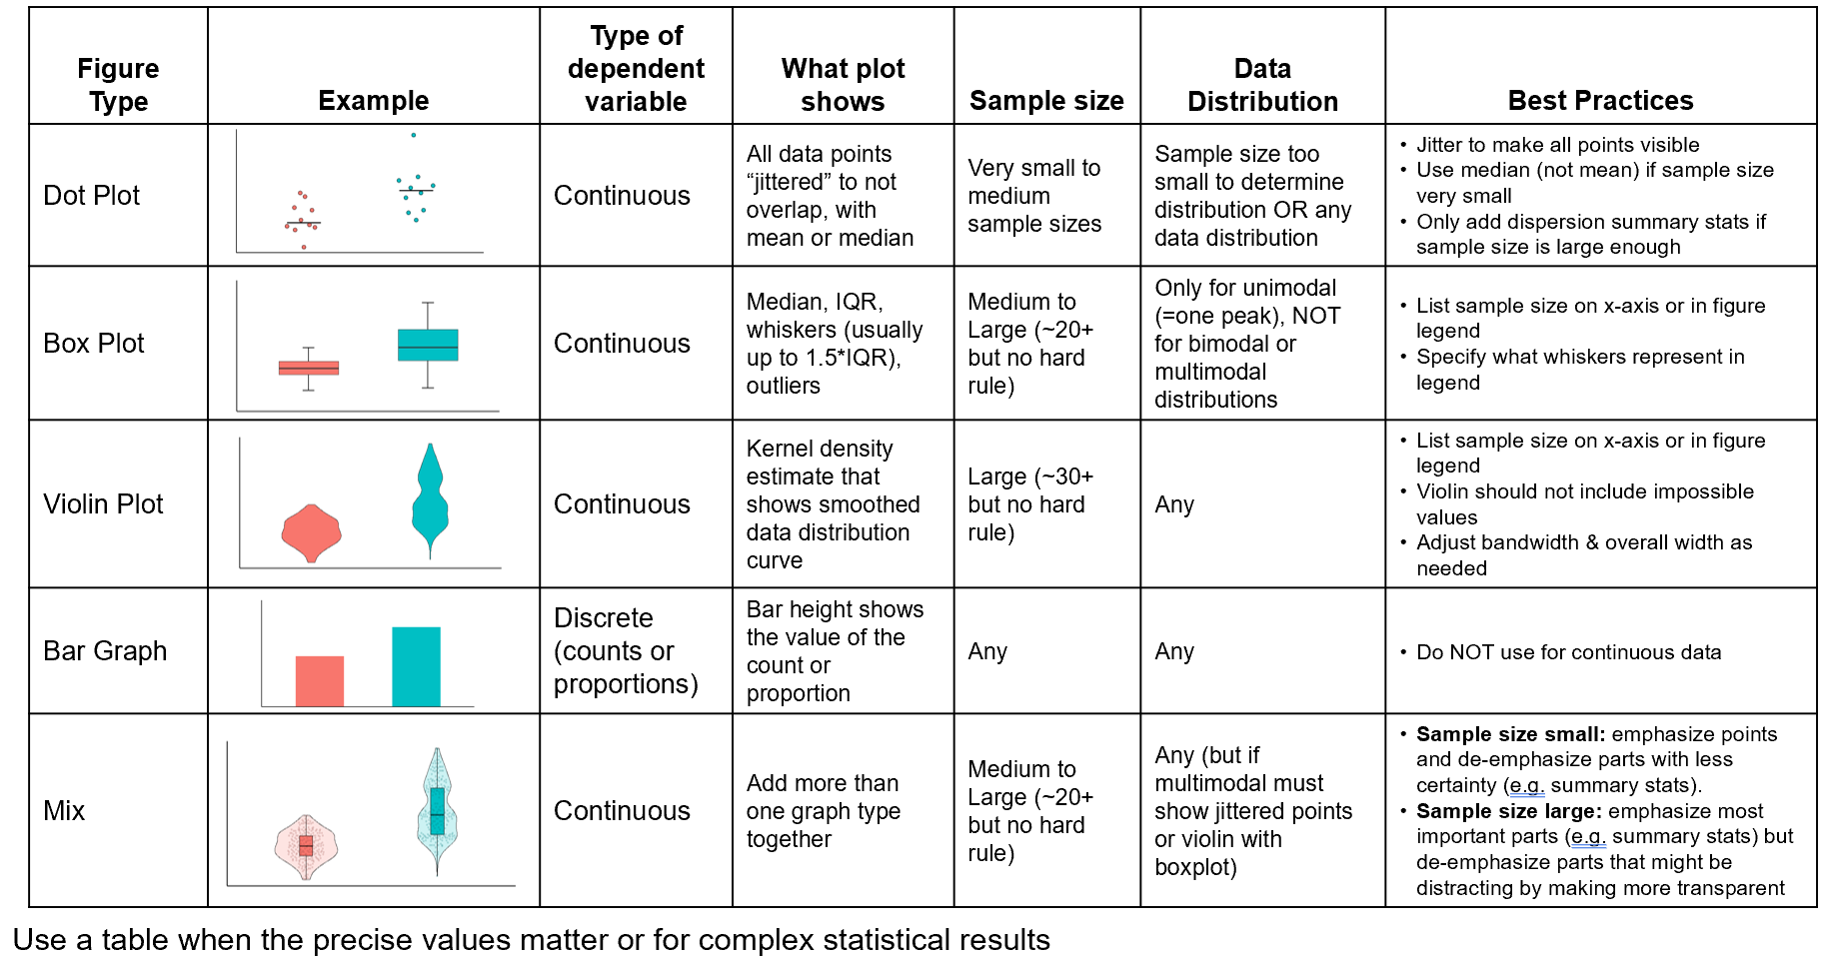
What Graph to Choose When You Have a Categorical Independent Variable
(adapted from Weissgerber et al. 2019 by Marney Pratt, March 3, 2022)
Notes:
Here are some more in depth best practices to help you choose the best graph type

Slide 13
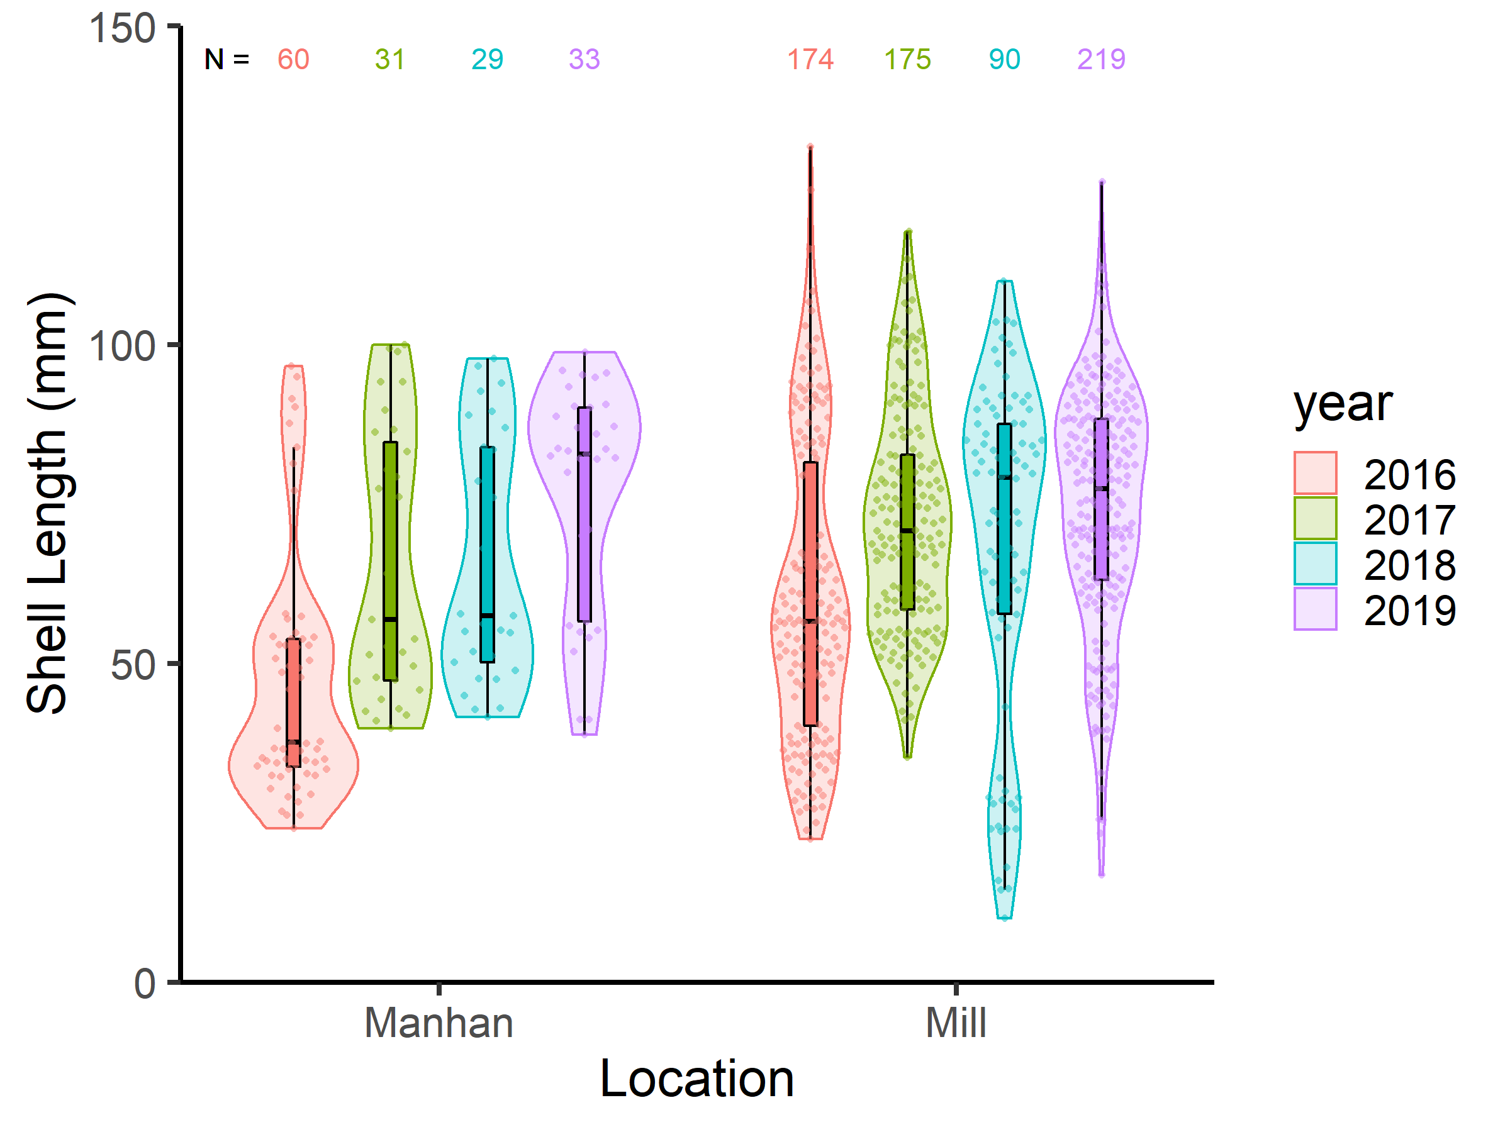
Mix and Match When Needed
Notes:
It can be helpful to mix and match different graph types to get the benefits of each to compliment each other. Here we have mixed a dot plot, box plot, and violin plot. The sample size for the number of mussels from each year in each river has also been added.
In this particular case, the distribution of mussel shell lengths is multimodal (several clumps), which suggests different size/age classes of mussels.
Since we moved sediment upstream of the mussels in the Mill River later in the summer of 2016, the 2016 samples collected early in the summer are considered our “before” samples, while the other years are “after” sediment redistribution. To see a negative impact of sediment redistribution on the mussels in the Mill River, we might expect to see a decrease in mussel density or size in the Mill River (our “impact” site) compared to the Manhan River (our “control” site) after sediment is moved.
It looks like there was a better recruitment of small mussels in 2018 in the Mill River. Note the median looks slightly higher in the Manhan River than the Mill River in 2019, but there are a lot more small mussels as well as some larger mussels in the Mill River. Since we find the mussel density has increased (see Table 1 in the chapter 1 Introduction slide set) and there is a good mix of sizes of mussels (including those that are smaller and larger than in the Manhan River). We don’t see any clear evidence of a negative impact of managing sediment upstream in Paradise Pond on the Mill River mussels.
Next we will practice using template code to make these different graphs using R

Slide 14
Why use R?
It’s free, open source
TONS of resources & flexibility
Lots of packages & functions specific to ecology
Online R community
Cool graphs: R Graph Gallery
Reproducible
Many journals now require code for analysis to be shared
Everything (clean, analyze, plot, communicate data) all in one
Highly transferable skill
Used by an increasing number of ecologists
Notes:
We can use R (an opensource programming language and environment) to make just about any graph you want, but it is not the easiest to learn. So why learn R? R is useful to learn because it is free, flexible, reproducible, transferable, and used by an increasing number of ecologists.
When it comes to graphing grouped continuous data like, we have seen that bar graphs can be misleading and there are a variety of other graph types that are better. Some of these graph types (such as dot plots) can be really hard to get other software to do well (for example, Excel can’t do them well).

Slide 15
Can You Learn R or Teach it to Students with NO Experience?
YES!
Start with code templates to make different graph types
Tip: Manipulating data (“data wrangling”) is much harder than graphing. For people just starting in R, we recommend doing the data wrangling in a spreadsheet program or use already prepared data. Beginners will have a better experience just using R for graphing with template code.
Notes:
Graphs are fun to make and if you have a code template or example to tweak, it isn’t that hard to make an impressive one.
Manipulating data (often called “data wrangling”) to get it in the right format to use in analysis can often be the hardest part of any analysis process (and learning how to do this with code is a steep learning curve). So you can have novice learners prepare the data in a spreadsheet program they already know (such as Excel or Google Sheets), import into R (or provide cleaned up data already imported), and then use code templates to get the graphs you want.

Slide 16
Let’s Make some Graphs!
https://raisethebar.netlify.app/chapter2
Tip: During very first exposures, it can be helpful if the learner doesn’t have to install anything - not R, RStudio, or packages.
The “Raise the Bar” website is one option for exposing novices to how to make some different graphs using R code templates without having to install anything. All you need is a browser and internet access!
Notes:
When learning as a novice or teaching novices, it can be helpful to start with most of the code for a particular graph type already written with just some blanks for the data, variables, and labels. Then users can fill in the blanks and tweak the code as desired if they want to try changing other aspects (colors, size, fonts, etc).
During very first exposures, it can be helpful if the learner doesn’t have to install anything - not R or RStudio (the two software packages needed to run R locally on your computer) and not any packages (packages that can expand the capabilities of base R to do all kinds of things are often needed and must be installed before first use).
The “Raise the Bar” website is one option for exposing novices to how to make some different graphs using R code templates without having to install anything. All you need is a browser and internet access.

