Slide 1
Catapult – Lab 2: Task Scheduling/Loop Pipelining
Margomenos Nikos

Slide 2
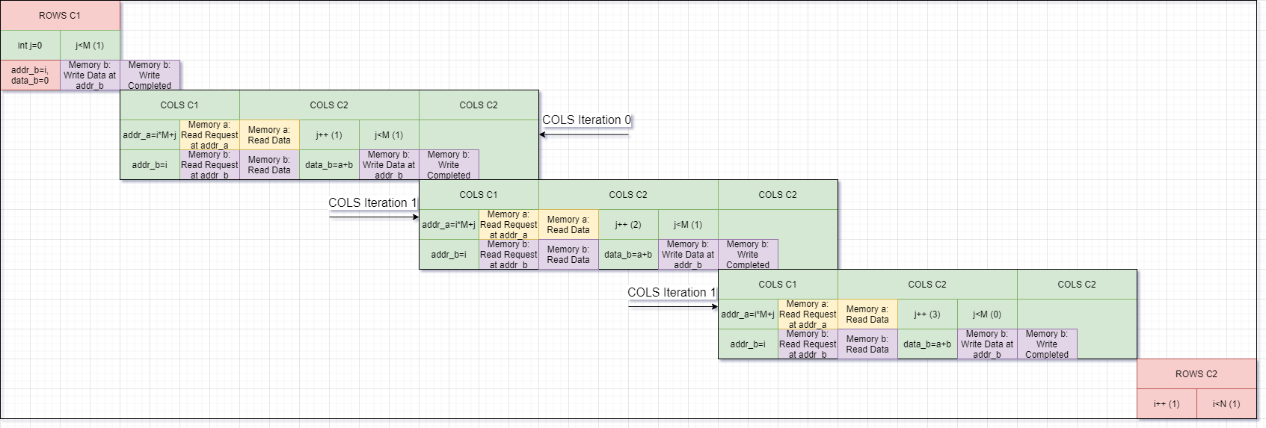
Initial Design – COLS Pipeline
Single-port memories:
Only one read or write can occur per cycle
Each read/write takes 1 cycle
Reading & writing to memory back-to-back requires at least 2 clock cycles:
Initiation interval cannot be less than 2 (II=2)
This scheduling requires:
1 cycle to initialize row sums (5 cycles)
2 cycles to read & write an element (30 cycles)
1 additional cycle for the last element of each row (5 cycles)
1 cycle to prepare for the next ROWS iteration (5 cycles)

Slide 3
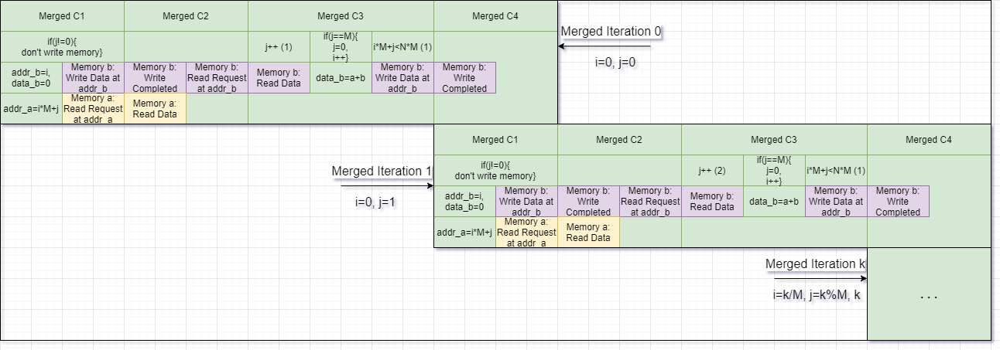
Initial Design – Main Pipeline
Having 2 nested loops hinders performance:
1 wasted cycle to prepare for the next ROWS iteration (5 cycles)
1 wasted cycle for breaking the pipeline at the last element of each row (5 cycles)
However, merging these two loops adds another stage in the pipeline:
Once every 3 iterations, an extra write is required to initialize row sums
Initiation interval increases to 3 (II=3)
This scheduling requires:
3 cycles to initialize, read & write an element (45 cycles)

Slide 4

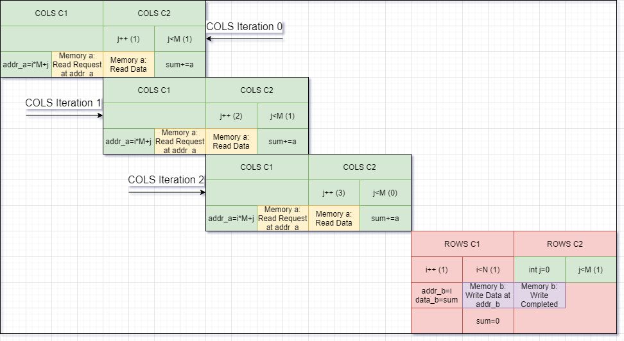
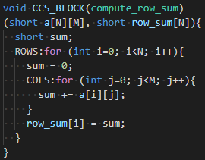
Improved Design – COLS Pipeline
By observing this design, there is no need to read from the return array before writing back to it. The previous sum can be kept internally in a local register.
Reading from memory requires only 1 clock cycle:
Initiation interval can be 1 (II=1)
This scheduling requires:
1 cycle to read an element (15 cycles)
1 additional cycle for the last element of a row (5 cycles)
2 cycles to write each output & to reset local sum (10 cycles)

Slide 5
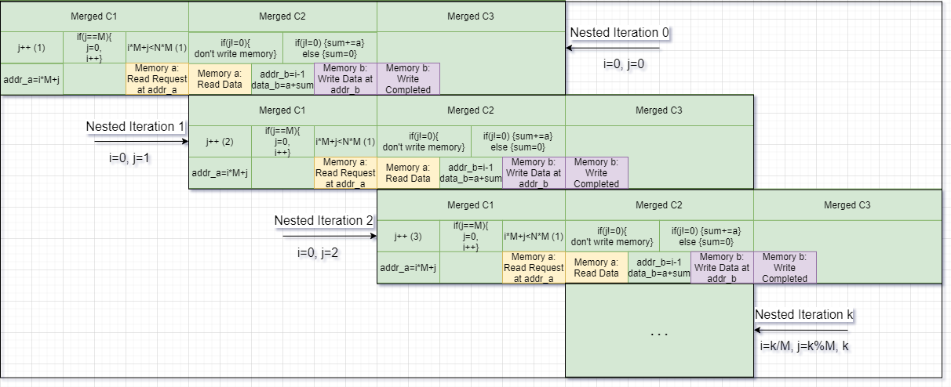
Improved Design – Main Pipeline
Merging the two loops creates the following pipe:
Read – write
The write occurs only once every 3 iterations
To pipeline this design, a read can be performed alongside with a write:
Initiation interval remains 1 (II=1)
This scheduling requires:
1 cycle for each read & write (15 cycles)

Slide 6
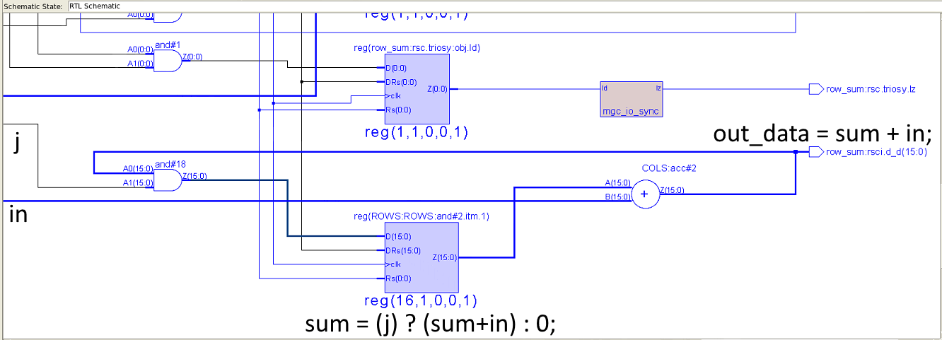
Improved Design – Main Pipeline

