Slide 1
Catapult – Lab 4: Hardware Accelerators
Margomenos Nikos

Slide 2
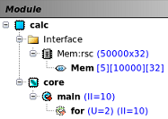
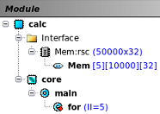

Exercise 1: Loop Acceleration
Code:
Highest Attainable Throughput:
Available Hardware:
One single-port memory
One multiplier
One adder
Limitations:
There are 4 read and 1 write operations, for a total of 5 consecutive memory accesses
Best-case scenario:
Theoretical pipeline with ii = 5
Practically implements unroll = 2 & ii = 10
Settings & Results:
#Note: A pipeline with ii = 5 cannot be applied to the main loop

Slide 3
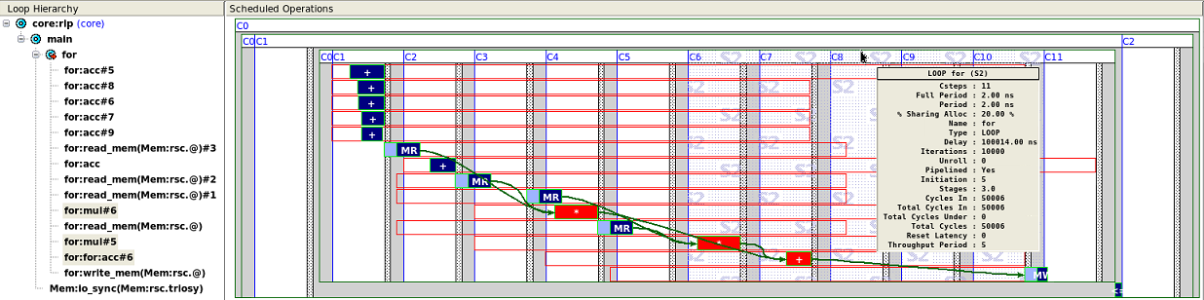
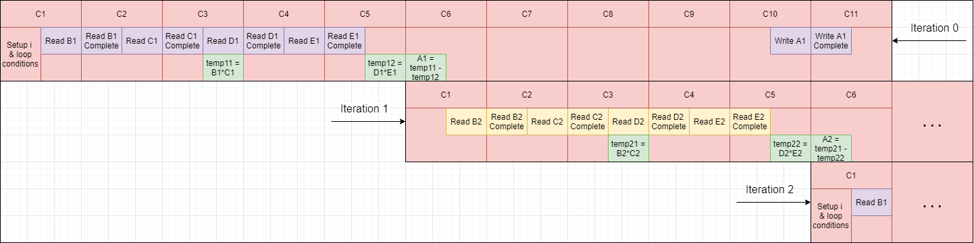
Exercise 1: Scheduling (ii = 5 & unroll = 0)

Slide 4
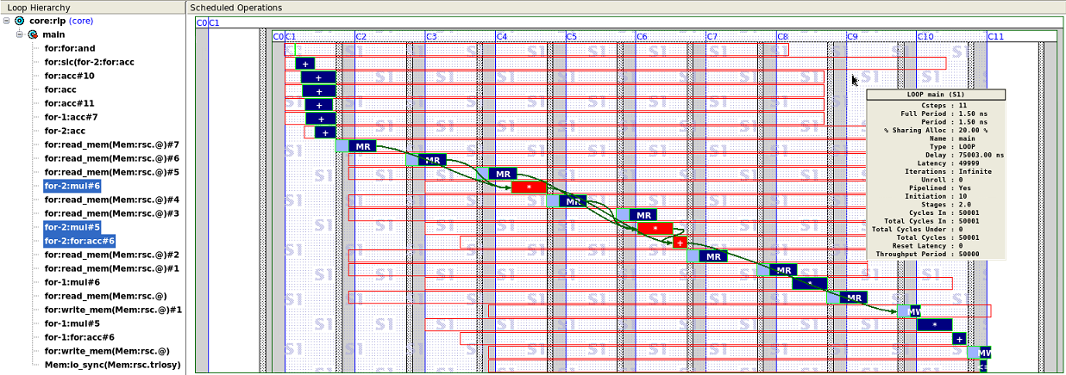
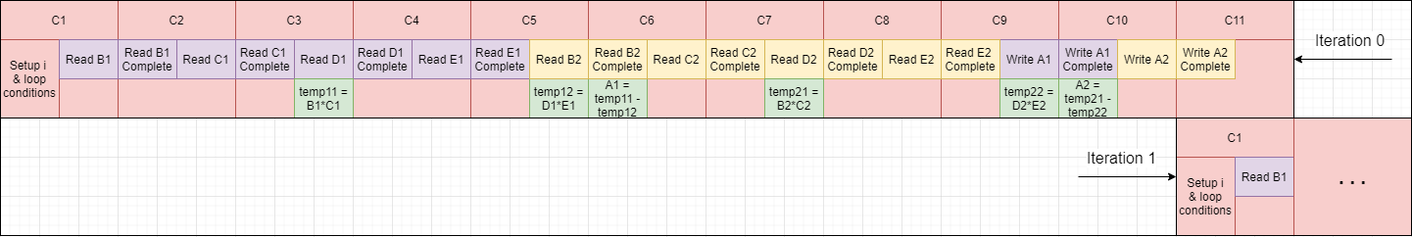
Exercise 1: Scheduling (ii = 10 & unroll = 2)

Slide 5
Exercise 2: Mean Filter Acceleration
Default Code:
Improved Code:

Slide 6
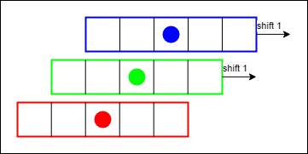
Exercise 2: Mean Filter Acceleration
Settings/Results (default code):
Settings/Results (improved code):
Limiting factors:
Available resources are a factor:
5 read operations from a dual-port memory, for a total of 3 consecutive cycles for memory accesses
Dependencies are not a factor:
1 write operation but to a different memory, therefore no feedback path is created
Best-case scenario:
Pipeline with ii = 3 wastes memory resources (only 1 read @ 3rd cycle)
Unroll = 2 allows 10 read operations in 5 cycles, and so it can be pipelined with ii = 5
Reduced read operations:
Neighboring pixels have overlapping kernels that do not need to be read from scratch in each iteration
With each shift, one pixel is read and one pixel is written. The dual-port memories allow for 2 shifts in 1 cycle, with a pipeline of ii = 1 (no unroll)
When changing to a new row, an extra cycle is required for the first kernel

Slide 7
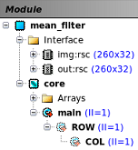
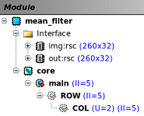
Exercise 2: Mean Filter Acceleration
Best throughput (default code):
Best throughput (improved code):
Expected results:
10(rows) * 26(columns) = 260 pixels
260 * 5(kernel) = 1300 reads
1300 / 2(reads/cycle) = 650 cycles
Total throughput: 650 cycles
Expected results:
10(rows) * 26(columns) = 260 pixels
260 / 2(reads/cycle) = 130 cycles
10(rows) * 1(cycle/row) = 10 cycles
Total throughput: 140 cycles

Slide 8
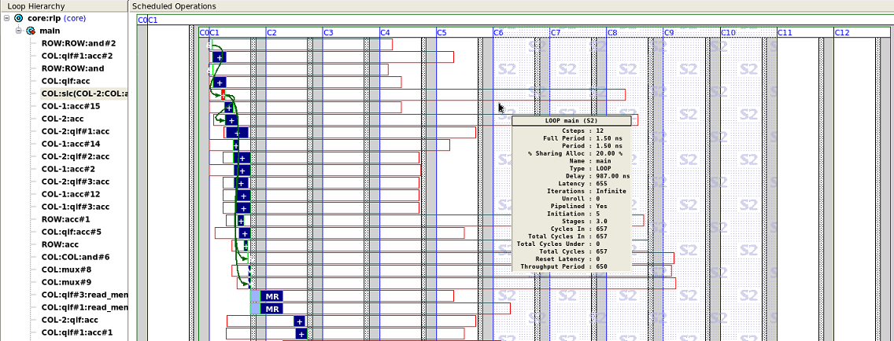
Exercise 2a: Scheduling (ii = 5 & unroll = 2)

Slide 9
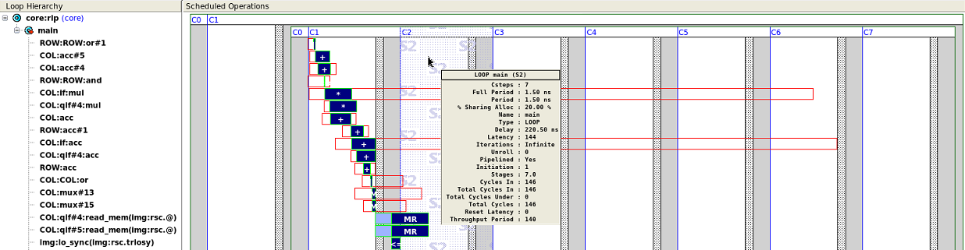
Exercise 2b: Scheduling (ii = 1)

