Slide 1
Catapult – Lab 3: Color Nodes: Maximum Throughput
Margomenos Nikos

Slide 2
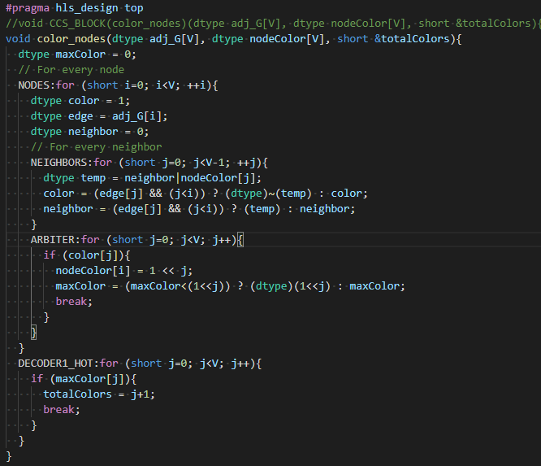
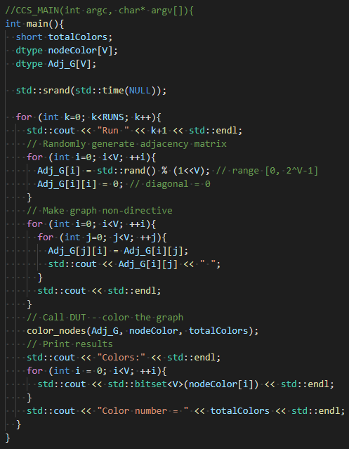
Algorithm Implementation & Code

Slide 3
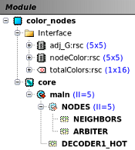

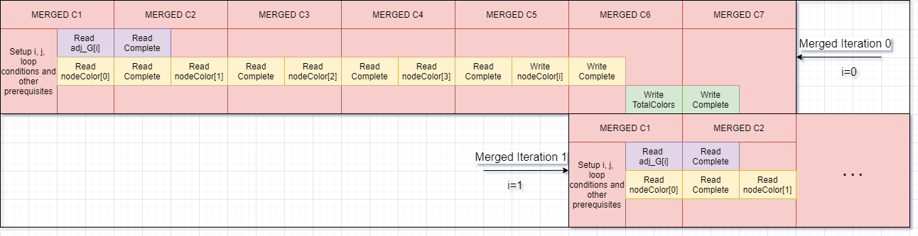
Maximum Throughput with Unroll & Pipeline
Combinational logic procedures are unrolled in order to be executed within a single cycle:
ARBITER
DECODER1_HOT
NEIGHBORS loop is unrolled to create a deeper but more efficient main pipeline with less wasted stages (II=5) :
Not unrolling the loop would create a pipeline with II=2, but that would need 8 cycles per array row (3 wasted cycles)
For a 5x5 array, this scheduling requires 5 cycles per array row (25 cycles)

Slide 4
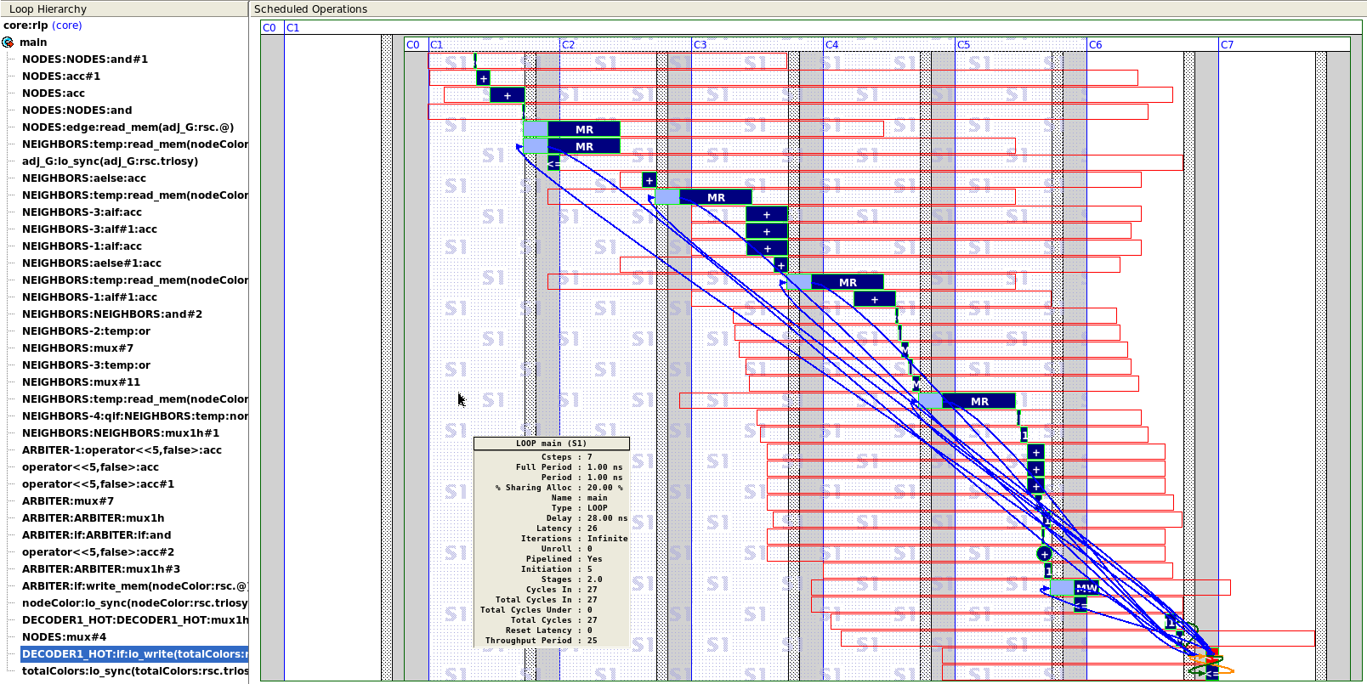
Maximum Throughput with Unroll & Pipeline

Slide 5
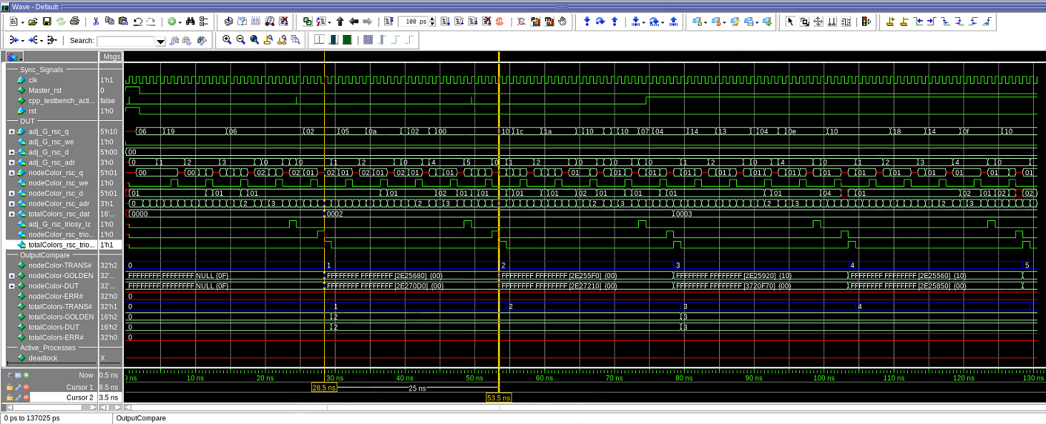
Questa Sim: Simulation & Results

Slide 6
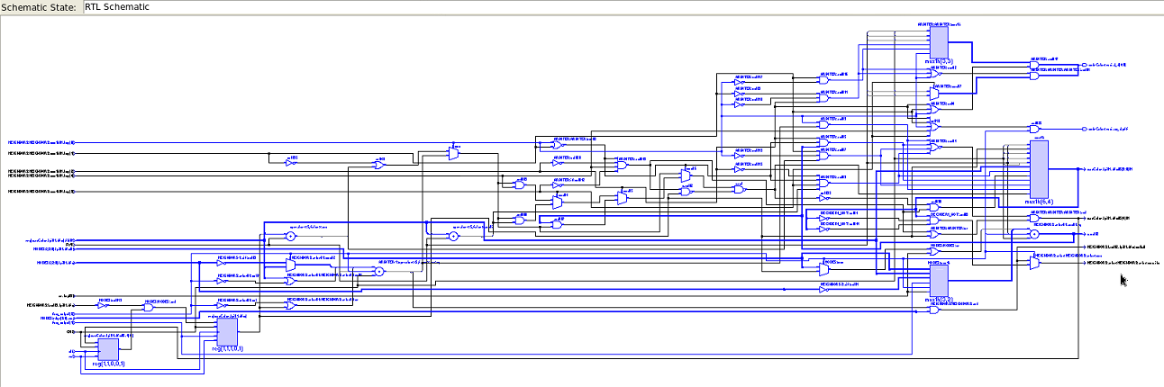
Improved Design – Main Pipeline

