Slide 1
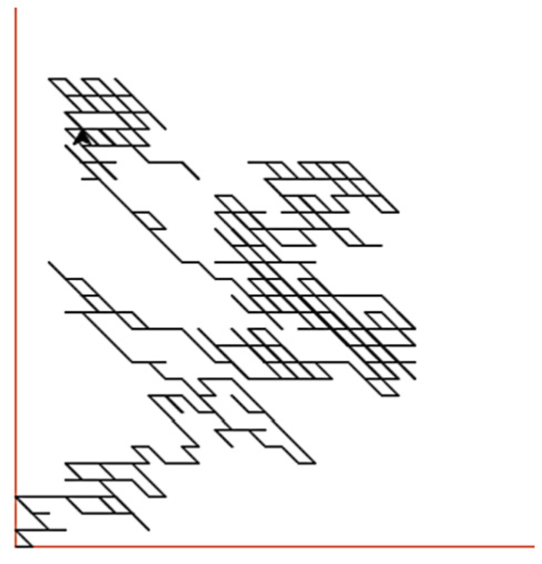
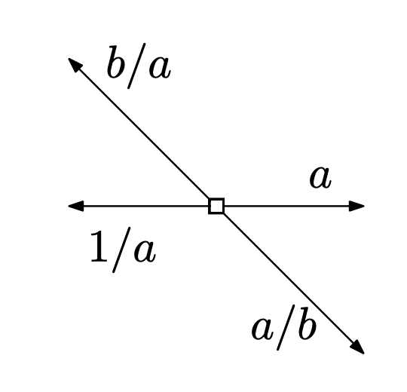
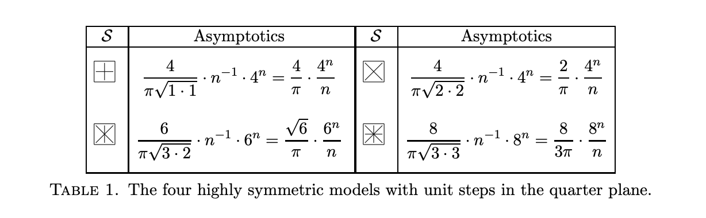
Goal: Understand asymptotics for weighted reflectable walks
Notes:
Main Question: What are the weighted asymptotics of weighted walks in Weyl chambres? There will be different regimes based on the weights; part of the question is understanding when these regimes change over, and this comes from understanding the critical points

Slide 2
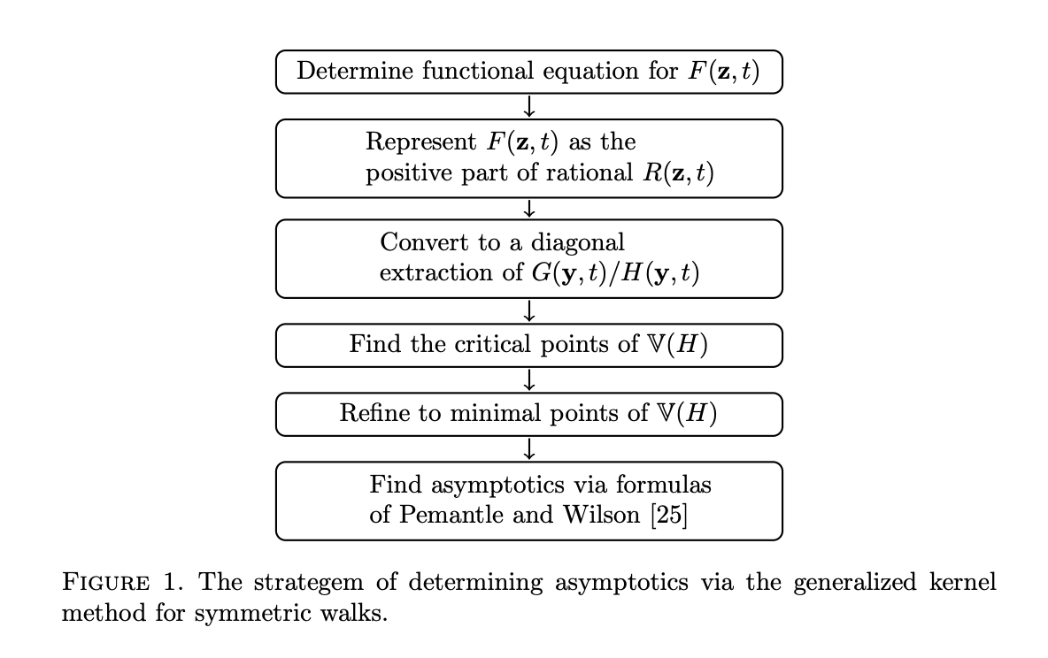
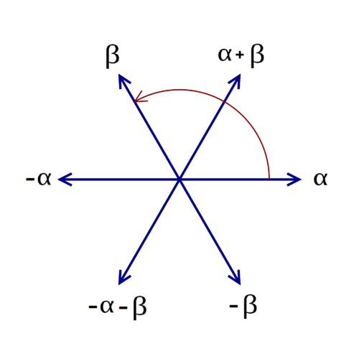
Goal: Understand asymptotics for weighted reflectable walks
Melczer & Mishna
Notes:
The Weyl chambre part is wrapped up in getting the rational expression: i.e. “highly symmetric gives us the first arrow.”
General nonsense gives us the second arrow.
Our coding trouble was in the fifth arrow, namely we kept trying to apply inappropriate formulae for our critical points

Slide 3
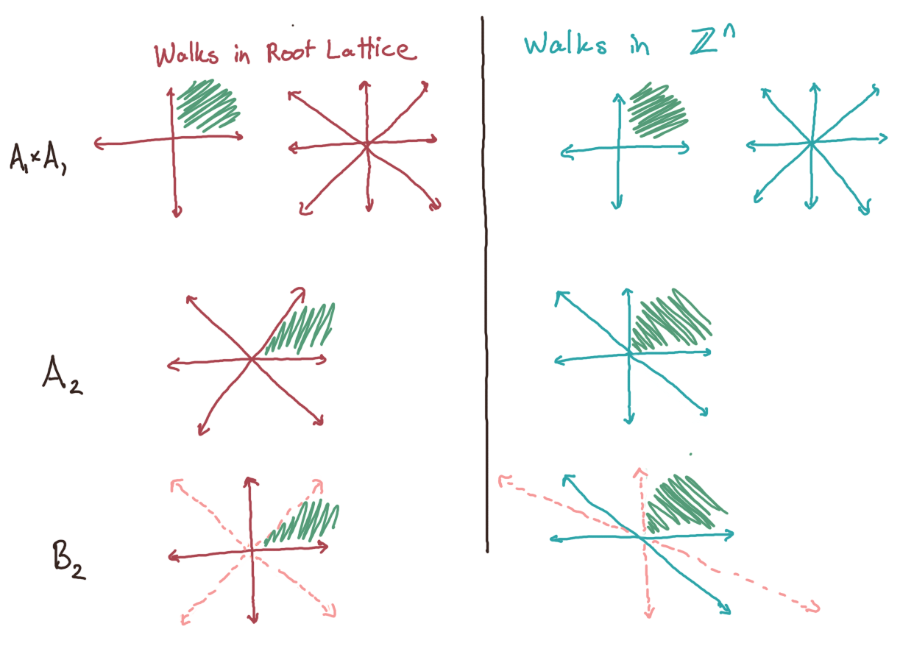

Slide 4
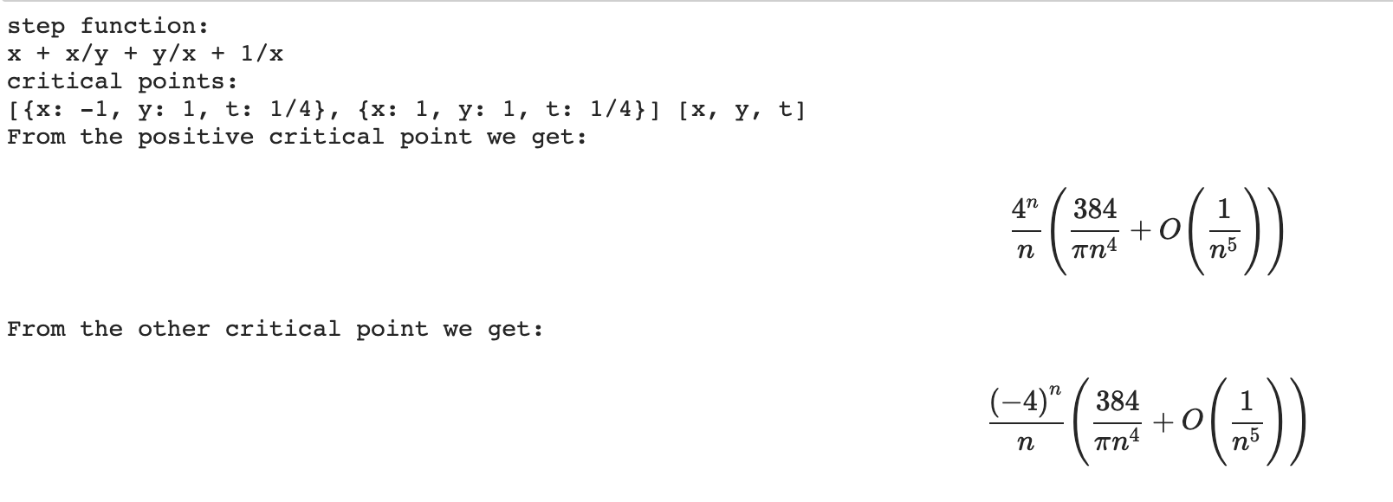
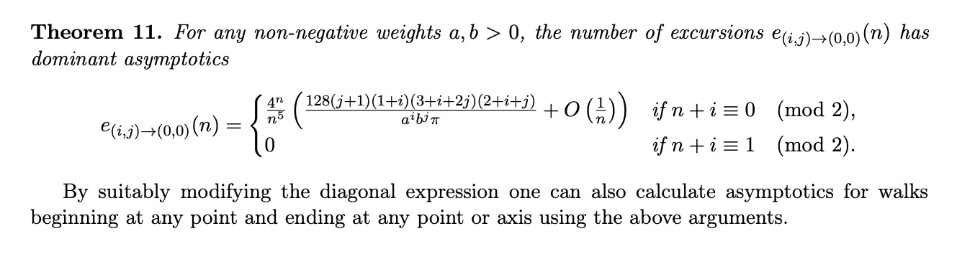
Example: Asymptotics for Gouyou-Beauchamps excursions
Courtiel, Melczer, Mishna, Raschel
Notes:
For instance we computed the asymptotics for excursions with this step set, which comes from the root system B_2
What we’re showing is the unweighted case
The code filters to only consider critical points with positive coordinates
In this case there is a second critical point we have to consider
We compute the contribution for each of the critical points and we get 0

Slide 5
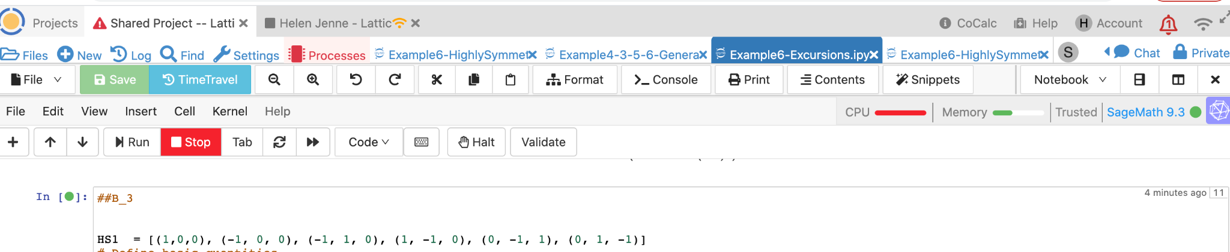

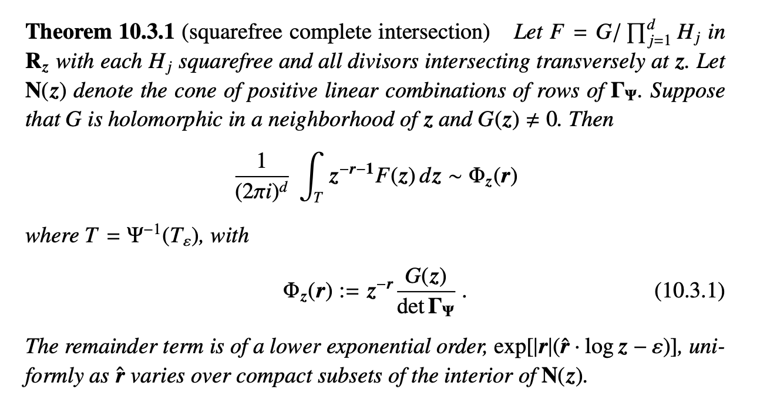
Next Steps
Pemantle, Wilson
Notes:
The code assumes we’re in the smooth case, so it isn’t appropriate for the examples we want to do
In the previous example it only found the contribution from the positive critical point
We’re going to apply a theorem from section 10.3 of Robin and Marc’s book, which is for points that are complete intersections
We expect that this will be faster than the code we’re currently using.
We will also be able to look at weighted models.
If we start with large weights, we won’t have to go through the computationally expensive steps

Slide 6
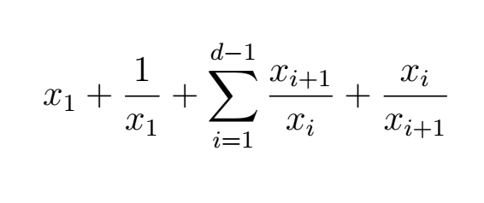
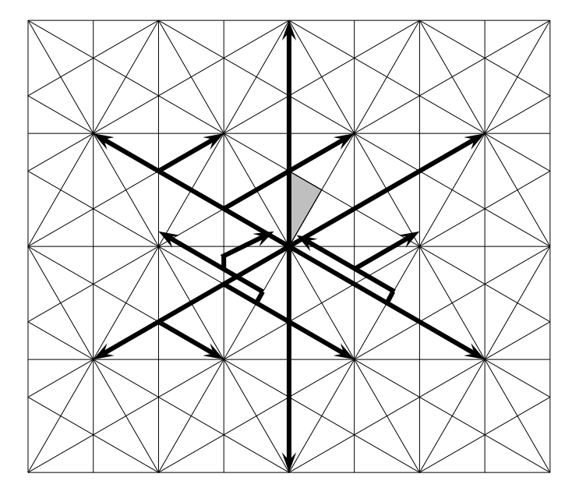
Next Steps
Step function for B_{d}:
Data collection
How are the weights being processed?
Walks for G₂
Notes:
We want an asymptotic formula for reflectable weighted walks in the root system for B_d
The step function shown restricted to the nonnegative orthant corresponds to a reflectable stepset in B_d
We will then go through the computation by hand to see if we can keep track of how the weights are being processed.

Slide 7
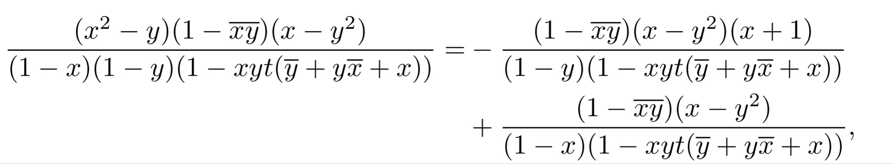
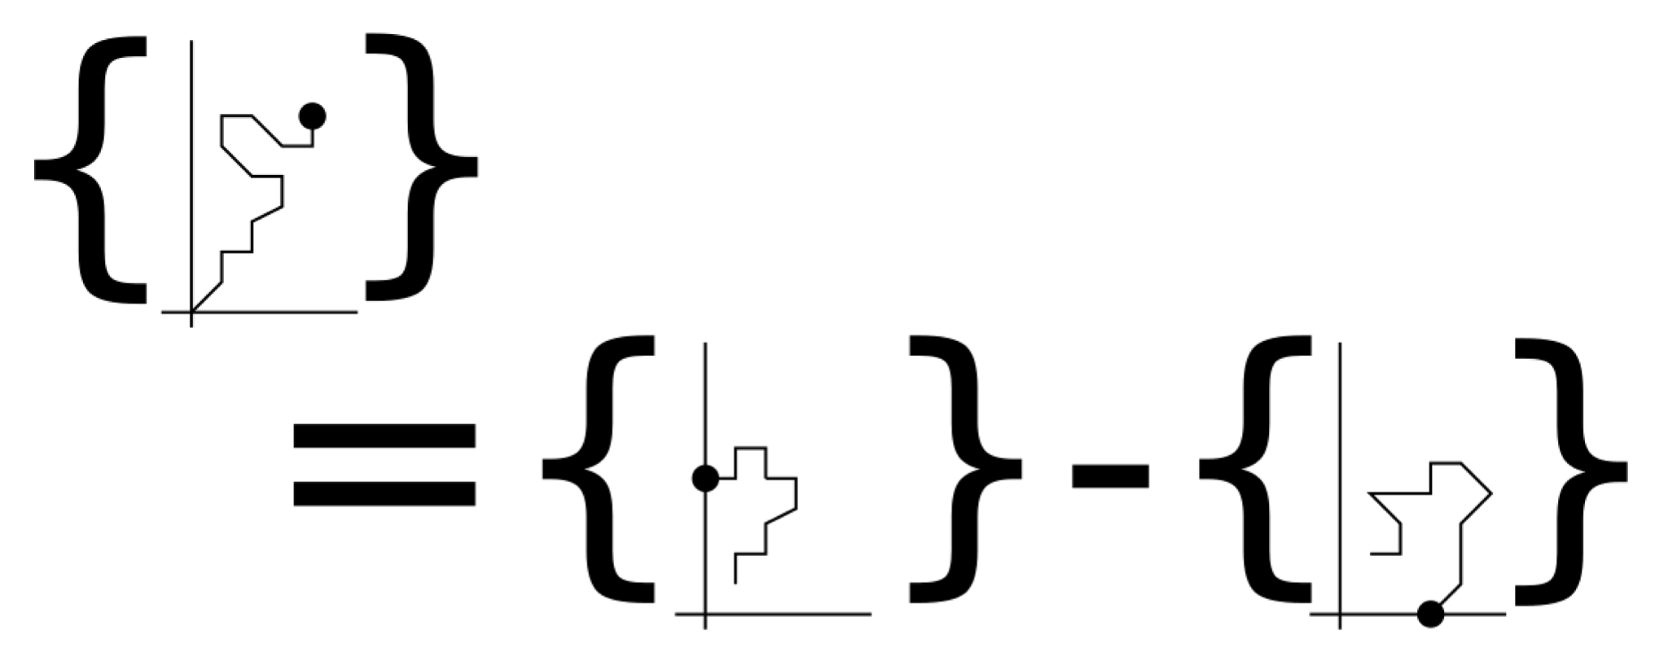
Next Steps
Combinatorial identities?
Melczer, Wilson

