Slide 1

Who Wins the "Phone" Search on Amazon?
Market analysis of 311 Amazon US phone listings — brands, prices, promotions and stock risk
Data Analysis Diploma · Final Project
Tools: Python (pandas) · SQL Server · Power BI
Notes:
Introduce the team and the question: in the Amazon search for "phone", which products, brands and price points capture demand — and what should a seller or category manager do about it? We used Python for cleaning, SQL Server for storage, validation and modelling, and Power BI for the dashboard.

Slide 2





Project pipeline
Each tool does the job it is best at — and every stage is reproducible
Raw data
Python
SQL Server
Power BI
Insights
phone_search_raw.csv
340 rows · 20 columns
Profile, clean, engineer
20 → 45 columns
Star schema, validation,
views, 10 business queries
2-page dashboard,
27 DAX measures
Conclusions &
recommendations
Deliverables in the project folder: 01_Data · 02_Python (notebook) · 03_SQL (5 scripts) · 04_PowerBI (dashboard + DAX + theme) · 05_Presentation · 06_Documentation
2
Notes:
Walk left to right. Python handles the messy text parsing; SQL Server enforces types, constraints and gives Power BI a clean star schema through views; Power BI turns it into an interactive dashboard.

Slide 3
The dataset: Amazon US search results for "phone"
One row = one product listing on the search results page
What
Product listings returned when a shopper searches "phone" on Amazon.com — smartphones, landlines, flip phones, accessories.
340
20
Source
Collected through a real-time Amazon product-search API (RapidAPI "Real-Time Amazon Data" schema), exported to CSV.
raw rows
raw columns
When
Snapshot of 19 September 2024 (derived from delivery text "Tomorrow, Sep 20").
311
41
Why it matters
Shows what shoppers see and buy: price, reviews, badges, discounts and a monthly sales badge.
unique, priced listings
brands
3
Notes:
Explain where the data came from and its limits: it is a single snapshot of one search keyword, so it describes what is visible and selling in that moment, not the full phone market.

Slide 4






What each column means
20 raw columns in six groups — full dictionary in 06_Documentation/Data_Dictionary_and_Issues_Log.xlsx
Identity
Price
Reputation
asin
Amazon product ID
product_title
Listing name (brand, model, specs)
has_variations
Has colour/size variants
product_price
Current price
product_original_price
Crossed-out list price
product_minimum_offer_price
Lowest seller price
currency
Always USD
product_star_rating
Average stars 1–5
product_num_ratings
Number of reviews
product_num_offers
Number of sellers
Badges
Logistics
Sales & offers
is_best_seller
#1 Best Seller
is_amazon_choice
Amazon's Choice
is_prime
Prime eligible
climate_pledge_friendly
Sustainability badge
delivery
Delivery promise text
product_availability
"Only N left in stock"
sales_volume
"X+ bought in past month"
coupon_text
"Save 10% with coupon"
unit_price / unit_count
Multipack pricing
4
Notes:
Do not read every column; highlight that several important ones (sales_volume, delivery, availability, coupon) are free text and need parsing before they can be analysed.

Slide 5





17 data-quality problems found during profiling
Grouped into five types — every one has a documented rule in the notebook
Duplicates
25 rows
21 exact copies + 4 same-ASIN rows with different price
Wrong data types
5 columns
Prices as "$1,614.99 ", sales as "1K+ bought…", dates as "Tomorrow, Sep 20"
Missing values
6 columns
No price (4 rows), no list price (57%), no sales badge, no rating, 99%-empty columns
Wrong / merged values
96 cells
Stock text inside delivery column; page labels scraped into sales_volume; HTML codes in titles
Missing structure
all rows
No brand, category, condition or storage column — cases mixed with $1,600 phones
5
Notes:
The biggest analytical risk was not missing values but missing structure: without a category column, averages mix phone cases with flagship phones. The sales column is also only a lower bound.

Slide 6
How we solved them — and why
Rules are explained, not just applied; removed rows are kept in rejected_rows.csv for audit
Problem | Example | Solution (Python) | Why this rule
Duplicate listings | Same ASIN on 2 result pages | drop_duplicates(); keep first (best rank) | Double counting inflates revenue
Price as text | "$1,614.99 " | Strip $ , spaces → float | Needed for sums, bands, DAX
No price (4 rows) | Unavailable offer | Exclude, log in rejected_rows.csv | Cannot value a product with no price
Empty list price | 192 nulls | list_price = price, discount = 0 | Null means "no discount", not unknown
Sales badge text | "1K+ bought in past month" | Regex → 1000 (lower bound) | Turns text into a measurable demand proxy
Mis-scraped badge | "More Buying Choices" | Treat as no badge → 0 units | Page label, not a sales figure
Merged columns | "…Sep 24 Only 1 left in stock" | Regex split → stock_left + delivery date | One fact per column
No category / brand | "TracFone | Motorola Moto g…" | Rule-based classifier + brand map (41) | Compare like with like
Rating with 0 reviews | star_rating = blank | Keep NULL + is_rated flag | 0 stars would bias averages
6
Notes:
This slide answers the brief's warning: explain the solution. For each issue state the rule and the reason. Mention the sanity checks: list price is never below price, minimum offer is never above price — both verified with asserts in Python and CHECK constraints in SQL.

Slide 7
From messy text to analysis-ready features
20 raw columns → 45 clean columns
Raw value
Engineered features
product_title
brand = Samsung · category = Smartphone · condition = Renewed · lock = Unlocked · 5G · 128 GB
"Samsung Galaxy S21 5G, US Version, 128GB … Unlocked (Renewed)"
sales_volume
monthly_units_min = 2000 · sales_band = "4. 1K+" · est_monthly_revenue = price × units
"2K+ bought in past month"
delivery
free_delivery = True · delivery_date = 2024-09-24 · days_to_delivery = 5 · stock_left = 1
"FREE delivery Tue, Sep 24 Only 1 left in stock"
coupon_text
coupon_type = Percent · saving = $1.80 · net_price_after_coupon
"Save 5% with coupon"
price + list price
discount_amt = $70.99 · discount_pct = 41.8% · price_band = $50–99
$99.00 vs $169.99
7
Notes:
The category classifier was checked manually against every one of the 311 titles: 206 smartphones, 76 landline/cordless, 11 basic/flip, 16 accessories, 2 toy phones.

Slide 8

SQL Server: a validated star schema for Power BI
5 scripts: schema → load → validation → Power BI views → 10 business questions
dim_brand
Validation script results (03_data_validation.sql)
41 brands · tier
Staged vs loaded rows
311 | 311
Duplicate ASINs
0
Failed type conversions
0
fact_listing
dim_price
stg
List price < price
0
311 rows · 42 cols
PK asin
6 bands
raw text
Rating outside 1–5
0
Orphan foreign keys
0
Est. revenue control total
$20,680,783.50
dim_category
Techniques used: TRY_CAST, CHECK & FK constraints, CTEs, window functions (RANK, NTILE, running SUM), views.
5 categories
8
Notes:
Staging everything as text then converting with TRY_CAST means one bad value cannot break the load. Constraints repeat the Python sanity rules in the database. The control totals match the notebook and the Power BI cards exactly.

Slide 9
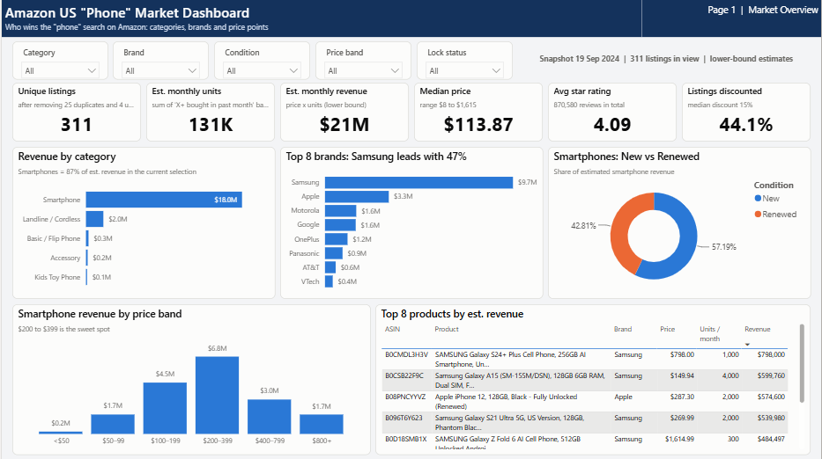
Dashboard page 1 — Market Overview
1
Slicers
Category, brand, condition, price band and lock status — synced across both pages
2
KPI cards
Listings, units, revenue, median price, rating, % discounted
3
Category & brand bars
Where revenue concentrates; Top-N filter on brands
4
New vs Renewed
Donut of smartphone revenue split
5
Price band + top products
Sweet-spot bar highlighted; table of top 8 earners
Replace this image with a screenshot of your finished Power BI page before presenting.
9
Notes:
Demo live in Power BI if possible: clear filters and confirm 311 listings and $20.7M; then click Smartphone and Renewed to show cross-filtering.

Slide 10
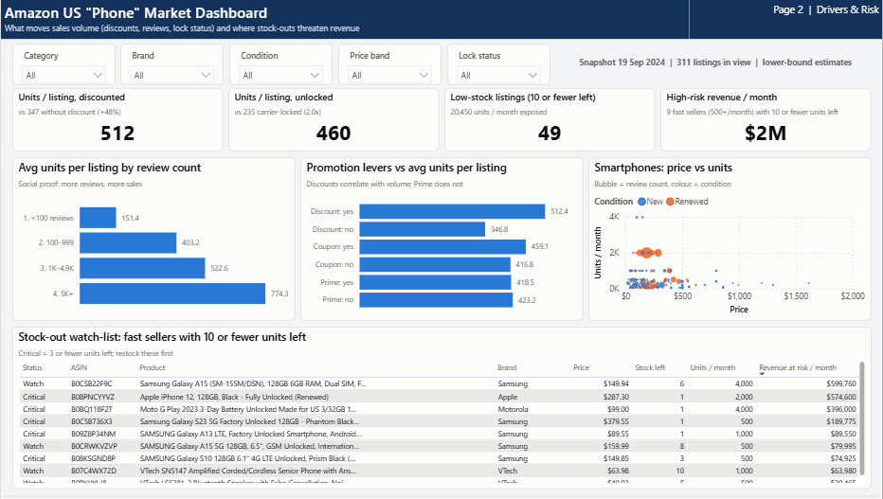
Dashboard page 2 — Drivers & Risk
1
Driver KPIs
Units per listing for discounted vs not, unlocked vs locked
2
Social proof
Average units by review-count bucket
3
Promotion levers
Discount, coupon and Prime compared
4
Price vs units
Log-scale scatter, bubble = reviews, colour = condition
5
Stock-out watch-list
Fast sellers with ≤10 units left, colour-coded by severity
Replace this image with a screenshot of your finished Power BI page before presenting.
10
Notes:
Use this page to move from "what" to "why": discounts, reviews and unlocked status are linked with higher volume; the watch-list turns the analysis into an operational action.

Slide 11
Insight 1 — Demand is concentrated
Smartphones and a few brands capture almost all estimated revenue
87%
of revenue comes from smartphones (206 of 311 listings)
47%
Samsung alone — top 5 brands (all major OEMs) = 84%
55%
of revenue from just the top 10% of listings (32 products)
38%
of smartphone revenue sits in the $200–399 band (21% of listings)
11
Notes:
Revenue is estimated: Amazon badge (lower bound) × current price. Absolute values are conservative, but shares and rankings are reliable for comparison.

Slide 12




Insight 2 — What is linked to higher sales volume
Average units sold per listing per month (association, not proven cause)
5×
+48%
Reviews
Discounts
5K+ reviews: 774 units vs 151 for <100 reviews. Review count is the strongest correlate (ρ = 0.38); star rating itself barely matters (ρ = 0.05).
Discounted listings: 512 units vs 347. Median discount 15%. Coupons add little (+10%).
2×
+52%
Unlocked
Renewed
Unlocked handsets: 460 units vs 235 for carrier-locked phones.
Renewed smartphones: 528 units vs 347 for new; 34% of listings but 43% of smartphone revenue.
Prime eligibility shows no difference (419 vs 423 units). 49 listings show ≤10 units in stock; 9 fast sellers put ≈$2.1M of monthly revenue at risk.
12
Notes:
Be careful with wording: this is one snapshot, so these are associations. For example, popular products may attract more reviews because they sell more — causality can run both ways.

Slide 13
Recommendations
For a seller or category manager competing in the "phone" search
# | Action | Evidence | Owner
1 | Focus the range on $100–399 unlocked smartphones | 63% of smartphone revenue; unlocked sells 2× locked | Assortment
2 | Grow the renewed (refurbished) line | Sells 52% more units per listing at lower price points | Assortment
3 | Invest in review generation for new listings | <100 reviews = 151 units vs 774 for 5K+; e.g. Amazon Vine, follow-up emails | Marketing
4 | Use visible list-price discounts rather than coupons | Discounts +48% units; coupons only +10% | Pricing
5 | Restock the 9 high-risk fast sellers now | ≈$2.1M monthly revenue on items with ≤10 units left | Operations
6 | Track daily, not once | Schedule the Python → SQL → Power BI refresh to build a time series | Analytics
13
Notes:
Each recommendation ties to a number on the dashboard. The owner column shows who acts on it.

Slide 14


Limitations & next steps
Being clear about what the data cannot tell us
Limitations
Next steps
One snapshot of one keyword — no trend over time
Units are lower bounds ("1K+" could be 1,999); revenue is an estimate
Category, brand and storage are rule-based from titles (manually reviewed)
Correlation only — no experiment to prove causation
Collect daily snapshots and add a date dimension
Add more keywords ("smartphone", "iphone", "cordless phone")
Model price elasticity once a time series exists
Publish to Power BI Service with scheduled refresh
How to read the revenue figures: est. revenue = badge units (lower bound) × current price. Use it to rank and compare shares — not as accounting revenue.
14
Notes:
Showing limitations is part of a professional analysis — it tells the audience how much weight to put on each number.

Slide 15
Conclusion
1
Clean data first
340 messy rows → 311 trusted listings, 17 issues fixed with documented rules
2
Demand is concentrated
Smartphones 87%, Samsung 47%, $200–399 is the sweet spot
3
Volume follows trust & value
Review count, visible discounts, unlocked and renewed phones sell more
4
Act on it
Restock 9 fast sellers, build reviews, refresh the pipeline daily
Thank you — questions?
Notes:
Close with the four take-aways and invite questions. Have the Power BI file open for live drill-downs.

