Slide 1

TOP 5 CANDIDATES FOR INTO’S US EXPANSION
Proven performance, powered by partnership

Slide 2



Understanding what makes an institution a potential partner
State Benchmarks
IP OF 4.5% | Average Cost of $38,000
1
2
Prop Score
(1 to 10)
Cost Score
(1 to 10)
Full Score
(1 to 100)
$$×$$
$$=$$

Slide 3

1
Kentucky State University
2
Northern New Mexico College
3
Yeshiva Gedolah of Greater Detroit
4
University of Phoenix (Texas)
5
Concord University (West Virginia)

Slide 4

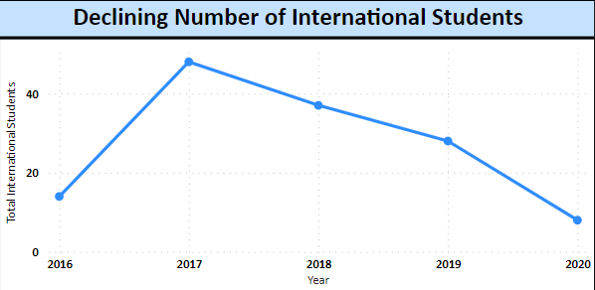
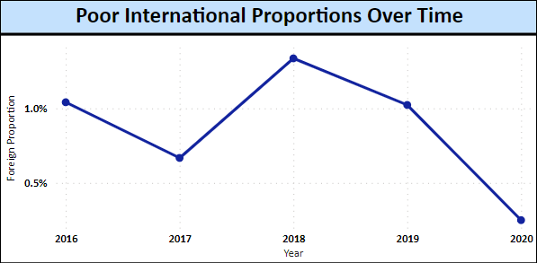
Reduction of International Students over time
83% aggregated decline from 2017 to 2020
Average IP of Top 5 universities is 3.64 PPTs lower than the State benchmark
Listed institutions have highest priority to improve International presence

Slide 5

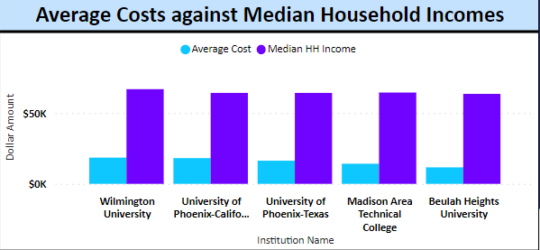
Low Average Costs against Household Incomes
Average Cost
Median HH Income
The average cost of attendance (including fees and living costs)
Average median household income for a typical student
Average Cost is around 30% of the average median household income, leaving international students with minimal financial worries

Slide 6

Thank you!
Any questions?

Slide 7
