Slide 1

Employee Management System

Slide 2
About me
Name: Maroju Anand Sai
Background: B.Tech – (Computer Science Engineering)
My Interest in Data Science:
“I’m learning Data Science because I enjoy working with data, and I believe that AI and ML will drive the future. I want to use data to solve real business problems and help companies make smarter decisions.”
Work Experience:
“Though I’m a fresher, I’ve done real-time projects in SQL and Data Science that gave me practical experience.”

Slide 3
OBJECTIVE OF THE PROJECT
To build a structured SQL database system for managing employee records.
To store and track job roles, departments, and employee qualifications.
To manage payroll, including bonus allocation and leave-based deductions.
To record employee leave details and analyze their impact on salary.
To support HR teams with accurate data for efficient decision-making.

Slide 4
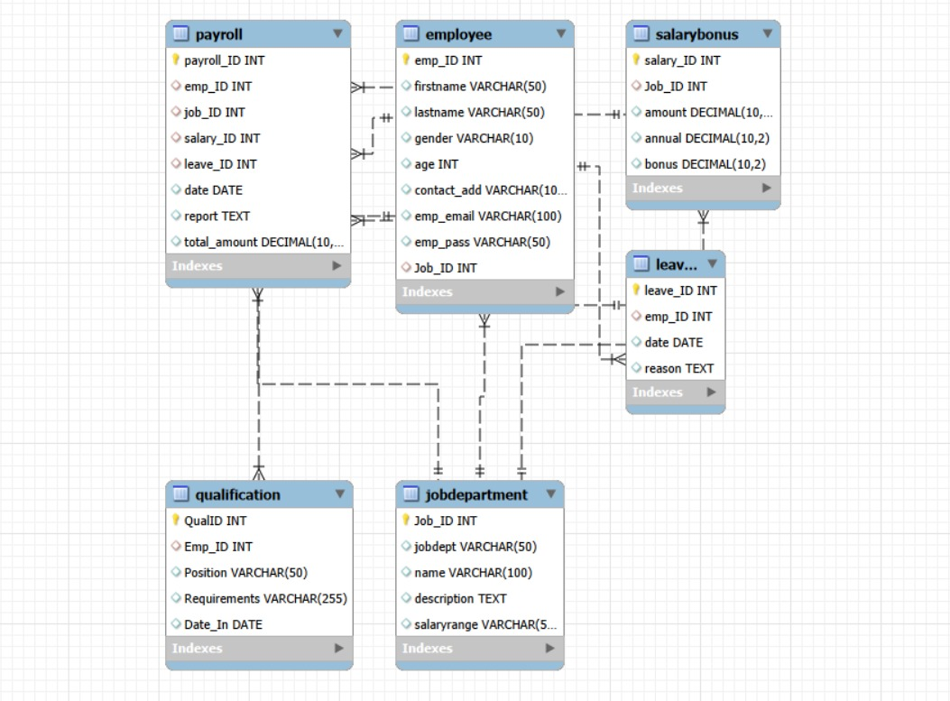
ER Diagram
The ER diagram shows how Employee, Job Department, Salary Bonus, Qualification, Leaves, and Payroll tables are linked using primary and foreign keys to store and manage employee details, salaries, leaves, and qualifications.
Employee is the central table, connected to job roles, qualifications, leave records, and payroll. Payroll combines data from all related tables to calculate the final salary.

Slide 5
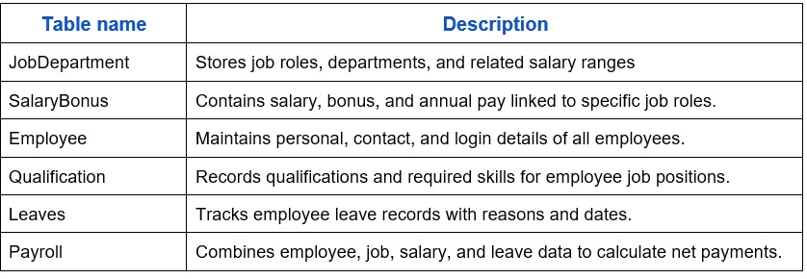
Project Schema (Employee Management System)
Each table stores a specific type of employee-related data.
Tables are connected using IDs (like emp_ID, Job_ID).
Salary and payroll depend on job roles and leave records.
Qualifications help determine the skills required for each position.
Payroll uses data from other tables to calculate final salary with bonuses and deductions.

Slide 6
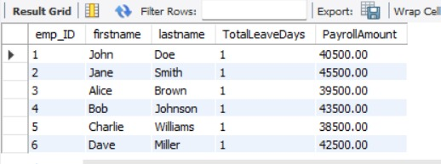
SQL query results with screenshots and summaries
How do leave days correlate with payroll amounts

Slide 7
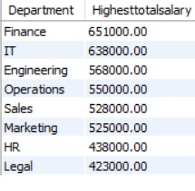
Departments have the highest total salary allocation

Slide 8
Final business insights and recommendations
Business Insights :
Departments like IT and Finance have the highest employee count, indicating high business demand.
Employees with higher qualifications receive better salary & bonus benefits.
Leave count affects payroll, showing a negative impact on salary deductions.
Payroll data shows bonus distribution varies by job roles, not equally.
Recommendations :
HR can hire more employees for understaffed departments to balance workload.
Provide skill training based on qualification analysis to increase productivity.
Implement clear leave policies to avoid excess salary loss for employees.
Use payroll data to design performance-based incentives.

Slide 9
CONCLUSION :
The Employee Management System effectively stores and manages employee details, job roles, qualifications, leaves, and payroll data in a structured way.
It ensures accurate salary calculation by linking bonuses with job roles and applying leave-based deductions.
The system helps HR make data-driven decisions related to hiring, skill development, and payroll management.
Overall, the project improves efficiency, reduces manual errors, and supports better organizational planning.

Slide 10
QUESTION AND ANSWERS

Slide 11
Experience/Challenges working on SQL – Data Analysis Project :
Working on this SQL–Data Analysis project helped me understand how real databases store and connect information.
I faced challenges while joining multiple tables and calculating payroll with leave deductions.
Debugging SQL queries taught me how small mistakes in joins or grouping can change the entire result.
Overall, this project improved my confidence in SQL, data analysis, and real-world problem solving.

Slide 12

THANK YOU

