Slide 1
Effects of Augmented-Reality Mirror Therapy System on Sensorimotor Performance of Upper Extremity for the Healthy Adults

Slide 2
Purpose
To develop a new ARMT(Augmented-Reality Mirror Therapy ) System
To identify the difference in treatment effects between ARMT and traditional mirror therapy

Slide 3
METHODS
Participants:
Thirty young volunteers (17 males, 13 females) with the mean age of 23.0 ± 2.7 years old were recruited.
no current or past history of neuromuscular or orthopedic problems in the upper extremities
Notes:
Study participants included subjects suffered from a stroke.
They should meet the following criteria: (1) unilateral cerebral infarction or hemorrhage,

Slide 4
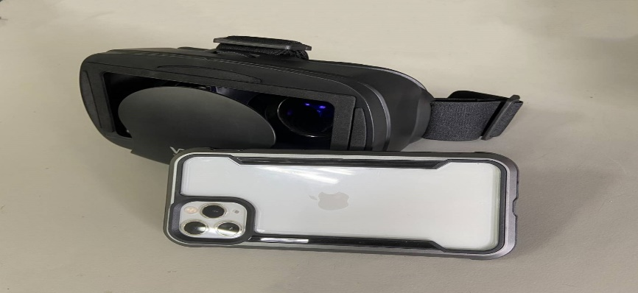
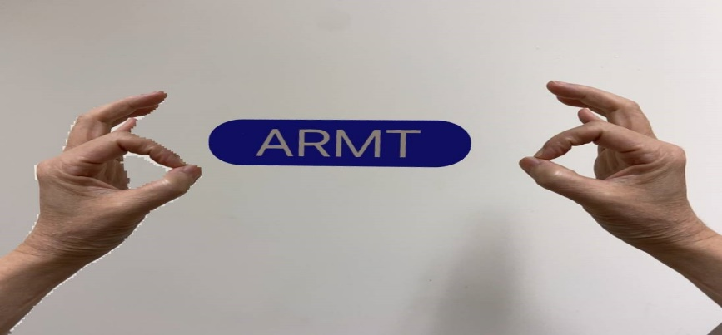
METHODS
Instruments: ARMT (Augmented-Reality Mirror Therapy) System
Fig : ARMT System
Notes:
Vibrotactile therapy system were used to apply vibrotactile cueing for pinch profiles.
A pinch apparatus, an actuator was mounted inside

Slide 5
Study design
Study design
Assessor blinded
Randomized control crossover trial
Assessment: baseline and endpoint
Notes:
受試者會隨機分派至實驗組(虛擬實境基礎的鏡像治療) 或控制組 (傳統鏡像)，進行30 分鐘之介入，休息兩週後，受試者交換組別。而評估會由兩名對治療不知情的評估員在治療前（T0）、第一次治療後與治療兩小時後、第二次治療後與治療兩小時後進行。

Slide 6
Interventions
Treatment protocol
The participants received either 30 minutes of traditional mirror therapy or ARMT training in each treatment session.

Slide 7
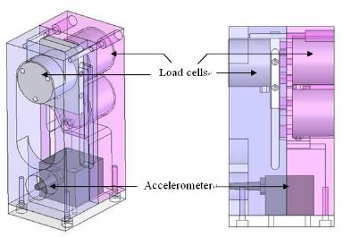
Outcomes measures- PHUA
Pinch-Holding-Up Activity (PHUA) :
Load cell: detected the applied force of the thumb and index finger during pinch –holding-up performance.
Three-axis accelerometer: registered the acceleration of pinch device during test in space.
Weight: 480 gm
Notes:
抓握提舉測試是用來評估手部感覺動作控制之有效評估工具.在正常狀況下握力會隨著負重值的變化而適時適量調整
有學者將提舉過程中的最大握力值比上最大負重值視為一敏感的參數，藉由此一參數可觀測握力的產生相對於出因動量引起的負重
抓握設備:為一重480g的長方體，包括兩個荷重規及加速規，荷重規可偵測到受試者執行活動中個案的捏力表現，加速規則偵測抓握設備在空間中移動時的加速度，用以了解物體負重的變化。在之前的研究得到相關係數為0.96-0.98之間，存在重複測試的一致性。

Slide 8
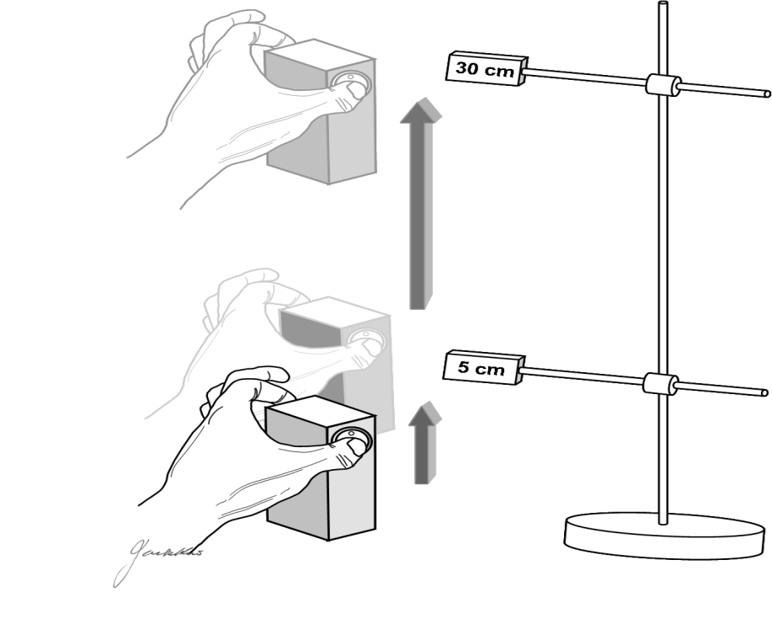
Outcomes measures- PHUA
The pinch-instrument was lifting to 5 cm above the table and holding for 5 seconds.
Afterwards, the participants were asked to lift the device to the position at 30 cm above the table
Duration for data collection is 15 seconds.
Three trials with inter-trial intervals of 1 minute
Notes:
首先，受測者將pinch apparatus抬離桌面5公分高，然後停在此高度5秒。接下來，會依電腦音效提示，受測者將抓握設備抬高至30公分。資料收集共15秒。受測者共執行3次，每次休息1分鐘。

Slide 9
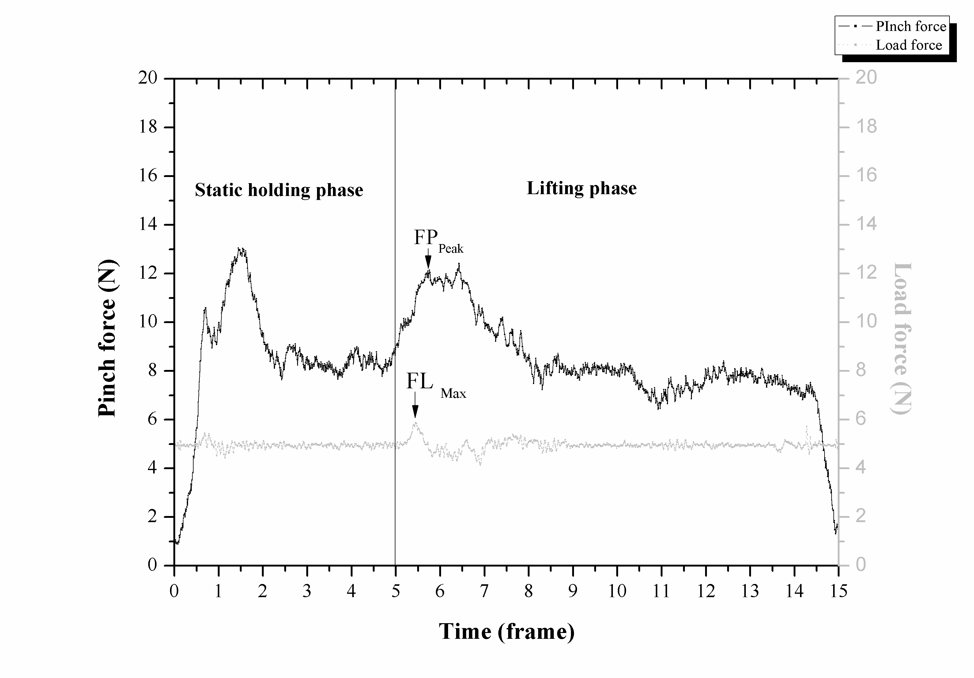
Outcomes measures- PHUA
Parameters :
FR_{peak}: the ratio between FP_{peak} and FL_{max} (Flanagan & Wing, 1995)
measure grip force production in relation to the momentum-induced load
an objective criteria for sensorimotor evaluation of a hand
Percentage of maximal pinch strength: peak pinch force divided by the maximal static pinch force
The lower value in FR_{peak} and percentage of maximal pinch strength: more precise pinch force scaling
Notes:
資料分析包含執行活動時所施的的最大握力，物體在空間移動時的最大負重值，至於兩者之間的比值，定為force ratio，用以分析抓握力量調整效率。

Slide 10
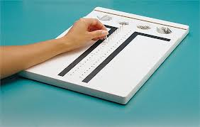
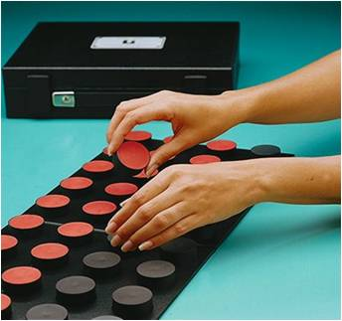
Outcomes measures-Hand function tests
Purdue Pegboard test
Minnesota Manual Dexterity Test (MMDT)
Notes:
手工能測試普渡手工能測試與明尼蘇達操作測試。Purdue pegboard test. A fine fingertip dexterity test with validity and reliability. Participants were timed as they arrange pins and assemble pins, washers and collars. Results of unilateral pin insertion, bilateral pin insertion and assembly subtest were consisted in testing outcomes.
Minnesota manual dexterity test (MMDT). A test measures gross motor skill of upper extremity. Of the current study, the time of completing the placing and turning subtest was recorded.

Slide 11
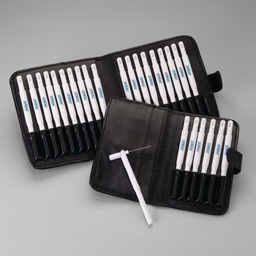
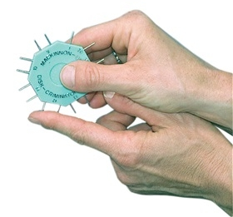
Outcomes measures-Hand sensory tests
Semmes-Weinstein monofilament Test
detect pressure from filament
touch-pressure threshold
Two-point Discrimination Test
detect the least distance between two prongs
tactile discrimination

Slide 12
METHODS
Statistical analysis:
SPSS 17.0
Normality in the data distribution was examined with Shapiro-Wilk’s test.
Repeated measured ANOVA
Differences in outcomes measures bwtween baseline, ARMT and MT conditions

Slide 13
RESULTS

Slide 14
effectiveness (index) | Conditions |  |  |  | Difference between conditions (P-value)
 | Baseline | ARMT | MT | P-value | Baseline VS ARMT | Baseline VS MT | ARMT VS MT
PHUA FR_{peak} | 3.35 ± .64 | 3.01 ± .56 | 3.30 ±.60 | .004 | .003 | .513 | .002
PHUA Percentage (%) | 42.1 ± 13.7 | 34.7 ± 11.0 | 39.0 ± 11.9 | < .001 | < .001 | .105 | .021
PPT (DH) | 14.98 ± 1.69 | 17.20 ± 1.61 | 15.90 ± 1.48 | < .001 | < .001 | < .001 | < .001
PPT (NDH) | 14.75 ± 1.34 | 16.02 ± 1.52 | 12.97 ± 1.49 | < .001 | < .001 | .380 | .001
PPT (BH) | 12.48 ± 1.49 | 14.05 ± 1.26 | 13.27 ± 1.09 | < .001 | < .001 | .001 | .001
PPT (Assembly) | 40.43 ± 5.38 | 46.33 ± 5.74 | 42.53 ± 5.63 | < .001 | < .001 | .001 | < .001
SWM (Thumb) | 2.387 ± .038 | 2.381± .036 | 2.384± .037 | .381 | .161 | .662 | .662
SWM (Index fingeer) | 2.360 ± .139 | 2.352 ± .137 | 2.360 ± .139 | .401 | .184 | 1.000 | .264
MMDT (Placing) | 63.37 ± 6.95 | 58.39 ± 5.93 | 61.39 ± 6.99 | < .001 | < .001 | .002 | < .001
MMDT (Turning) | 48.06 ± 5.80 | 41.42 ± 5.12 | 43.81 ± 6.41 | < .001 | < .001 | < .001 | < .001
Statistics: ANOVA with repeated measure; FR_{peak}: Force ratio (FP_{peak}: FL_{max}) during the lifting phase; percentage: peak pinch force/ maximal static pinch force during the lifting phase; PPT: Purdue Pegboard Test; DH: Dominant hand; NDH: Non dominant hand; BH: Both hands; MMDT: Minnesota Manual Dexterity Test.

Slide 15
effectiveness (index) | Conditions |  |  |  | Difference between conditions (P-value)
 | Baseline | ARMT | MT | P-value | Baseline VS ARMT | Baseline VS MT | ARMT VS MT
2PD (Thumb) | 3.4 ± .7 | 3.1 ± .6 | 3.3 ± .6 | .048 | .017 | .601 | .070
2PD (Index finger) | 3.2 ± .5 | 2.6 ± .6 | 3.1 ± .6 | < .001 | < .001 | .489 | < .001
2PD (Middle finger) | 3.3 ± .6 | 3.2 ± .6 | 3.4 ± .6 | .072 | .423 | .169 | .032
2PD (Ring finger) | 3.6 ± .6 | 3.3 ± .7 | 3.6 ± .7 | .007 | .005 | .573 | .017
2PD (Ilittle finger) | 3.7 ± .7 | 3.2 ± .8 | 3.7 ± .7 | < .001 | .003 | .489 | .001
Statistics: ANOVA with repeated measure;; 2PD: Two-point Discrimination Test.

Slide 16
RESULTS AND DISCUSSION
Statistically significant difference between baseline and ARMT as well as ARMT and MT condition for FR_{Peak} and percentage of maximal pinch strength
Notes:
Now, we move on results and discussion
Improvement of FP_{Peak} (peak pinch force in precision pinch performance) has been found in group of VRMT and traditional MT.

Slide 17
RESULTS AND DISCUSSION
Decrease of FR_{peak} after receiving ARMT
improvement in capability of pinch force adjusting in relation to the momentum-induced load

Slide 18
RESULTS AND DISCUSSION
Significant effects on results of dominant hand pin insertion, bilateral hands pin insertion and assembly of Purdue pegboard test for participants following ARMT and MT(p<0.05).
ARMT condition has better training effects than MT condition (p<0.05).
Unilateral pin insertion-
Dominant hand
Bilateral pin insertion
Assembly

Slide 19
RESULTS AND DISCUSSION
Significant effects on results of non-dominant hand pin insertion of Purdue pegboard test for participants following ARMT training(p<0.05).
ARMT condition has better training effects than MT condition (p<0.05).
Unilateral pin insertion- non-dominant hand pin insertion

Slide 20
RESULTS AND DISCUSSION
Significant effects on results of the placing and turning subtest of MMDT in both ARMT and MT conditions(p<0.05).
ARMT has better training effects on the results of all the subtests of MMDT than MT condition.
Notes:
在明尼蘇達操作測試結果也有同樣的現象。

Slide 21
ARMT has better short-term training effects on sensorimotor control in hands of healthy young adults the MT.
Future work: clinical application for the patients with neurological impairment.

Slide 22
Thanks for your attention

