Slide 2
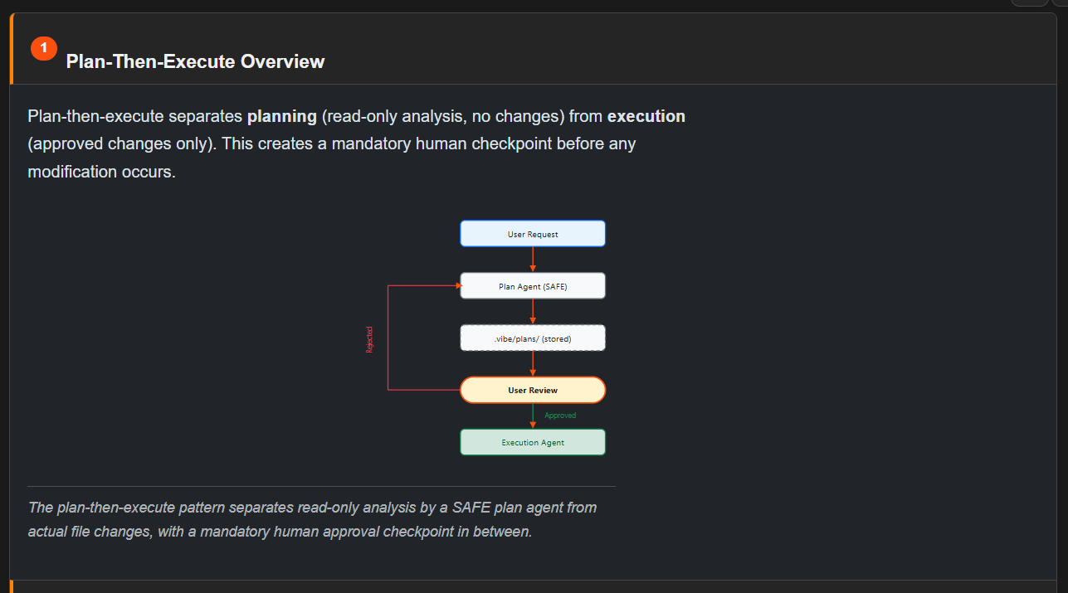

Slide 3
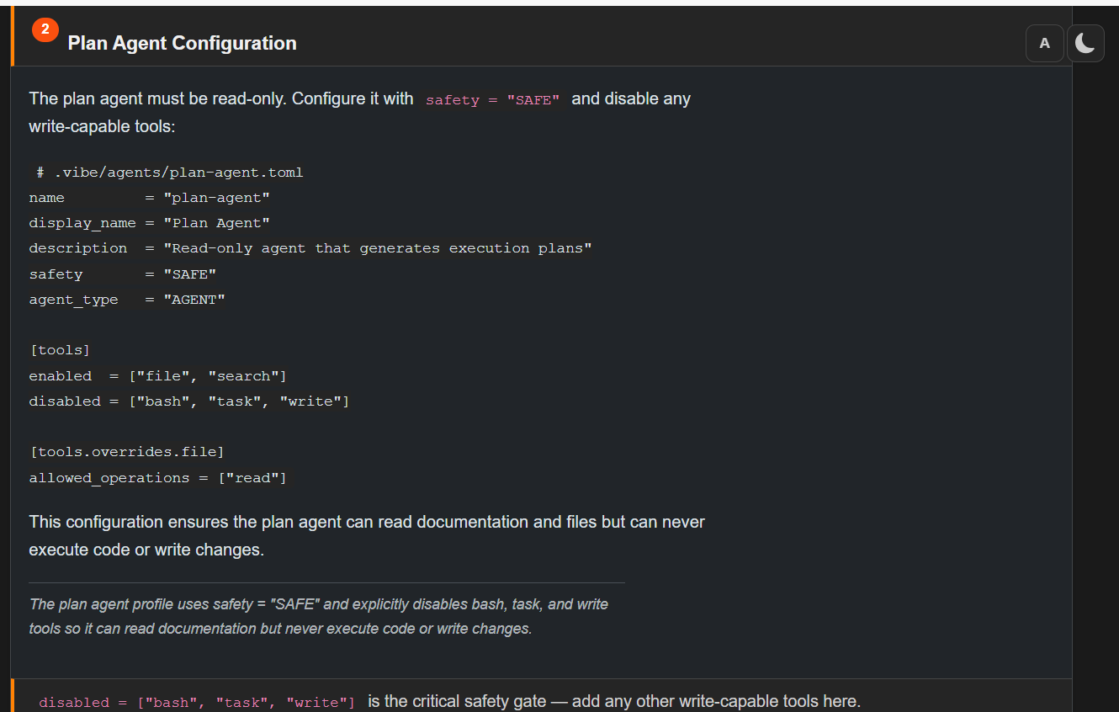
Notes:
The plan agent must be read-only. Configure it with safety = "SAFE" and disable any write-capable tools:
# .vibe/agents/plan-agent.toml
name = "plan-agent"
display_name = "Plan Agent"
description = "Read-only agent that generates execution plans"
safety = "SAFE"
agent_type = "AGENT"
[tools]
enabled = ["file", "search"]
disabled = ["bash", "task", "write"]
[tools.overrides.file]
allowed_operations = ["read"]
This configuration ensures the plan agent can read documentation and files but can never execute code or write changes.
The plan agent profile uses safety = "SAFE" and explicitly disables bash, task, and write tools so it can read documentation but never execute code or write changes.
disabled = ["bash", "task", "write"] is the critical safety gate — add any other write-capable tools here.

Slide 4
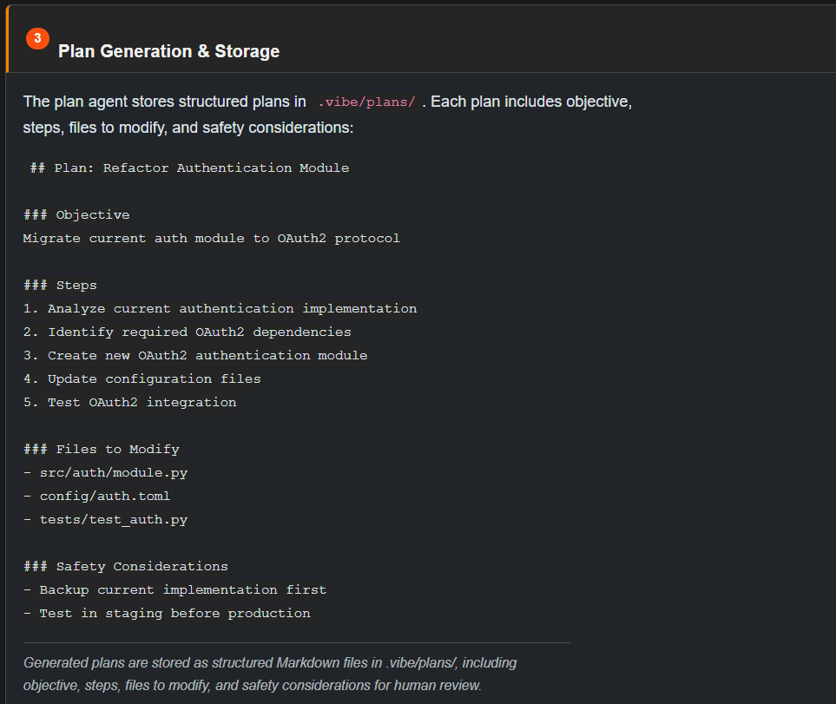
Notes:
The plan agent stores structured plans in .vibe/plans/. Each plan includes objective, steps, files to modify, and safety considerations:
## Plan: Refactor Authentication Module
### Objective
Migrate current auth module to OAuth2 protocol
### Steps
1. Analyze current authentication implementation
2. Identify required OAuth2 dependencies
3. Create new OAuth2 authentication module
4. Update configuration files
5. Test OAuth2 integration
### Files to Modify
- src/auth/module.py
- config/auth.toml
- tests/test_auth.py
### Safety Considerations
- Backup current implementation first
- Test in staging before production
Generated plans are stored as structured Markdown files in .vibe/plans/, including objective, steps, files to modify, and safety considerations for human review.
Plans stored on disk allow asynchronous review — a team lead can review the plan before approving execution later.

Slide 5
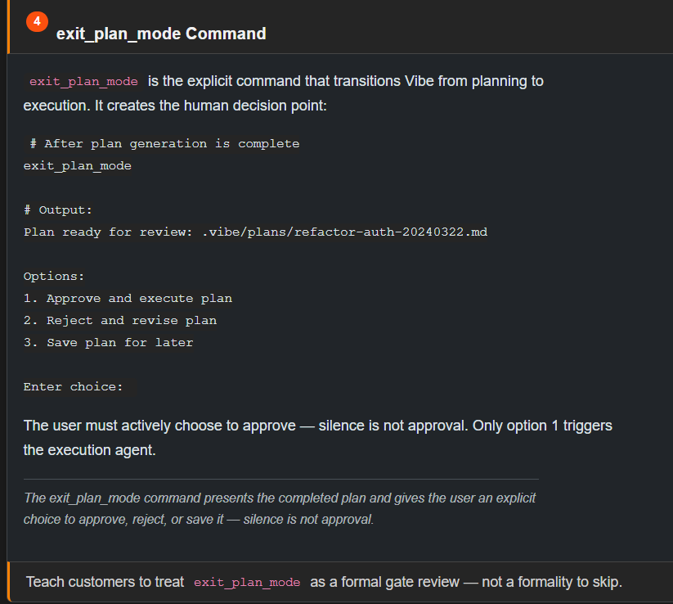
Notes:
exit_plan_mode is the explicit command that transitions Vibe from planning to execution. It creates the human decision point:
# After plan generation is complete
exit_plan_mode
# Output:
Plan ready for review: .vibe/plans/refactor-auth-20240322.md
Options:
1. Approve and execute plan
2. Reject and revise plan
3. Save plan for later
Enter choice:
The user must actively choose to approve — silence is not approval. Only option 1 triggers the execution agent.
The exit_plan_mode command presents the completed plan and gives the user an explicit choice to approve, reject, or save it — silence is not approval.

Slide 6
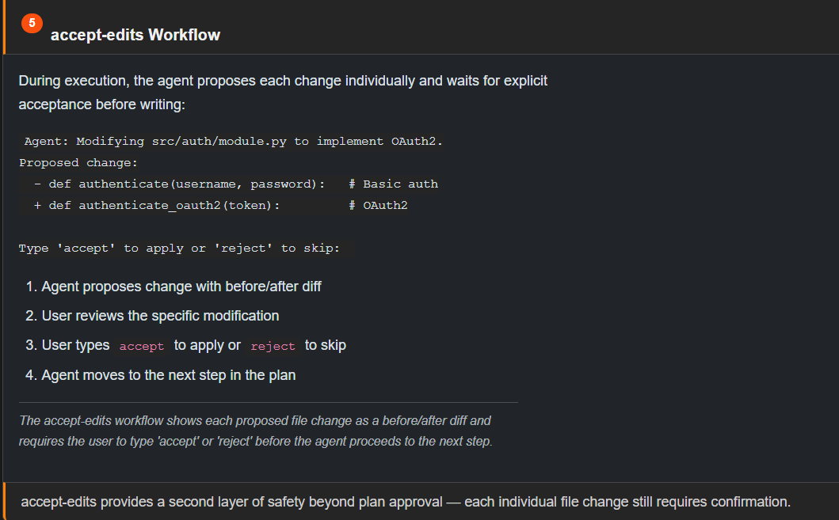
Notes:
During execution, the agent proposes each change individually and waits for explicit acceptance before writing:
Agent: Modifying src/auth/module.py to implement OAuth2.
Proposed change:
- def authenticate(username, password): # Basic auth
+ def authenticate_oauth2(token): # OAuth2
Type 'accept' to apply or 'reject' to skip:
Agent proposes change with before/after diff
User reviews the specific modification
User types accept to apply or reject to skip
Agent moves to the next step in the plan
The accept-edits workflow shows each proposed file change as a before/after diff and requires the user to type 'accept' or 'reject' before the agent proceeds to the next step.

Slide 7
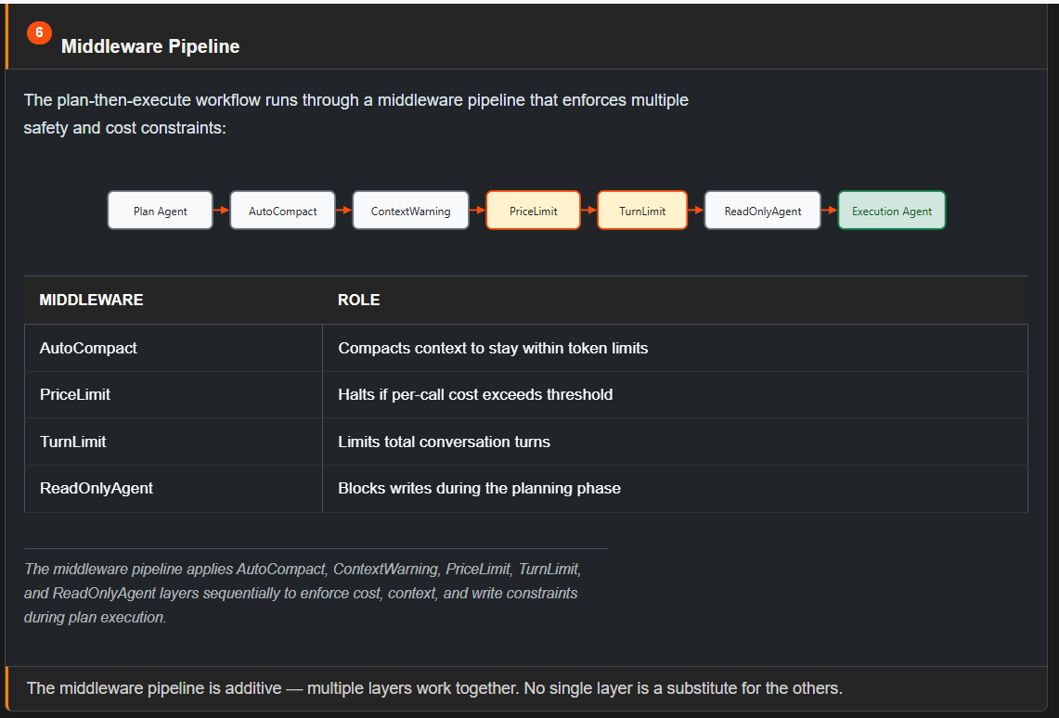

Slide 8
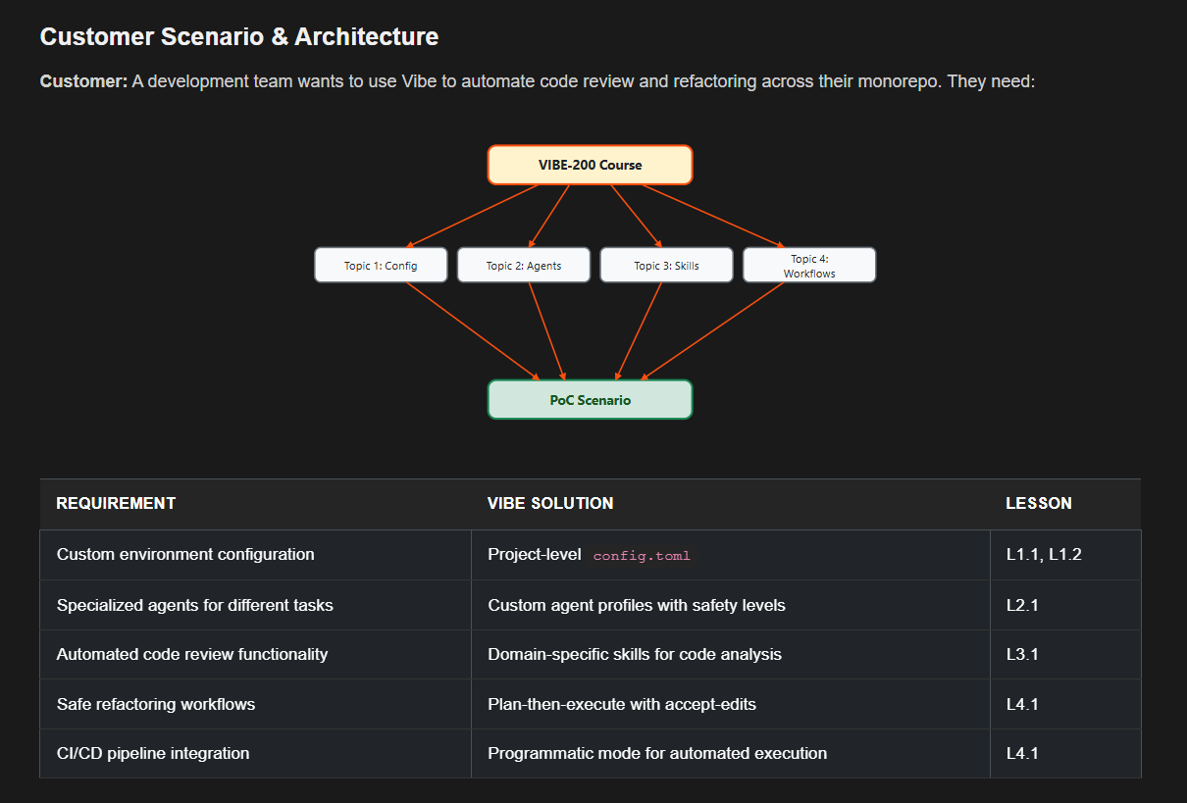

Slide 9
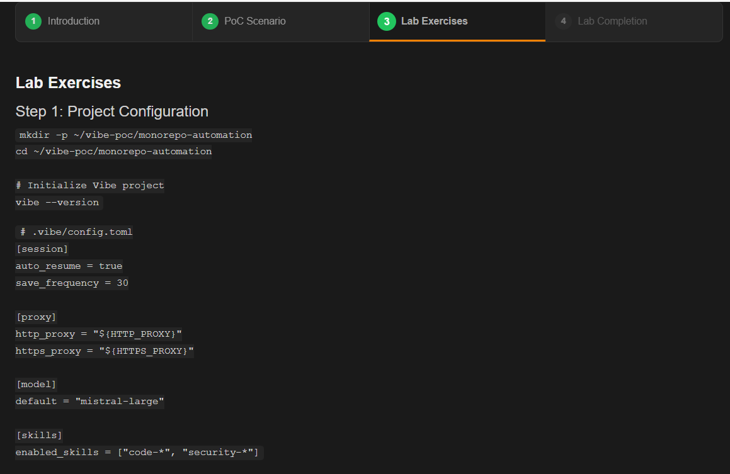
Notes:
Lab Exercises
Step 1: Project Configuration
mkdir -p ~/vibe-poc/monorepo-automation
cd ~/vibe-poc/monorepo-automation
# Initialize Vibe project
vibe --version
# .vibe/config.toml
[session]
auto_resume = true
save_frequency = 30
[proxy]
http_proxy = "${HTTP_PROXY}"
https_proxy = "${HTTPS_PROXY}"
[model]
default = "mistral-large"
[skills]
enabled_skills = ["code-*", "security-*"]
Step 2: Custom Agents
# .vibe/agents/code-review-agent.toml
name = "code-review-agent"
safety = "SAFE"
agent_type = "AGENT"
[tools]
enabled = ["file", "search"]
disabled = ["bash", "write"]
# .vibe/agents/refactoring-agent.toml
name = "refactoring-agent"
safety = "DESTRUCTIVE"
agent_type = "AGENT"
[tools]
enabled = ["file", "bash", "search", "task"]
Step 3: Code Review Skill
---
name: "code-review-checklist"
description: "Automated code review for syntax, security, style, and performance"
user_invocable: true
allowed_tools: ["file", "search"]
license: "MIT"
compatibility: ["vibe>=1.0.0"]
---
## Instructions
Analyze the files at the specified path for:
1. Syntax errors and missing imports
2. Hardcoded secrets and SQL injection risks
3. Naming conventions and documentation
4. Memory leaks and inefficient algorithms
Step 4: Plan-Then-Execute Refactoring
# Start the plan agent
vibe --agent plan-agent
# Request: "Refactor the data processing module to use async operations"
# Plan agent generates: .vibe/plans/refactor-data-async.md
# Review the plan, then:
exit_plan_mode
# → Choose option 1 to approve and execute
Step 5: CI/CD Integration
# .github/workflows/vibe-code-review.yml
name: Vibe Code Review
on: [push, pull_request]
jobs:
code-review:
runs-on: ubuntu-latest
steps:
- uses: actions/checkout@v3
- name: Run Vibe code review
run: |
vibe --prompt "Run code-review-checklist on ./src" \
--output json \
--agent code-review-agent
PoC Delivery Checklist
CategoryItemVerification commandConfigurationProject config.tomlvibe --validate-configConfigurationProxy settingsvibe --test-proxyAgentsCode review agentvibe --list-agents | grep code-reviewAgentsRefactoring agentvibe --list-agents | grep refactoringSkillsCode review skillvibe --list-skills | grep code-reviewWorkflowsPlan-then-executeTest with sample refactoring taskCI/CDGitHub Actions workflowcat .github/workflows/vibe-code-review.yml

Slide 10
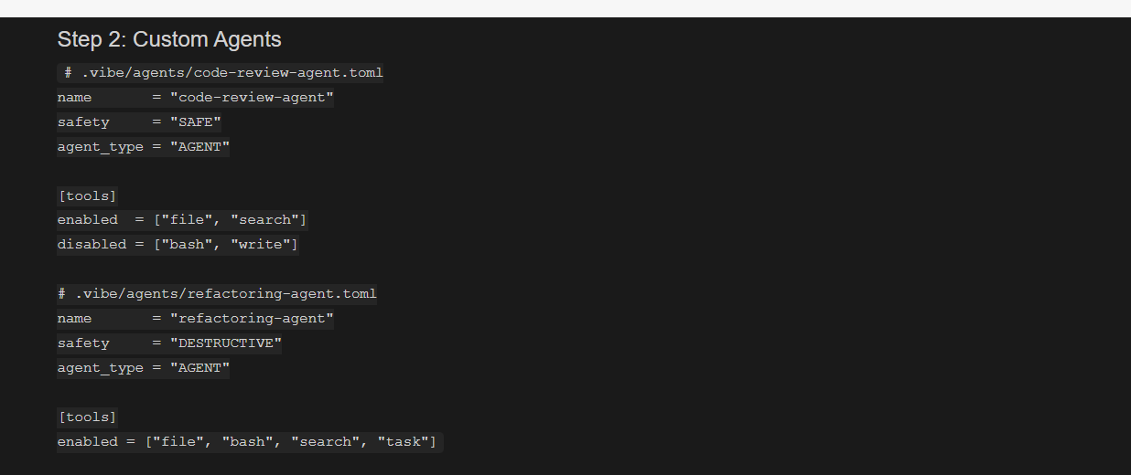

Slide 11
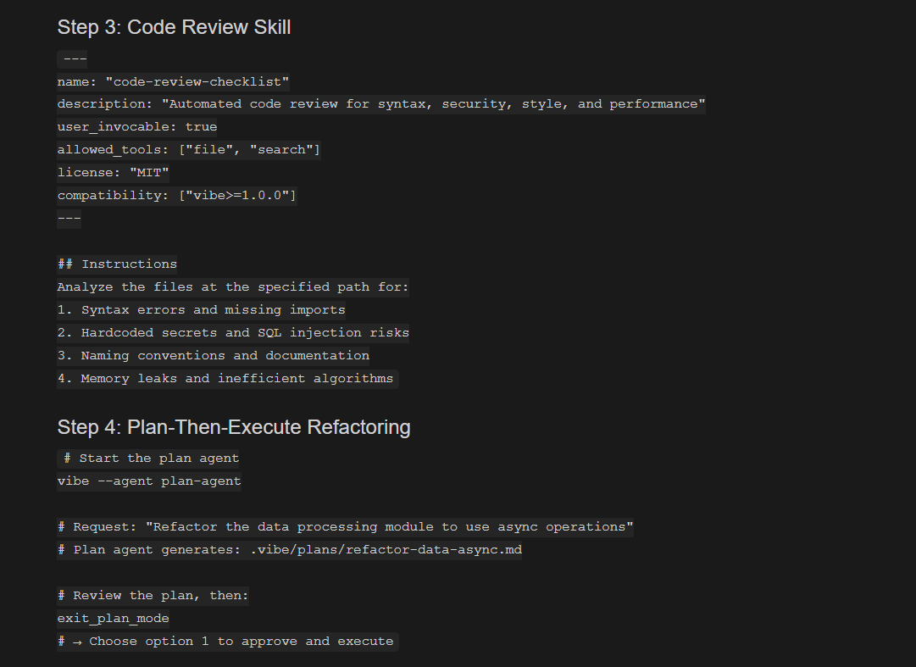

Slide 12
