Slide 1
Angry Obama Text Generator
Project 4 – code – Fletcher
Maroof Khan

Slide 2
Aim
Write like Obama
Talk like Obama
Not Play Basketball like Obama

Slide 3
Aim
Kind of write
Write like Obama
Talk like Obama
Not Play Basketball like Obama

Slide 4
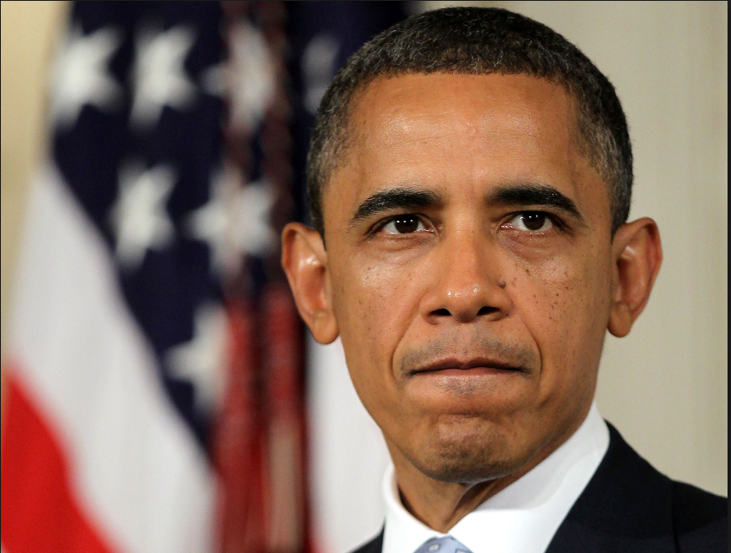
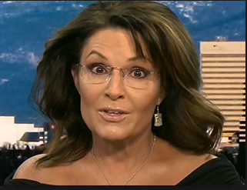
Change will not come if we wait for some other person or some other time. We are the one we’ve been waiting for. We are the change we seek
- President Barak Obama
“If God had not intended for us to eat animals, how come He made them out of meat”
- Sarah Palin, in ‘Going Rogue’

Slide 5
Prelim Result
Angry Obama seems to make more sense than real Sarah Palin

Slide 6
Some samples
I would retire from here and never have to work hard, you can get the same kind of either-or tradeoff where our problems like discrimination and poverty that they put forward
And just today, we learned that wages are an illusion, we've been in nearly fifty percent of the great civil rights long before so many immigrants - crossed an ocean to reach a little more indication of how an immediate plan might be structured until I can afford to pay off hundreds of thousands
Global health problem like Pakistan from the beginning
McCain felt the need to cut the red states

Slide 7
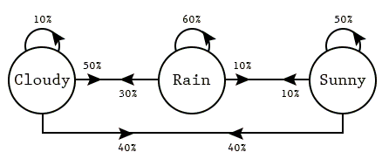
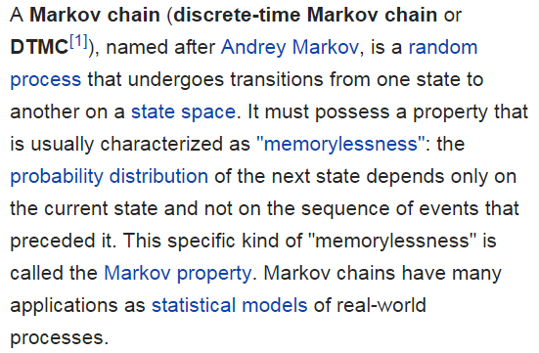
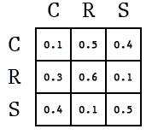
Markov Chain: Spark Notes Version

Slide 8
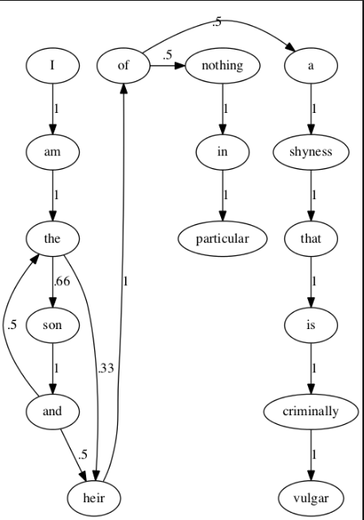
Markov Chain: with words
(I) → [am, am, am]
(am) → [the, the]
(the) → [son]
(the) → [son, heir, son]
(son) → [and]
(and) → [the, the, heir, the, heir, heir]
(heir) → [of]
(of) → [a, nothing]
...
...
...

Slide 9
Why not apply Markov chain to the whole speech corpus?

Slide 10



Text Generated does not jump between topics
Large corpus
Topic A
Topic B

Slide 11
Why ten topics?

Slide 12
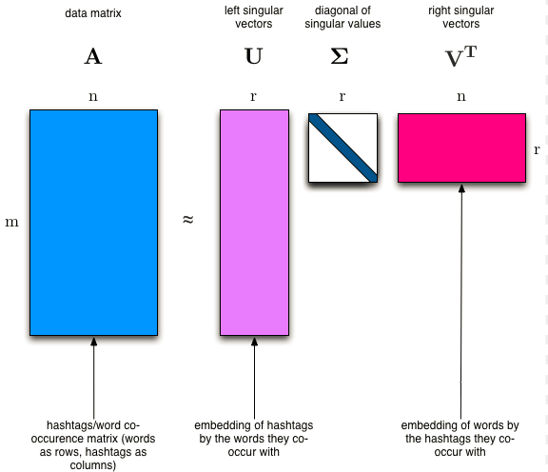
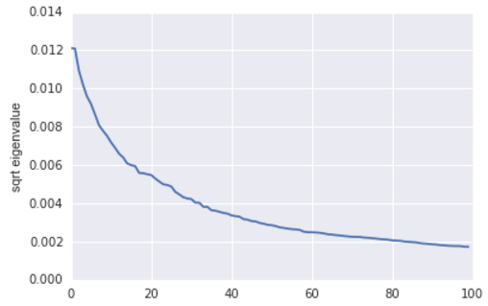
SVD: Safety Blanket
Notes:
Basic idea: meaning of a document is determined by the words that appear in it.
Meaning of a word is determined by the documents it appears in

Slide 13
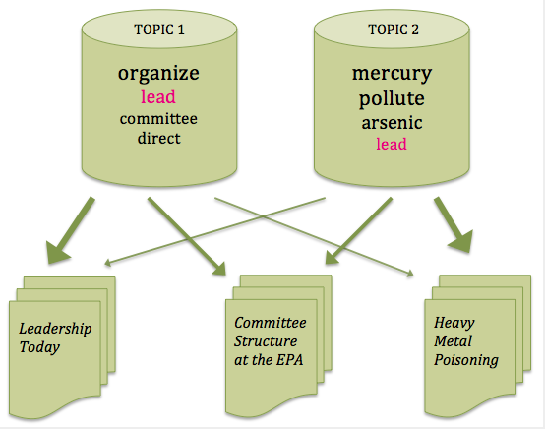
LDA: Latent Dirichlet Allocation
We have collection of documents
Identify the underlying organization of docs by topic
Process is a means of extrapolating backward from doc → topic
LDA represents documents as mixtures of topics → spit out words with certain probabilities

Slide 14
LDA: Methodology followed for
Project
Sentence 1x
Sentence 2x
Sentence 1
Sentence N
Sentence 2
Sentence 3
Probability of words in specific topic
Apply word probability at document level
Sentence 1x
Sentence 2x
Sentence N
Sentence N
Sentence 1x
Sentence 2x
Sentence N

Slide 15
Extra

Slide 16
Motivation
Separate out sentences by themes so that generated text is on-topic

Slide 17
