Slide 1
Hollywood goes International Project 2: Luther
Maroof Khan

Slide 2
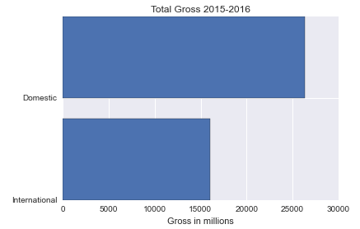
Scenario for trying to predict WW Gross
Premise
We have released a movie both in domestic and international markets
Depending on initial gross between foreign and international markets we strategize spending on advertisement
Consider only the most significant countries:
China
Japan
Russia (commonwealth of independent states)
UK

Slide 3
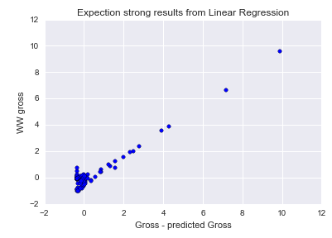
Base Model: Setup
Base Model includes the follow:
Label: World wide gross
Features:
Budget
Country percentages
Using Random Forest regression
Optimized with Grid Search CV (5 fold)
Parameters: number of estimates and maximum features used
Note to audience:
Data has outliers!
Found out later: During cleanup if a country did not show a movie I would populate it with 0

Slide 4
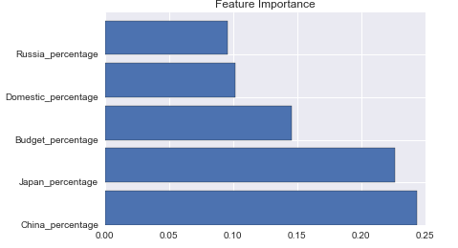
Base Model: Results
Score: 0.60
Surprised since the weight of China and Japan seem to be most significant

Slide 5
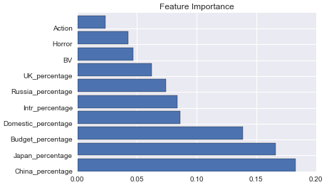
Second run with more features
Adding more features
Rating
Updated Genre
Result:
Score of 0.56 [I consider this to be the same as before]
Anticipating that score will drop even more each category added a lot of noise to model

Slide 6
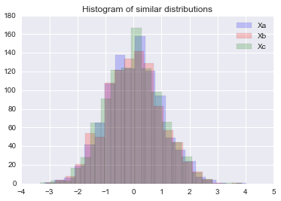

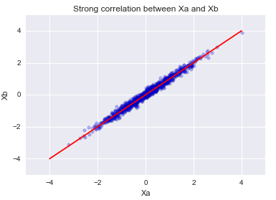
What if the features are correlated?
Generated three distributions
Xa, Xb, and Xc
No noise
Highly correlated (no surprise!)
Random Forest results:

Slide 7
Future Improvements
Get rid of correlated features – PCA
Try model where we consider only movies that play in all countries and not a few
Run updated model with more data
Reason Disney was stronger than usual was data is from 2015-6

Slide 8
My Predictions
We are going to keep on getting sub-par action movies owning to international distributors
Star Wars Rogue Nation will be a winner!
Godzilla will pronounced ‘Gozilla’

