Slide 1

Customer Shopping Behavior Analysis
Uncovering spending patterns, customer segments, product preferences, and subscription behavior from 3,900 transactional records to guide strategic business decisions.

Slide 2

Dataset at a Glance
3,900 Rows · 18 Columns
Key Feature Groups
Missing Data
37 null values in the Review Rating column — imputed using category median
Transactional records across multiple product categories
Demographics: Age, Gender, Location, Subscription
Purchase: Item, Category, Amount, Season, Size
Behavior: Discounts, Frequency, Ratings, Shipping

Slide 3

Data Preparation in Python
Load Data
Explore Structure
Handle Missing
Feature Engineering
Columns were standardized to snake_case. Redundant field promo_code_used was dropped after confirming overlap with discount_applied. Cleaned data was loaded into PostgreSQL for SQL analysis.

Slide 4
SQL Analysis in PostgreSQL
We answered 10 key business questions using structured queries — covering revenue, customer segments, product performance, and subscription behavior.
01
02
03
Revenue by Gender
High-Spending Discount Users
Top 5 Products by Rating
Compared total revenue from male vs. female customers
Highest average review ratings per product
Customers using discounts yet spending above average
04
05
Shipping Type Comparison
Subscribers vs. Non-Subscribers
Average spend: Standard vs. Express shipping
Average spend and total revenue by subscription status

Slide 5
More SQL Queries
Discount-Dependent Products
1
5 products with the highest % of discounted purchases
Customer Segmentation
2
Classified customers as New, Returning, or Loyal based on purchase history
Top 3 Products per Category
3
Most purchased products within each product category
Repeat Buyers & Subscriptions
4
Whether customers with 5+ purchases are more likely to subscribe
Revenue by Age Group
5
Total revenue contribution broken down by customer age group

Slide 6
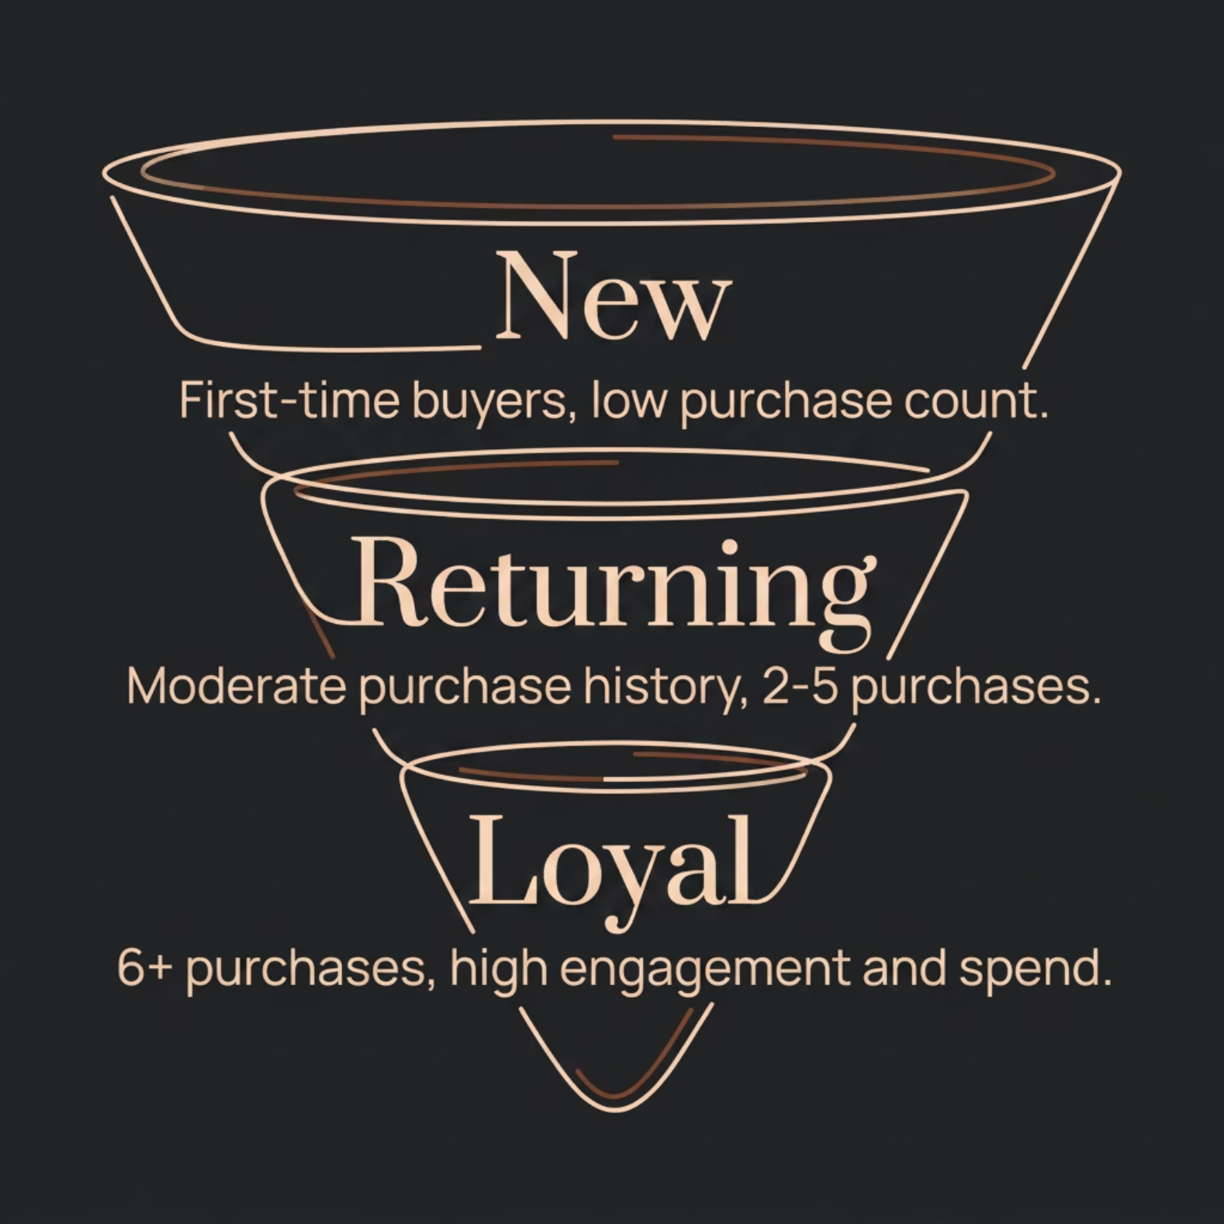


Customer Segmentation
Segment Classification Logic
Customers were classified using SQL based on their total number of prior purchases:
New — First-time or very low purchase count
Returning — Moderate history (2–5 purchases)
Loyal — 6+ purchases, highest spend and engagement
Repeat buyers with 5+ purchases showed a notably higher likelihood of subscribing.

Slide 7
Subscription & Discount Insights
Subscribers vs. Non-Subscribers
High-Spending Discount Users
Discount-Dependent Products
Subscribers generated higher average spend and total revenue — a clear case for growing the subscriber base.
A segment of customers used discounts yet still spent above the average purchase amount — valuable, high-intent buyers.
5 products showed the highest % of discounted purchases, signaling potential margin risk.

Slide 8
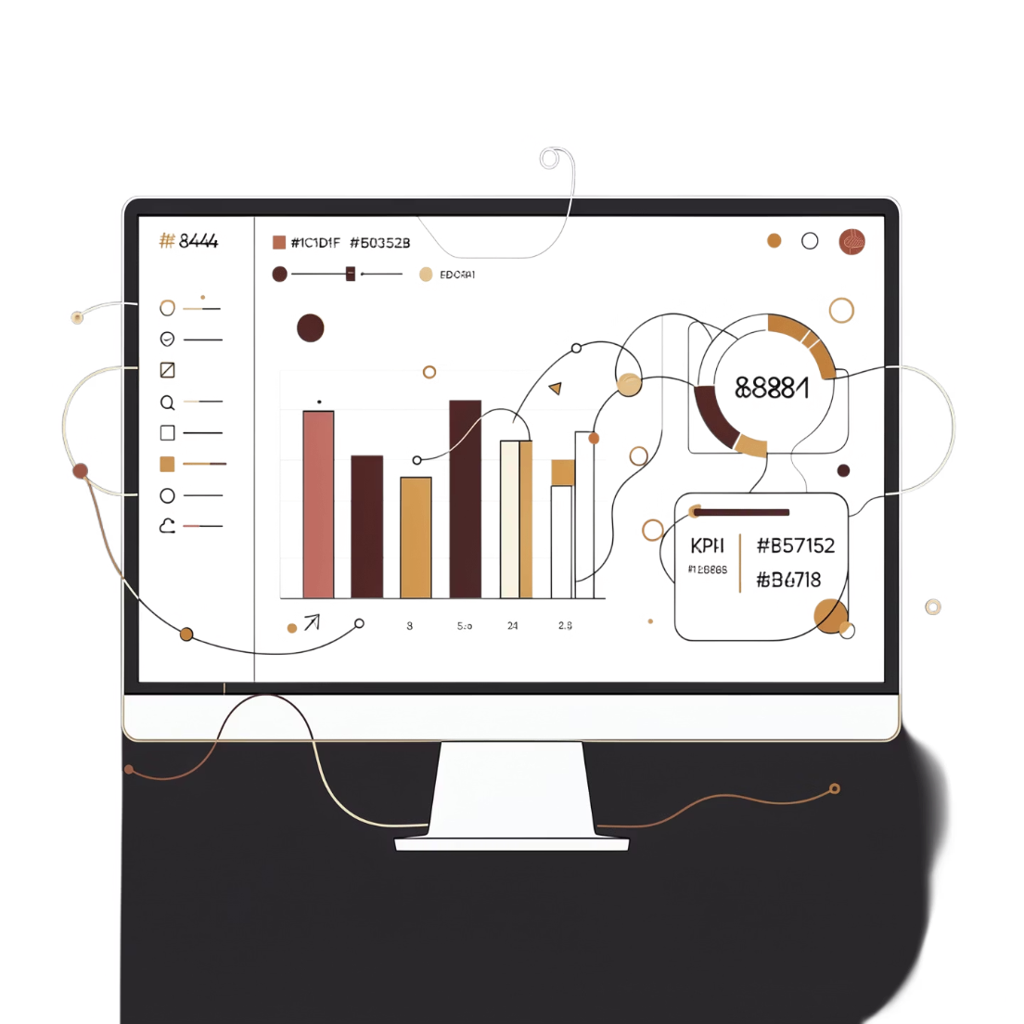

Power BI Dashboard
Interactive Visual Reporting
An interactive Power BI dashboard was built to present all key insights visually — enabling stakeholders to explore revenue trends, segment performance, product rankings, and subscription metrics in one place.
Combines Python cleaning, SQL analysis, and Power BI visualization into a seamless end-to-end pipeline.

Slide 9
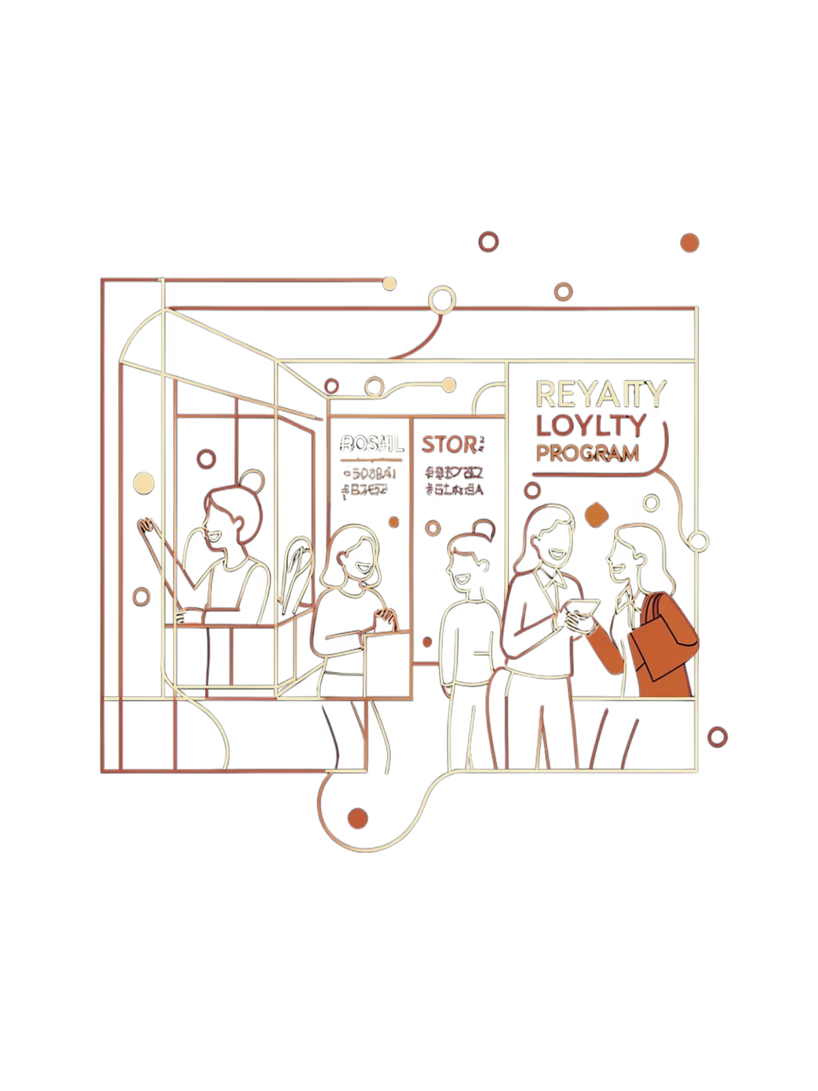

Business Recommendations
Boost Subscriptions
Promote exclusive subscriber benefits to convert high-frequency buyers
Loyalty Programs
Reward repeat buyers to move them into the "Loyal" segment
Review Discount Policy
Balance sales boosts with margin control on discount-dependent products
Targeted Marketing
Focus on high-revenue age groups and express-shipping users

Slide 10
Key Takeaways
End-to-End Pipeline
Actionable Segments
Python (cleaning & engineering) → PostgreSQL (SQL analysis) → Power BI (visualization)
New, Returning, and Loyal customer tiers provide a clear framework for targeted campaigns
Subscription Opportunity
Product & Discount Strategy
Subscribers outspend non-subscribers — growing this base is a high-priority lever
Highlight top-rated products in campaigns; audit discount-heavy SKUs for margin impact

