Slide 1
Spring Integration Introduction

Slide 2
Spring Integration
Spring integration is technology widely used in different parts of Mercury and Quicksilver
?

Slide 3
Spring integration allows you to :
1) Let application components exchange data through in-memory messaging
2) Integrate with external applications in a variety of ways through adapters
- Builds on Enterprise Integration Patterns for both

Slide 4
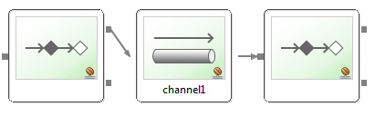
Ground rules
Simple core API:
A Message is sent by an endpoint
Endpoints are connected to each other using MessageChannles
An endpoint can receive Messages from a MessageChannels
- by subscribing (passive) or pooling (active)

Slide 5
Message
A Message consists of MessageHeaders and a payload
- Some headers are pre defined
- payload is just Java object
A message is immutable
- Let framework wrap payload for you or use a MessageBuilder to create it
Each Message is created with unique ID

Slide 6
MessageChannels
Connect message endpoints (loose coupling)
Optional buffering, Interception
Just spring beans
- No broker needed
- No persistance by default

Slide 7

MessageChannel Types
Point-to-point
Only one receiver by message
DirectChannel
- Message passed to receiver in senders's thread (return, exceptions), synchronous
- passive subscriber
QueueChannel
- Message is queued, sending doesn't block
- Active receiver polls from different thread

Slide 8
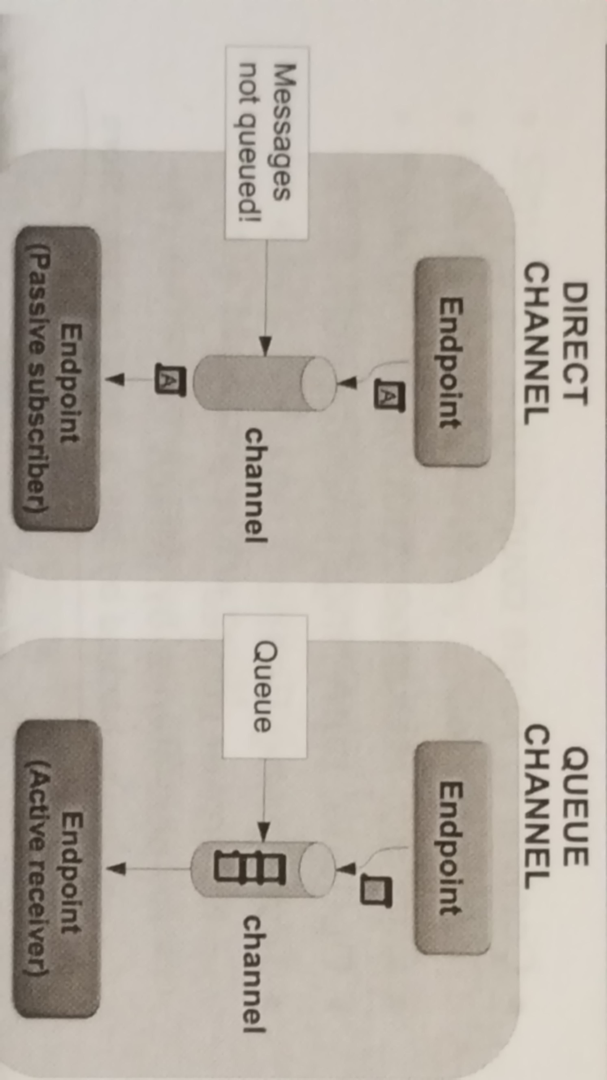
Direct vs Queue Channel

Slide 9
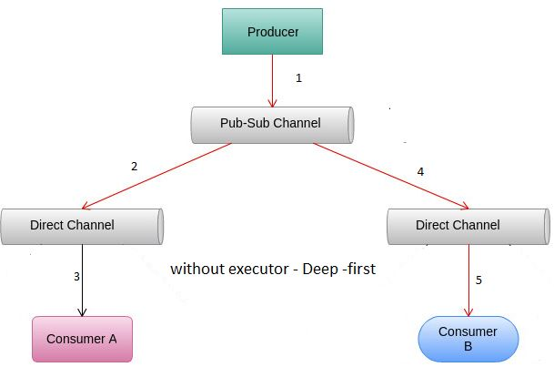
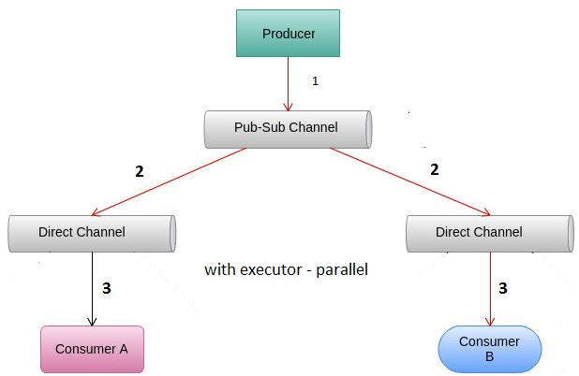
MessageChannel Types
Publish-subscribe
Multiple receivers per message
PublishSubscribeChannel
- Receivers invoked one by one in senders thread
- Or invoked in parallel on different threads using TaskExecutor

Slide 10
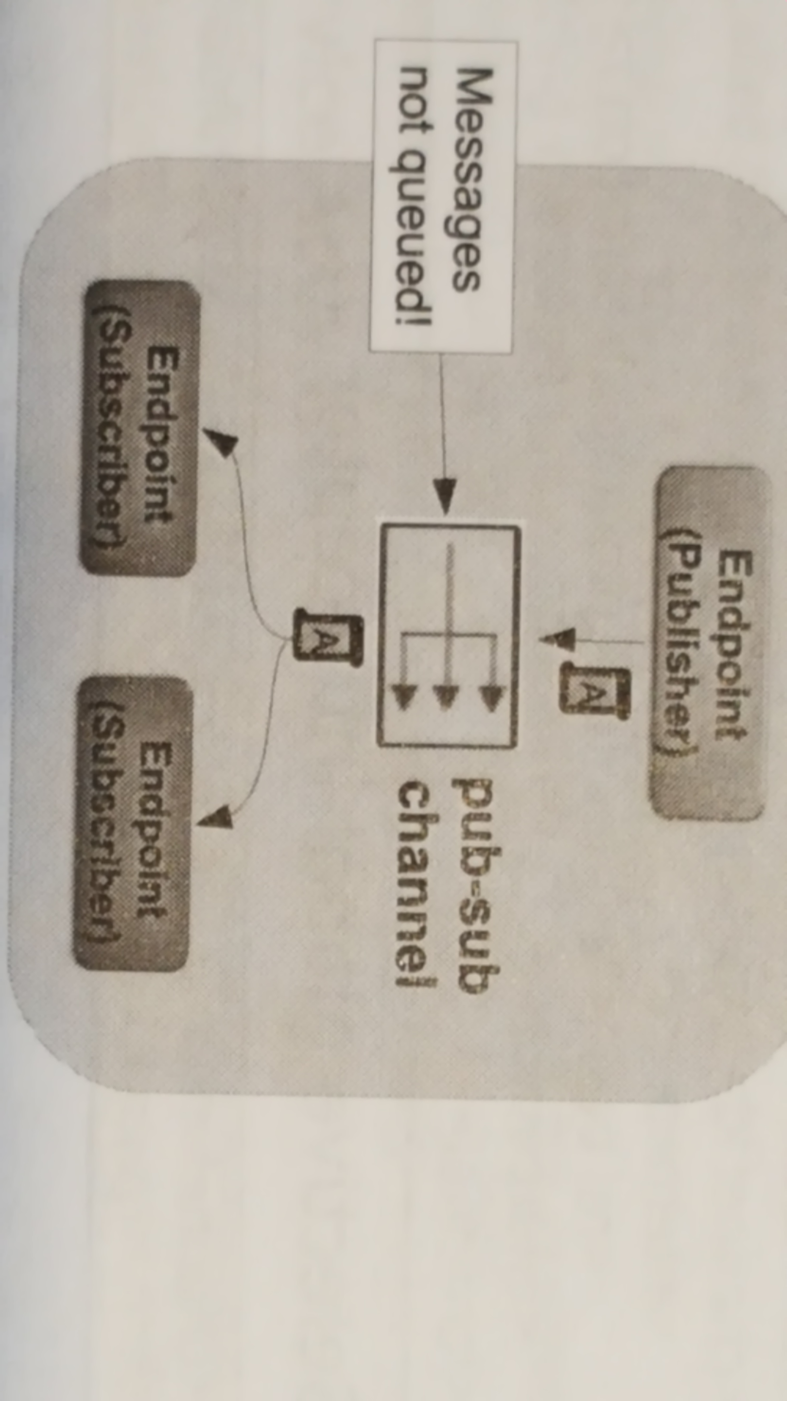
Publish Subscribe

Slide 11
Defining Channels
DirectChannel (sync)
<channel id="incoming">
QueueChannel (async)
  <channel id="orderedNotifications">
    <queue capacity="10"/>
  </channel>

Slide 12
Defining Channels
PublishSubscribeChannel (sync)
<publish-subscribe-channel id="statistics" />
PublishSubscribeChannel (async)
<publish-subscribe-channel id="appEvents"
  task-executor="pubSubExecutor" />
<task-exacutor id="pubSubExecutor" pool-size="10" />

Slide 13
Message Endpoints
Channel Adapter: One way integration
- message enters or leaves application
- Called 'inbound' or 'outbund'
Gateway: Two way integration
- Bring message into application and wait for response (inbound) or invoke external system and feed response back into application (outbound)
Service Activator
- Call method and wrap message into response channel

Slide 14
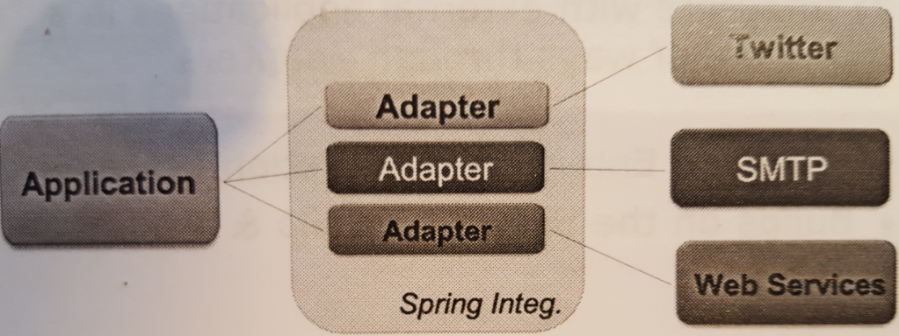
Adapters
Connect your application to the outside world
- Remoting, REST, WS, File & FTP, SMTP, Twitter, ...
- Also Mirrorlake, PCS, Jupiter, ION, ...
- For accepting input or producing output

Slide 15
Adapters
External events produce incomming message
- Incoming emails, new file (in folder), SOAP request
Internal message can trigger external event
- Calling a service, sending JMS message or email

Slide 16
Gateways and Adapters
Remember the dfference:
- Channel adapter is one way (in or out)
- Inbound Gateway awaits internal reply and returns it in-band
- Outbound Gateway awaits external response and puts it on a channel in invoking thread
Often use or add message headers
- inbound HTTP: copies request header to SI headers
- outbound JMS: copies SI headers to JMS headers

Slide 17
Service Activator
<service-activator ref="orderProcessor"
  input-channel="orders" output-channel="confirmations" />
<beans:bean id="orderProcessor" class="broker.OrderProcessor" />
Invoke bean method for incoming message
Take massage from channel execute business logic and put returned object to new channel

Slide 18
Integration Namespaces
Spring integration has dedicated namespaces for different integration types
For example :
- file, http, xml, jms, ip, twitter
In Mercury we have own namespaces
- pcs, jupiter, ml
<jupiter:publisher id="publisher" inputChannel="channelName" serverUrl="${host}" userName="${username}"
userPassword="${password}" />

Slide 19
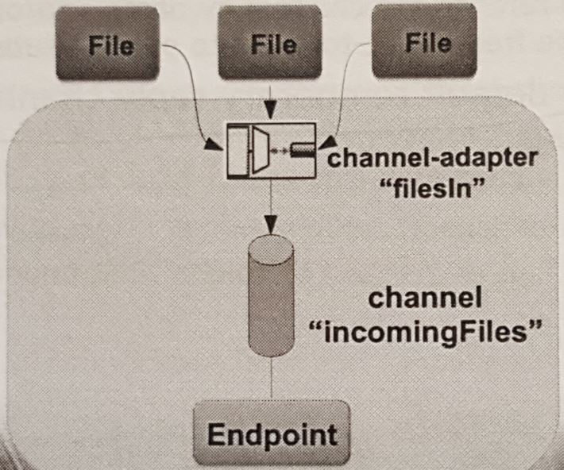
Sample : Inbound File Adapter
It is triggered on new files in directory
<int-file:inbound-channel-adapter id="filesin"
  channel="incommingFiles"
  directory="file:C:/inputResource" />

Slide 20
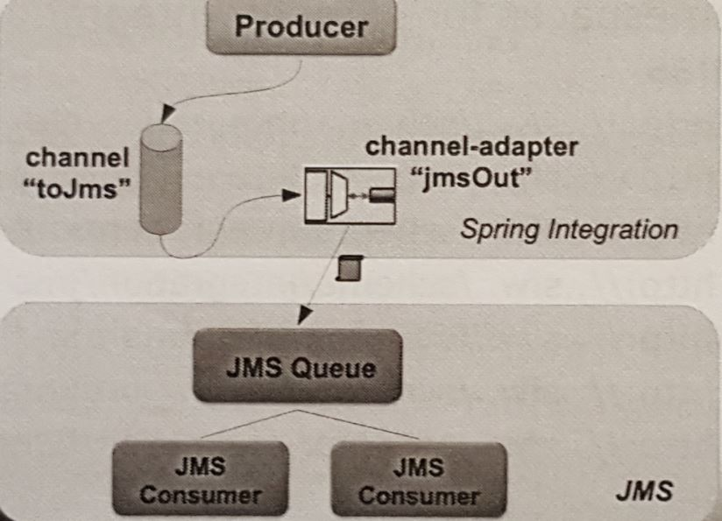
Sample: Outbound JMS Adapter
Adapter translate to jms message
<int-jms:outbound-channel-adapter id="jmsOut"
  channel="toJms" destination="jmsQueue" />

Slide 21
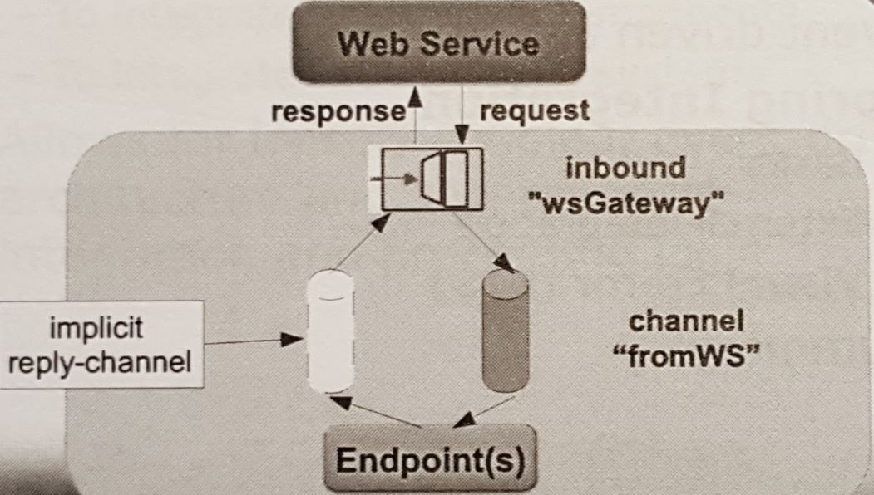
Sample : Inbound Web Service Gateway
<int-ws:inbound-gateway id="wsGateway" channel="fromWS" marshaller="jaxb2" unmarshaller="jaxb2" />
<oxm:jaxb2-marshaller id="jaxb2" contextPath="com.example.xml" />
In com.example.xml we can fing xsd

Slide 22
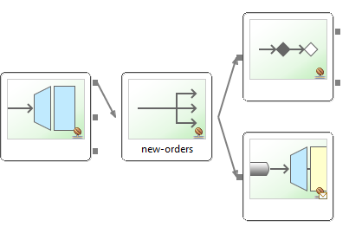
STS Visual Editor
SpringSource Tool Suite includes a visual editor for Spring Integration flows
Select 'integration-graph' tab on open Spring Integration configuration file

Slide 23
Sample: Combining Components - call
@Controller
public class OrderController {
  @Autowired OrderService orderService;
  @PostMapping("/orders")
  @ResponseStatus(CREATED)
  public void placeOrder(@RequestBody Order order)
    Confirmation conf = orderService.submitOrder(order)
  ...
}

Slide 24
Sample: Combining Components
Message is processed by service adapter and additionaly send to jms queue :
<gateway default-request-channel="new-orders"
  service-interface="com.example.OrderService" />
<publish-subscribe-channel id="new-orders"/>
<service-activator input-channel="new-orders" requires-reply="true" ref="orderProcessor" method="processOrder" />
<int-jms:outbound-channel-adapter channel="new-orders" destination-name="queue.orders" />

Slide 25
Benefits
Loose coupling between components
  - Small focused components
  - Eases testing, reuse
Event-driven architecture
  - No hard-coded process flow
  - Easy to change or expand
Separates integration and processing logic
  - Framework handle routing, transformation ...
  - Easily switch beetwen sync & async processing

Slide 26
Benefits
Loose coupling between components
  - Small focused components
  - Eases testing, reuse
Event-driven architecture
  - No hard-coded process flow
  - Easy to change or expand
Separates integration and processing logic
  - Framework handle routing, transformation ...
  - Easily switch beetwen sync & async processing

Slide 27
Next time
More Endpoint types (bridge, transformer, router, filter)
Error handling
Chains
Using SpEL

Slide 28
LAB

