Slide 1

Spring Integration Introduction

Slide 2
Why Spring Integration in eTrading
Spring integration is technology built in Mercury
Applying Spring Integration allows to standardize architecture of components
Helps to follow best industry standards (not only Citi)
Having common base components will be supported by all regions.
Available very detailed documentation
Offers many threading models

Slide 3
What offers Spring Integration
Spring integration allows you to:
1) Let application components exchange data through in-memory messaging
2) Integrate with external applications in a variety of ways through adapters
- Builds on Enterprise Integration Patterns for both

Slide 4
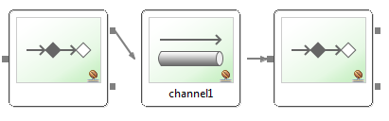
Building bricks
Simple core API:
A Message is sent by an endpoint
Endpoints are connected to each other using MessageChannles
An endpoint can receive Messages from a MessageChannels
- by subscribing (passive) or pooling (active

Slide 5
Message
A Message consists of MessageHeaders and a payload
- Some headers are pre defined
- payload is just Java object
A message is immutable
Let framework wrap payload for you or use a MessageBuilder to create it
Each Message is created with unique ID

Slide 6
MessageChannels
Just spring beans
Connect message endpoints (loose coupling)
Optional buffering, Interception
- No broker needed
- No persistence by default

Slide 7
MessageChannel Types
Point-to-point
Only one receiver by message
DirectChannel
- Message passed to receiver in senders' thread (return, exceptions), synchronous
- passive subscriber
QueueChannel
- Message is queued, sending doesn't block
- Active receiver polls from different thread

Slide 8
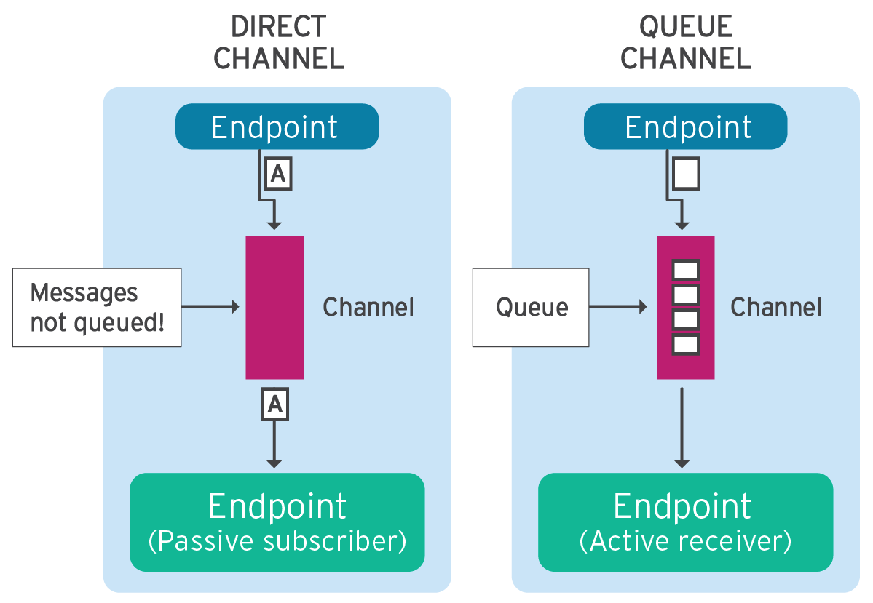
Direct vs Queue Channel

Slide 9
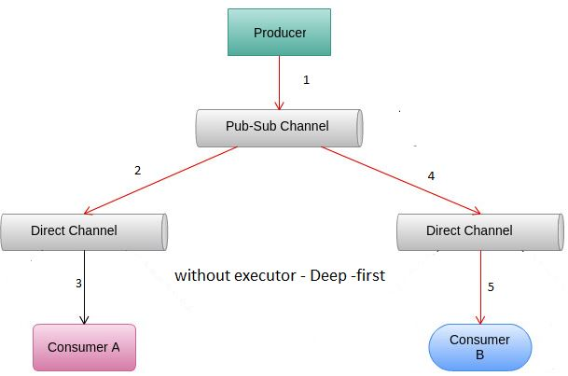
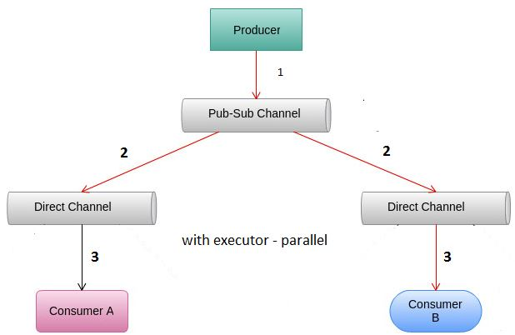
MessageChannel Types
Publish-subscribe
Multiple receivers per message
PublishSubscribeChannel
- Receivers invoked one by one in senders thread
- Or invoked in parallel on different threads using TaskExecutor

Slide 10
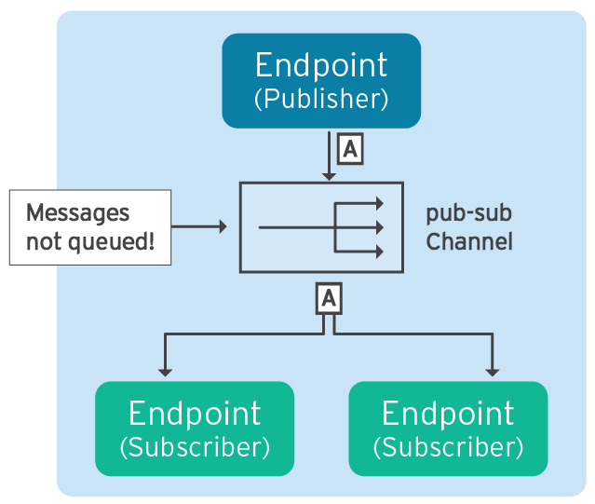
Publish Subscribe

Slide 11
Defining Channels
DirectChannel (sync)
<channel id="incoming">
QueueChannel (async)
<channel id="orderedNotifications">
<queue capacity="10"/>
</channel>

Slide 12
Defining Channels
PublishSubscribeChannel (sync)
<publish-subscribe-channel id="statistics" />
PublishSubscribeChannel (async)
<publish-subscribe-channel id="appEvents"
task-executor="pubSubExecutor" />
<task-exacutor id="pubSubExecutor" pool-size="10" />

Slide 13
Message Endpoints
Channel Adapter: One way integration
- message enters or leaves application
- Called 'inbound' or 'outbound'
Service Activator
- Call method and wrap message into response channel

Slide 14
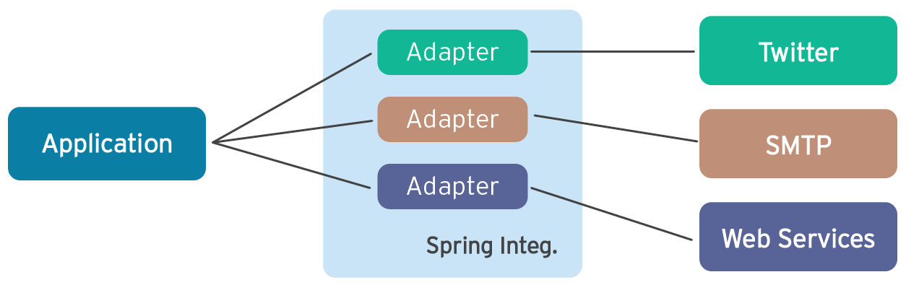
Adapters
Connect your application to the outside world
- Remoting, REST, WS, File & FTP, SMTP, Twitter, ...
- Also Mirrorlake, PCS, Jupiter, ION, ...
- For accepting input or producing output

Slide 15
Adapters
External events produce incoming message
- Incoming emails, new file (in folder), SOAP request
Internal message can trigger external event
- Calling a service, sending JMS message or email

Slide 16
Service Activator
<service-activator ref="orderProcessor"
input-channel="orders" output-channel="confirmations" />
<beans:bean id="orderProcessor" class="broker.OrderProcessor" />
Invoke bean method for incoming message
Take massage from channel execute business logic and put returned object to new channel

Slide 17
Integration Namespaces
Spring integration has dedicated namespaces for different integration types
For example :
- file, http, xml, jms, ip, twitter
In Mercury we have own namespaces
pcs, jupiter, ml
<jupiter:publisher id="publisher" inputChannel="channelName" serverUrl="${host}" userName="${username}"
userPassword="${password}" />

Slide 18
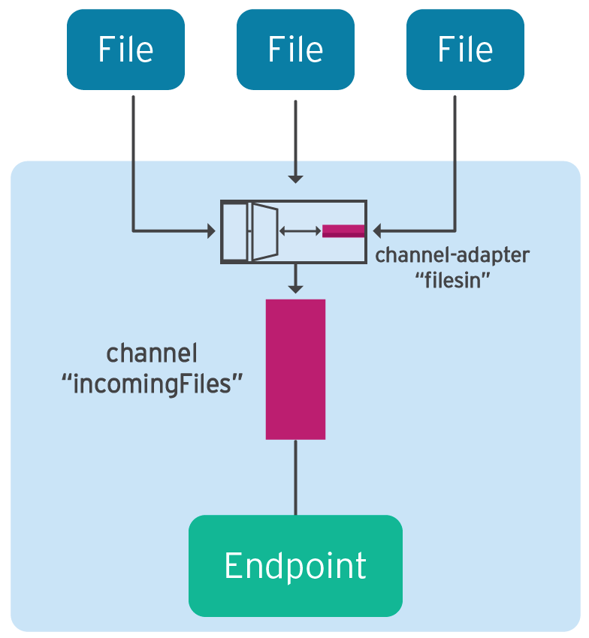
Sample : Inbound File Adapter
It is triggered on new files in directory
<int-file:inbound-channel-adapter id="filesin"
channel="incommingFiles"
directory="file:C:/inputResource" />

Slide 19
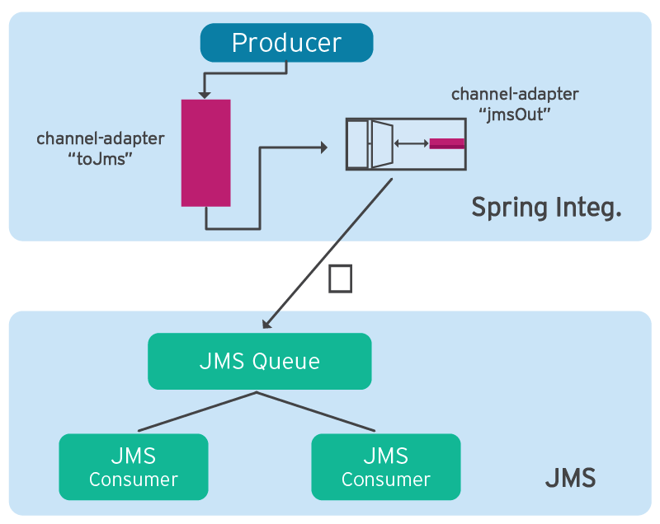
Sample: Outbound JMS Adapter
Adapter translate to jms message
<int-jms:outbound-channel-adapter id="jmsOut"
channel="toJms" destination="jmsQueue" />

Slide 20
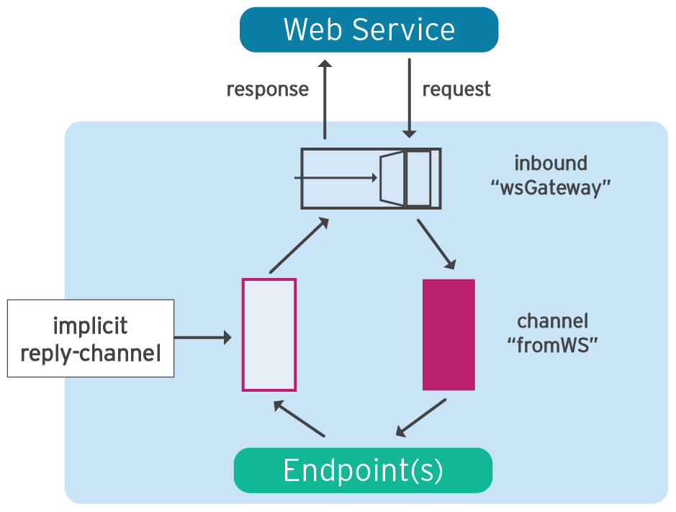
Sample : Inbound Web Service Gateway
<int-ws:inbound-gateway id="wsGateway" channel="fromWS" marshaller="jaxb2" unmarshaller="jaxb2" />
<oxm:jaxb2-marshaller id="jaxb2" contextPath="com.example.xml" />
In com.example.xml we can fing xsd

Slide 21
Benefits
Loose coupling between components
- Small focused components
- Eases testing, reuse
Event-driven architecture
- No hard-coded process flow
- Easy to change or expand
Separates integration and processing logic
- Framework handle routing, transformation ...
- Easily switch between sync & async processing

Slide 22
Next time
More Endpoint types (bridge, transformer, router, filter)
Error handling
Chains
Using SpEL

Slide 23
Thank you

