Slide 1

Spring Integration 2

Slide 2
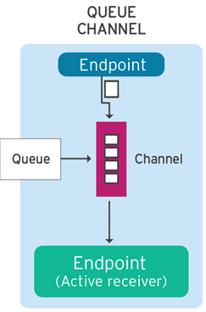
Active endpoints
Poller takes messages from queue channel and puts to endpoints
Endpoints can be made active using poller
- required for queue channel
We can have default for all endpoints
or override for specific endpoint
takes massage from queue
every 100 ms (fixed-delay)
<int:poller default="true" fixed-delay="100"/>

Slide 3
Poller types
By default single thread does the polling
<int:poller default="true" fixed-delay="100"/>
Optionally use the thread pool
<int:poller default="true" task-executor="pool" fixed-delay="500"/> <task:executor id="pool" pool-size="9" />

Slide 4
Endpoints Wired with poller
Endpoints use default poller when needed
- Overridable per endpoint
-- for example take message from queue for
service activator, which executes business logic and
put result to output channel
<int:service-activator ...> <int:poller task-executor="pool" fixed-delay="500"/> </int:service-activator> <task:executor id="pool" pool-size="9" />

Slide 5
Synchronous
DirectChannels and PublishSubscribeChannels without executor perform synchronous handoff
<channel id="direct">
<publish-subscribe-channel id="pubsub"/>
Sending thread invokes receiver(s) directly
Just like a regular method call :
- Transactions work
- Security context available
- Exceptions are simply propagated back to caller

Slide 6
Asynchronous
With other channel types receiver runs on different thread than sender
- Transactions and security context are lost
- Exceptions can typically not be propagated to caller

Slide 7
From sync to async
To switch from sync to async simply add a queue or task-executor
- point-to-point
<channel id="direct">
<channel id="queueChannle"> <int:queue/> </channel>
- publish-subscribe
<publish-subscribe-channel id="pubsub"/>
<publish-subscribe-channel id="confirmations" task-executor="taskExecutor"/>

Slide 8
Endpoint types
Spring provide implementation for enterprise integration patterns
We have many endpoint like : bridge, router, transformer, filter, ...

Slide 9
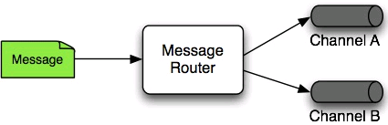
Router
Decides next channel(s) to send message to
Typically based on payload or headers
- Several default implementations available
public class OrderRouter { public String routeOrder(Order order) { return checkAvailable(order) ? "warehouse" : "resupply"; }
<channel id="warehouse" />
<channel id="resupply" />
<router input-channel="orders" ref="orderRouter" method="routeOrder" />
<beans:bean id="orderRouter" class="example.OrderRouter" />

Slide 10
Router
With SpEL
<router input-channel="pop3Channel" expression="payload.field1 instanceof T(String)">
<mapping value="true" channel="pop3PlainTextChannel"/>
<mapping value="false" channel="pop3InvalidChannel"/>
</router>

Slide 11
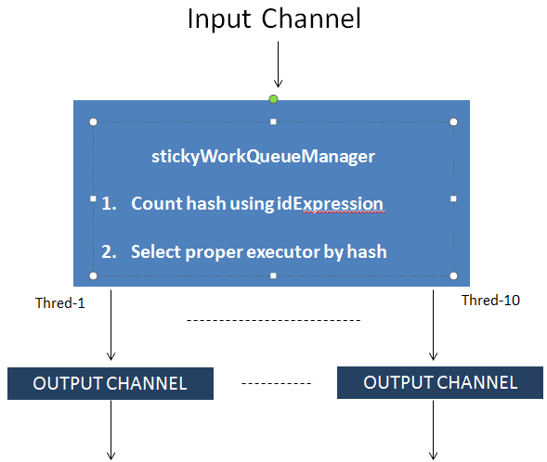
Router example
We want create our own router for sticky execution
- idExpression count hash for executor selection using SpEL
<stickyWorkQueueManager id="stickyWorkQueueManager" inputChannel="input" poolSize="10" idExpression="payload.key1 + " _” + payload.key2" ouputChannel="output” />

Slide 12
Filter
Decides whether to pass or drop a message
Implemented a boolean method
- true means pass, false means drop
- method can take as parameter Message (consists od payload and and header) or just payload as below
public boolean filter(Order order) { return order.isValid(); }
<filter input-channel="orders" output-channel="validOrders"
ref="orderFilter" method="filter" />

Slide 13
Filter Options
Default is to silent drop message
Alternatives :
- Throw exception on rejection
- Send message to discard channel
-- two way router
<filter input-channel="orders" output-channel="validOrders"
ref="orderFilter" method="filter" throw-exception-on-rejection="true"/>
<filter input-channel="orders" output-channel="validOrders"
ref="orderFilter" method="filter" discard-channel="invalidOrders"/>

Slide 14
SpEL Expressions
Many endpoints support expression attribute
Inline handler logic for avoid writing trivial Java code
Spring Integration variables available: headers, payload
But SpEL will be not used for FIX transformation as before – instead new translating model
<int:router input-channel="in" expression="payload.attribute1 + 'Channel'" />
<int:filter input-channel="in" output-channel="out" expression="payload.key1.equals('example')" />
<int:service-activator input-channel="in" output-channel="out" expression="@accountService.processAccount(payload.headers.accountId)" />

Slide 15
Jupiter subscriber
We have our own schema, where we can define subscriptions to jupiter in one tag
Under the hood few classes are loaded and connected
For subscription with esper (join-subscription) more
user do not have to know about details below
We specify only required attributes for all beans below
<subscriber id="subscriber" serverUrl="tcp://etclnx31u.nam.nsroot.net:8222" userName="PCSUser" userPassword="PCSUser" > <subscription redisKeyPattern="Prices:*" queryBody="updated(*)" regexKeyPattern="Prices:.*" channel="outputChannel1" /> <subscription redisKeyPattern="ReferenceData:*" queryBody="updated(*)" regexKeyPattern="ReferenceData:.*" channel="outputChannel2" /> <join-subscription joins="MLX:DEP.__KEY_SUFFIX=MLX:EMP.dep_id,MLX:EMP.emp_id=MLX:PHONE.emp_id" channel="outputChannel3" /> </subscriber>

Slide 16
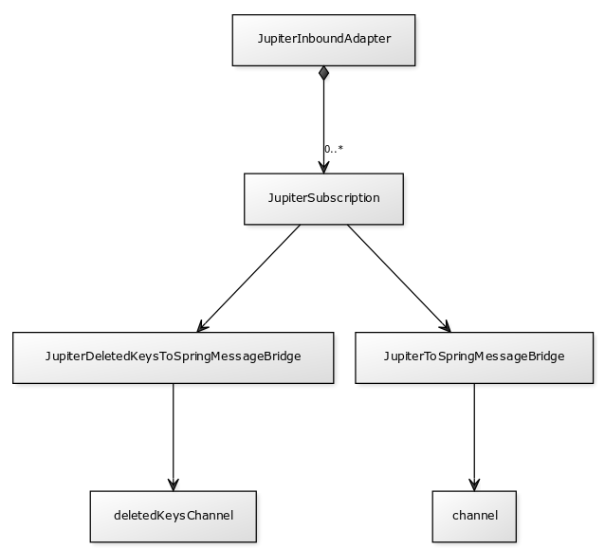
Jupiter Subscriber class diagram
For join-subscription we need to additionally load all esper classes like esperChannel, EsperServiceActivator, EsperJupiterHandler, EsperEventsListener, EsperSnapshotCache

Slide 17
Mirrorlake publisher example – old way
For ml connection we need to specify connection parameters, entity name and key fields
<bean id="mlPublisher" class="com.citi.etrading.rfq2ml.MLPublisher"> <property name="mlEntityName" value="${ml.entity}"/> <property name="mlKeyFields"> <list> <value>ecnMarket</value> <value>RFQCreateDate</value> <value>Id</value> <value>TimeStamp</value> </list> </property> <property name="mlSender" ref="mlSender"/> </bean> <bean id="mlSender" class="com.citi.etrading.rfq2ml.JMSMLObjectSender"> <constructor-arg> <bean class="org.springframework.jms.connection.CachingConnectionFactory"> <constructor-arg> <ref bean="jmsMLConnectionFactory"/> </constructor-arg> </bean> </constructor-arg> <constructor-arg value="${ml.topic}"/> <constructor-arg value="topic"/> </bean> <bean id="jmsMLConnectionFactory" class="com.citi.mercury.middleware.jms.JMSMLConnectionFactory"> <property name="env" value="${ml.env}"/> <property name="user" value="${ml.user}"/> <property name="password" value="${ml.password}"/> <property name="destination" value="${ml.topic}"/> </bean>

Slide 18
Mirrorlake publisher example – new way
For new way we have all in single tag
There are also all additional optional attributes allowed like before
<ems-publisher id="mlPublisher" inputChannel="input" outputMessageType="GDM" auto-startup="true"> <!-- true means foo1 is taken to key build, false means that value for key foo2 is taken from incoming map --> <ems-converter mlEntityName="TEST" mlKeyFields="foo1:true,foo2:false,foo3:true" payloadConverterType="JSON" /> <ems-sender user="${user}" password="${password}" env="${environment}" destination="${topic}" destinationType="topic" /> </ems-publisher>

Slide 19
Summary
Spring Integration takes care of messaging/threading plumbing code
- Transparently configures polling
Simple but powerful scheduling
Many types of endpoints
SpEL expressions

Slide 20
Next time
Error handling
Additional endpoints
Transformer example
Endpoints chaining
Example application

Slide 21
Thank you

