Slide 1
Spring Integration 2

Slide 2
Active endpoints
Endpoints can be made active using pollers
- take messages from queue channel
By default single thread does the polling
- Optionally use the thread pool
<int:poller default="true" task-executor="pool" fixed-delay="500"/>
<task:executor id="pool" pool-size="9" />

Slide 3
Endpoints Wired with poller
Endpoints use default poller when needed
- Overridable per endpoint
Diagram!!!!!!!!!
<int:service-activator ...>
<int:poller task-executor="pool" fixed-delay="500"/>
</int:service-activator>
<task:executor id="pool" pool-size="9" />

Slide 4
Synchronous
DirectChannels and PublishSubscribeChannels without executor perform synchronous handoff
Sending thread invokes receiver(s) directly
Just like a regular method call :
- Transactions work
- Security context available
- Exceptions are simply propagated back to caller
<int:channel id="direct">
<publish-subscribe-channel id="pubsub"/>

Slide 5
Asynchronous
With other channel types receiver runs on different thread than sender
- Transactions and security context are lost
- Exceptions can typically not be propagated to caller

Slide 6
From sync to async
To switch from sync to async simply add a queue or task-executor
<int:channel id="queueChannle">
<int:queue/>
</int:channel>
<publish-subscribe-channel id="confirmations" task-executor="taskExecutor"/>

Slide 7
Synchronous error handling
Sender receives a MessageHandlingException when receiving endpoint throws exception in sender's thread
- wraps original exception and failed Message

Slide 8
Asynhronous error handling
What if async receiver throws Exception ?
- Sender has already moved on
MessageHandlingException is sent to error channel

Slide 9
errorChannel
Created as publis-subscribe-channel by default
- define your own errorChannel to override
(for example for async handling)
Register handler for global error handling
- could be simple logger or complete custom flow
- Build-in router based on exception type :
<int:exception-type-router input-channel="myErrorChannel">
<int:mapping exception-type="java.lang.IllegalArgumentException" channel="illegalChannel"/>
<int:mapping exception-type="java.lang.NullPointerException" channel="npeChannel"/>
</int:exception-type-router>

Slide 10
Endpoint types
Spring provide implementation for enterprise intergration patterns
Wymieniam : !!!!!!!!

Slide 11
Bridge
Simply connect to channels or channel adapters
- to connect pollable to subscribable channel
- or subscribable to pollable (in app example)
Can have a <poller /> - used to throttle messages
- Diagram !!!!!!!!
<int:bridge input-channel="errorChannel" output-channel="errorTestChannel"/>
<int:bridge input-channel="input" output-channel="output">
<int:poller/>
</int:bridge>

Slide 12
Message Transformer
Basically service activator with specific intent
<transformer input-channel="input" output-channel="output" ref="anyPOJO" method="doTransform"/>
Common use cases :
- Payload format conversion, incl. (un)mashalling
- Payload or header enriching
Sygnatura do transform – klasa !!!!

Slide 13
Meaasage Enricher
Specific type of transformer
- add to payload or to header
<header-enricher input-channel="inputChannel" output-channel="outputChannel">
<header name="justValue" value=„valueString" />
<header name="beanEnrichValue" ref="headerBean" method="enrichValue" /> // co dostaje enrichValue
</header-enricher>
Can use SpEL
<enricher input-channel="inputChannel" output-channel="outputChannel">
<property name="dateObjectUsingExpr" expression="new java.util.Date()" />
<property name="serialNbrFetchedFromPayloadUsingExpr"
expression="payload.uniqueNbr() + '_' + T(java.lang.System).currentTimeMillis()" />
</enricher>

Slide 14
Router
Decides next channel(s) to send message to
Typically based on payload or headers
- Several default implementations available
public class OrderRouter {
public String routeOrder(Order order) {
return checkAvailable(order) ? "warehouse" : "resupply";
}
<router input-channel="orders" ref="orderRouter" method="routeOrder" />
<beans:bean id="orderRouter" class="example.OrderRouter" />
<stickyWorkQueueManager id=„manager1” inputChannel=„input” hashExecutor=bean poolSize=10 ouputChannel=„output” > --
// co sie stanie gdy przyjdzie cos innego typu
// 2 bean podac jakie, ze to nazwy bean zwracamy

Slide 15
Router
With SpEL
<router input-channel="pop3Channel" expression="payload.field1 instanceof T(String)">
<mapping value="true"
channel="pop3PlainTextChannel"/>
<mapping value="false"
channel="pop3InvalidChannel"/>
</router>

Slide 16
Filter
Decides whether to pass or drop a message
Usually implemented a boolean method
- true means pass, false means drop
public boolean filter(Order order) {
return order.isValid();
}
<filter input-channel="orders" output-channel="validOrders"
ref="orderFilter" method="filter" />

Slide 17
Filter Options
Default is to silent drop message
Alternatives :
- Throw exception on rejection
- Send message to discard channel
-- to way router
<filter input-channel="orders" output-channel="validOrders"
ref="orderFilter" method="filter" throw-exception-on-rejection="true"/>
<filter input-channel="orders" output-channel="validOrders"
ref="orderFilter" method="filter" discard-channel="invalidOrders"/>

Slide 18
Chaining Endpoints
Many endpoints work together in a chain
- Unmarshal
- Filter out redundant messages
- Invoke service
Requires multiple channels to tie them together
Reduce boilerplate with chains

Slide 19
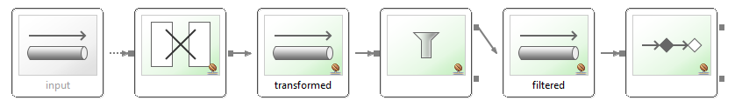
Consider this setup

Slide 20
Without Chain
<transformer input-channel="input" output-channel="transformed" ref="unmarshallingTransformer"/>
<channel id="transformed" />
<filter input-channel="transformed" output-channel="filtered" ref="filterBean"/>
<channel id="filtered" />
<service-activator input-channel="filtered" output-channel="output" ref="newsProcessor" method="processNews" />

Slide 21
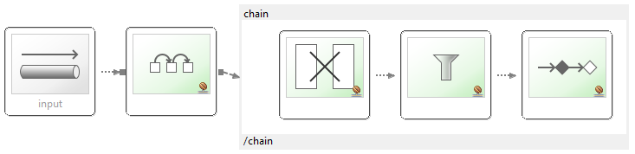
With Chain
<chain input-channel="input" output-channel="output">
<transformer ref="unmarshallingTransformer" />
<filter ref="filterBean" />
<service-activator ref="newsProcessor"
method="processNews" />
</chain>

Slide 22
Chaining contract
All endpoint wired with implicit DirectChannels in order
All endpoints, but the last MUST return output
- Endpoint can filter the message by returning null
If last endpoint returns something output-channel must be set

Slide 23
Endpoint Congiguration
Annotations are also supported
- @MessageEndpoint stereotype - indicating that a class is capable of serving as a Message Endpoint
-- class can be picked up by component scanning
- Method annotations for various endpoint types
-- @Gateway, @ServiceActivator, @Router, @Filter, etc.

Slide 24
SpEL Expressios
Many endpoints support expression attribute
Inline handler logic for avoid writing trivial Java code
SI variables available: headers, payload
<int:router input-channel="in" expression="payload + 'Channel'" />
<int:filter input-channel="in" output-channel="out" expression="payload.equals('example')" />
<int:service-activator input-channel="in" output-channel="out" expression="@accountService.processAccount(payload.headers.accountId)" />

Slide 25
Summary
Spring Integration takes care of messaging/threading plumbing code
- Transparently configures polling
Simple but powerful scheduling
Many types of endpoints
Additional annotations and SpEL

Slide 26
LAB

