Slide 1

Spring Integration 3

Slide 2
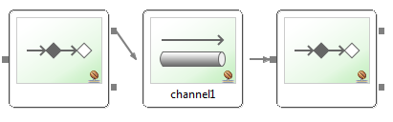
Synchronous error handling
DirectChannels and PublishSubscribeChannels without executor perform synchronous handoff
<channel id="direct">
<publish-subscribe-channel id="pubsub"/>
Sender receives a MessageHandlingException when receiving endpoint throws exception in sender's thread
- wraps original exception and failed Message

Slide 3
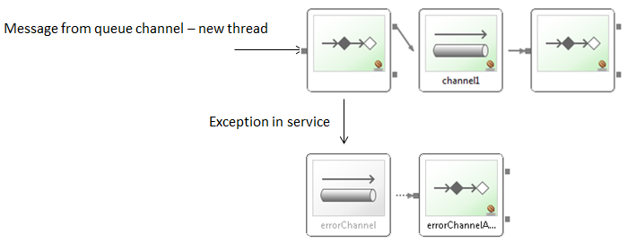
Asynchronous error handling
If async receiver throws Exception sender has already moved on
MessageHandlingException is sent to error channel

Slide 4
errorChannel
Created as publis-subscribe-channel by default
- define your own errorChannel to override (for example for async handling)
Register handler for global error handling
- could be simple logger or complete custom flow
- Build-in router based on exception type :
<int:exception-type-router input-channel="myErrorChannel"> <int:mapping exception-type="java.lang.IllegalArgumentException" channel="illegalChannel"/> <int:mapping exception-type="java.lang.NullPointerException" channel="npeChannel"/> </int:exception-type-router>

Slide 5
Endpoint types
Spring provide implementation for enterprise intergration patterns
We have many endpoint like : bridge, router, transformer, filter, ...
Few of them were presented on previous sessions

Slide 6
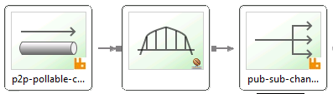
Bridge
Simply connect 2 channels or channel adapters
- to connect pollable to subscribable channel
- or subscribable to pollable (example in application)
Can have a <poller /> - used to throttle messages
<int:bridge input-channel="errorChannel" output-channel="errorTestChannel"/>
<int:bridge input-channel="input" output-channel="output"> <int:poller fixed-delay="500"/> </int:bridge>

Slide 7
Message Transformer
Service activator – take message from channel do business logic and put message to next channel
Basically service activator with specific intent
Common use cases :
- Payload format conversion (to other type)
- Payload or header enriching
<transformer input-channel="input" output-channel="output" ref="anyPOJO" method="doTransform"/>
Map<String, Object> doTransform(Map<String, Map<String, Object>> messageMap)

Slide 8
Message Enricher
Specific type of transformer
- add to payload or to header
<header-enricher input-channel="inputChannel" output-channel="outputChannel">
<header name="justValue" value=„valueString" />
<header name="beanEnrichValue" ref="headerBean" method="enrichValue" />
</header-enricher>
Method which enriches the value:
public String enrichValue(SomePayload payload) {
return "'" + payload.getId() + "' enriched";
}

Slide 9
Message Enricher - SpEL
Example of payload enricher
<enricher input-channel="inputChannel" output-channel="outputChannel">
<property name="dateObjectUsingExpr" expression="new java.util.Date()" />
<property name="serialNbrFetchedFromPayloadUsingExpr"
expression="payload.uniqueNbr() + '_' + T(java.lang.System).currentTimeMillis()" />
</enricher>

Slide 10
SpEL Expressions - reminder
Many endpoints support expression attribute
Inline handler logic for avoid writing trivial Java code
Spring Integration variables available: headers, payload
<int:router input-channel="in" expression="payload.attribute1 + 'Channel'" />
<int:filter input-channel="in" output-channel="out" expression="payload.key1.equals('example')" />

Slide 11
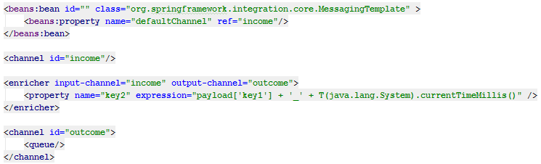
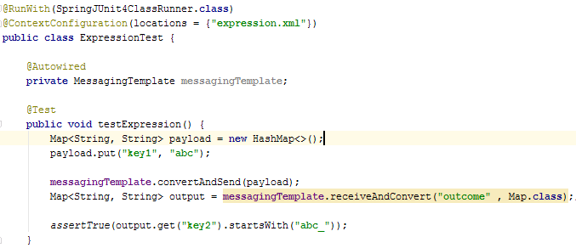
Expression test
As mentioned it is trivial java code, so no need to test it
If we really want :
Configuration :
2. Test:

Slide 12
Chaining Endpoints
Many endpoints work together in a chain
For example :
- Unmarshal
- Filter out redundant messages
- Invoke service
Requires multiple channels to tie them together

Slide 13
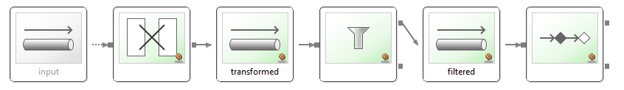
Without Chain
<transformer input-channel="input" output-channel="transformed" ref="unmarshallingTransformer"/>
<channel id="transformed" />
<filter input-channel="transformed" output-channel="filtered" ref="filterBean"/>
<channel id="filtered" />
<service-activator input-channel="filtered" output-channel="output" ref="newsProcessor" method="processNews" />

Slide 14
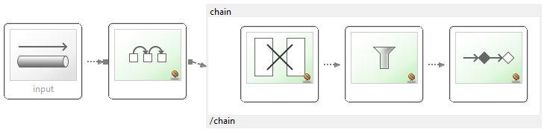
With Chain
<chain input-channel="input" output-channel="output">
<transformer ref="unmarshallingTransformer" />
<filter ref="filterBean" />
<service-activator ref="newsProcessor" method="processNews" />
</chain>

Slide 15
Chaining contract
All endpoint wired with implicit DirectChannels in order
All endpoints but the last MUST return output
- Endpoint can filter the message by returning null
If last endpoint returns something output-channel must be set

Slide 16
New Transformer example from Mercury
Transformation is done in steps :
Transform input to map (from fix, json, xml, ion, javabean, cfore)
Select interesting fields from map structure
Add some values to output map (enrich) - optional
Today simple example, to see how it works – xml
- During next session will be fix as it was before and now using the same scenario

Slide 17
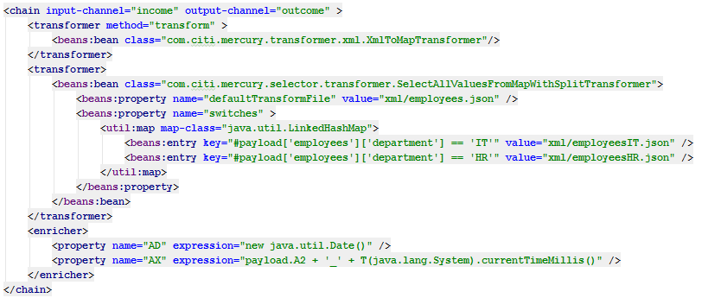
New Transformer Mercury
Transform input to map (from fix, json, xml, ion, javabean, cfore)
Select interesting fields from map structure
Add some values to output map (enrich)

Slide 18
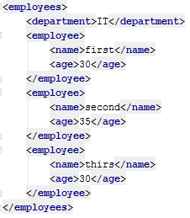
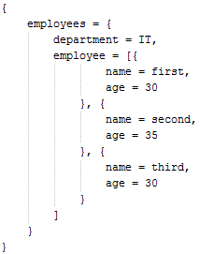
New Transformer Mercury – step 1
We receive XML as input
In first step it is transormed to the map

Slide 19
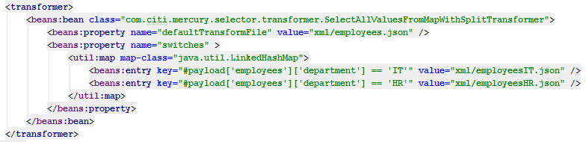
New Transformer Mercury – step 2
In selector phase we decide what information we need in result map
What will be taken from map is defined in specific .json file
Specify .json file based on message (switches) – use SpEL
- If not selected use defaultTransformFile
So for our message we will use employeesIT.json

Slide 20
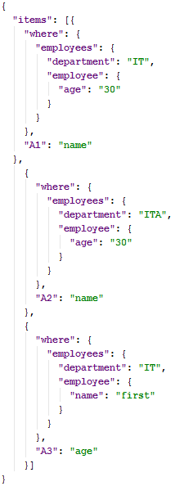


New Transformer Mercury – step 2
Based on employeesIT.json some fields will be
selected to new map
In result map :
- A1 : first or third
- A2: null, so not in map
- A3: 30
Wewill receive 2 messages

Slide 21

New Transformer Mercury – step 3
Here we can optionally add enricher, which will put additional values to our message

Slide 22
Summary
Many types of endpoints
Chaining connection
New transformer concept in Mercury

Slide 23
Next time
Fix transformer old and new
- with benchmark output
Some Mercury adapters
Some additional endpoints
Dispatcher in channel

Slide 24
Thank you

