Slide 1

Spring Integration 4

Slide 2
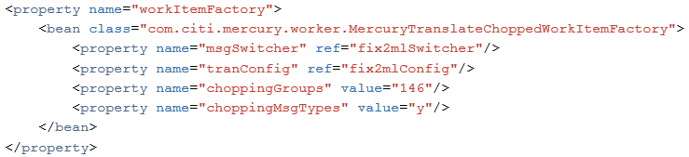
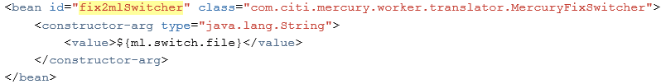
Fix Transormer – old way – step 1
Previously fix message was in first step chopped by groups, so after it we had many fix messages with one group inside

Slide 3
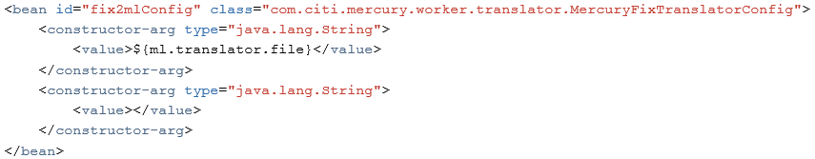

Fix Transormer – old way – step 2
In second step specific data are taken from chopped message, using transform config with SpEL inside

Slide 4
New transormer informations
Spring Integration used only for flow order, beans config
All transformers are written in java code
Code is fast - based on Java 8 streams
Json config is loaded once into map, quick access to conditions inside stream filters
Code is covered by tests with many examples
Spring integration use reflection for method call, but it is as fast as simple method call
- direct : (min, avg, max) = (2053068824,856, 2083384199,804, 2104466310,279) op/sec
- reflection: (min, avg, max) = (2057757369,639, 2082925698,129, 2099493480,454) op/sec

Slide 5
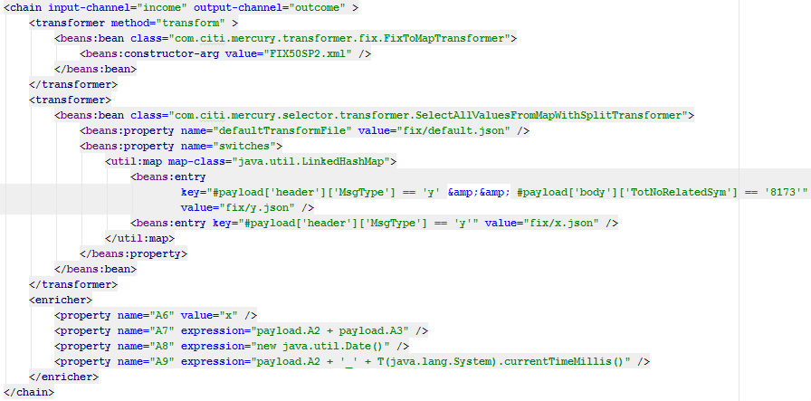
Fix Transormer – new way
Transformation is done in steps :
Transform input to map (from fix, json, xml, ion, javabean, cfore)
Select interesting fields from map structure
Add some values to output map (enrich) - optional

Slide 6
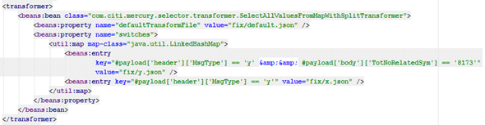
Fix Transormer – new way – step 2
In selector phase we decide what information we need in result map
What will be taken from map is defined in specific .json file
Select .json file based on message (switches) – use SpEL
-- take first which matches (because LikedHashMap)
- If not selected use defaultTransformFile
So for our message we will use y.json

Slide 7
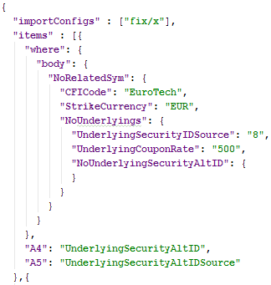
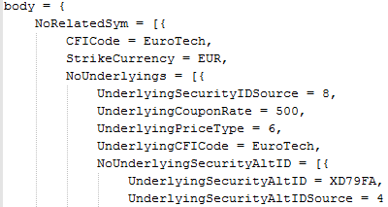
Fix Transormer – new way – step 2
Using previously chosen .json, selection to result map is done (config applied for each group)
On the left is part of message map and on the right part of json config
We select fields A4 and A5 from NoUnderlyingSecurityAltID group where conditions are satisfied

Slide 8

Fix Transormer – new way – step 3
We can optionally enrich our message
For this purpose we can use enricher, which use SpEL
We can in expression call method of other bean, where could be complicated java logic
Instead of enricher we can use usual transformer, where message will be modified in java code

Slide 9
Benchmarks
We have done benchmarks for the same fix message, and selected few values in each example
Below results for old way (op/sec)
(min, avg, max) = (34,952, 36,959, 39,026)
Below results for new way (op/sec)
(min, avg, max) = (169,525, 173,872, 177,650)

Slide 10
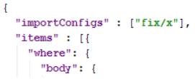
Import config from other config file
in step 2 is selected config file based on message, which is required to select values from message
some configurations could be similar
we can keep common part in separate file and import this file in other configs
for example in y.json config we have import od x.json, example :

Slide 11
Using custom transformers
Using configs we can select values where some conditions are satisfied
In conditions we simply check if specific field in map is equal to value in configuration
If we want some advanced operations we can use ExpressionTransformer with custom SpEL or write own transformer in java

Slide 12
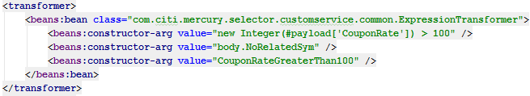
Using custom transformer - spring config
After transformation to map we can add some transformers for advanced operations
We can use ExpressionTransformer
First argument is expression we want execute
Second argument is place where new key is added (CouponRateGreaterThan100) and when expression attribute/attributes exist (CouponRate)
Third argument is name of new key, which is used in .json config file

Slide 13
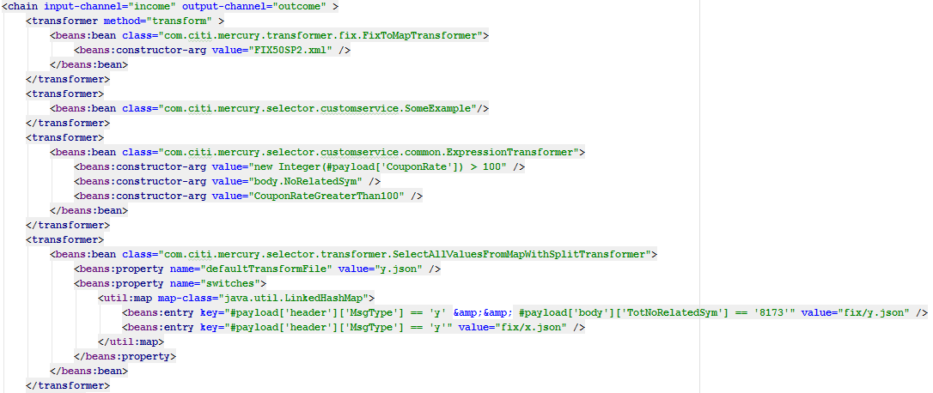
Using custom transformers - put transformer to chain
As mentioned we can put advanced transformers into chain, after transformation to map and before selector which use config

Slide 14
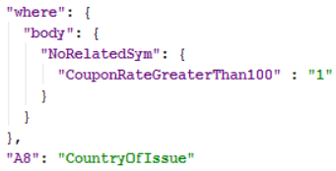

Using custom transformers - prepare json config file
When value is added to map we can use it in config file
for example in y.json we use it like in example below :
And message map (group):

Slide 15
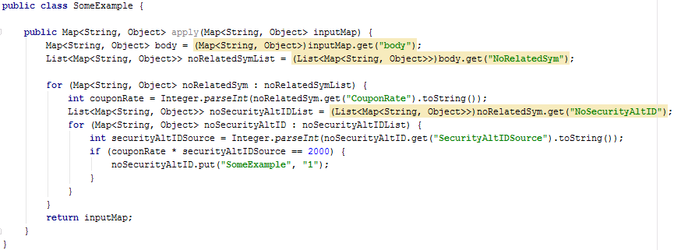
Writing own transformer in java
Below simple example how to write transformer in java
a) transformer code:
- SomeExample=1 where couponRate * securityAltIDSource = 2000

Slide 16
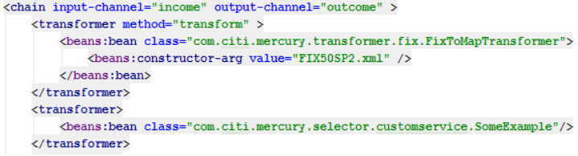
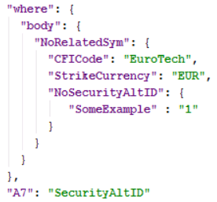
Writing own transformer in java
b) using in spring chain:
c) using value in config:
we want take SecurityAltID,
where CFICode=EuroTech,
StrikeCurrency=EUR and
SomeExample=1

Slide 17
Summary
New fix transformer
Own transformers creation

Slide 18
Next time
New adapters types
Additional endpotints
Dispatcher

Slide 19
Thank you

