Slide 1
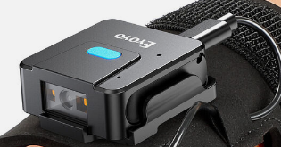
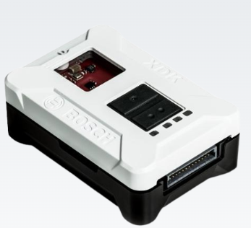
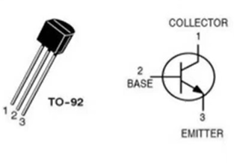
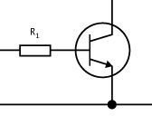
Camera Emulation: Option 1
Eyoyo Wearable Glove QR Code Scanner
XDK
SBU?/CC? on USB-C
2K
N2222
GPIO port B3
GND

Slide 2
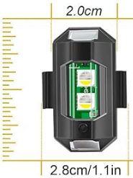
Camera Emulation: Option 2
Modified Strobe Drone Light
XDK
3.3V
GPIO port B3
GND

