Slide 1
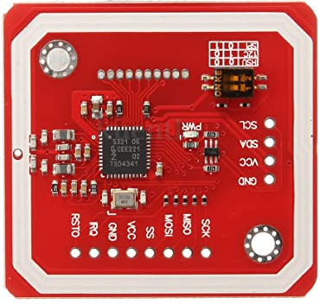
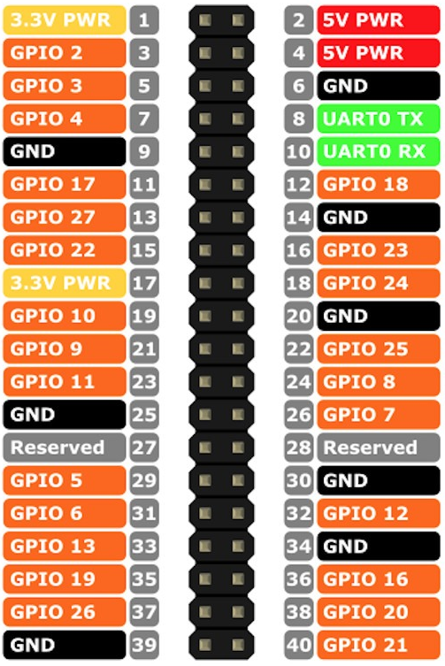

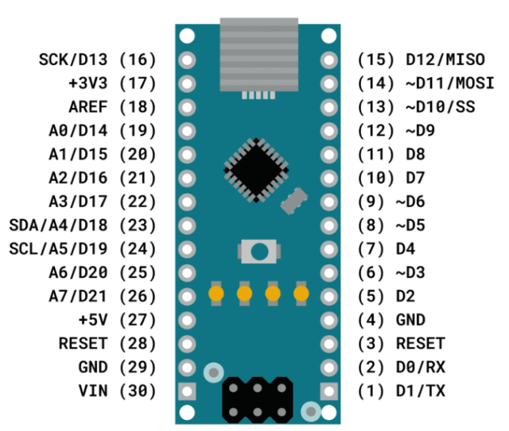
Connect sense
SPI mode
SPI mode
neopixel
LED
SPI mode
2nd AGV
D2 Sense reader
HSU mode (Tag Emulator)
tx
rx

Slide 2
Connect sense
SPI mode
SPI mode
LED
SPI mode
2nd AGV
D2 Sense reader
HSU mode (Tag Emulator)
tx
rx

